Slide 1
Health monitoring system
Presented by(Team E) : Yashodhan Vishvesh Deshpande
Md Limon Apu

Slide 2
AGENDA
Introduction
Sensors and boards
Use case
Technical details
Simulation
Summary

Slide 3
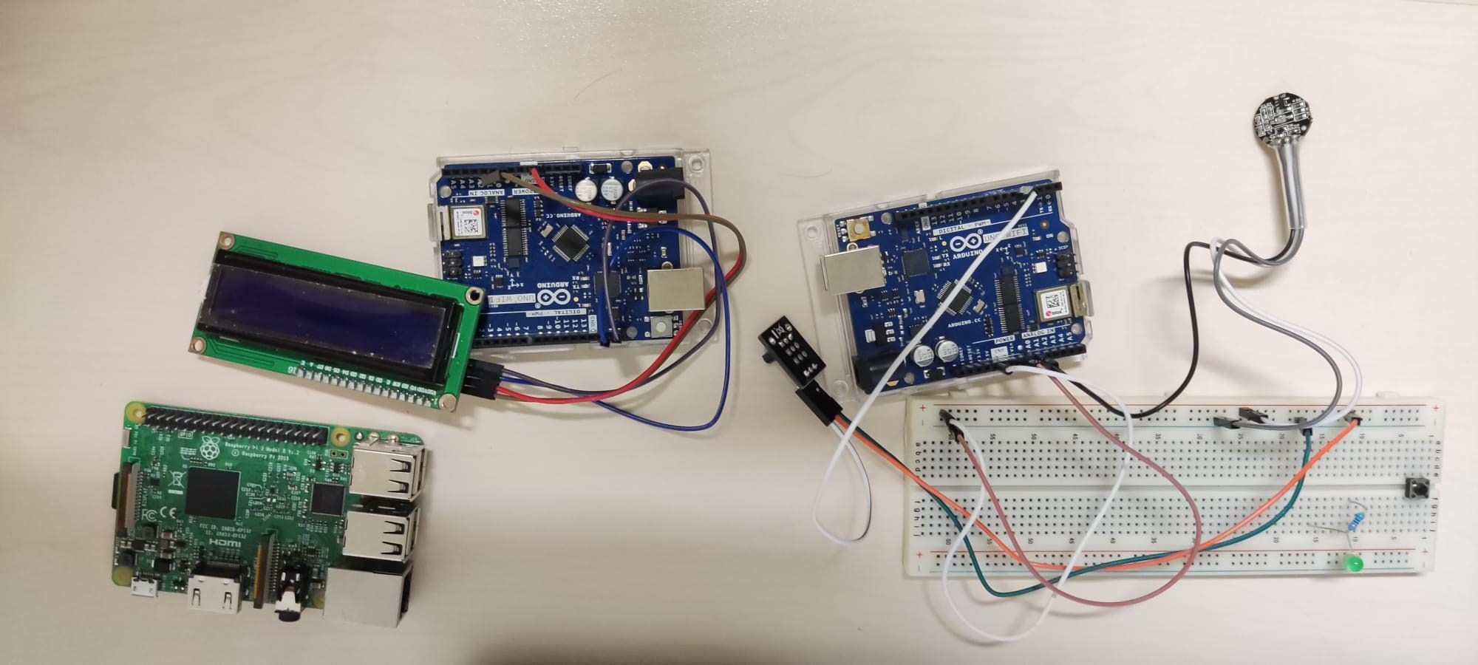
INTRODUCTION
Health monitoring system with sensors data.
Tracking heart rate, temperature of user.
Uses Client devices to communication.
Uses MQTT protocol.
Results display on Client device & LCD display.

Slide 4
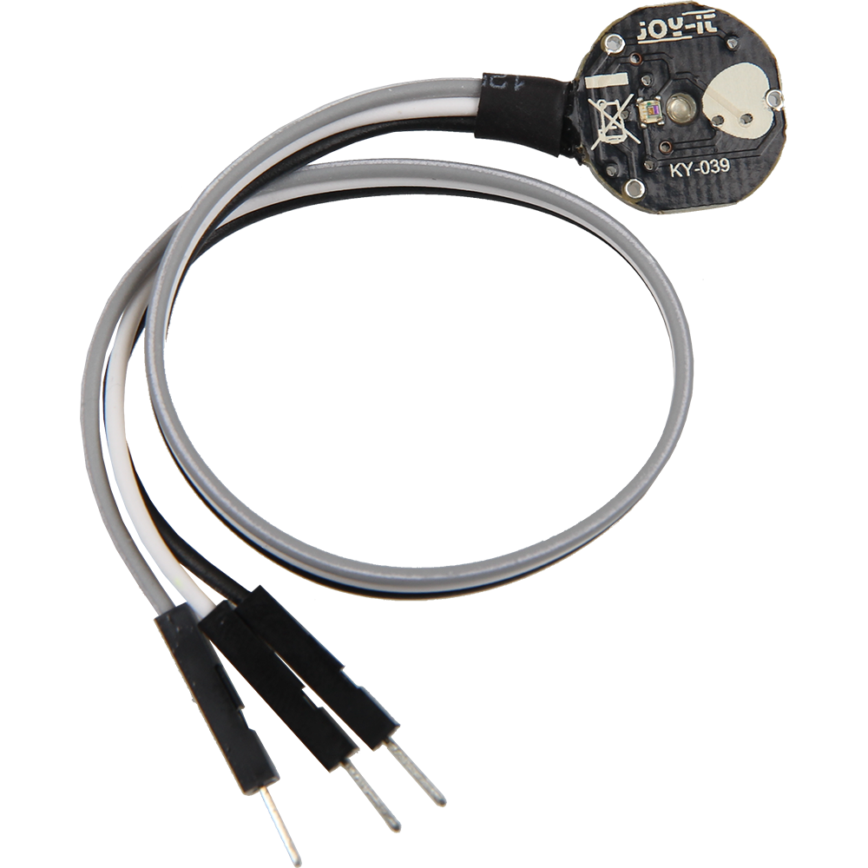
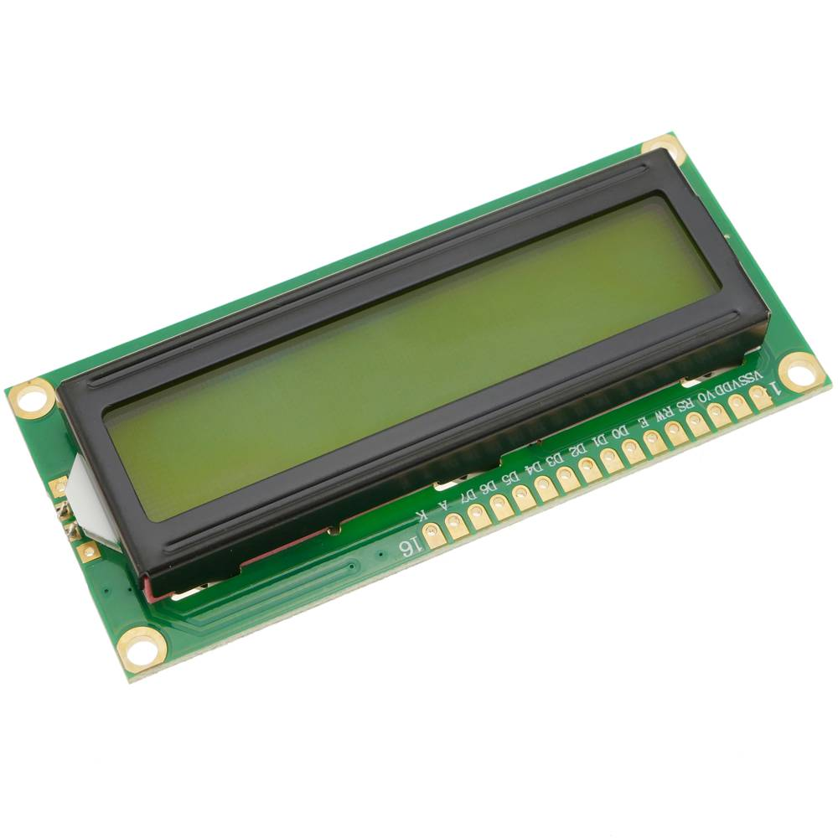
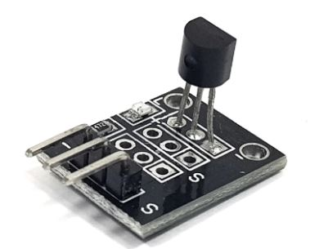
Sensors & Boards
KY-039 Heartbeat Sensor
KY-001 Temperature sensor module
LCD

Slide 5
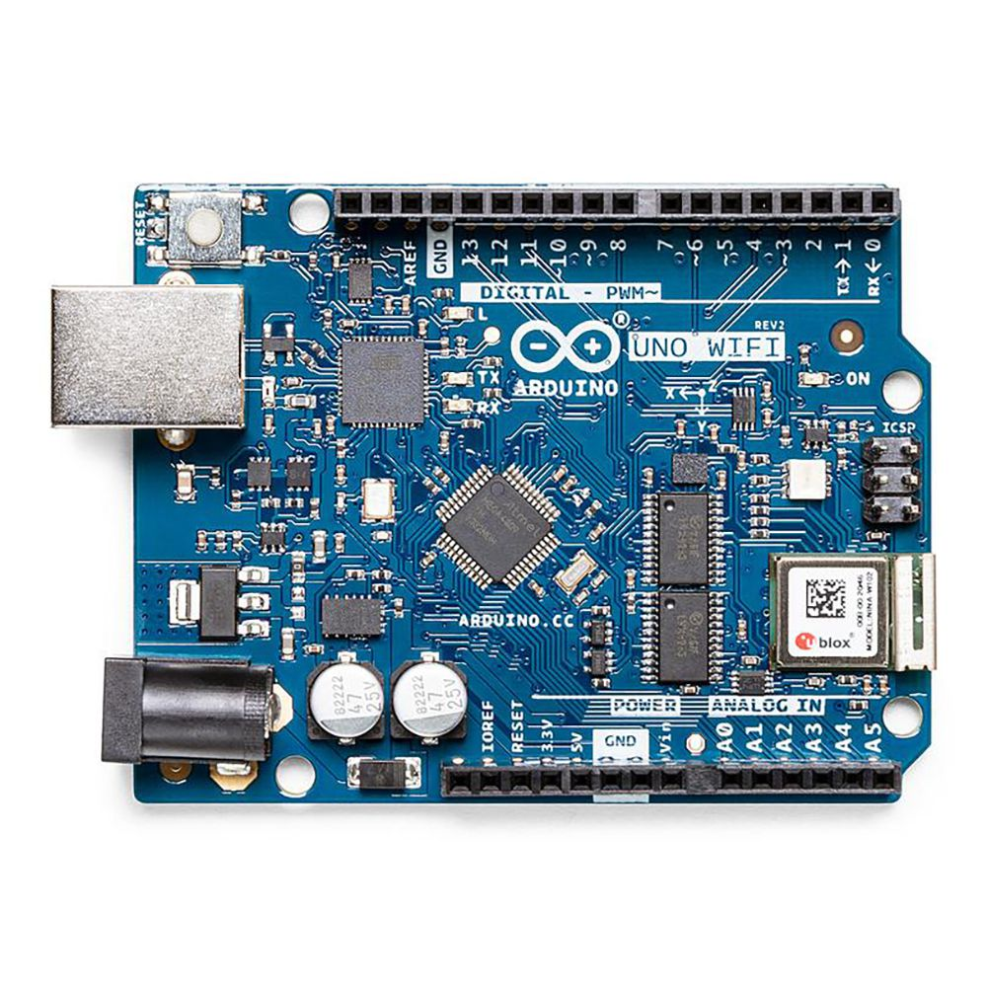
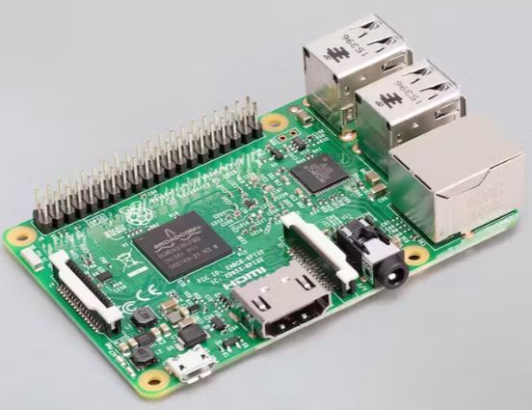
Sensors & Boards
Arduino Uno Wifi
Raspberry Pi 3 Model B

Slide 6
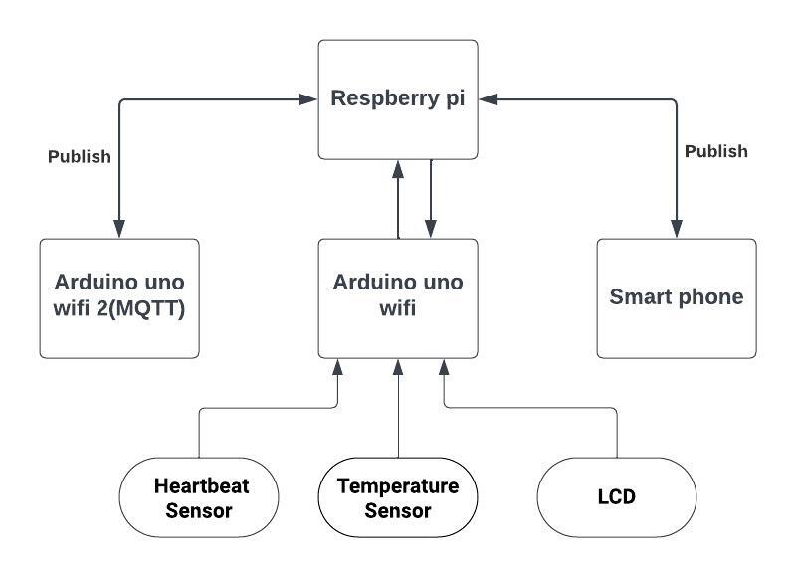
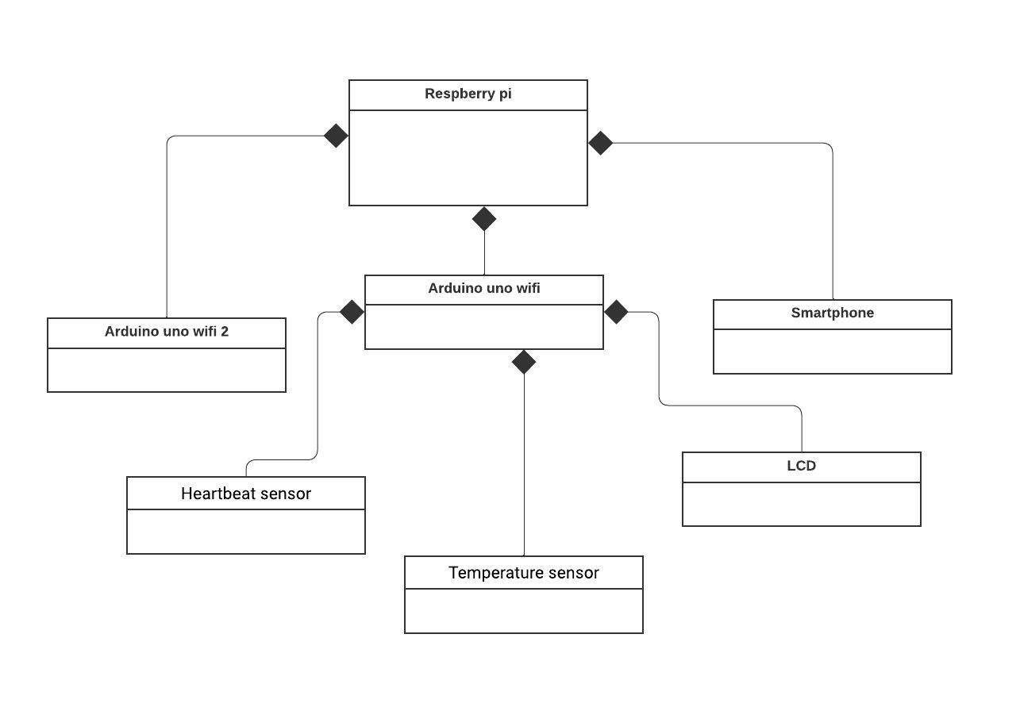
DIAGRAM
Block Diagram
Class Diagram

Slide 7
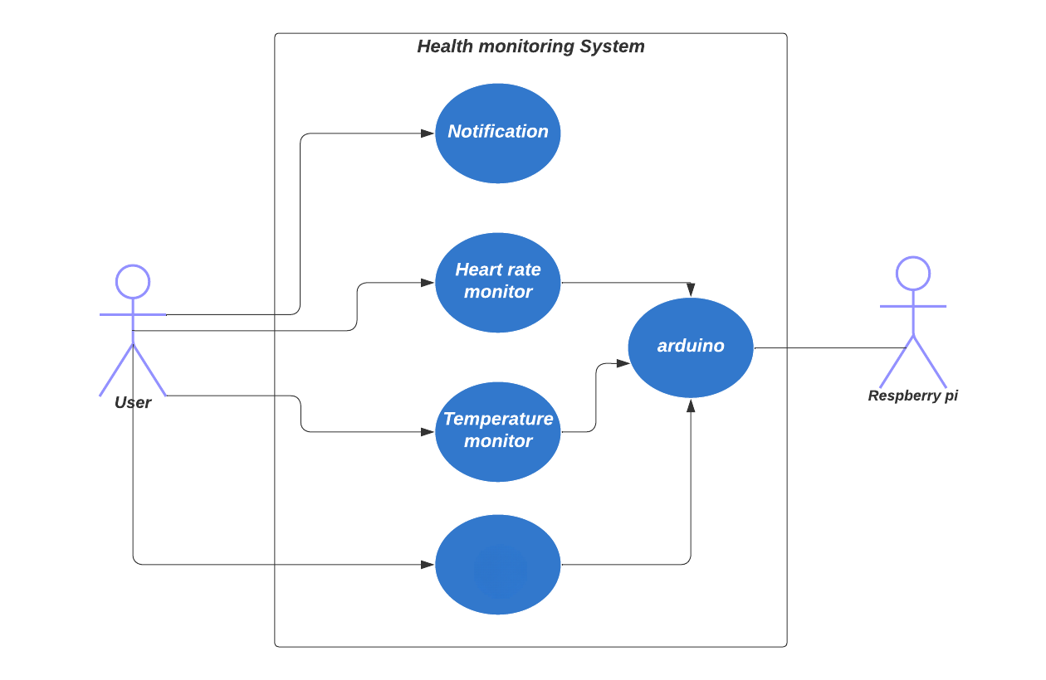

DIAGRAM
LCD
LCD
USE CASE Diagram

Slide 8
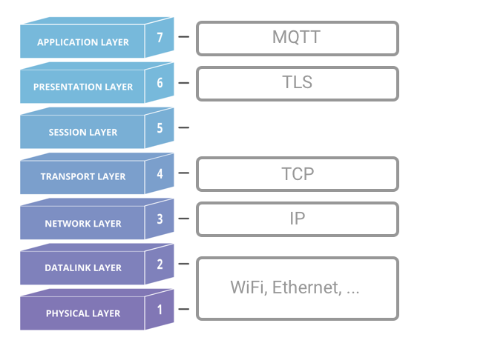
MQTT
MQTT: Lightweight protocol for IoT.
Publish/Subscribe model for data exchange.
Uses TCP/IP for communication efficiency.
Minimal bandwidth and resource consumption.
Reliable message delivery with QoS.

Slide 9
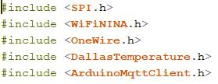
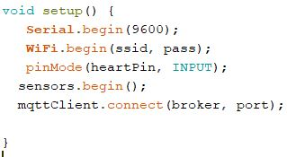
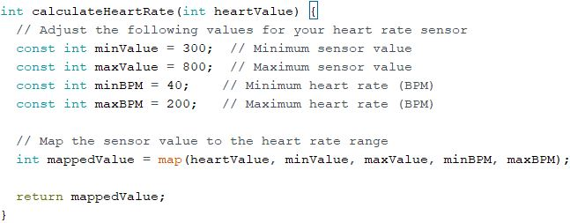
Arduino input node initializations
Libraries for Input Arduino node
Setup for Input Arduino node
Map function used to convert raw data to medical data of heart beat sensor

Slide 10
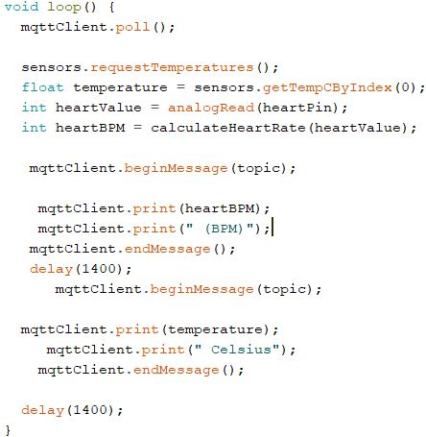
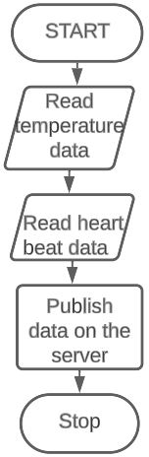
Input node Arduino main loop

Slide 11
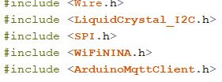
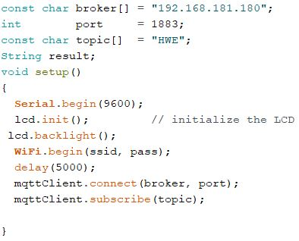
Arduino OUTput node
Libraries for Output Arduino node
Setup for output Arduino node

Slide 12
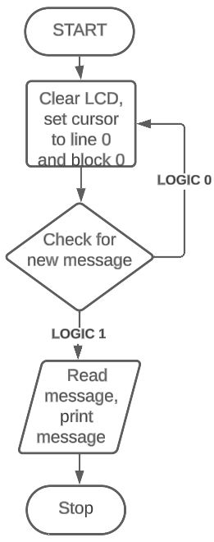
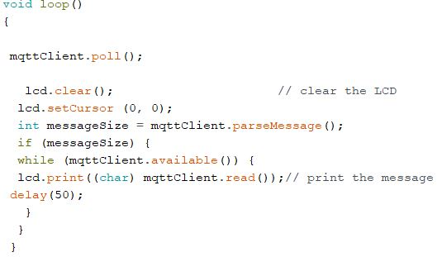
OUtput node Arduino main loop

Slide 13
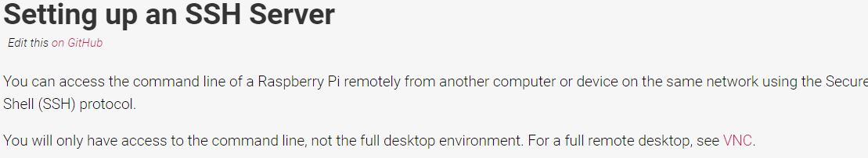
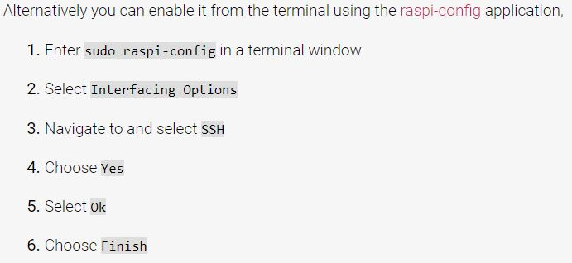

Raspberry Pi setup (Headless/remote)
Step 1: Setup SSH server
https://www.raspberrypi.com/documentation/computers/remote-access.html#setting-up-an-ssh-server

Slide 14
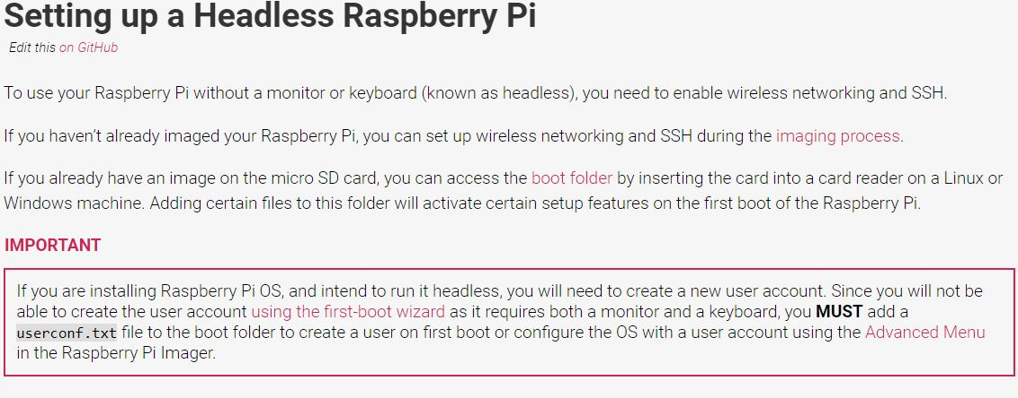
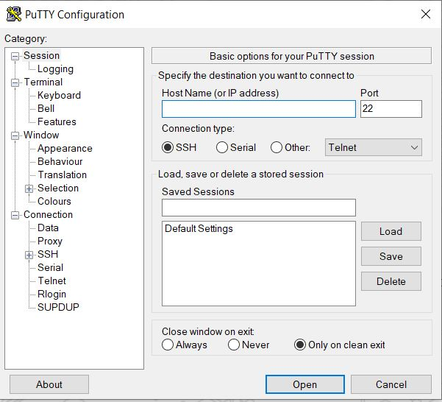
Raspberry Pi setup (Headless/remote)
Step 2: Headless raspberry pi setup

Slide 15
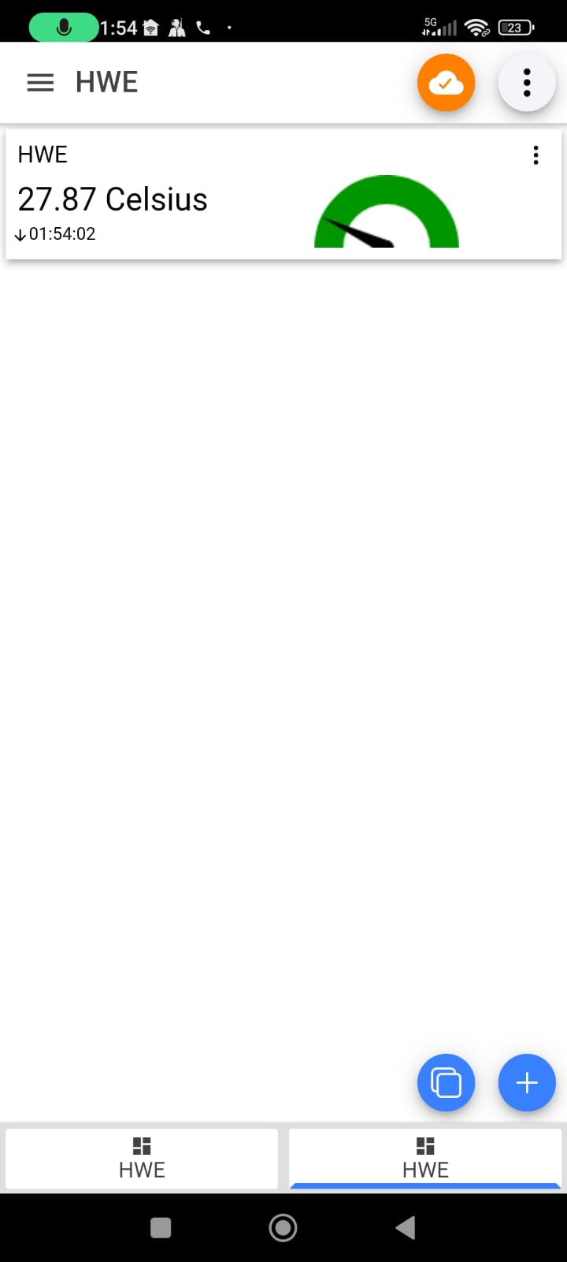
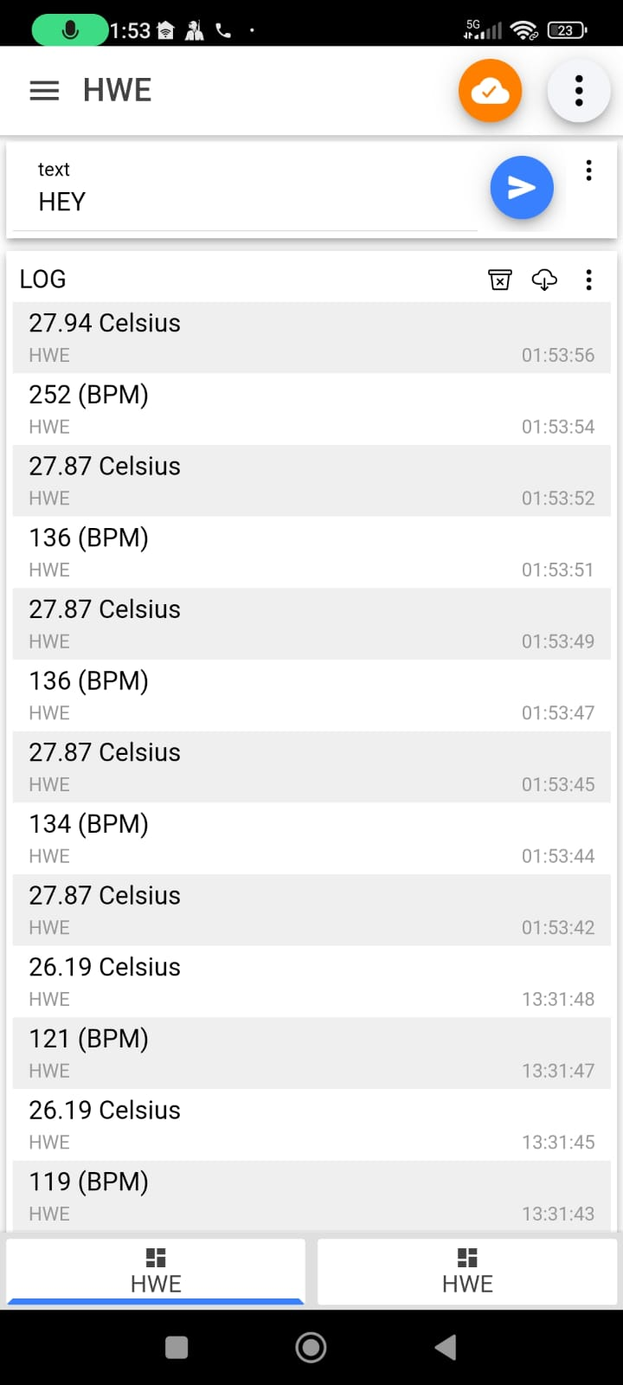
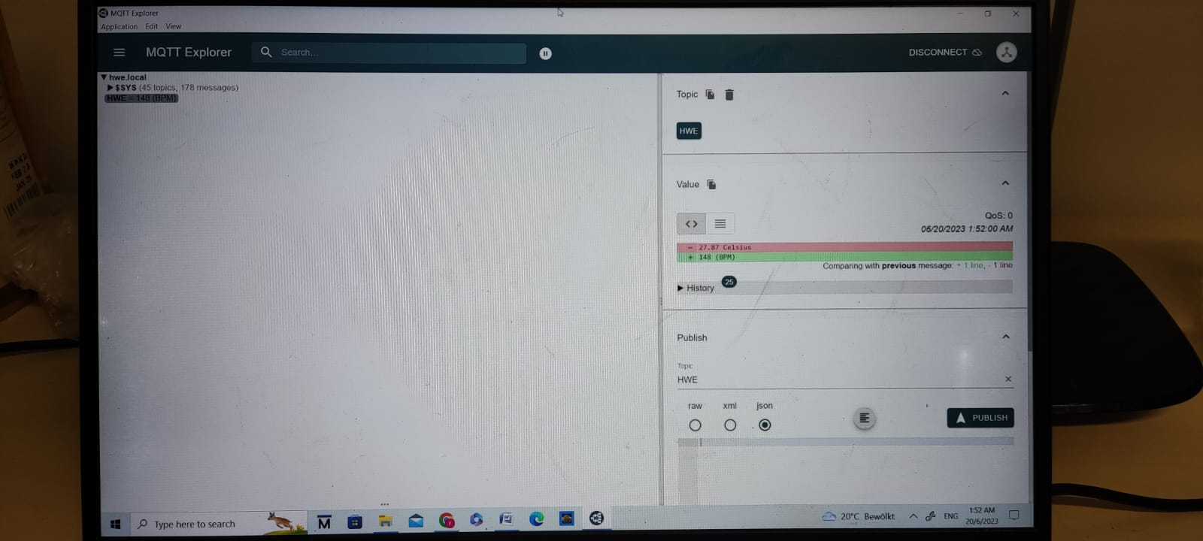
Smartphone and laptop as mqtt client
IOT MQTT Panel application has been used in smartphone for enabling MQTT client subscription.
Mqtt explorer has been used on laptop for enabling mqtt client subscription.

Slide 16
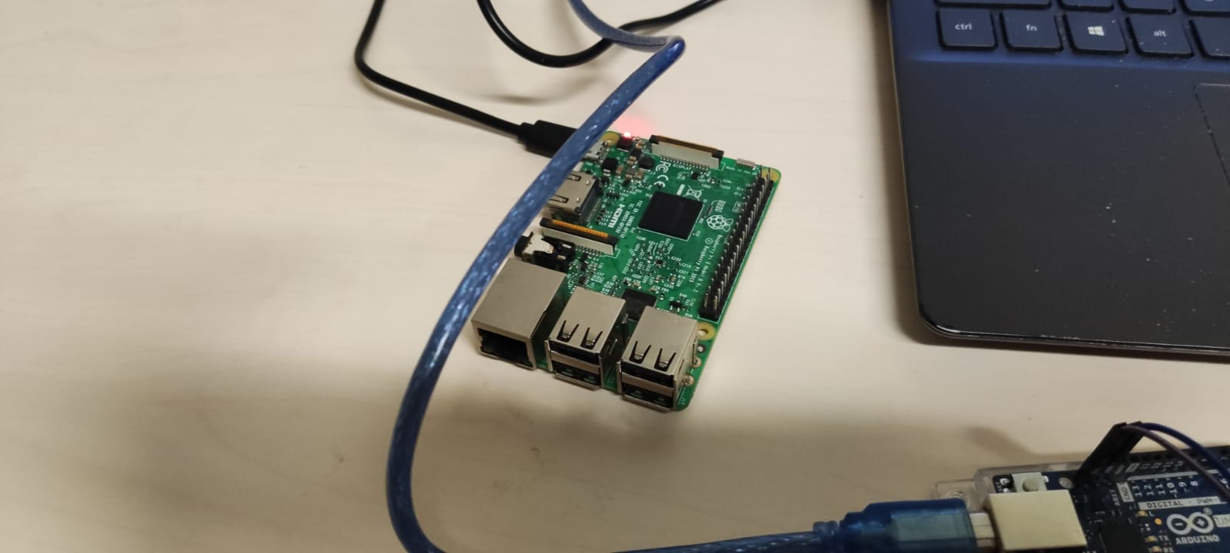
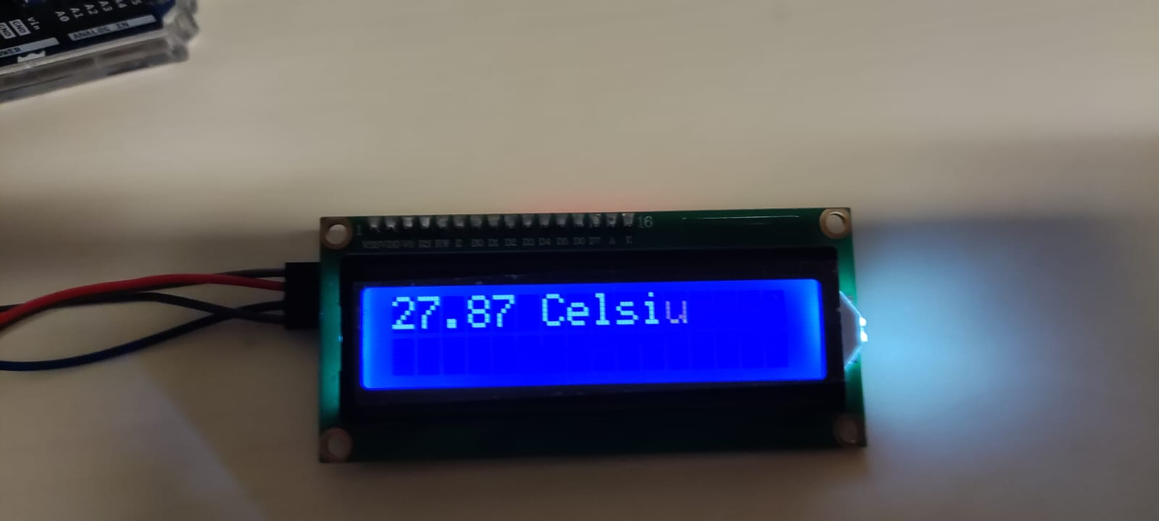
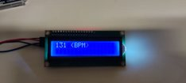
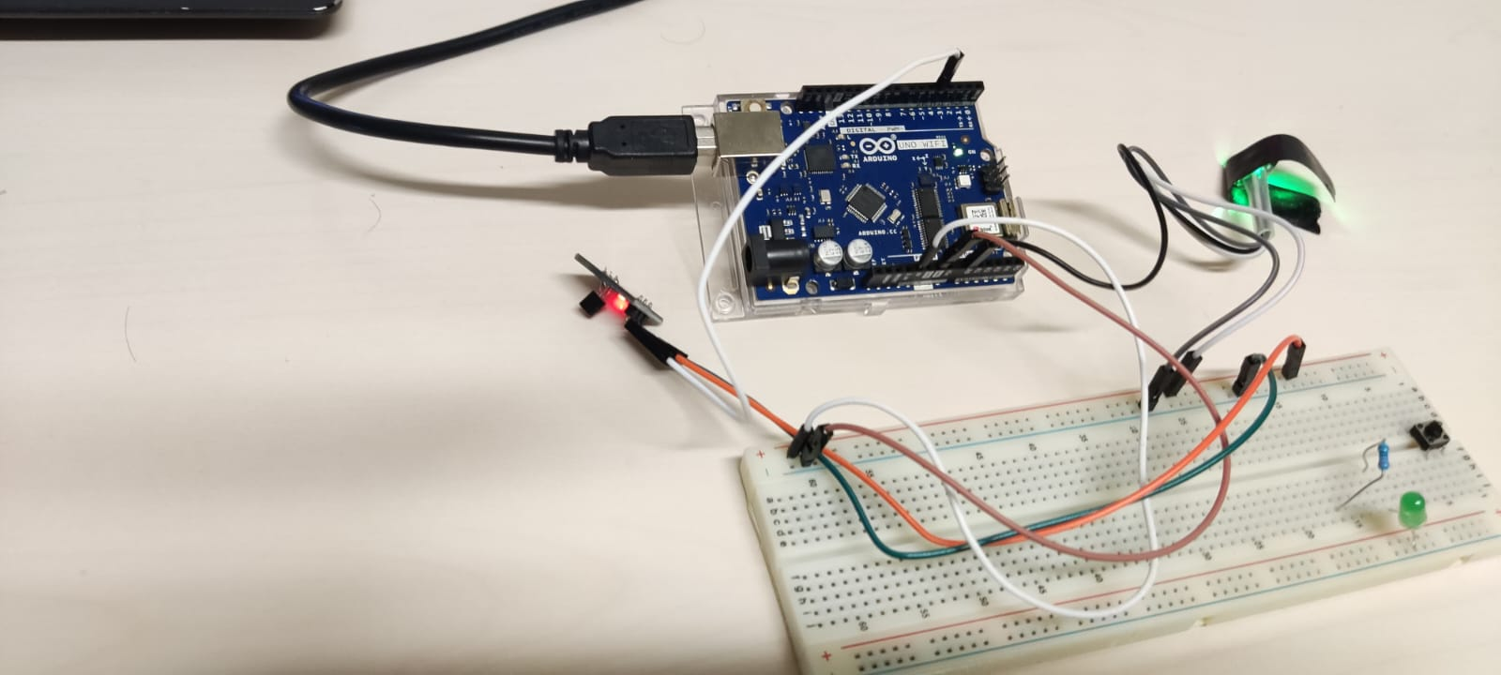
SUMMARY
Key take away from the project:
Using Arduino Uno wifi with wifi connectivity
Setting up raspberry pi and configuring a server.
Data transfer over Mqtt (Message Queuing Telemetry Transport) protocol.

Slide 17
THANK YOU

