Slide 1
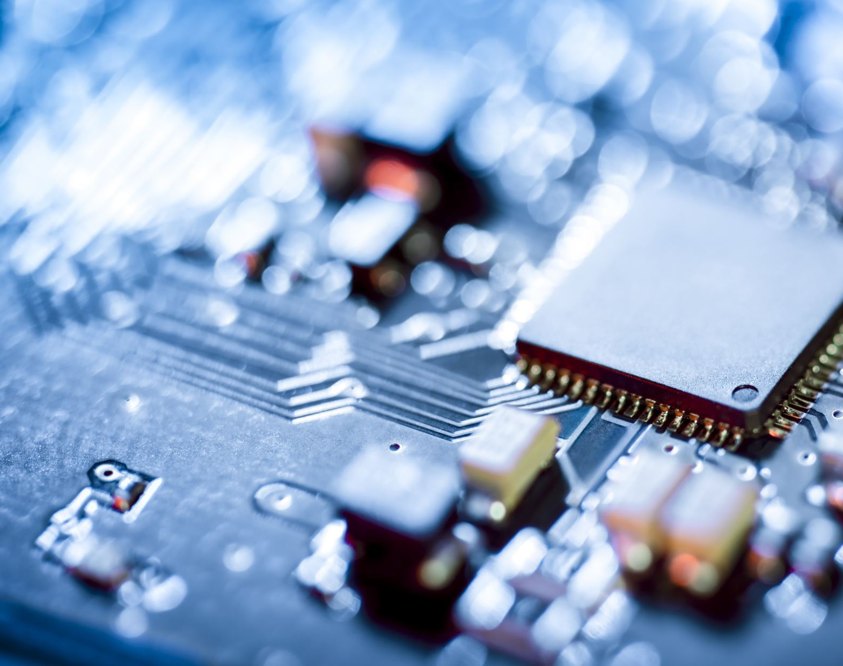
Software Synthesis for Embedded Processors
Yashodhan Vishvesh Deshpande

Slide 2
Motivation
Increasing demand for applications using embedded systems creates need for more software synthesis.
Need for connect between human readable language and machine readable language.
Easier and non-tedious programming process.

Slide 3
Embedded Processors
RISC Architecture
Harvard Architecture

Slide 4
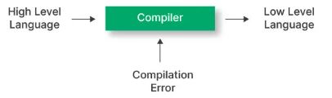
High Level Programming Languages
Human readable languages
Easier to code
Needs compilers
Examples : C, Python and Java

Slide 5
Processes in a compiler
Lexical analysis
Syntax analysis
Semantic analysis
Intermediate representation code generation
Optimization
Output code

Slide 6
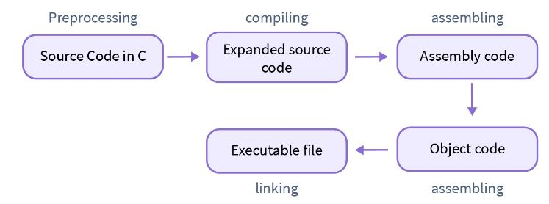
Pre-processing
Removing Comments
Macro Expansion
#define PI 3.141592653589793
File Inclusion
#include "math.h"

Slide 7
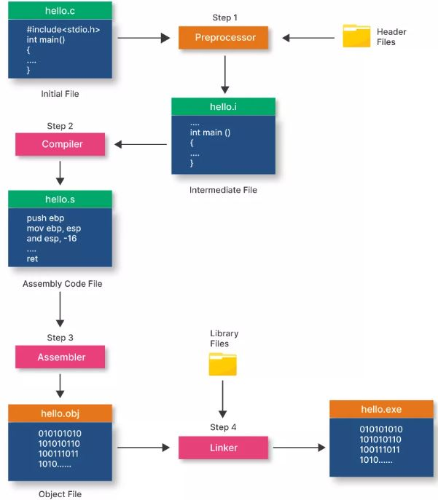
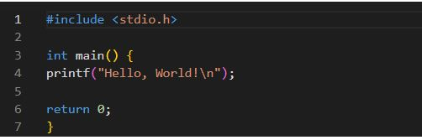
Compilation
Code Compilation - .obj file
Assembler - machine code
Linking

Slide 8
Conclusion
Embedded Processors
High Level Programming languages
Compiler

Slide 9
Thankyou

