Slide 1

Dynamic Motion Sensing System
Project Work by
Yashodhan Vishvesh Deshpande

Slide 2
Motivation
Explore recent developments in Dynamic motion sensing aspects.
Explore the use of Pmod ACL and BLE sensors using Vivado.
Learn the use FPGA and vitis software
Understand the hardware and software co-development.

Slide 3
Problem space
Many dynamic motion sensing systems exist in the current world of technology. After conducting a review of various such systems it was discovered that there are limited number of such FPGA based systems.

Slide 4
Project concept
A dynamic motion sensing a real time system was proposed that would measure acceleration in 3D space and display it on the OLED display.
The proposed system would consist of both hardware and embedded software parts that would make the entire system.
This would give a global view of the entire system from bottom up approach.

Slide 5
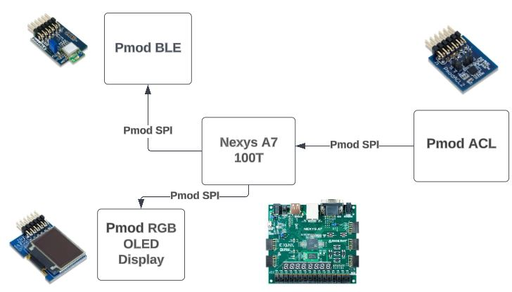
System design and Block diagram

Slide 6
Hardware requirements
Xilinx Nexys A7 FPGA board
Pmod ACL sensor
Pmod BLE sensor
Pmod Oled Display

Slide 7


Software Requirements
Vivado 2023.1
Vitis

Slide 8
Conclusion
This project gave me understanding of FPGA and vivado usage.
Gave me an overview of a motion sensing system using IOT.
Emboldened my understanding about integration of hardware and software system.

