Slide 1
Cloud Storage

Slide 2
What is Cloud Storage?
Cloud storage is a web service where your data can be stored, accessed, and quickly backed up by users on the internet. It is more reliable, scalable, and secure than traditional on-premises storage systems.
Cloud storage is offered in two models:
Pay only for what you use
Pay on a monthly basis

Slide 3
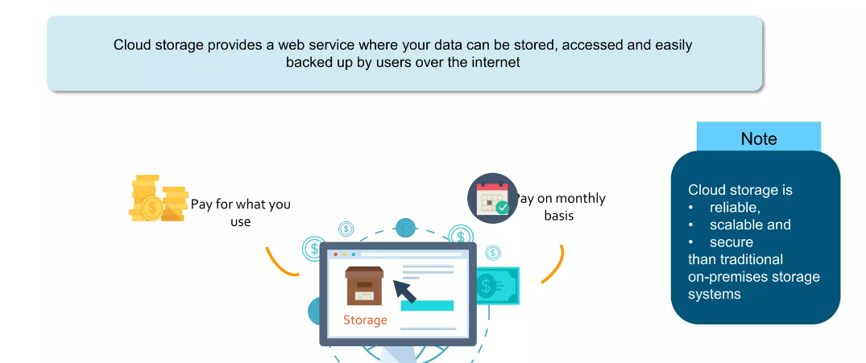

Slide 4
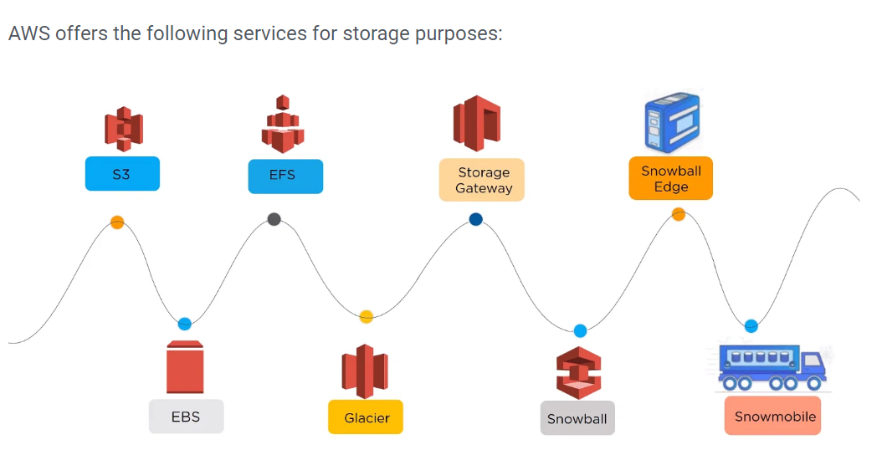
Types of AWS Storage

Slide 5
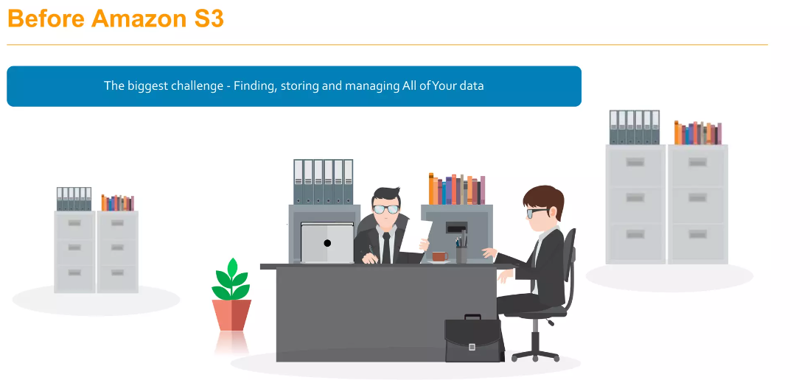

Slide 6
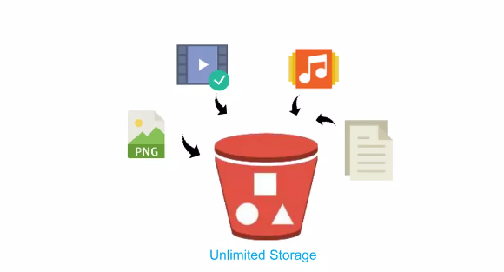
AWS S3
Amazon Simple Storage Service (Amazon S3) is an object storage service that offers
industry-leading scalability
data availability
Security
performance.

Slide 7
Customers of all sizes and industries can use Amazon S3 to store and protect any amount of data for a range of use cases:
Data lakes
Websites
Mobile applications
Backup and restore
Archive enterprise applications IoT devices
Big data analytics.

Slide 8
Provides storage through web services interfaces
While designed for developers for easier web-scale computing
it provides 99.999999999 percent durability and 99.99 percent availability of objects.
It can also store computer files up to 5 terabytes in size.

Slide 9
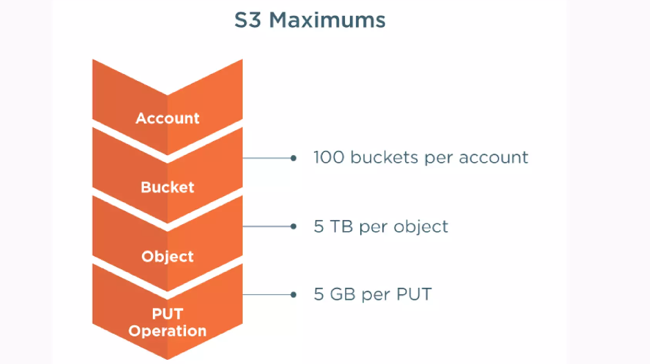

Slide 10
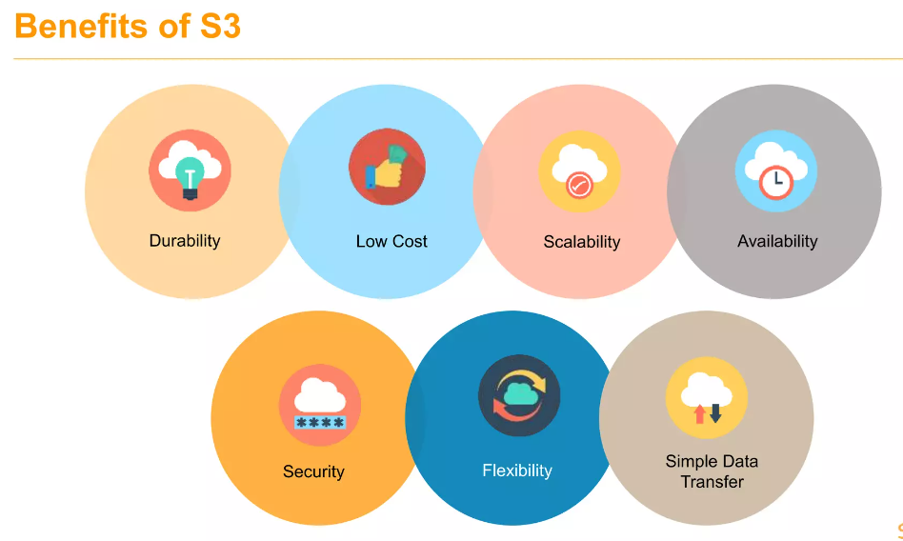

Slide 11
Durability: S3 provides 99.999999999 percent durability.
Low cost: S3 lets you store data in a range of “storage classes.” These classes are based on the frequency and immediacy you require in accessing files.
Scalability: S3 charges you only for what resources you actually use, and there are no hidden fees or overage charges. You can scale your storage resources to easily meet your organization’s ever-changing demands.
Availability: S3 offers 99.99 percent availability of objects

Slide 12
Security: S3 offers an impressive range of access management tools and encryption features that provide top-notch security.
Flexibility: S3 is ideal for a wide range of uses like data storage, data backup, software delivery, data archiving, disaster recovery, website hosting, mobile applications, IoT devices, and much more.
Simple data transfer: You don’t have to be an IT genius to execute data transfers on S3. The service revolves around simplicity and ease of use.

Slide 13
AWS Buckets and Objects
An object consists of data, key (assigned name), and metadata. A bucket is used to store objects. When data is added to a bucket, Amazon S3 creates a unique version ID and allocates it to the object.
Object : Folder/filename.jpg
Bucket: demo_bucket
Link address:

Slide 14
Features of Amazon S3
Storage classes:
Amazon S3 offers a range of storage classes designed for different use cases.
For example, you can store mission-critical production data in S3 Standard for frequent access, save costs by storing infrequently accessed data in S3 Standard-IA or S3 One Zone-IA, and archive data at the lowest costs in S3 Glacier Instant Retrieval, S3 Glacier Flexible Retrieval, and S3 Glacier Deep Archive.

Slide 15
You can store data with changing or unknown access patterns in S3 Intelligent-Tiering, which optimizes storage costs by automatically moving your data between four access tiers when your access patterns change.
These four access tiers include two low-latency access tiers optimized for frequent and infrequent access, and two opt-in archive access tiers designed for asynchronous access for rarely accessed data.

Slide 16
Storage management:
Amazon S3 has storage management features that you can use to manage costs, meet regulatory requirements, reduce latency, and save multiple distinct copies of your data for compliance requirements.
S3 Lifecycle – Configure a lifecycle policy to manage your objects and store them cost effectively throughout their lifecycle. You can transition objects to other S3 storage classes or expire objects that reach the end of their lifetimes.

Slide 17
S3 Object Lock – Prevent Amazon S3 objects from being deleted or overwritten for a fixed amount of time or indefinitely. You can use Object Lock to help meet regulatory requirements that require write-once-read-many (WORM) storage or to simply add another layer of protection against object changes and deletions.
S3 Replication – Replicate objects and their respective metadata and object tags to one or more destination buckets in the same or different AWS Regions for reduced latency, compliance, security, and other use cases.
S3 Batch Operations – Manage billions of objects at scale with a single S3 API request or a few clicks in the Amazon S3 console. You can use Batch Operations to perform operations such as Copy, Invoke AWS Lambda function, and Restore on millions or billions of objects.

Slide 18
Access management
Amazon S3 provides features for auditing and managing access to your buckets and objects. By default, S3 buckets and the objects in them are private.
You have access only to the S3 resources that you create.
To grant granular resource permissions that support your specific use case or to audit the permissions of your Amazon S3 resources, you can use the following features.
S3 Block Public Access – Block public access to S3 buckets and objects. By default, Block Public Access settings are turned on at the account and bucket level.

Slide 19
AWS Identity and Access Management (IAM) – IAM is a web service that helps you securely control access to AWS resources, including your Amazon S3 resources. With IAM, you can centrally manage permissions that control which AWS resources users can access. You use IAM to control who is authenticated (signed in) and authorized (has permissions) to use resources.
Bucket policies – Use IAM-based policy language to configure resource-based permissions for your S3 buckets and the objects in them.
Amazon S3 access points – Configure named network endpoints with dedicated access policies to manage data access at scale for shared datasets in Amazon S3.

Slide 20
Access control lists (ACLs) – Grant read and write permissions for individual buckets and objects to authorized users. As a general rule, we recommend using S3 resource-based policies (bucket policies and access point policies) or IAM policies for access control instead of ACLs. ACLs are an access control mechanism that predates resource-based policies and IAM. For more information about when you'd use ACLs instead of resource-based policies or IAM policies, see Access policy guidelines.
S3 Object Ownership – Disable ACLs and take ownership of every object in your bucket, simplifying access management for data stored in Amazon S3. You, as the bucket owner, automatically own and have full control over every object in your bucket, and access control for your data is based on policies.

Slide 21
Access Analyzer for S3 – Evaluate and monitor your S3 bucket access policies, ensuring that the policies provide only the intended access to your S3 resources.

Slide 22
Data processing
To transform data and trigger workflows to automate a variety of other processing activities at scale, you can use the following features.
S3 Object Lambda – Add your own code to S3 GET, HEAD, and LIST requests to modify and process data as it is returned to an application. Filter rows, dynamically resize images, redact confidential data, and much more.
Event notifications – Trigger workflows that use Amazon Simple Notification Service (Amazon SNS), Amazon Simple Queue Service (Amazon SQS), and AWS Lambda when a change is made to your S3 resources.

Slide 23
Storage logging and monitoring
Amazon S3 provides logging and monitoring tools that you can use to monitor and control how your Amazon S3 resources are being used. For more information, see Monitoring tools.
Automated monitoring tools
Amazon CloudWatch metrics for Amazon S3 – Track the operational health of your S3 resources and configure billing alerts when estimated charges reach a user-defined threshold.
AWS CloudTrail – Record actions taken by a user, a role, or an AWS service in Amazon S3. CloudTrail logs provide you with detailed API tracking for S3 bucket-level and object-level operations.

Slide 24
Manual monitoring tools
Server access logging – Get detailed records for the requests that are made to a bucket. You can use server access logs for many use cases, such as conducting security and access audits, learning about your customer base, and understanding your Amazon S3 bill.
AWS Trusted Advisor – Evaluate your account by using AWS best practice checks to identify ways to optimize your AWS infrastructure, improve security and performance, reduce costs, and monitor service quotas. You can then follow the recommendations to optimize your services and resources.

Slide 25
Analytics and insights
Amazon S3 offers features to help you gain visibility into your storage usage, which empowers you to better understand, analyze, and optimize your storage at scale.
Amazon S3 Storage Lens – Understand, analyze, and optimize your storage. S3 Storage Lens provides 29+ usage and activity metrics and interactive dashboards to aggregate data for your entire organization, specific accounts, AWS Regions, buckets, or prefixes.
Storage Class Analysis – Analyze storage access patterns to decide when it's time to move data to a more cost-effective storage class.
S3 Inventory with Inventory reports – Audit and report on objects and their corresponding metadata and configure other Amazon S3 features to take action in Inventory reports. For example, you can report on the replication and encryption status of your objects. For a list of all the metadata available for each object in Inventory reports, see Amazon S3 Inventory list.

