Slide 1
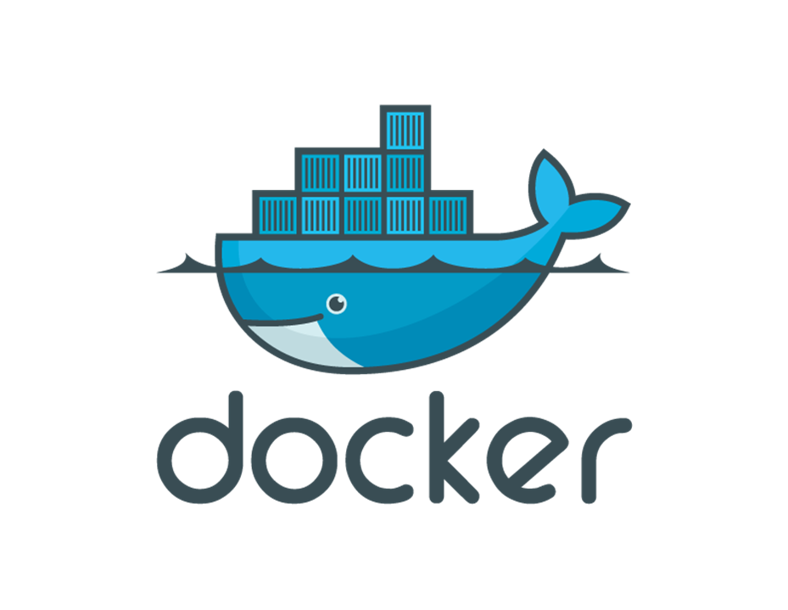

Slide 2
What is Virtualization?
Virtualization is the technique of importing a Guest operating system on top of a Host operating system.
This technique was a revelation at the beginning because it allowed developers to run multiple operating systems in different virtual machines all running on the same host.
This eliminated the need for extra hardware resource.

Slide 3
The advantages of Virtual Machines or Virtualization are:
Multiple operating systems can run on the same machine
Maintenance and Recovery were easy in case of failure conditions
Total cost of ownership was also less due to the reduced need for infrastructure

Slide 4
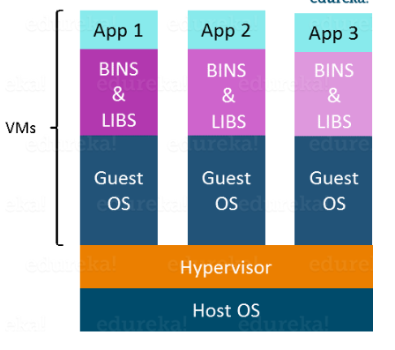

Slide 5
Following are the disadvantages of Virtualization:
Running multiple Virtual Machines leads to unstable performance
Hypervisors are not as efficient as the host operating system
Boot up process is long and takes time

Slide 6
What is Containerization?
Containerization is the technique of bringing virtualization to the operating system level
While Virtualization brings abstraction to the hardware, Containerization brings abstraction to the operating system. Do note that Containerization is also a type of Virtualization. Containerization is however more efficient because there is no guest OS here and utilizes a host’s operating system, share relevant libraries & resources as and when needed unlike virtual machines. Application specific binaries and libraries of containers run on the host kernel, which makes processing and execution very fast.

Slide 7
Advantages of Containerization over Virtualization:
Containers on the same OS kernel are lighter and smaller
Better resource utilization compared to VMs
Boot-up process is short and takes few seconds

Slide 8
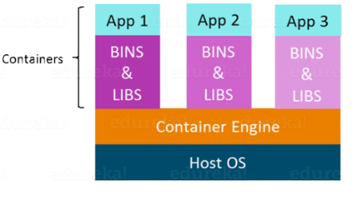
All these containers are handled by the containerization layer which is not native to the host operating system.

Slide 9
What is Docker?
Docker is a tool that allows developers, sys-admins etc. to easily deploy their applications in a sandbox (called containers) to run on the host operating system i.e. Linux.
Docker is that it allows users to package an application with all of its dependencies into a standardized unit for software development.
Unlike virtual machines, containers do not have high overhead and hence enable more efficient usage of the underlying system and resources.

Slide 10
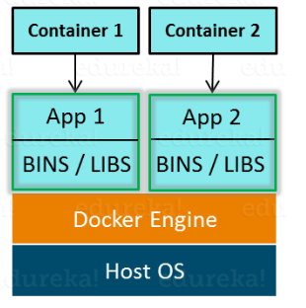

Slide 11
Benefits of Docker
Docker has the ability to reduce the size of development by providing a smaller footprint of the operating system via containers.
With containers, it becomes easier for teams across different units, such as development, QA and Operations to work seamlessly across applications.
You can deploy Docker containers anywhere, on any physical and virtual machines and even on the cloud.
Since Docker containers are pretty lightweight, they are very easily scalable.

