Slide 1
AWS IAM

Slide 2
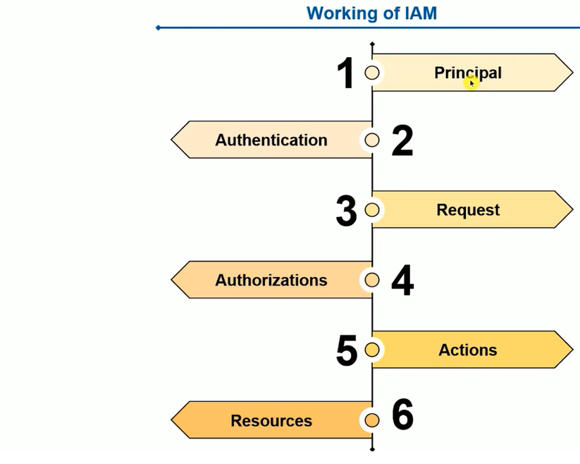

Slide 3
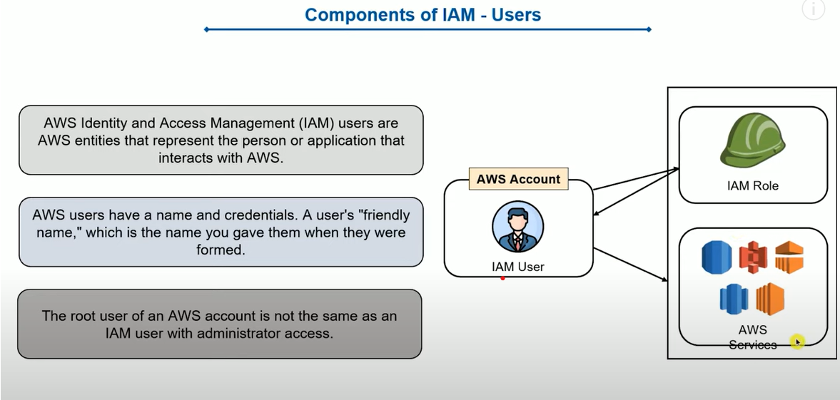
Components of IAM users

Slide 4
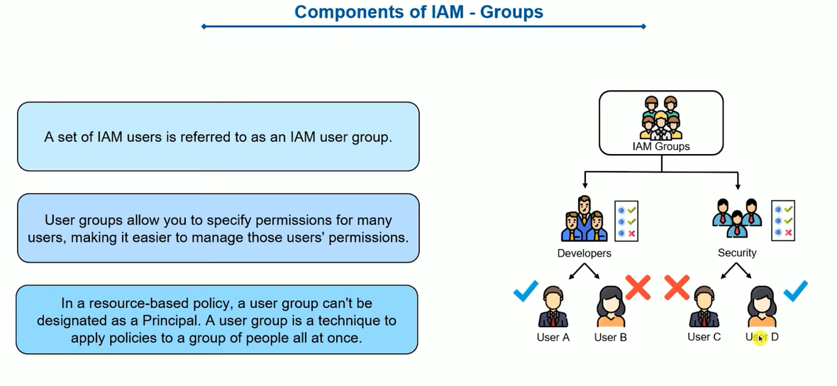

Slide 5
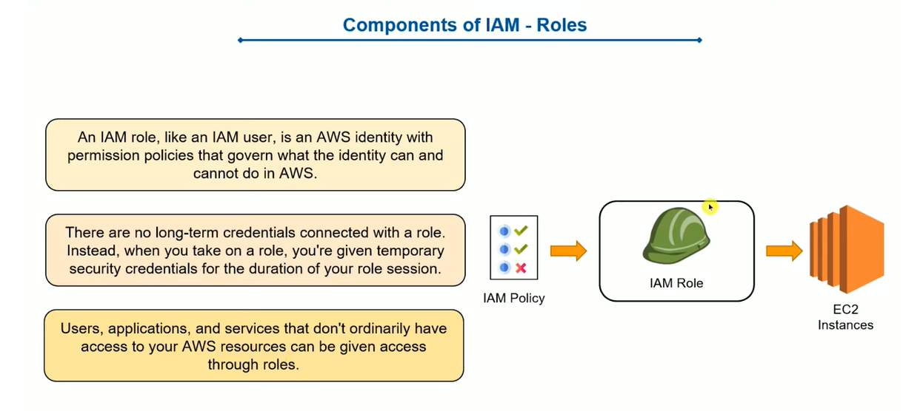

Slide 6
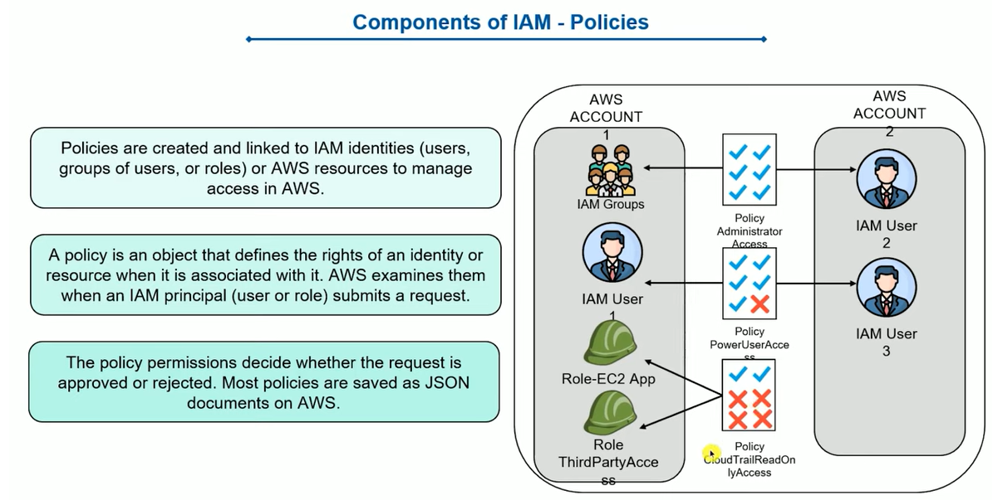

Slide 7
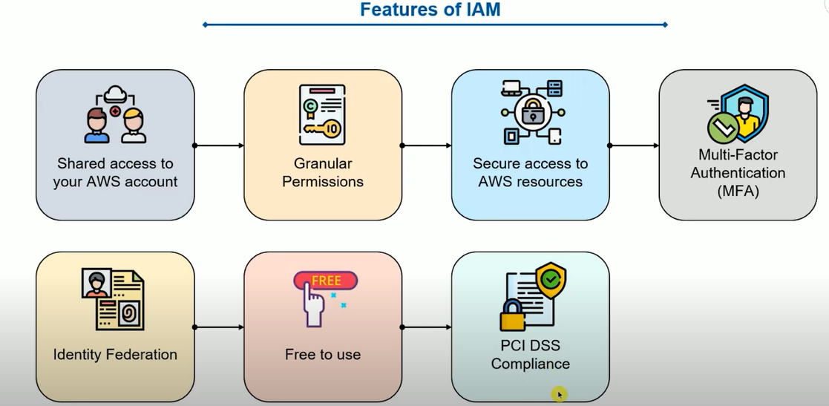

Slide 8
SCENARIO 1:
Create an EC2 instance using the root user.
Attach a policy to this EC2 instance that allows the IAM user to access it
SCENARIO 2:
Attach a policy to the IAM user that allows him to create an EC2 instance.
Sign-in to the console with the IAM user, and create the EC2 instance.
Generate the ACCESS_KEYS that gives the user access to this instance.
SCENARIO 3:
Create an instance using the root user
Since each instance has its own ACCESS_KEYS, there's no need to do any of what I mentioned above, and I can simply hand the access keys to the IAM user.

