Slide 1
Docker Installation
Sudo apt-get install docker.io
To check the Docker Version
docker –version
To start the Docker service
sudo service docker start
To check the status of Docker
sudo service docker status

Slide 2
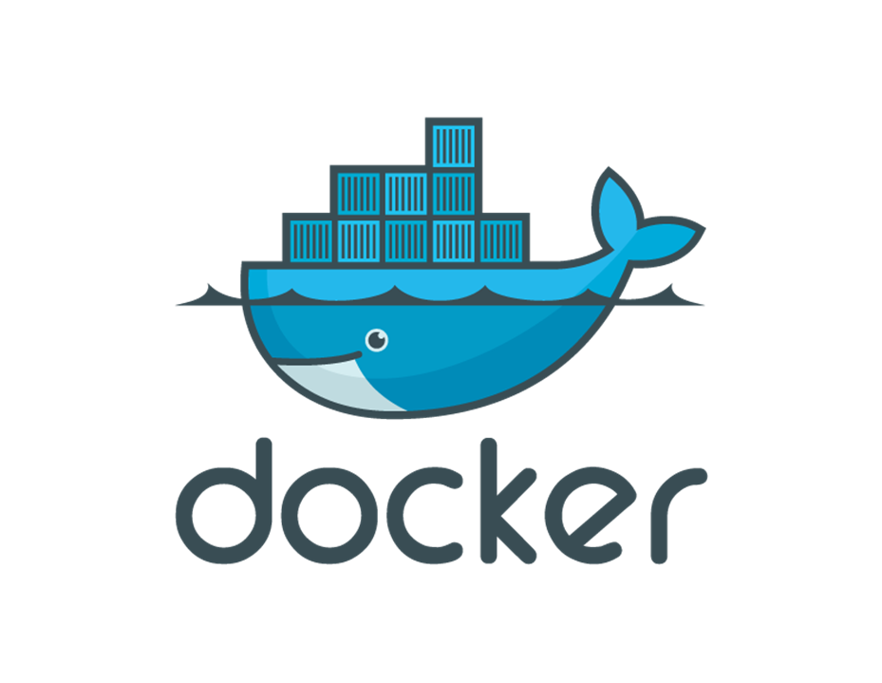

Slide 3
What is Virtualization?
Virtualization is the technique of importing a Guest operating system on top of a Host operating system.
This technique was a revelation at the beginning because it allowed developers to run multiple operating systems in different virtual machines all running on the same host.
This eliminated the need for extra hardware resource.

Slide 4
The advantages of Virtual Machines or Virtualization are:
Multiple operating systems can run on the same machine
Maintenance and Recovery were easy in case of failure conditions
Total cost of ownership was also less due to the reduced need for infrastructure

Slide 5
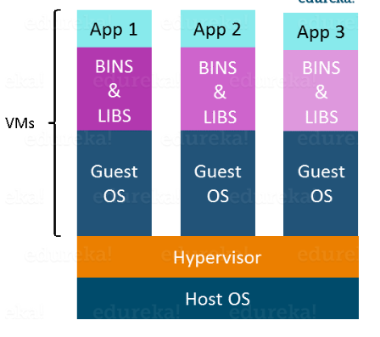

Slide 6
Following are the disadvantages of Virtualization:
Running multiple Virtual Machines leads to unstable performance
Hypervisors are not as efficient as the host operating system
Boot up process is long and takes time

Slide 7
What is Containerization?
Containerization is the technique of bringing virtualization to the operating system level
While Virtualization brings abstraction to the hardware, Containerization brings abstraction to the operating system. Do note that Containerization is also a type of Virtualization. Containerization is however more efficient because there is no guest OS here and utilizes a host’s operating system, share relevant libraries & resources as and when needed unlike virtual machines. Application specific binaries and libraries of containers run on the host kernel, which makes processing and execution very fast.

Slide 8
Advantages of Containerization over Virtualization:
Containers on the same OS kernel are lighter and smaller
Better resource utilization compared to VMs
Boot-up process is short and takes few seconds

Slide 9
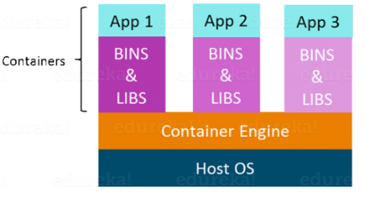
All these containers are handled by the containerization layer which is not native to the host operating system.

Slide 10
What is Docker?
Docker is a tool that allows developers, sys-admins etc. to easily deploy their applications in a sandbox (called containers) to run on the host operating system i.e. Linux.
Docker is that it allows users to package an application with all of its dependencies into a standardized unit for software development.
Unlike virtual machines, containers do not have high overhead and hence enable more efficient usage of the underlying system and resources.

Slide 11
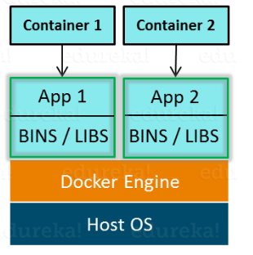

Slide 12
Benefits of Docker
Docker has the ability to reduce the size of development by providing a smaller footprint of the operating system via containers.
With containers, it becomes easier for teams across different units, such as development, QA and Operations to work seamlessly across applications.
You can deploy Docker containers anywhere, on any physical and virtual machines and even on the cloud.
Since Docker containers are pretty lightweight, they are very easily scalable.

Slide 13
Important Docker concepts.
Dockerfile, Docker Image And Docker Container:
A Docker Image is created by the sequence of commands written in a file called as Dockerfile.
When this Dockerfile is executed using a docker command it results in a Docker Image with a name.
When this Image is executed by “docker run” command it will by itself start whatever application or service it must start on its execution.

Slide 14
Docker container
Docker container is a separate virtualized environment that is used to test, run and deploy the applications.
The docker container is used in application development. If any problem or bug comes then it does not affect our Base OS and it also gives extra security.
we can easily create new containers with help of docker images. we can also destroy these containers easily.

Slide 15
Docker image
Docker images are like snapshots in VMs. Docker images are executable files that are used to create separate containers in Docker. We create lots of containers using single docker images.
Docker hub is a centralized location that is maintaining docker images.
We also create our own customize image using the docker commit command and using Dockerfile and publish or push them on the docker hub.

Slide 16
Dockerfile
Dockerfile is a scripted text file that is used to customize our container and install desire software inside the docker container.
we just write the commands in Dockerfile and using this file we build our own image. Later we use this image in our container as well as we push the image on Dockerhub.

Slide 17
Docker Hub:
Docker Hub is like GitHub for Docker Images. It is basically a cloud registry where you can find Docker Images uploaded by different communities, also you can develop your own image and upload on Docker Hub, but first, you need to create an account on DockerHub.

Slide 18
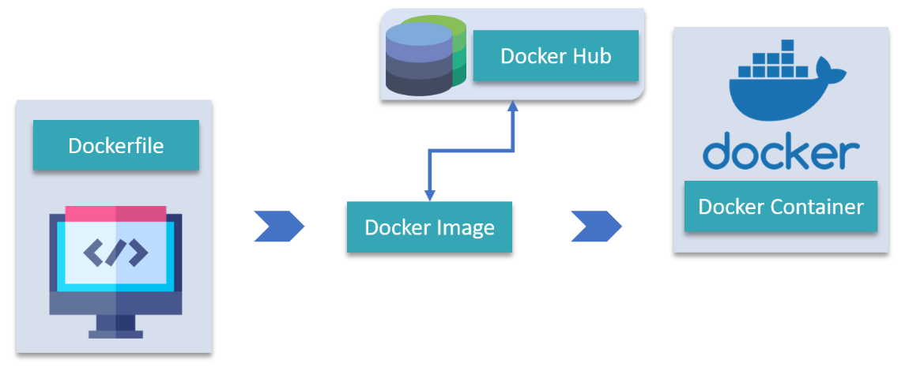

Slide 19
Docker architecture
Docker uses a client-server architecture.
The Docker client talks to the Docker daemon, which does the heavy lifting of building, running, and distributing your Docker containers.
The Docker client and daemon can run on the same system, or you can connect a Docker client to a remote Docker daemon.
The Docker client and daemon communicate using a REST API, over UNIX sockets or a network interface.
Another Docker client is Docker Compose, that lets you work with applications consisting of a set of containers.

Slide 20
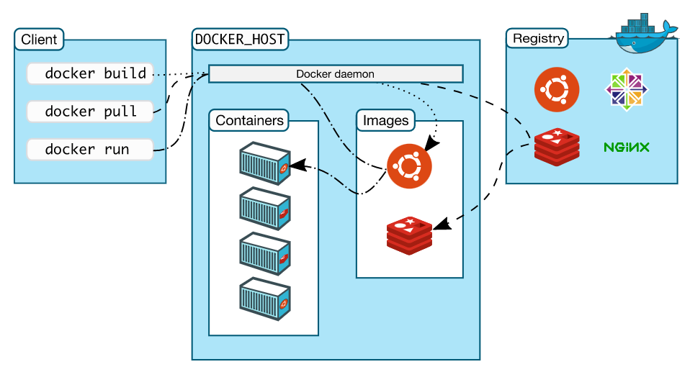

Slide 21
The Docker daemon
The Docker daemon (dockerd) listens for Docker API requests and manages Docker objects such as images, containers, networks, and volumes.
A daemon can also communicate with other daemons to manage Docker services.

Slide 22
The Docker Client
The Docker client (docker) is the primary way that many Docker users interact with Docker.
When you use commands such as docker run, the client sends these commands to dockerd, which carries them out.
The docker command uses the Docker API. The Docker client can communicate with more than one daemon

Slide 23
Docker Desktop
Docker Desktop is an easy-to-install application for your Mac, Windows or Linux environment that enables you to build and share containerized applications and microservices.
Docker Desktop includes the Docker daemon (dockerd), the Docker client (docker), Docker Compose, Docker Content Trust, Kubernetes, and Credential Helper.

Slide 24
Docker registries
A Docker registry stores Docker images.
Docker Hub is a public registry that anyone can use, and Docker is configured to look for images on Docker Hub by default.
You can even run your own private registry.
you use the docker pull or docker run commands, the required images are pulled from your configured registry.
When you use the docker push command, your image is pushed to your configured registry.

Slide 25
Docker Objects
When you use Docker, you are creating and using images, containers, networks, volumes, plugins, and other objects.

Slide 26
Images
An image is a read-only template with instructions for creating a Docker container.
Often, an image is based on another image, with some additional customization. For example, you may build an image which is based on the ubuntu image, but installs the Apache web server and your application, as well as the configuration details needed to make your application run.

Slide 27
You might create your own images or you might only use those created by others and published in a registry. To build your own image, you create a Dockerfile with a simple syntax for defining the steps needed to create the image and run it.
Each instruction in a Dockerfile creates a layer in the image. When you change the Dockerfile and rebuild the image, only those layers which have changed are rebuilt.

Slide 28
Containers
A container is a runnable instance of an image. You can create, start, stop, move, or delete a container using the Docker API or CLI.
You can connect a container to one or more networks, attach storage to it, or even create a new image based on its current state.
By default, a container is relatively well isolated from other containers and its host machine. You can control how isolated a container’s network, storage, or other underlying subsystems are from other containers or from the host machine.

Slide 29
docker run -i -t ubuntu /bin/bash

Slide 30
When you run this command, the following happens (assuming you are using the default registry configuration):
If you do not have the ubuntu image locally, Docker pulls it from your configured registry, as though you had run docker pull ubuntu manually.
Docker creates a new container, as though you had run a docker container create command manually.

Slide 31
Docker allocates a read-write filesystem to the container, as its final layer. This allows a running container to create or modify files and directories in its local filesystem.
Docker creates a network interface to connect the container to the default network, since you did not specify any networking options. This includes assigning an IP address to the container. By default, containers can connect to external networks using the host machine’s network connection.
Docker starts the container and executes /bin/bash. Because the container is running interactively and attached to your terminal (due to the -i and -t flags), you can provide input using your keyboard while the output is logged to your terminal.
When you type exit to terminate the /bin/bash command, the container stops but is not removed. You can start it again or remove it.

Slide 32
Hello World
Steps to achieve the goal.
Basic terminologies like docker container, docker image, dockerfile.
Docker installation on Redhat/centos.
How to start docker services.
How to pull Hello-world image from docker hub.
Hello-world.

Slide 33
docker pull
Download an image from a registry
docker pull [OPTIONS] NAME[:TAG|@DIGEST]
Most of your images will be created on top of a base image from the Docker Hub registry.
Docker Hub contains many pre-built images that you can pull and try without needing to define and configure your own.

Slide 34
Proxy configuration
If you are behind an HTTP proxy server, for example in corporate settings, before open a connect to registry, you may need to configure the Docker daemon’s proxy settings, using the HTTP_PROXY, HTTPS_PROXY, and NO_PROXY environment variables.
To set these environment variables on a host using systemd, refer to the control and configure Docker with systemd for variables configuration.

Slide 35
Pull an image from Docker Hub
To download a particular image, or set of images (i.e., a repository), use docker image pull (or the docker pull shorthand). If no tag is provided, Docker Engine uses the :latest tag as a default.
docker image pull debian

Slide 36
Pull an image by digest (immutable identifier)
For example, docker pull ubuntu:22.04 pulls the latest version of the Ubuntu 22.04 image.
you’ve pulled images by their name (and “tag”). Using names and tags is a convenient way to work with images.
When using tags, you can docker pull an image again to make sure you have the most up-to-date version of that image.
For example, docker pull ubuntu:22.04 pulls the latest version of the Ubuntu 22.04 image.
docker pull ubuntu:22.04

Slide 37
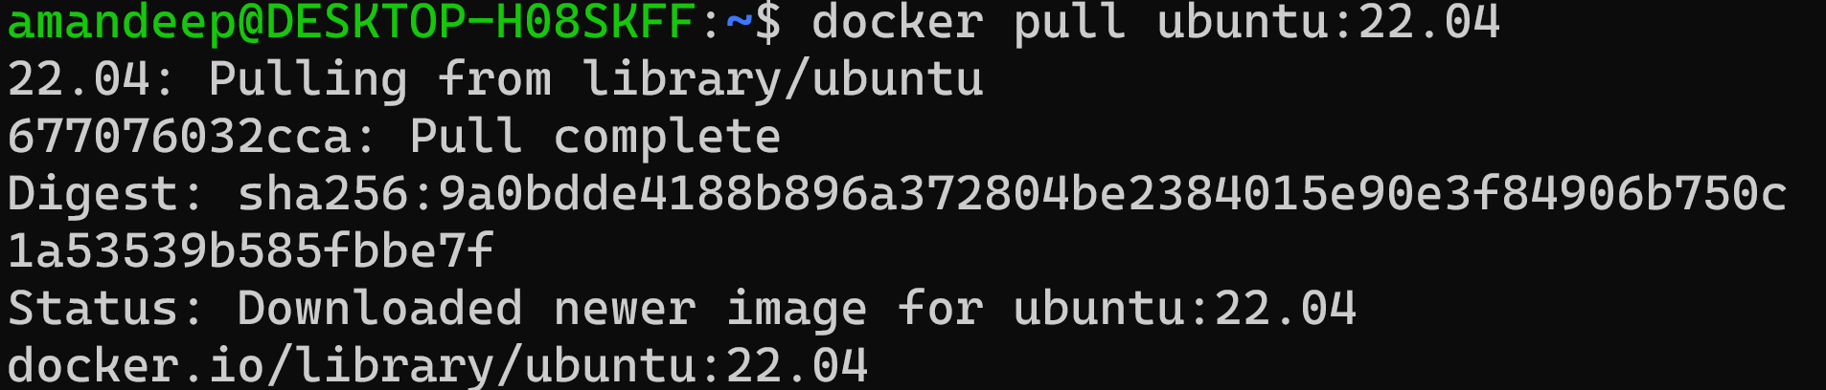

Slide 38
Docker prints the digest of the image after the pull has finished. In the example above, the digest of the image is:
Digest: sha256:9a0bdde4188b896a372804be2384015e90e3f84906b750c1a53539b585fbbe7f
docker pull ubuntu@sha256:9a0bdde4188b896a372804be2384015e90e3f84906b750c1a53539b585fbbe7f

Slide 39
Pull from a different registry
By default, docker pull pulls images from Docker Hub. It is also possible to manually specify the path of a registry to pull from
For example, if you have set up a local registry, you can specify its path to pull from it. A registry path is similar to a URL, but does not contain a protocol specifier (https://).
The following command pulls the testing/test-image image from a local registry listening on port 5000 (myregistry.local:5000):
docker image pull myregistry.local:5000/testing/test-image
Registry credentials are managed by docker login.
Docker uses the https:// protocol to communicate with a registry, unless the registry is allowed to be accessed over an insecure connection.

Slide 40
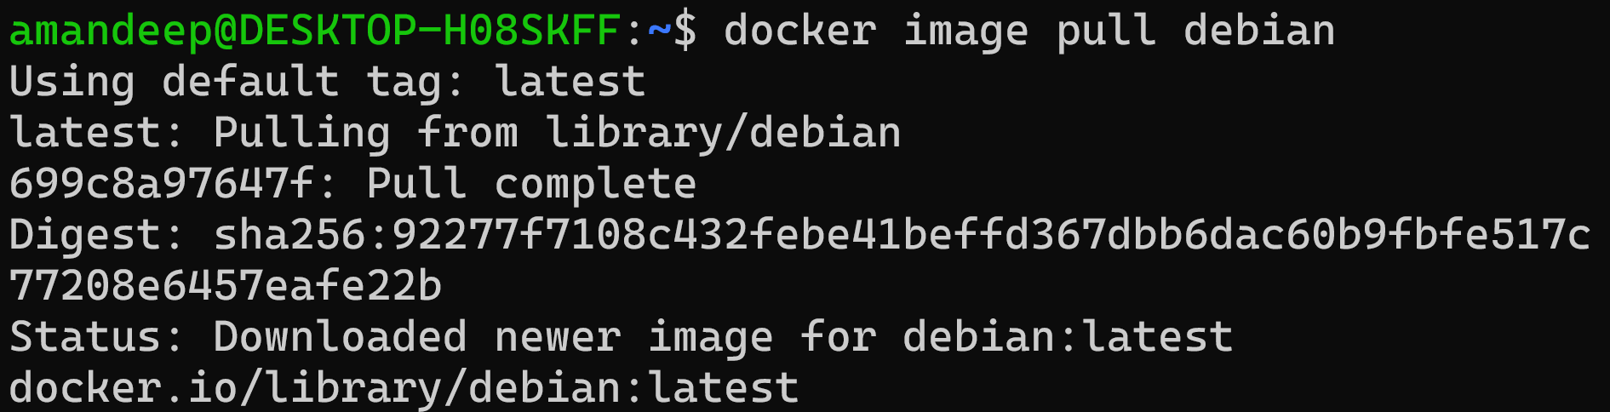

Slide 41
Docker images can consist of multiple layers. In the example above, the image consists of a single layer; e756f3fdd6a3.
Layers can be reused by images. For example, the debian:bullseye image shares its layer with the debian:latest. Pulling the debian:bullseye image therefore only pulls its metadata, but not its layers, because the layer is already present locally:
docker image pull debian:bullseye

Slide 42
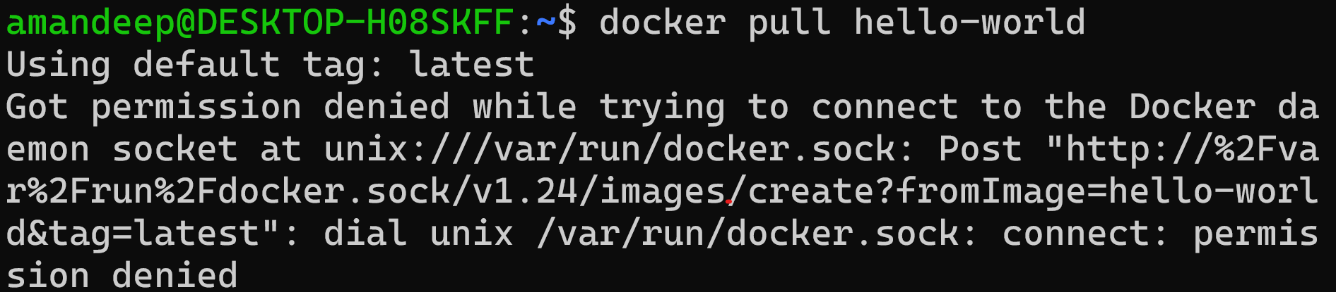

Slide 44
