Slide 1
Docker networks feature

Slide 2
Connect using network port mapping
docker run -d -P training/webapp python app.py
When that container was created, the -P flag was used to automatically map any network port inside it to a random high port within an ephemeral port range on your Docker host. Next, when docker ps was run, you saw that port 5000 in the container was bound to port 49155 on the host.

Slide 3
docker ps
You also saw how you can bind a container’s ports to a specific port using the -p flag. Here port 80 of the host is mapped to port 5000 of the container:

Slide 4
docker run -d -p 80:5000 training/webapp python app.py
And you saw why this isn’t such a great idea because it constrains you to only one container on that specific port.

Slide 5
docker run -d -p 8000-9000:5000 training/webapp python app.py
you may specify a range of host ports to bind a container port to that is different than the default ephemeral port range
This would bind port 5000 in the container to a randomly available port between 8000 and 9000 on the host.

Slide 6
There are also a few other ways you can configure the -p flag. By default the -p flag binds the specified port to all interfaces on the host machine. But you can also specify a binding to a specific interface, for example only to the localhost.
docker run -d -p 127.0.0.1:80:5000 training/webapp python app.py

Slide 7
This would bind port 5000 inside the container to port 80 on the localhost or 127.0.0.1 interface on the host machine.
Or, to bind port 5000 of the container to a dynamic port but only on the localhost, you could use:
docker run -d -p 127.0.0.1::5000 training/webapp python app.py

Slide 8
You can also bind UDP and SCTP (typically used by telecom protocols such as SIGTRAN, Diameter, and S1AP/X2AP) ports by adding a trailing /udp or /sctp. For example:
docker run -d -p 127.0.0.1:80:5000/udp training/webapp python app.py

Slide 9
Connect with the linking system
Network port mappings are not the only way Docker containers can connect to one another. Docker also has a linking system that allows you to link multiple containers together and send connection information from one to another. When containers are linked, information about a source container can be sent to a recipient container.

Slide 10
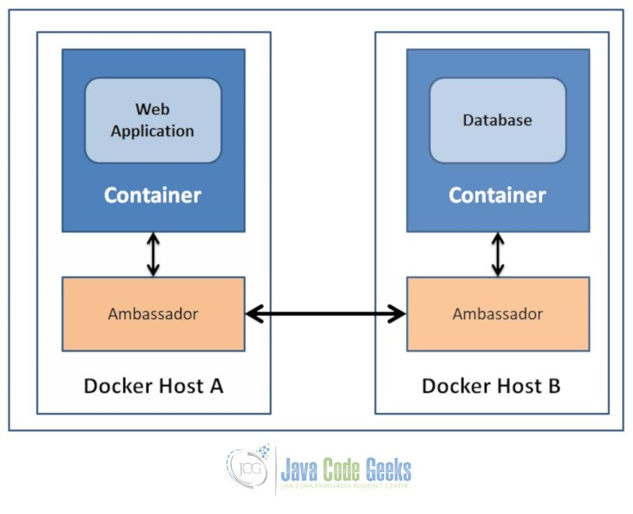

Slide 11
The importance of naming
To establish links, Docker relies on the names of your containers. You’ve already seen that each container you create has an automatically created name; indeed you’ve become familiar with our old friend nostalgic_morse during this guide. You can also name containers yourself. This naming provides two useful functions:
It can be useful to name containers that do specific functions in a way that makes it easier for you to remember them, for example naming a container containing a web application web.
It provides Docker with a reference point that allows it to refer to other containers, for example, you can specify to link the container web to container db.

Slide 12
docker run -d -P --name web training/webapp python app.py
This launches a new container and uses the --name flag to name the container web. You can see the container’s name using the docker ps command.
docker ps -l CONTAINER ID IMAGE COMMAND CREATED STATUS PORTS NAMES aed84ee21bde training/webapp:latest python app.py 12 hours ago Up 2 seconds 0.0.0.0:49154->

Slide 13
Communication across links
Links allow containers to discover each other and securely transfer information about one container to another container. When you set up a link, you create a conduit between a source container and a recipient container. The recipient can then access select data about the source. To create a link, you use the --link flag. First, create a new container, this time one containing a database.
docker run -d --name db training/postgres
This creates a new container called db from the training/postgres image, which contains a PostgreSQL database.

Slide 14
you need to delete the web container you created previously so you can replace it with a linked one:
docker container rm -f web
Now, create a new web container and link it with your db container.
docker run -d -P --name web --link db:db training/webapp python app.py

Slide 15
This links the new web container with the db container you created earlier. The --link flag takes the form:
--link <name or id>:alias
docker run -d -P --name web --link db training/webapp python app.py

Slide 16
, inspect your linked containers with docker inspect:
docker inspect -f "{{ .HostConfig.Links }}" web
[/db:/web/db]

