Slide 1
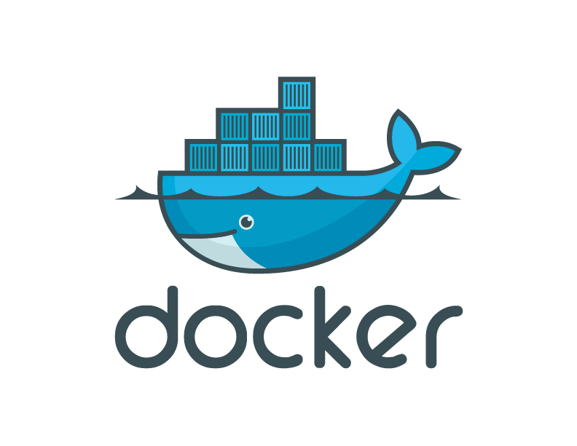


Dockerfiles basics
Docker version 0.6.6

Slide 2
Dockerfiles
Dockerfiles = image representations
Simple syntax for building images
Automate and script the images creation

Slide 3
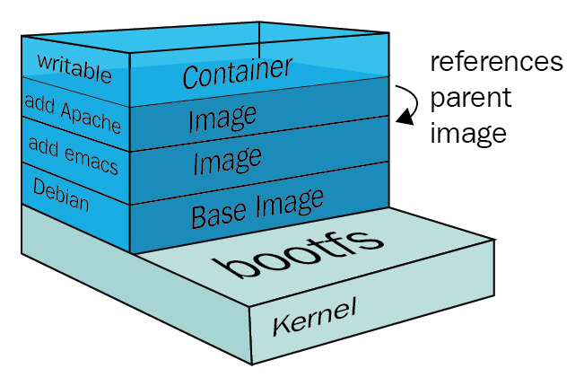

Slide 4
The specific commands you can use in a dockerfile are:
FROM, PULL, RUN, and CMD
FROM - Creates a layer from the ubuntu
PULL - Adds files from your Docker repository
RUN - Builds your container
CMD - Specifies what command to run within the container

Slide 5
Mentioned below is an example of the dockerfile with the important commands
FROM ubuntu:18.04
PULL. /file
RUN make /file
CMD python /file/file.py

Slide 6
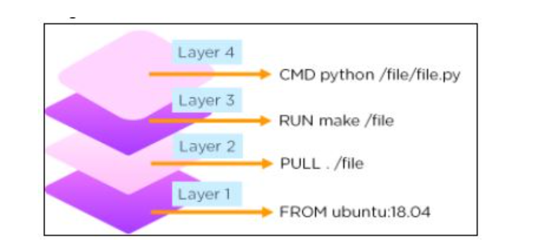

Slide 7
FROM
42
Sets the base image for subsequent instructions
Usage: FROM <image>
Example: FROM ubuntu
Needs to be the first instruction of every Dockerfile
TIP: find images with the command: docker search

Slide 8
RUN
Executes any commands on the current image and commit the results
Usage: RUN <command>
Example: RUN apt-get install –y memcached
FROM ubuntu
RUN apt-get install -y memcached
is equivalent to:
$ docker run ubuntu apt-get install -y memcached
$ docker commit XXX

Slide 9
docker build
Creates an image from a Dockerfile
From the current directory
From stdin
From GitHub
TIP: Use –t to tag your image
$ docker build .
$ docker build - < Dockerfile
$ docker build github.com/creack/docker-firefox

Slide 10
Example: Memcached
FROM ubuntu
RUN echo "deb http://archive.ubuntu.com/ubuntu precise main universe" > /etc/apt/sources.list
RUN apt-get update
RUN apt-get install -y memcached
Dockerfile: https://github.com/jbarbier/Dockerfile-Basics-Docker-Workshop-2-Twitter/blob/master/slide_6/Dockerfile
Test it
$ docker build –t memcached_d1 .
$ docker run -i -t memcached_d1 /bin/bash
root@1f452c9442fb:/# memcached -u daemon -vvv

Slide 11
#Commenting
#
Dockerfile: https://github.com/jbarbier/Dockerfile-Basics-Docker-Workshop-2-Twitter/blob/master/slide_7/Dockerfile
# Memcached
#
# VERSION 1.0
# use the ubuntu base image provided by Docker
FROM ubuntu
# make sure the package repository is up to date
RUN echo "deb http://archive.ubuntu.com/ubuntu precise main universe" > /etc/apt/sources.list
RUN apt-get update
# install memcached
RUN apt-get install -y memcached

Slide 12
MAINTAINER
specify name / contact of the person maintaining the Dockerfile
Example: MAINTAINER Julien, julien@docker.com
Dockerfile: https://github.com/jbarbier/Dockerfile-Basics-Docker-Workshop-2-Twitter/blob/master/slide_8/Dockerfile
# Memcached
#
# VERSION 1.0
# use the ubuntu base image provided by Docker
FROM ubuntu
MAINTAINER Julien, julien@docker.com
# make sure the package repository is up to date
RUN echo "deb http://archive.ubuntu.com/ubuntu precise main universe" > /etc/apt/sources.list
RUN apt-get update
# install memcached
RUN apt-get install -y memcached

Slide 13
LABEL Instruction
You can add labels to your image to help organize images by project, record licensing information, to aid in automation, or for other reasons
LABEL "com.example.vendor"="ACME Incorporated"
LABEL com.example.label-with-value="foo"
LABEL version="1.0"
LABEL description="This text illustrates \
that label-values can span multiple lines."

Slide 14
WORKDIR instruction is used to set the working directory for all the subsequent Dockerfile instructions.
WORKDIR does not create new intermediate Image layers.
It adds metadata to the Image Config.
You can have multiple WORKDIR instructions in your Dockerfile.
If you use relative paths as Working Directory, it will be relative to the previous Working Directory.
The default path is /

Slide 15
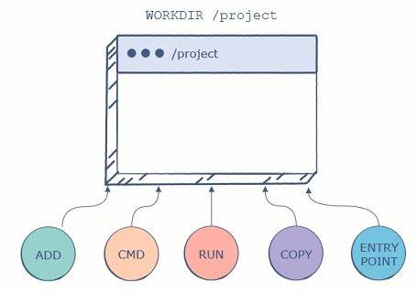

Slide 16
You can use the following template to create the Dockerfile.
FROM ubuntu:latest
WORKDIR /my-work-dir

Slide 17
Docker Copy Command
Docker Copy is a directive or instruction that is used in a Dockerfile to copy files or directories from local machine to the container filesystem where the source is the local path and destination is the path in the container filesystem.
We can specify multiple source paths and we need to use a relative path while specifying multiple sources. We can use wildcards to specify the source as well. We can specify the destination as an absolute path or relative to the WORKDIR directive if the WORKDIR directive is defined in the Dockerfile.
We can change the ownership of the files or directories while copying it to the container filesystem. In this topic, we are going to learn about Docker Copy Command.

Slide 18
There are two forms of COPY instructions we have: –
1. COPY [–chown=<user>:<group>] <src>… <dest>
2. COPY [–chown=<user>:<group>] [“<src>”,… “<dest>”]
–chown is used to change the ownership of the file in the container filesystem
<user>:<group> is used to specify the user and group to whom we want to give the ownership
<src> is where we specify the path of the localhost
<dest> is where we specify the path in the container filesystem.
2nd form is used when we have whitespaces in the source or destination path.

Slide 19
Docker ENTRYPOINT
Docker entrypoint is a Dockerfile directive or instruction that is used to specify the executable which should run when a container is started from a Docker image.
It has two forms, the first one is the ‘exec’ form and the second one is the ‘shell’ form.
If there is no entrypoint or CMD specified in the Docker image, it starts and exits at the same time that means container stops automatically so, we must have to specify entrypoint or CMD so that when we will start the container it should execute something rather than going to stop.

Slide 20
ENTRYPOINT [“executable”, “param1”, “param2”, ..]

Slide 21
ENTRYPOINT 1/2
Triggers a command as soon as the container starts
Example: ENTRYPOINT echo “Whale You Be My Container?”
Dockerfile: https://github.com/jbarbier/Dockerfile-Basics-Docker-Workshop-2-Twitter/blob/master/slide_9/Dockerfile
# Whale you be my container?
#
# VERSION 0.42
# use the base image provided by Docker
FROM base
MAINTAINER Moby Dock victor.coisne@docker.com
# say hello when the container is launched
ENTRYPOINT echo "Whale you be my container"

Slide 22
ENTRYPOINT 2/2
Run containers as executables! :)
Dockerfile: https://github.com/jbarbier/Dockerfile-Basics-Docker-Workshop-2-Twitter/blob/master/slide_10/Dockerfile
# This is wc
#
# VERSION 0.42
# use the base image provided by Docker
FROM base
MAINTAINER Roberto roberto@docker.com
# count lines with wc
ENTRYPOINT ["wc", "-l"]
$ cat /etc/passwd | docker run -i wc

Slide 23
USER
Sets the username to use when running the image
Example: USER daemon

Slide 24
USER Instruction
By default, a Docker Container runs as a Root user. This poses a great security threat if you deploy your applications on a large scale inside Docker Containers. You can change or switch to a different user inside a Docker Container using the USER Instruction. For this, you first need to create a user and a group inside the Container.

Slide 25
FROM ubuntu:latest
RUN apt-get -y update
RUN groupadd -r user && useradd -r -g user user
USER user

Slide 26
Docker – EXPOSE Instruction
The EXPOSE instruction exposes a particular port with a specified protocol inside a Docker Container.
Sets ports to be exposed to other containers when running the image
These ports can be either TCP or UDP, but it’s TCP by default. It is also important to understand that the EXPOSE instruction only acts as an information platform.
Example: EXPOSE 80

Slide 27
It can use TCP or UDP protocol to expose the port.
Default Protocol is TCP if no other protocol is specified.
It does not map ports on the host machine.
It can be overridden using the publish flag (-p) while starting a Container.

Slide 28
FROM ubuntu:latest
EXPOSE 80/tcp
EXPOSE 80/udp

Slide 29
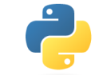


Exercice: create a perfect Memcached Dockerfile
Answer https://github.com/jbarbier/Dockerfile-Basics-Docker-Workshop-2-Twitter/blob/master/memcached/Dockerfile
#BOOM
Try it (update port number, $ docker ps)
Python https://github.com/jbarbier/Dockerfile-Basics-Docker-Workshop-2-Twitter/blob/master/memcached/test.py
Ruby https://github.com/jbarbier/Dockerfile-Basics-Docker-Workshop-2-Twitter/blob/master/memcached/test.rb
PHP https://github.com/jbarbier/Dockerfile-Basics-Docker-Workshop-2-Twitter/blob/master/memcached/test.php
$ docker build -t memcached .
$ docker run –p 11211 memcached

Slide 30
Quizz: Online Dockerfile Tutorials
Test your skills here:
http://www.docker.io/learn/dockerfile/

Slide 31
www.docker.io
Thank you!

