Slide 1
AWS Default Virtual Private Cloud (VPC)

Slide 2
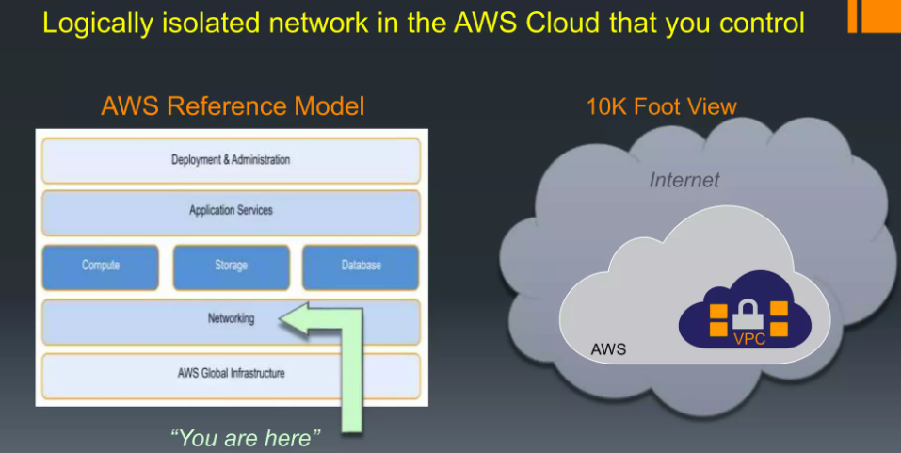

Slide 3
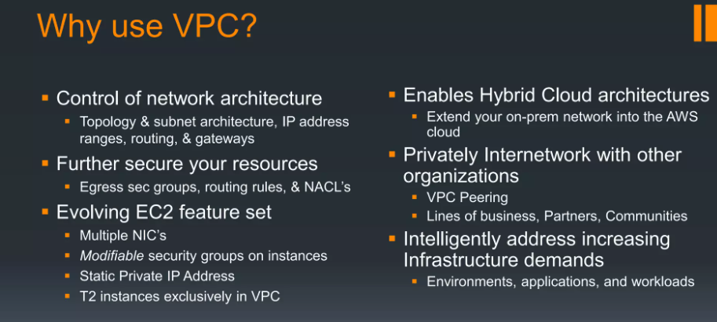

Slide 4
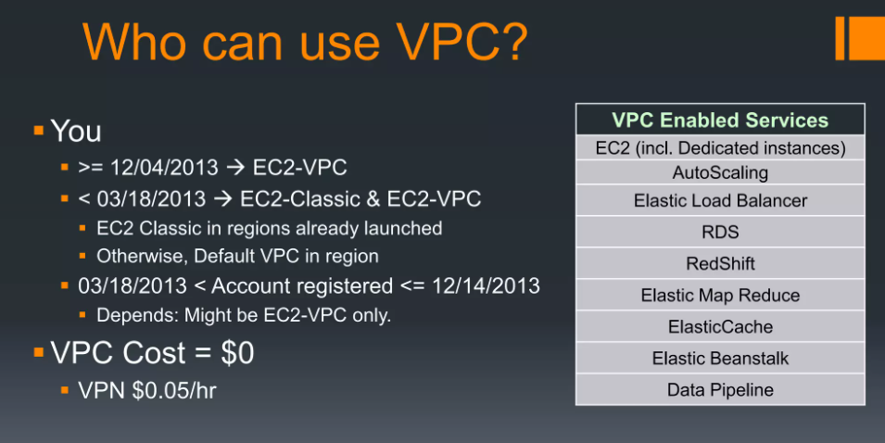

Slide 5
What is Amazon VPC?
Amazon Virtual Private Cloud (Amazon VPC) enables you to launch AWS resources into a virtual network that you've defined.
This virtual network closely resembles a traditional network that you'd operate in your own data center, with the benefits of using the scalable infrastructure of AWS.

Slide 6
Features
The following features help you configure a VPC to provide the connectivity that your applications need:
Virtual private clouds (VPC)
A VPC is a virtual network that closely resembles a traditional network that you'd operate in your own data center. After you create a VPC, you can add subnets.

Slide 7
Subnets
A subnet is a range of IP addresses in your VPC. A subnet must reside in a single Availability Zone. After you add subnets, you can deploy AWS resources in your VPC.

Slide 8
IP addressing
You can assign IPv4 addresses and IPv6 addresses to your VPCs and subnets. You can also bring your public IPv4 and IPv6 GUA addresses to AWS and allocate them to resources in your VPC, such as EC2 instances, NAT gateways, and Network Load Balancers.

Slide 9
Routing
Use route tables to determine where network traffic from your subnet or gateway is directed.

Slide 10
Gateways and endpoints
A gateway connects your VPC to another network. For example, use an internet gateway to connect your VPC to the internet. Use a VPC endpoint to connect to AWS services privately, without the use of an internet gateway or NAT device.
Peering connections
Use a VPC peering connection to route traffic between the resources in two VPCs.

Slide 11
Traffic Mirroring
Copy network traffic from network interfaces and send it to security and monitoring appliances for deep packet inspection.

Slide 12
Transit gateways
Use a transit gateway, which acts as a central hub, to route traffic between your VPCs, VPN connections, and AWS Direct Connect connections.
VPC Flow Logs
A flow log captures information about the IP traffic going to and from network interfaces in your VPC.
VPN connections
Connect your VPCs to your on-premises networks using AWS Virtual Private Network (AWS VPN).

Slide 13
Default VPCs
When you start using Amazon VPC, you have a default VPC in each AWS Region. A default VPC comes with a public subnet in each Availability Zone, an internet gateway, and settings to enable DNS resolution.
You can immediately start launching Amazon EC2 instances into a default VPC. You can also use services such as Elastic Load Balancing, Amazon RDS, and Amazon EMR in your default VPC.
A default VPC is suitable for getting started quickly and for launching public instances such as a blog or simple website. You can modify the components of your default VPC as needed.

Slide 14
Default VPC components
When we create a default VPC, we do the following to set it up for you:
Create a VPC with a size /16 IPv4 CIDR block (172.31.0.0/16). This provides up to 65,536 private IPv4 addresses.
Create a size /20 default subnet in each Availability Zone. This provides up to 4,096 addresses per subnet, a few of which are reserved for our use.
Create an internet gateway and connect it to your default VPC.

Slide 15
Add a route to the main route table that points all traffic (0.0.0.0/0) to the internet gateway.
Create a default security group and associate it with your default VPC.
Create a default network access control list (ACL) and associate it with your default VPC.
Associate the default DHCP options set for your AWS account with your default VPC.

Slide 16
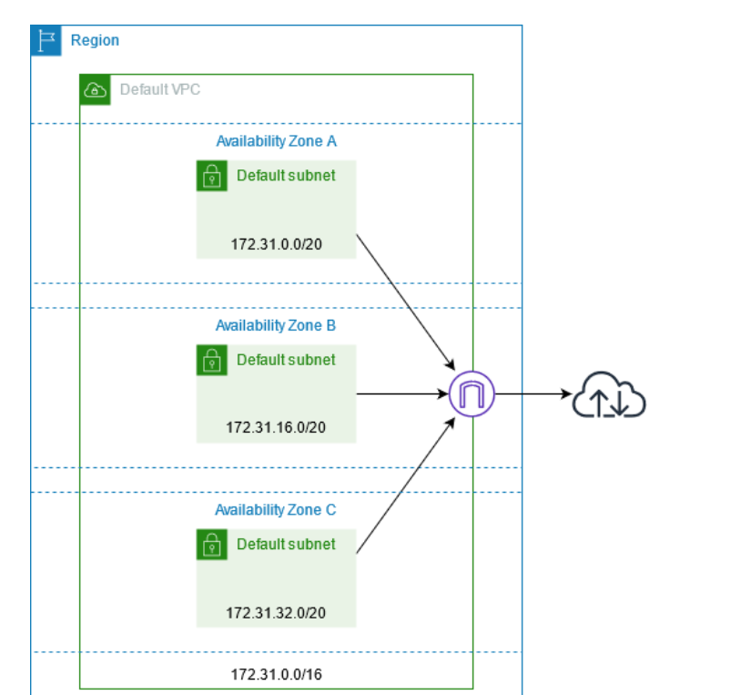

Slide 17
Getting started with Amazon VPC
Your AWS account includes a default VPC in each AWS Region. Your default VPCs are configured such that you can immediately start launching and connecting to EC2 instances. For more information, see Get started with Amazon VPC.
You can choose to create additional VPCs with the subnets, IP addresses, gateways and routing that you need. For more information, see Create a VPC.

Slide 18
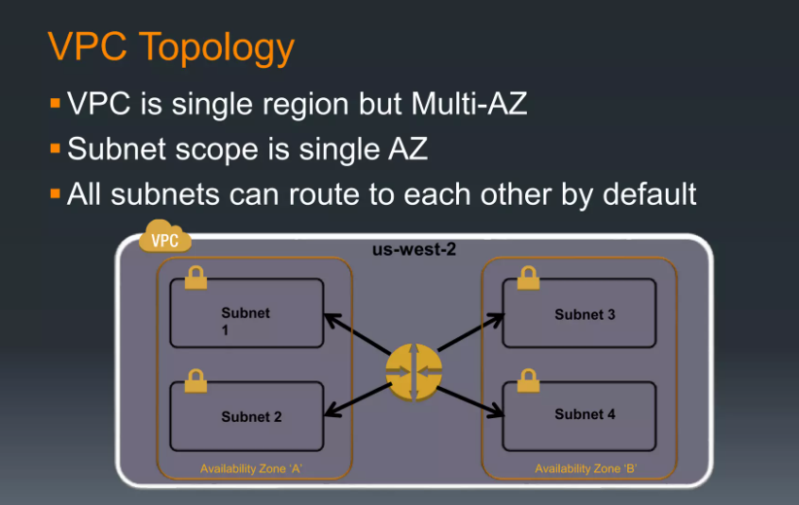
VPC Building Blocks

Slide 19
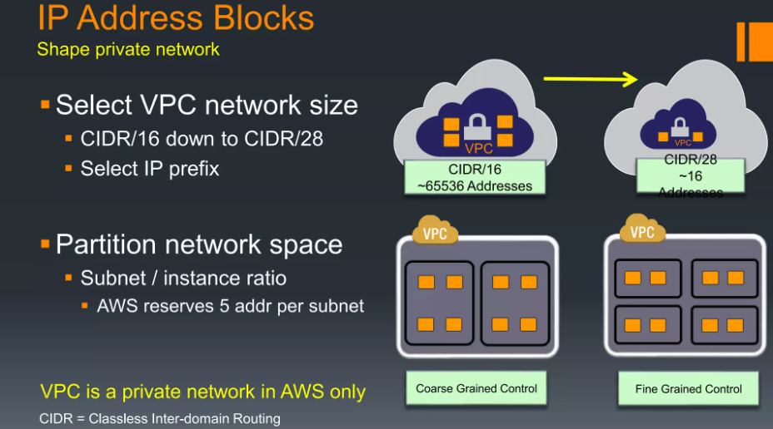

Slide 20
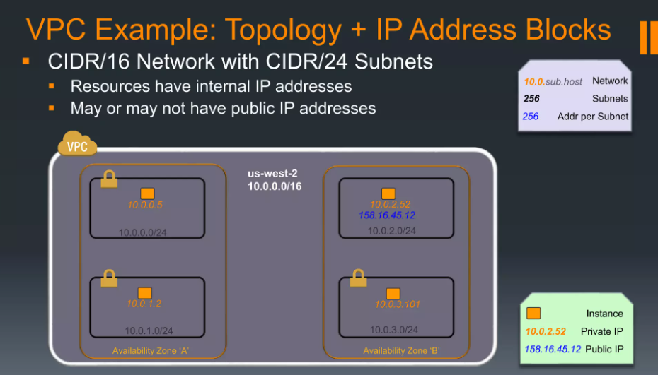

Slide 21
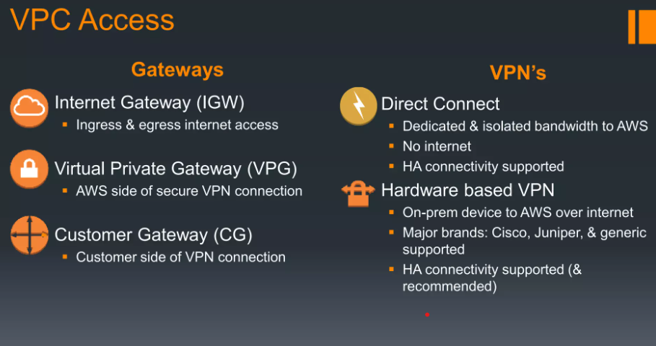

Slide 22
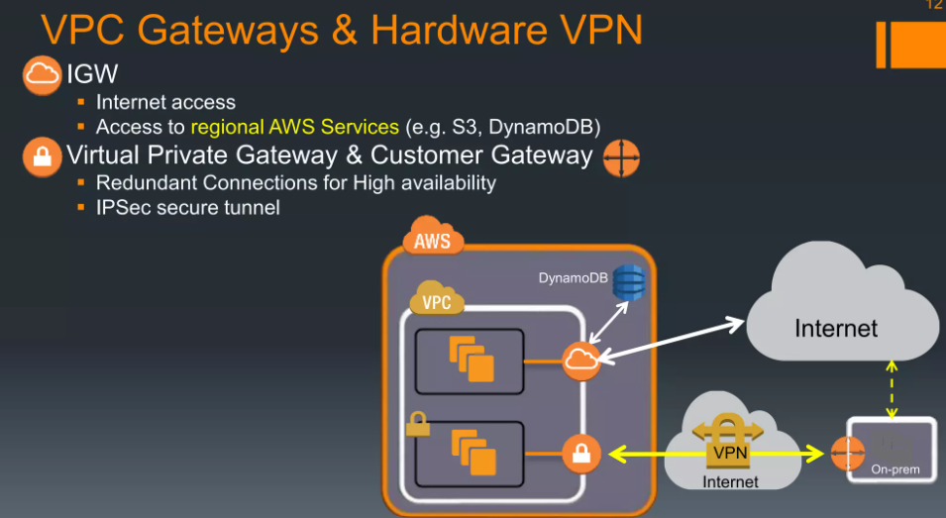

Slide 23
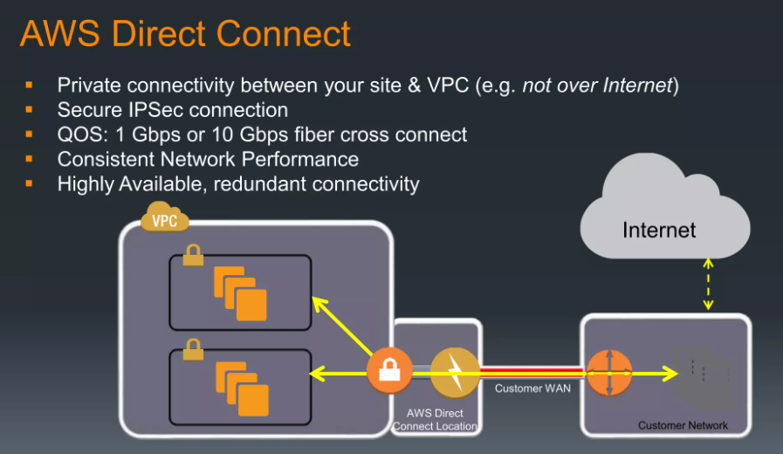

Slide 24
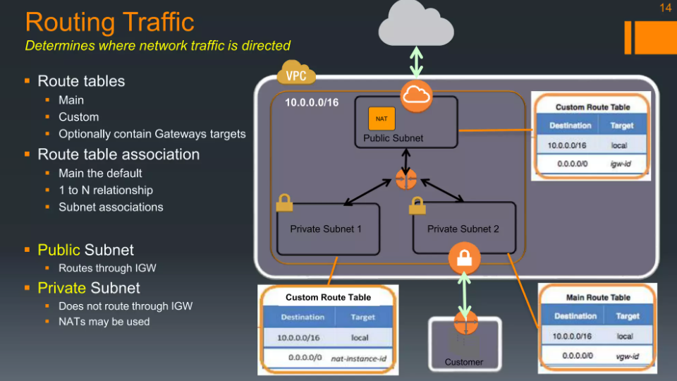

Slide 25
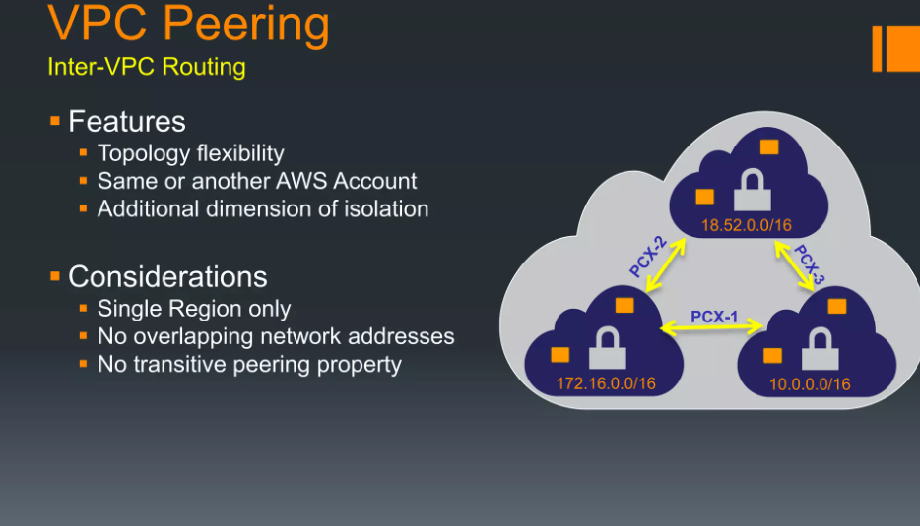

Slide 26
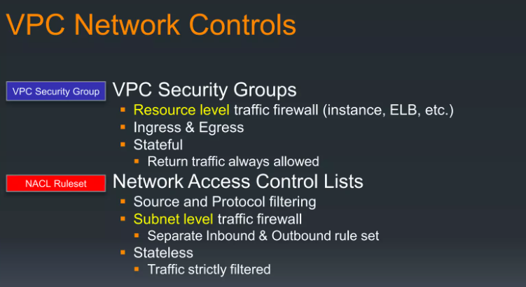

Slide 27
