Slide 1
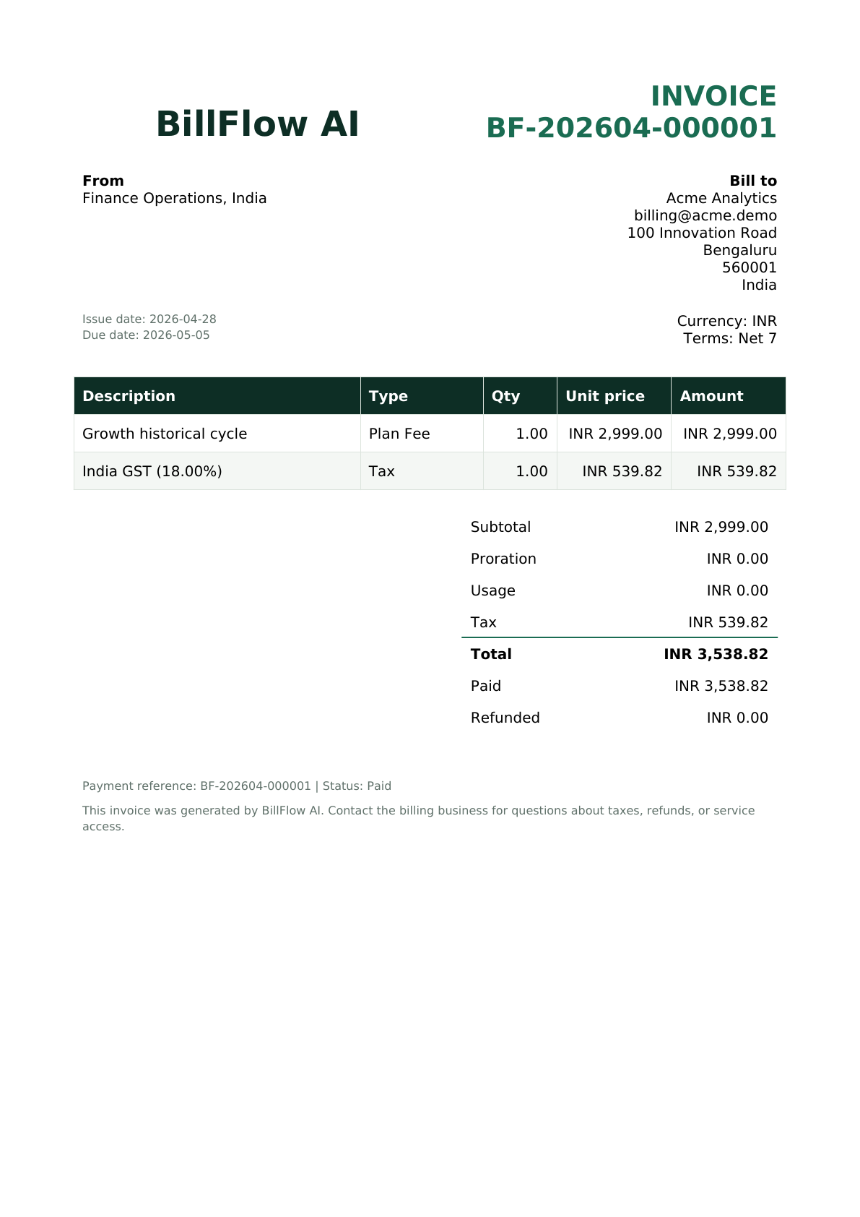
BILLFLOW AI
Recurring Payment,
Subscription Management
and Billing Automation
Python full-stack platform with explainable finance guidance and an auditable billing control plane
Yashovardhan K
September 2026
Notes:
Open with the product outcome: one Python full-stack system for personal bill decisions and recurring billing operations. The invoice shown is generated by the implemented ReportLab service. Source: repository implementation and supplied weekly requirements PDF.

Slide 2
02
Recurring billing fails at the transitions
The difficult work starts after a customer chooses a plan
01
Lifecycle drift
Outcome
Trial, renewal, pause and cancellation dates can disagree across systems.
A single operating record from plan setup through collection, recovery, refund and compliance.
02
Invoice accuracy
Plan changes need exact credits, usage lines and regional tax.
03
Payment recovery
One decline must trigger a bounded retry policy without duplicate charges.
04
Financial evidence
Every payment, refund and state change needs a durable audit trail.
BillFlow AI
02
Notes:
Explain that the project focuses on state transitions and financial correctness, not only CRUD screens. The supplied problem statement calls out proration, state machines, retry logic, tax and invoice formatting as the core complexity.

Slide 3
03
Two product areas share one trust boundary
Personal guidance and SaaS billing remain distinct, but they use the same accountable foundation
PERSONAL FINANCE OS
BILLING OPERATIONS
User obligations
Operator control plane
Bills across home, health, education and entertainment
SafePay cash flow forecast and reserve protection
Browse Apps advice based on balance and deadlines
Explicit user authorization before settlement
Plan catalog and customer accounts
Subscription lifecycle and billing periods
Invoices, tax, payment events and refunds
Retry queue, analytics, PDFs and audit evidence
Shared rule: AI can recommend and automation can schedule. A verified provider event or explicit user approval changes financial state.
BillFlow AI
03
Notes:
Keep the distinction clear. The left side manages a person’s bills and recommendations. The right side manages a SaaS business’s recurring revenue. Both avoid silent real-money actions and preserve evidence.

Slide 4
04
Runtime architecture
FastAPI owns business rules while Celery executes scheduled work
Signed mock
gateway
React + Vite
Recharts
HTTP
FastAPI
OpenAPI + JWT
PostgreSQL
Alembic schema
ReportLab
PDF engine
Celery Beat
renewal clock
Redis
job broker
Celery worker
cycles + retries
BillFlow AI
04
Notes:
Describe one migration owner: the API applies Alembic, then workers start after the health check. Redis transports scheduled jobs. PostgreSQL remains the source of truth. Source: docker-compose.yml, app/celery_app.py and docs/ARCHITECTURE.md.

Slide 5
05
Subscription lifecycle and renewal flow
Central validation prevents impossible state changes
TRIAL
ACTIVE
PAST DUE
CANCELLED
PAUSED
Trial can cancel directly. Payment recovery can restore past due to active.
RENEWAL ENGINE
1
Find due
subscription
2
Lock idempotent
cycle
3
Price plan, usage
and proration
4
Apply regional
tax
5
Persist invoice
and next period
BillFlow AI
05
Notes:
Mention the timestamp fields for each state. End of cycle plan and cancellation requests stay pending until renewal. The cycle key combines subscription and period start, so a repeated scheduler run returns the same invoice instead of duplicating it.

Slide 6
06
Billing operator journey
Each action remains visible, reversible where appropriate and linked to audit evidence
01
Define offers
02
Onboard customers
Monthly or annual plans, entitlements, trials and archive policy
Billing identity, address, jurisdiction and tax ID
03
Run subscriptions
04
Collect revenue
Trial, plan change, pause, resume and cancellation timing
Itemized invoices, signed events and persisted PDF downloads
05
Recover failures
06
Prove the record
Past due status with bounded day 1, 3 and 7 attempts
Refund lines, tax summaries, notifications and customer audit history
BillFlow AI
06
Notes:
Use this slide as the live demo map. The same six stages appear as tabs and actions in Billing Operations. Contextual help explains proration, sandbox payments, archive behavior and refunds before confirmation.

Slide 7
07
Seeded demo confirms the full financial path
Operational snapshot after deterministic invoices, payments and one failed annual renewal
Collected revenue by plan
INR 2,999
Monthly recurring revenue
1
active
1
trial
1
past due
1
cancelled
8
invoices
3
queued retries
Seed data only. Revenue values are paid amounts including configured tax.
BillFlow AI
07
Notes:
Clarify that these figures describe the deterministic demo portfolio, not company performance. Growth includes six paid invoices. Starter includes one paid invoice. The annual invoice failed and therefore contributes no collected revenue. Source: app/services/billing_demo.py and billing_dashboard calculations.

Slide 8
08
Payment recovery has a bounded end state
Signed events and idempotency protect every attempt
DAY 1
DAY 3
DAY 7
PAYMENT
FAILED
PAST DUE
Any successful retry restores ACTIVE and cancels later queued attempts.
CANCELLED
HMAC
REPLAY
MONEY
TENANT
Constant time signature verification
Unique gateway event ID
Decimal values and refund ceiling
Owner scope on every resource
BillFlow AI
08
Notes:
Show the two outcomes. Success recovers the subscription and cancels later attempts. The third failed retry cancels service and queues a notification. Replay protection keeps a repeated provider event from applying money twice.

Slide 9
09
Verification covers behavior and operating load
The local benchmark completed 783 requests with zero failures
Average API response time
21
backend tests passed
0
load test failures
49 ms
aggregate p95
20 users, one Uvicorn process, local SQLite. This development profile is not a production capacity claim.
BillFlow AI
09
Notes:
The 21 backend tests include the original personal finance flows and 11 Billing Operations scenarios. The measured Locust profile used 20 users for 20 seconds. Browser E2E runs in CI. Source: pytest output and docs/PERFORMANCE.md dated 25 September 2026.

Slide 10
10
Eight week specification coverage
Every weekly requirement maps to code, an operator surface and verification evidence
Phase | Delivered evidence | Validation
Weeks 1–2 | PostgreSQL schema, state machine, plan and subscription APIs, Celery renewal scheduler | Migration smoke, lifecycle and due cycle tests
Weeks 3–4 | Proration, itemized invoices, signed mock gateway, webhook updates, unused period refunds | Proration, HMAC replay and refund tests
Weeks 5–6 | Day 1/3/7 retries, regional tax, persisted PDF, Recharts dashboard, customer audit | Retry exhaustion, tax/PDF and analytics tests
Weeks 7–8 | E2E path, Locust benchmark, responsive UX, architecture/API/ERD/deployment docs, final deck | CI jobs, measured benchmark and visual QA
Detailed file and test mappings: docs/REQUIREMENTS_TRACEABILITY.md
BillFlow AI
10
Notes:
Use this table to answer the completeness question. The repository traceability document expands each weekly bullet into exact code and test locations. Source: supplied weekly requirements PDF and docs/REQUIREMENTS_TRACEABILITY.md.

Slide 11
11
Engineering choices and production boundaries
The implementation is complete for the specification while external authority stays explicit
ENGINEERING DECISION
PRODUCTION REQUIREMENT
01
Mock gateway uses the real signed event path
Contract with a licensed payment or Bharat Connect partner
02
Tax engine supports effective country and region rates
Add jurisdiction rules, exemptions and statutory filing
03
Durable notification outbox isolates billing commits
Connect email, SMS or push delivery with callbacks
04
PostgreSQL constraints and idempotency protect state
Add KMS, rate limits, monitoring and disaster recovery
No bank password, UPI PIN, OTP, card data or biometric secret enters BillFlow.
BillFlow AI
11
Notes:
Describe these as honest integration boundaries rather than missing application code. Real payment rails, tax filing and provider account updates require commercial or regulatory authority that a code repository cannot create. Source: docs/KNOWN_LIMITATIONS.md.

Slide 12
12
Demo path and production milestones
The current build supports a complete end-to-end walkthrough
LIVE DEMO
NEXT MILESTONES
1
Load deterministic workspace
Official rails
Inspect MRR and revenue charts
Licensed settlement and provider APIs
2
3
Pause, resume and change a plan
Organization controls
RBAC, maker checker approval and SSO
4
Open invoice lines and PDF
Accounting depth
5
Trigger failure and recover payment
Ledger export and revenue recognition
6
Issue refund and review tax
Operations
7
Filter the customer audit trail
Metrics, tracing, alerts and recovery drills
BillFlow AI is ready for review, inspection and a confident end-to-end demonstration.
BillFlow AI
12
Notes:
Close by returning to the running product. Use docs/DEMO_SCRIPT.md for the 6 to 8 minute rehearsal. The future milestones add production partnerships and enterprise controls without changing the validated billing core.

