Slide 1
BRAIN TUMOUR DETECTION USING SIGNAL PROCESSING

Slide 2
INTRODUCTION
Medical image processing is the most challenging and emerging field now a days.
Processing of MRI images becomes an integral part because of the fact that it is easier to analyze them compared to CT Scan as morphological, segmentation, contrast enhancement etc can be applied to them.
This paper describes the proposed strategy to detect & extraction of brain tumour from patient’s MRI scan images of the brain.
This method incorporates with some noise removal functions, segmentation and morphological operations which are the basic concepts of image processing.

Slide 3
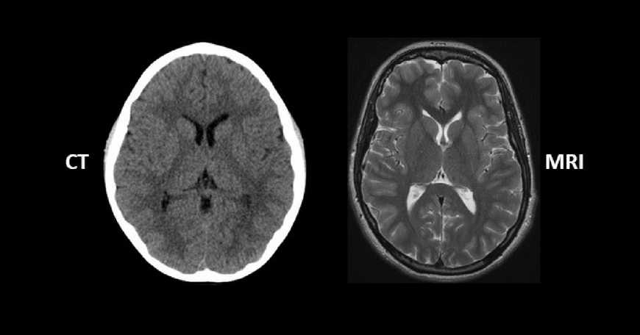

Slide 4
METHODOLOGY
1. Give MRI image of brain as input.
2. Convert it to gray scale image.
3. Apply high pass filter for noise removal.
4. Apply median filter to enhance the quality of image.
5. Compute threshold segmentation.
6. Compute morphological operation.
7. Finally output will be a tumour region.

Slide 5
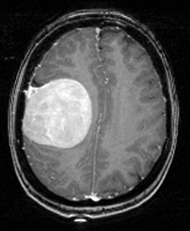
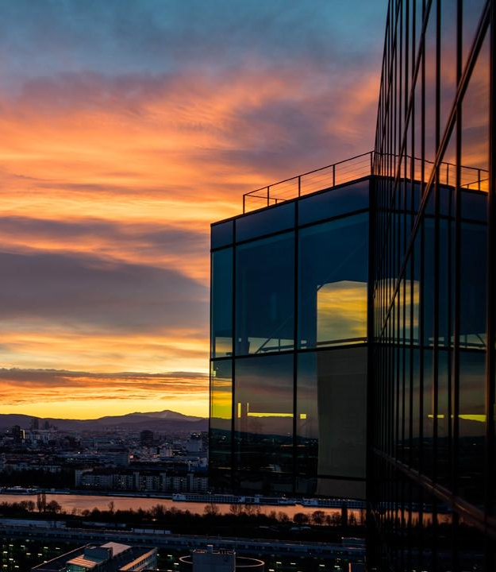
1. GIVE MRI IMAGE OF BRAIN AS INPUT
An MRI of a brain with a tumour region in white

Slide 6
GRAYSCALE IMAGING
In true black and white, also known as halftone, the only possible shades are pure black and pure white.
The illusion of gray shading in a halftone image is obtained by rendering the image as a grid of black dots on a white background (or vice-versa), with the sizes of the individual dots determining the apparent lightness of the gray in their vicinity.
The lightness of the gray is directly proportional to the number representing the brightness levels of the primary colors.
We convert our MRI image to be pre-processed in grayscale image.

Slide 7
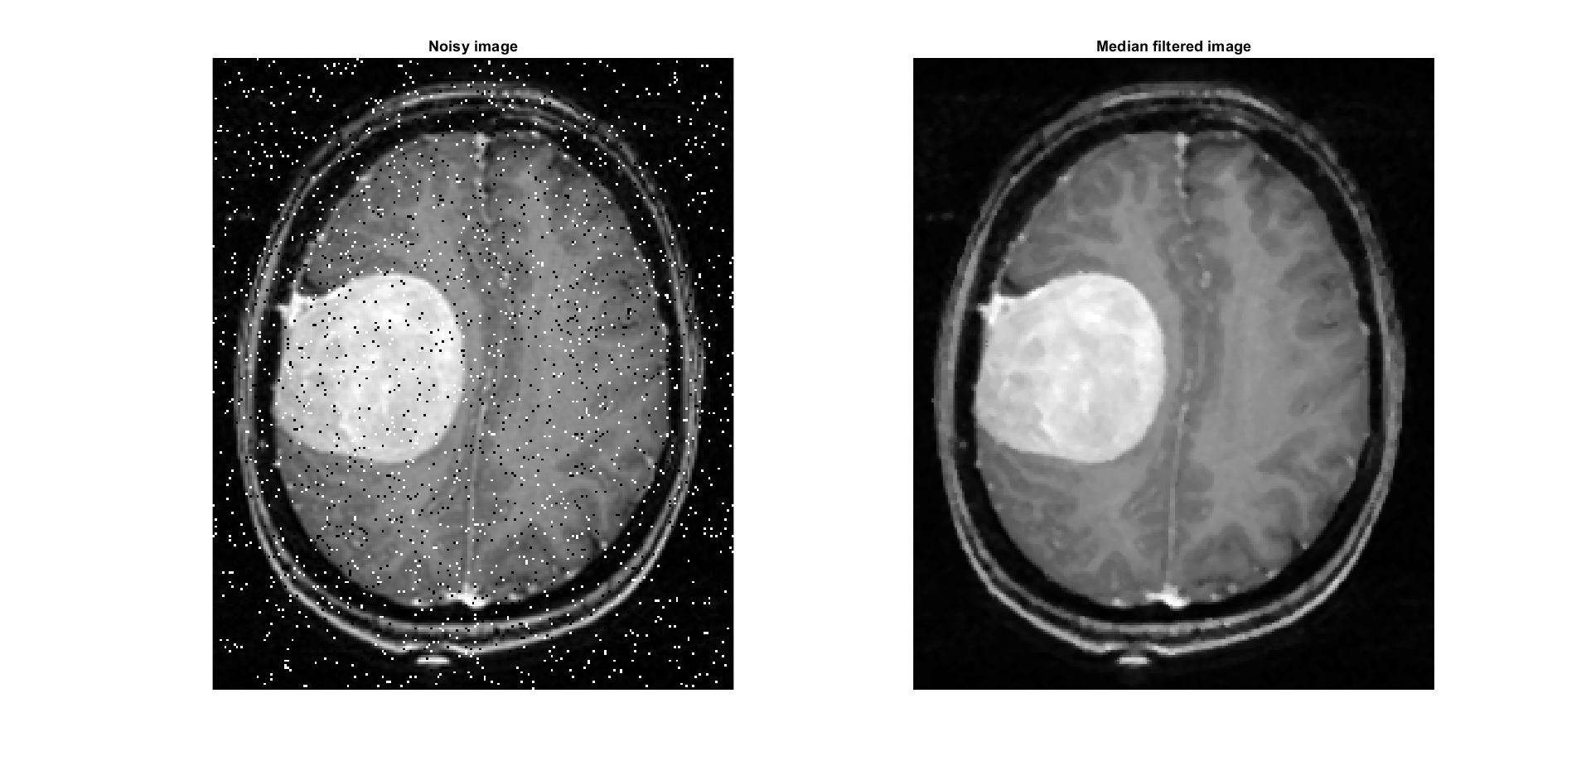
2. Filtering of a Noisy CT Scan using Median Filtering
White
Is the color of milk and fresh snow, the color produced by the combination of all the colors of the visible spectrum.
Black
Is the color of coal, ebony, and of outer space. It is the darkest color, the result of the absence of or complete absorption of light.

Slide 8
MEDIAN FILTER
The median filter is a nonlinear digital filtering technique, often used to remove noise.
It is very widely used in digital image processing because, under certain conditions, it preserves edges while removing noise.
The main idea of the median filter is to run through the signal entry by entry, replacing each entry with the median of neighboring entries.
The pattern of neighbors is called the "window", which slides, entry by entry, over the entire signal.
This filter enhance the quality of the MRI image.

Slide 9
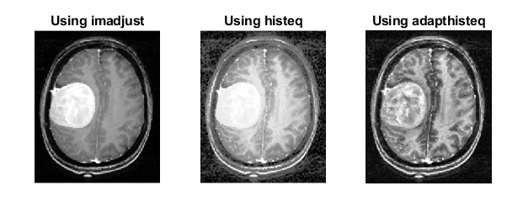
3. Contrasting the MRI effect through different methods
White
Is the color of milk and fresh snow, the color produced by the combination of all the colors of the visible spectrum.
Black
Is the color of coal, ebony, and of outer space. It is the darkest color, the result of the absence of or complete absorption of light.

Slide 10
HIGH PASS FILTER
An image is sharpened when contrast is enhanced between adjoining areas with little variation in brightness or darkness.
A high pass filter tends to retain the high frequency information within an image while reducing the low frequency information.
The kernel of the high pass filter is designed to increase the brightness of the center pixel relative to neighboring pixels.
The kernel array usually contains a single positive value at its center, which is completely surrounded by negative values.

Slide 11
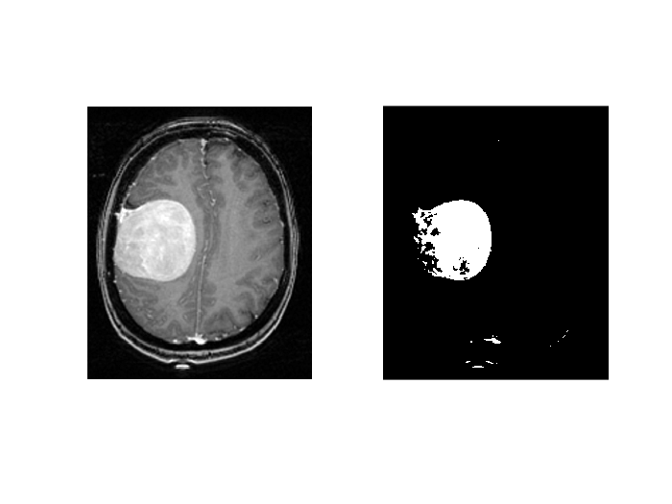
4. Performing Threshhold Segmentation without Erosion/Dilation
White
Is the color of milk and fresh snow, the color produced by the combination of all the colors of the visible spectrum.
Black
Is the color of coal, ebony, and of outer space. It is the darkest color, the result of the absence of or complete absorption of light.

Slide 12
THRESHHOLD SEGMENTATION
This segmentation method is based on a clip-level (or a threshold value) to turn a gray-scale image into a binary image.
The key of this method is to select the threshold value (or values when multiple-levels are selected).
The goal of segmentation is to simplify and/or change the representation of an image into something that is more meaningful and easier to analyze.
Image segmentation is typically used to locate objects and boundaries (lines, curves, etc.) in images, assigning a label to every pixel in an image such that pixels with the same label share certain visual characteristics.
The result of image segmentation is a set of segments that collectively cover the entire image, or a set of contours extracted from the image.

Slide 13
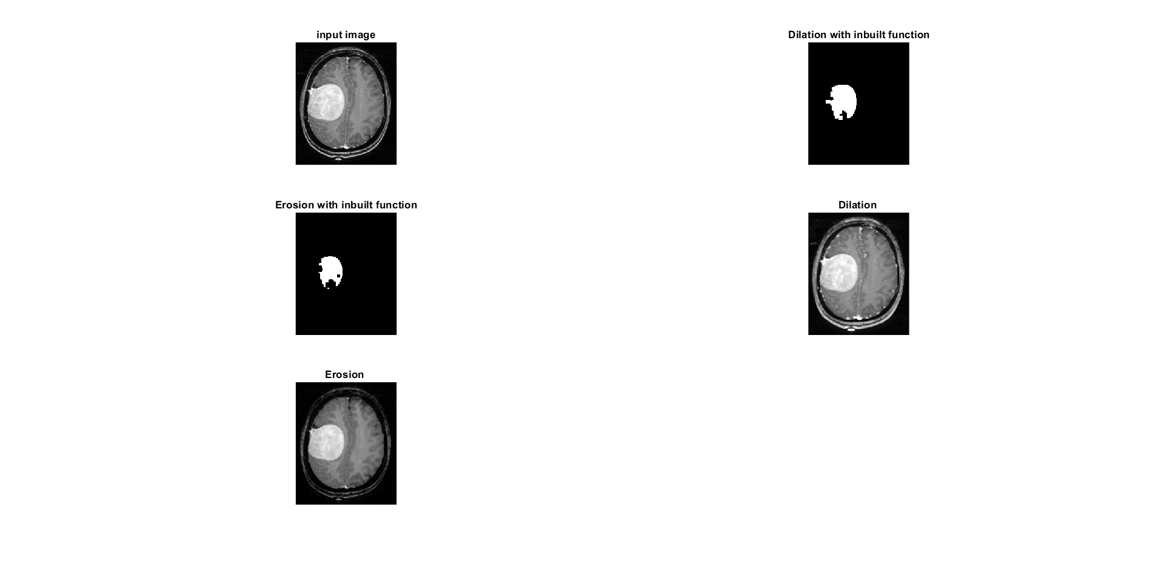
5. Using Erosion

Slide 14
6. Using Dilation

Slide 15
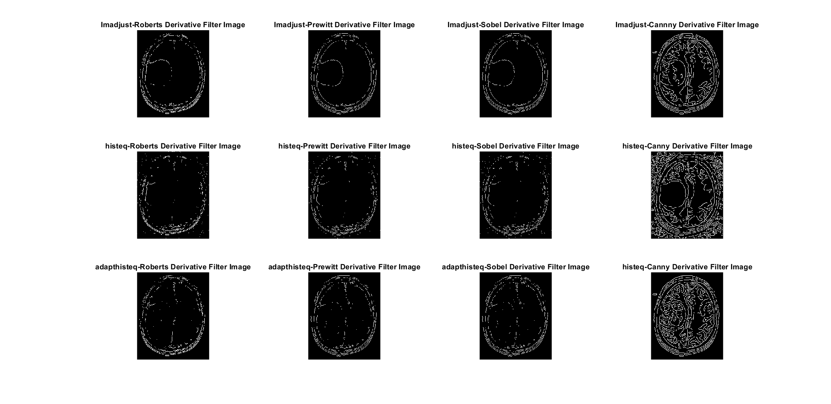
7. Edge detection – Part 1
White
Is the color of milk and fresh snow, the color produced by the combination of all the colors of the visible spectrum.
Black
Is the color of coal, ebony, and of outer space. It is the darkest color, the result of the absence of or complete absorption of light.

Slide 16
8. Edge detection – Part 2
White
Is the color of milk and fresh snow, the color produced by the combination of all the colors of the visible spectrum.
Black
Is the color of coal, ebony, and of outer space. It is the darkest color, the result of the absence of or complete absorption of light.

Slide 17
MORPHOLOGICAL OPERATIONS
Morphological image processing is a collection of nonlinear operations related to the shape or morphology of features in an image.
Morphological operations can also be applied to greyscale images such that their light transfer functions are unknown and therefore their absolute pixel values are of no or minor interest.
Morphological techniques probe an image with a small shape or template called a structuring element.
A morphological operation on a binary image creates a new binary image in which the pixel has a non-zero value only if the test is successful at that location in the input image.

Slide 18
