Slide 1

R.V. College of Engineering, Bangalore (Autonomous Institution Affiliated to VTU, Belagavi)
II semester
Phase I
ANALYSIS OF PROJECTILE MOTION USING TRACKER

Slide 2
What is tracker?
-Video tracking and analyzing tool.
Features include:
-Tracking position, velocity, acceleration etc from the physical graph obtained.
-Finding trajectory path.
-Modeling dynamic and kinetic models
-Data generation and analysis.

Slide 3
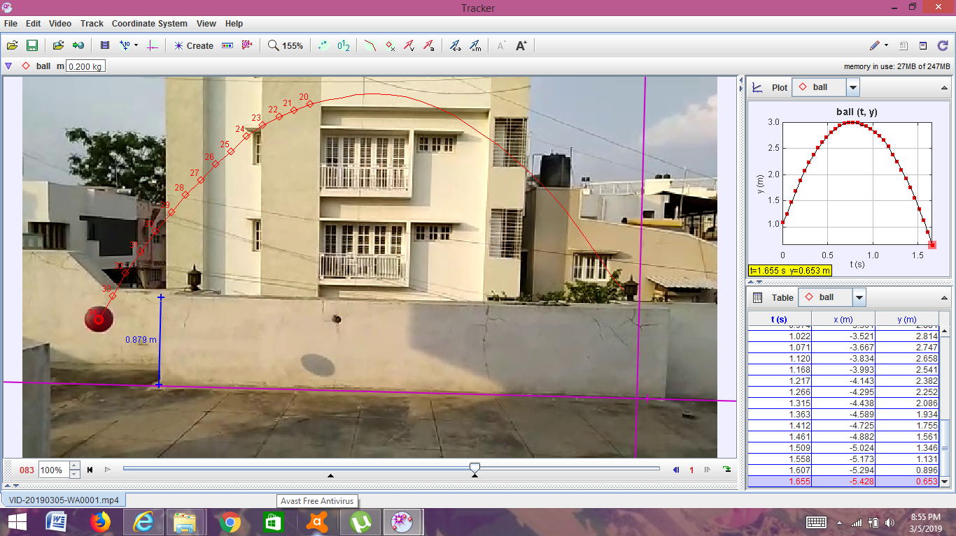
Projectile motion analysis:

Slide 4
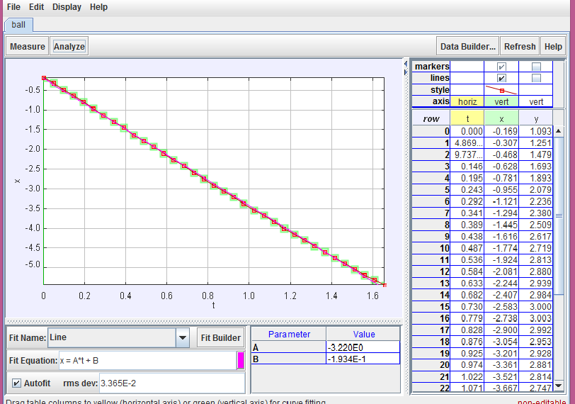

Slide 5
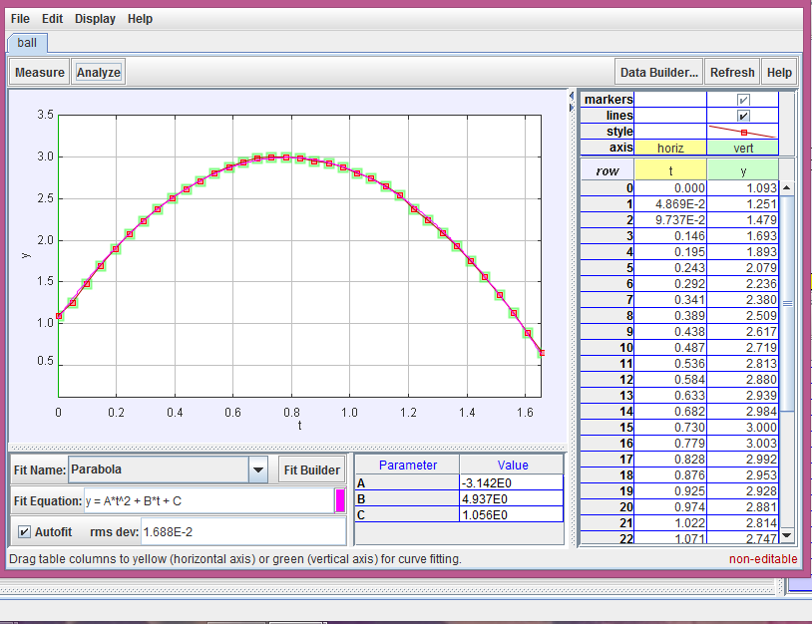

Slide 6
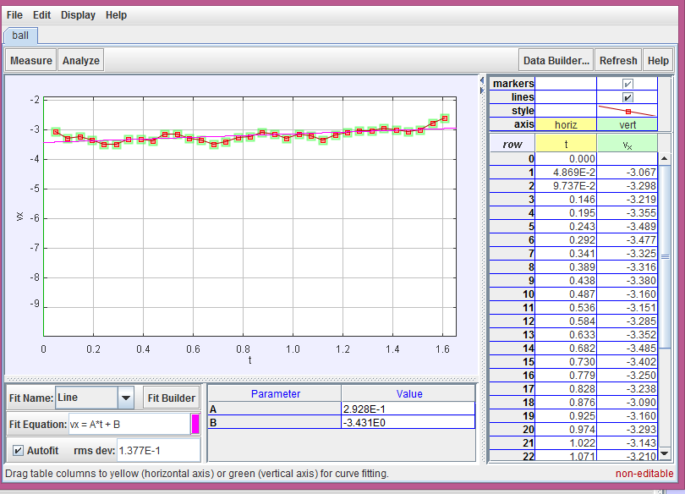

Slide 7
