Slide 1
Design Thinking Project
(Smart Campus)

Slide 2
Questionnaire/ Empathy Survey :
SURVEY 1:
Are you satisfied with the present management and working of campus?
Which according to you holds the highest priority for scope of improvement in campus ?
Do you think it would be efficient to implement green methods (eg:paperless) for campus environment

Slide 3
Is there any campus you hold as ideal or whose features you consider beneficial ?
Are your teachers willing to participate in campus improvement ?

Slide 4
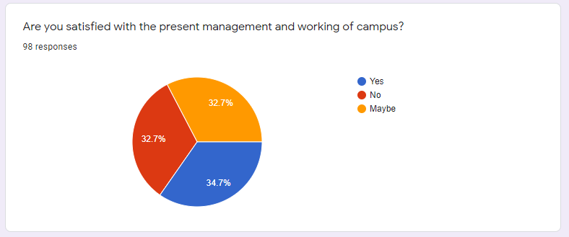
Survey Results:

Slide 5
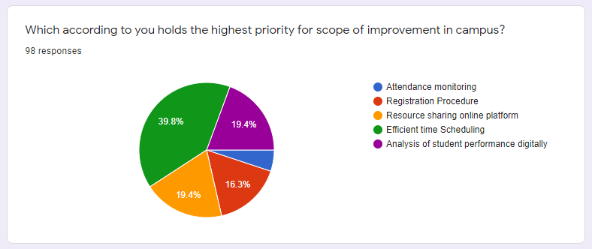
Survey Results:

Slide 6
Tentative problem statement:
Management and sustainability of time table/routine in colleges.

Slide 7
Target Audience:
College students
College faculty members
Management panel

Slide 8
Tentative Solution:
Flexible Time-Table

Slide 9
SURVEY 2:
-conducted among time table coordinators
What is the procedure of creating the time table?
Is it the most effective way and easy to use?
Do you think flexible automated time table generator will be useful?
If maybe or no for the previous question, please give a brief reason.
Any other comments or scope of improvement.

Slide 10
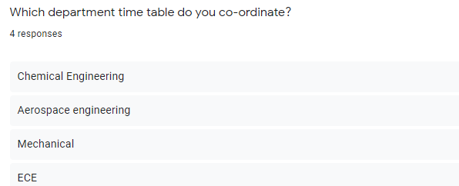
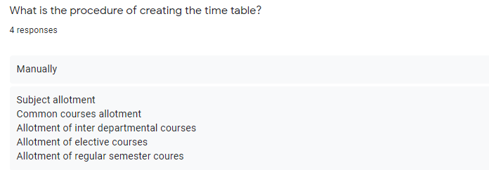
Survey Results:

Slide 11
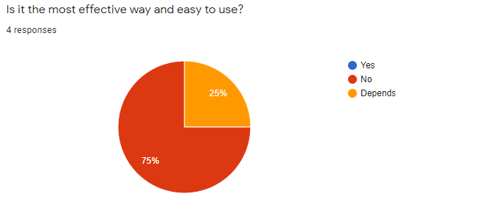
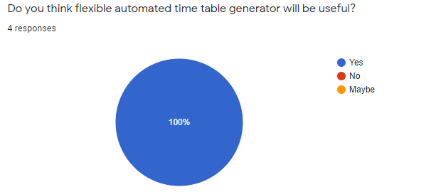
Survey Results:

Slide 12
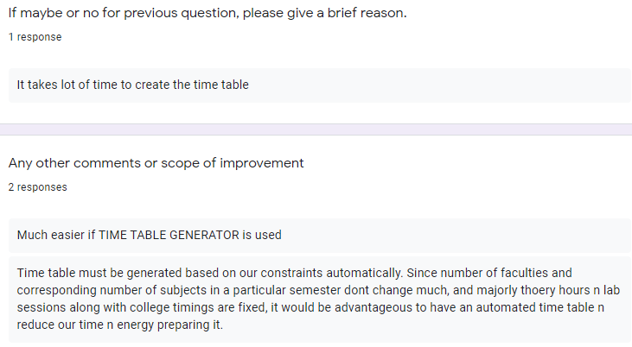
Survey Results:

Slide 13
SURVEY 3:
-conducted among faculties
How comfortable are you with your present time table?
Is your present time table flexible according to your need?
Is there proper break given between your classes and lab sessions?
What problem do you face with your present time table?

Slide 14
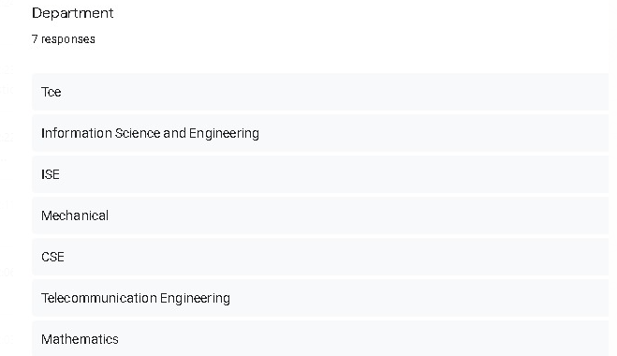
Survey Results:

Slide 15
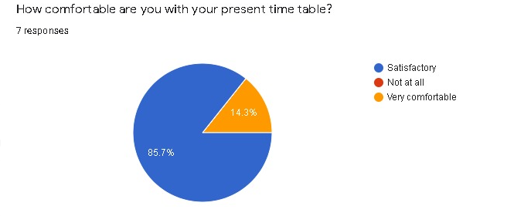
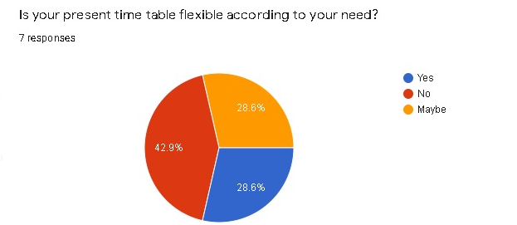
Survey Results:

Slide 16
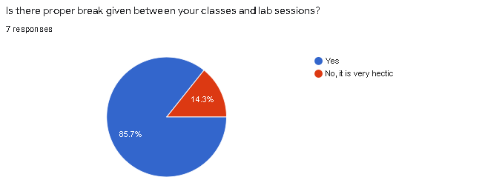
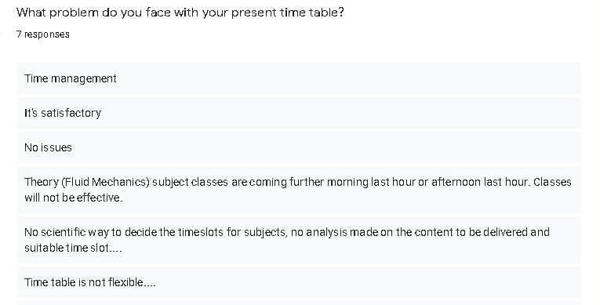
Survey Results:

Slide 17
Pros
Students will be given choice of faculty.
In the prototype of flexible time table we propose, the students will be given the choice of faculty. A student shall be able to enter into the system which teacher he/she wishes to have in which subject and accordingly the program shall generate the time table of the particular student. However to avoid any kind of conflicts, the software /program shall be based on some priority order. For example, students with highest grades shall be given more priority to choose. Also the number of student under each teacher shall be equal to avoid any kind of problem.

Slide 18
Students will be given choice of time slots thereby increasing performance
In this prototype, the student will be allowed to choose the time slots for a specific subject. For example, a student can choose morning or afternoon slot for a particular lab and a different slot for theory as preferable to the student. This will help a student to give better performance as the student will be comfortable with the allotted time slots, and hence will be able to give full attention in class.

Slide 19
Students can manage self study time, projects and class timings accordingly to give maximum productivity
When given a choice of time slots and faculty, the student will obviously be able to give better productivity with respect to all fields- including extra curricular activities and projects.
Work load on teachers is balanced
In the prototype proposed, the number of students under each faculty is fixed ,thereby resulting in a balanced workload on the faculty.

Slide 20
Cons:
Some students may be prone to taking studies lightly
Due to the freedom given to the students, the student might be prone to taking studies lightly.

Slide 21
Conflicts among students towards teacher partiality
Due to the freedom given to students of choosing faculty, there might be a chance of conflict among students towards choosing a particular teacher.
More variable parameters might increase complexity
The complexity of the prototype will increase if more number of parameters are made variable,like faculty,time slots and so on.

Slide 22
Do’s:
Credits based system:
Priority of the choice of student will be determined by the cgpa or other way in which specific credits can be given values.

Slide 23
Collect and analyse time tables
Collect time tables/ number of subjects and teachers of specific classes of specific departments and of the teachers taking those specific subjects so that a proper feasible time slots can be made for proper filling of choices without clashes.
Keep some Constraints
Make either faculty or time as variable\ flexible so that the designing and implementation of flexible time table is possible and not much complex

Slide 24
Allow students to approach all teachers
Keeping teachers fixed for any time slots and allowing students to have options only in time slots and not in the faculty incharge shouldn’t be thought of as a reason for which the students can’t approach other faculties. Students should be allowed to interact with any teacher they want. This ust means that a fixed faculty is being assigned to teach the class during that specific time slot.
Keep some time slots free for all classes
Keep a specific time slot free so that it can be utilized for activities,projects or extra classes according to the particular need at that time.

Slide 25
Don’ts:
Keep too many variables
Don't keep everything flexible (ex. both time and faculty) as the complexity of the program will increase and feasability will decrease and it will end up being a bigger problem then the solution itself.

Slide 26
Increase Lecture hours
Dont increase the lecture hours just because the time table is flexible. This is the direct consequence of keeping too many variables and not keeping any slot free and resulting in a poor implementation.
Assign too many students to a single faculty
Make sure to keep a limit on number of students that can take up a specific time slot/ be under a specific faculty.

Slide 27
Ideation:
Flexible time table is a feasible solution that can be implemented in our college but with few constraints and it will be very useful in deciding and making of proper unbiased time routines for all the classes in a better, easier and faster way.

Slide 28
Taking into account the dos and don'ts we see that incorporating all the features presented won't be possible as there will be trade off between a lot of parameters decided.
So the basic ideology is to start with a very simple prototype version and keep on trying to add in the features decided in such a way that the trade off that decreasing the performance efficiency is reduced.
This is further decided intricately over the plan of action for prototyping.

Slide 29
Plan of action:
Our plan of action ,as stated, is to start with basic model and keep incorporating features with completion of each previous step and its proper working.
The step wise plan of action is stated below:

Slide 30
Collection of data (time tables, subjects, number of professors for each subject, number of available rooms)
Sorting and arrangement of data
Analysis of present time tables and how its made manually
Trying to find specific algorithm if present to solve the problem. If found jump to point 7
Researching if any previously trial algorithms present. If yes, then jump to point 7

Slide 31
If no algorithm found, what other ways can we solve this problem by? Will reduction of some constraints work? Change variables and go back to point 4.
Work of the various inputting and output platforms separately
Find the proper platform and IDE for the working of the specific basic algorithm
Make proper changes and bend constraints according to the requirements.

Slide 32
Keep on checking if with every changes the output is still coming and if the change is viable or not
For every new change, go back to point 4 for proper use and application of the method
Try making the front end using proper programming for ease of user interfacing
*This is only the flow of decision that we are supposed to take. The amount of its implementation and use will depend on the algorithm found

Slide 33
The basic prototype:
To generate the algorithm we divide the constraints to hard and soft constraints.
Hard constraints- Those which if we violate them, the timetable is no longer valid.
Soft constraints- The ones which if we violate them in scheduling, the output is still valid.
We are trying to find a feasible solution, ie, which do not violate hard constraints and as well try to satisfy soft constraints.

Slide 34
Soft-constraints (flexible):
More or less equal load is given to all faculties
Required time (hours per week) is given to every Batch.
Hard-constraints (rigid):
There should not be any single instance of a faculty taking two classes simultaneously and class group must not have more than one lectures at the same time
A possible solution found- Genetic algorithm.

Slide 35
Genetic algorithm:
Based on the topic of genetics from biology and Darwin's Theorem.
Maintains numerous solutions for the problem at hand, and makes it evolve by iteratively applying a set of operations.
The fitness of every individual solution is evaluated, multiple i are selected from the current population (based on their fitness), and modified (recombined and possibly mutated) to form a new population.

Slide 36
Design and implementation:
-Objects and files included are:
Students group
Teacher
Slot
Time table
Gene
Chromosome
Utility
Inputdata
SchedularMain

Slide 37
Testing and Sample output:
For the ease of testing and tracking, a lot of information is printed on the console itself. It involves input information, slots generated,
few chromosomes from each generation of chromosome, fitness of these chromosomes, maximum fitness in a generation and final
selected chromosome.

Slide 38
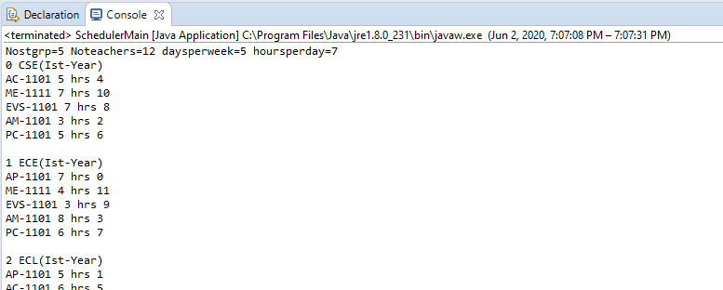
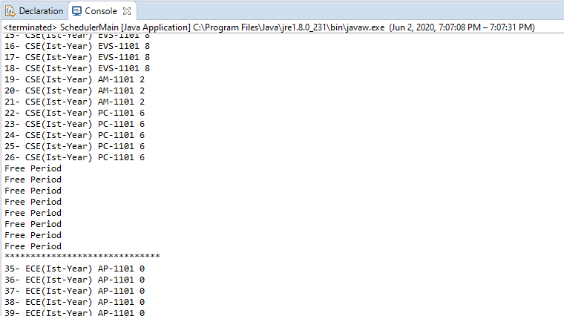

Slide 39
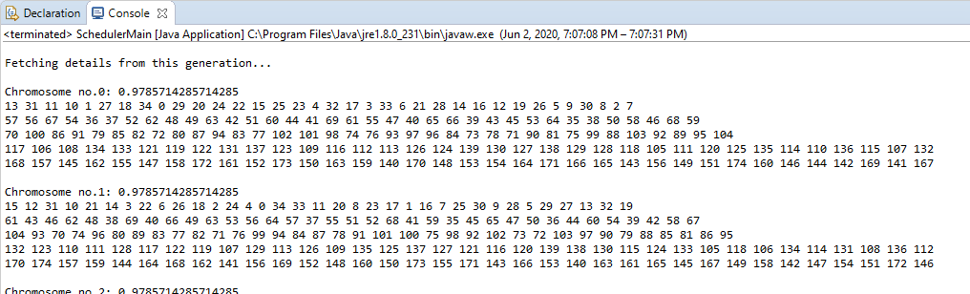
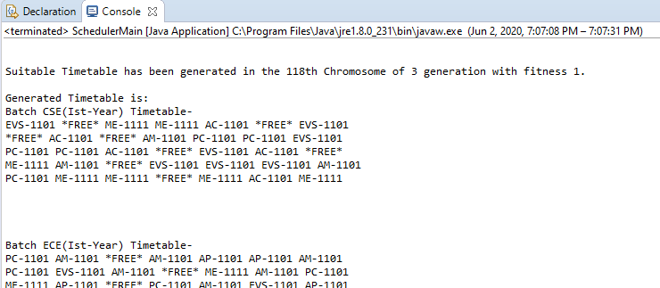
Output in the console->

Slide 40
Technical Descriptions:
Backend and Algorithm
Java 8
Struts-2 framework
Java Server Pages
Servlets
Database
MySql database

Slide 41
Frontend Design
HTML 5
Cascading style sheets (CSS)
Javascript
Bootstrap
Ajax
The web-app has been locally hosted during development using Apache Tomcat-7.

Slide 42
THANK YOU

