Slide 1

Raster analysis in R
-Yashparna De

Slide 2
Find and download Sentinel 2 data:
The satellite images of the area to be analysed is downloaded through sen2r application which can be accessed by calling sen2r() in the r console. The input could also be taken from the getSpatiaData app but it has less resolution and more time consuming for the same data area taken.
The area selected is converted to GeoTiff format and stored in the specified directory. For the use of analysis we need to set the directory to the same using setwd().
The area considered for this trial is taken to be New Town + Rajarhat area of Kolkata and the thumbnail for the images downloaded is given below.

Slide 3
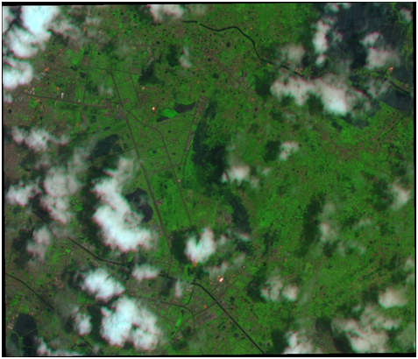
Time frame: ["2020-05-17", "2020-05-24"]

Slide 4
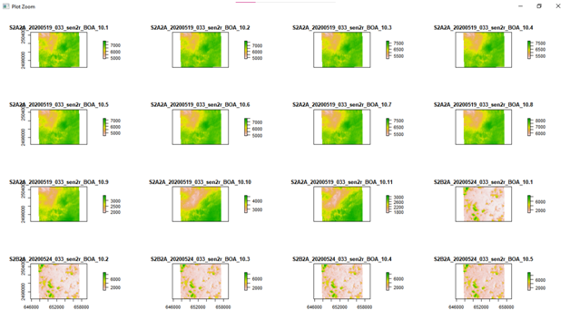
After setting the working directory and calling all the libraries, we create a list of all the .tif extension file here seen as rlist. Viewing rlist and the raster of each input we see it contains of 2 .tiff files, each having 11 bands. So we stack all the bands together using stack() and create a stack called as st.
On plotting the stack we get the following:

Slide 5
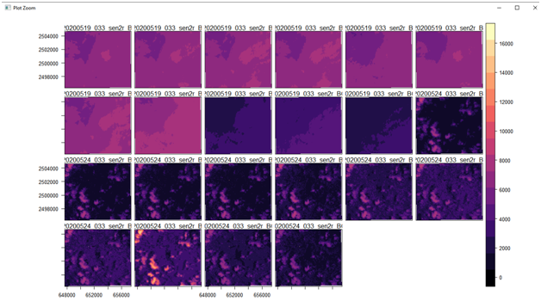
On plotting levelplot() we get:

Slide 6
Different earth surfaces reflect the solar radiation differently and each raster layer represents how much incident solar radiation is reflected at a particular wavelength bandwidth.
Vegetation reflects more NIR than other wavelengths but water absorbs NIR, therefore the lighter areas with high reflectance values are likely to be vegetation and the dark blue, low reflectance value areas, likely to be water.
As the area selected has almost no water bodies, we aren’t able to see any blue areas.
We can also see the results if we plot a single raster layer from rlist (taken in the program as lc) and plot it.

Slide 7
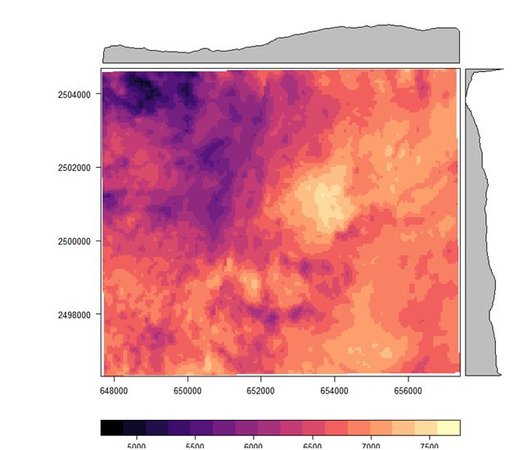

Slide 8
Manipulating rasters: For deeper analysis
Here we are going to use NDVI and KMN classification.
The Normalised Difference Vegetation Index (NDVI) is a widely used vegetation index that quantifies vegetation presence, health or structure. It is calculated using the Near Infrared (NIR) and Red bandwith of the spectrum. Healthy vegetation reflects light strongly in the NIR part of the spectrum and absorbs light in red part of the visible spectrum for photosynthesis. A high ratio between light refected in the NIR part of the spectrum and light reflected in the red part of the spectrum would represent areas that potentially have healthy vegetation. It is worth noting that different plant species absorb light in the red part of the spectrum at different rates.

Slide 9
The same plant will also absorb light in the red band differently depending on whether it is stressed or healthy, or the time of year. It is often used over large areas as an indication of land cover change.
The NDVI ratio is calculated using (NIR - Red) / (NIR + Red). For example, a pixel with an NDVI of less than 0.2 is not likely to be dominated by vegetation, and an NDVI of 0.6 and above is likely to be dense vegetation.
Hence here we create a function to do the above calculation and call it to the variable ndvi and plot it to get the below results.

Slide 10
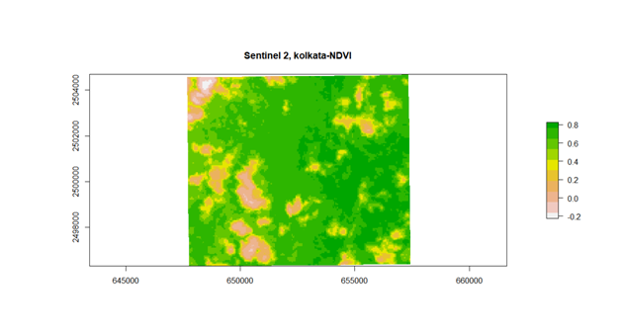

Slide 11
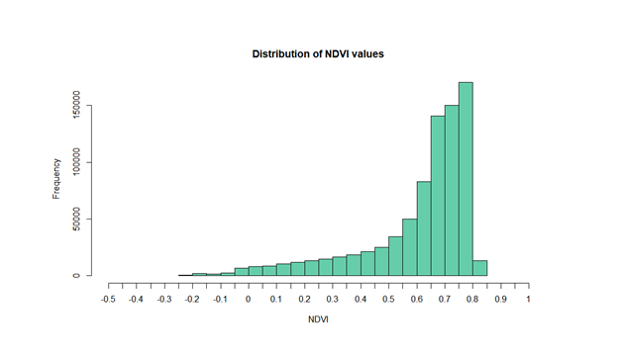
To find out the distribution of the pixel NDVI values, we can plot a histogram.
The histogram skewness tells us what kind of vegetation is present in majority in the selected area.

Slide 12
The histogram is strongly skewed to the right, towards high NDVI values, indicating a highly vegetated area.
Now that we know that this area has lots of vegetation, we can also mask the pixels with an NDVI value of less than 0.4 (less likely to be vegetation) to highlight where the vegetated areas occur.
Hence in the next step we classify and mask the areas that show ndvi value less than 0.4 and hence get the following output.

Slide 13
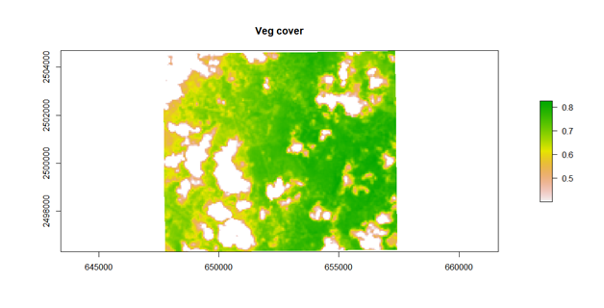

Slide 14
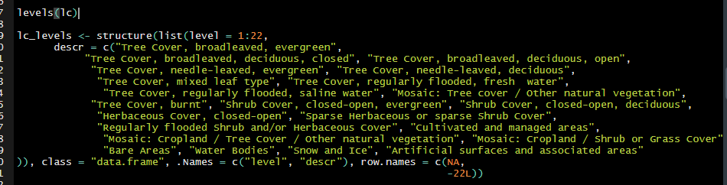
After this analysis we can check the levels of the stack made. If the levels are not huge numbers and the latitude and longitudes are given in decimal degrees, we can structure and rename the levels according to the vegetation to get a clearer classification.
But a here the number of levels come out to be huge and the grid is not in decimal degrees, this classification becomes an burden task and is hence neglected but a screenshot of how to structure it for if levels were only 22.

Slide 15
