Slide 1
LIGHT AUTOMATION USING PIR SENSORS
Group Members :
Name | Roll no.
Anushka Bhagwat | 224001
Aryan Pandita | 224004
Yashraj Aware | 224006
Kaustubh Bhoskar | 224007

Slide 2
CONTENTS
INTRODUCTION
HARDWARE COMPONENTS
CIRCUIT DIAGRAM
PSEUDO CODE & FLOWCHART
MODEL AND EXPERIMENTAL RESULTS
FUTURE ASPECTS
CONCLUSION
REFERENCES

Slide 3
INTRODUCTION
Many electrical devices are used in colleges, schools and home etc. Lot of electricity is consumed while using these devices which can be reduced by using certain electronic devices
Due to the human err and negligence the electrical comsumption increases drastically in such cases like forgetting to switch off the room light.
Thus in our proposed project a microcontroller is used to regulate various electrical appliances using multiple electronic devices. Identifying the presence of an individual in the room is done by making use of an Arduino microcontroller and with a PIR sensor and much more hardware.

Slide 4
Hardware REQUIREMENTS
BREADBOARD
PIR SENSORS
ARDUINO (UNO)
JUMPERS
POWER BANK
LCD (16x2)

Slide 5
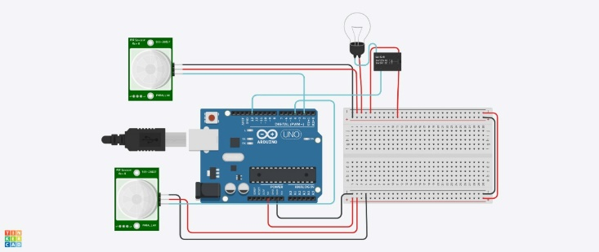
CIRCUIT DIAGRAM

Slide 6
Pseudo CODE & FLOCHART
#person entering room --→If(firstsensor==true)
Increment count
#person is leaving room-→If(secondsensor==true)
Decrement count
#If there is motion--→ If(pirsensor==true)
# show the count on screen
#no person in room i.e. no motion in room.
IF (COUNT<=0 || T==300000)
#turn off all electric appliances
Relay is ON
#display no of persons inside room.
Display(led(count))

Slide 7
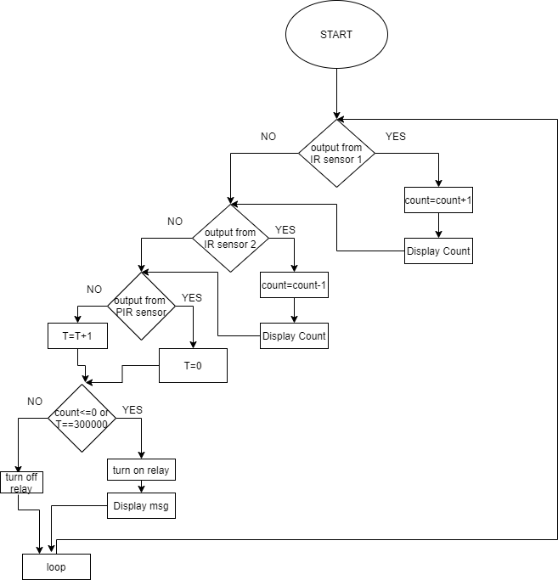

Slide 8
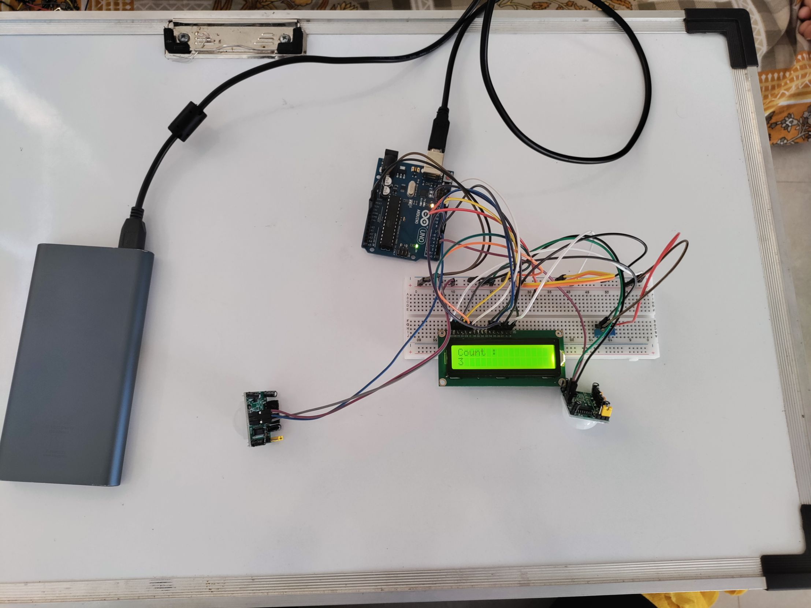
WORKING MODEL

Slide 9
CONCLUSION
In this we have presented the idea and design of an efficient lighting system using pir sensor
It describes about automatic controlling lights usingPIR sensors. Each sensor controls the turning ON or OFF of the lighting column using Arduino-UNO microcontroller.
Further it can also be modified into accepting a certain threshold of light and then illuminating the room or a specified number of person when they enter in the room And also,

Slide 10
Thank You

