Slide 1

File Organizer project
202401040319 : Yashraj Ghule
202401040283 : Shreyas Yadav
202401040124 : Tejas Jaju

Slide 2
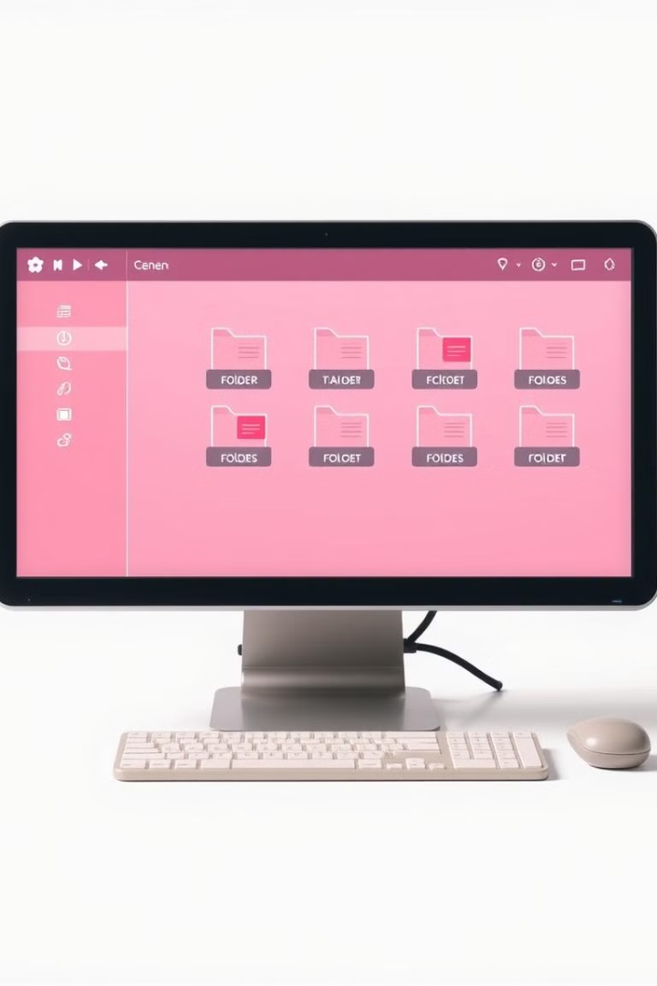
Introduction :
This presentation explores a file organizer project written in shell script. It's a powerful tool to efficiently manage your files and keep your data organized.

Slide 3
What is a File Organizer?
The Problem
The Solution
Many of us struggle with messy digital clutter. Files become scattered, making it hard to find what we need.
A file organizer script automates the process of organizing files, bringing structure and order to your data.

Slide 4



The Use of a File Organizer
Organization
Efficiency
Storage Management
A well-organized system makes it easy to find the files you need.
Save time by quickly locating specific files.
Optimize storage space by organizing files into logical groups.

Slide 5
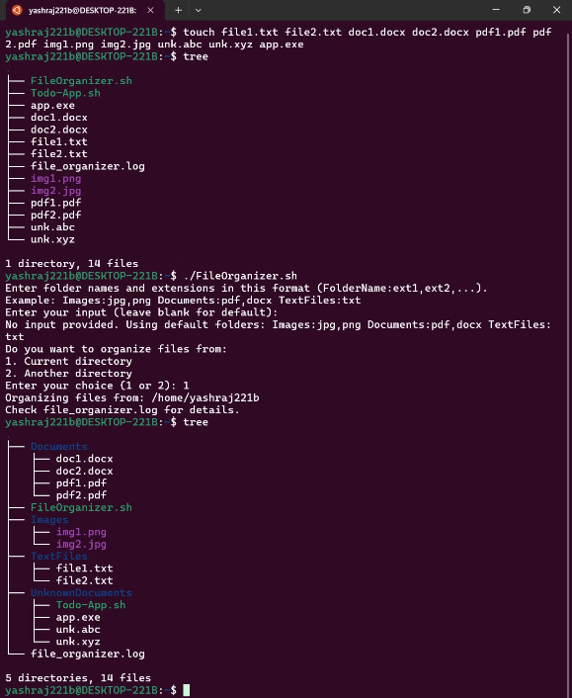
Output

Slide 6

Conclusion
The File Organizer project successfully delivers a valuable solution for efficient file management. Its automation features save time and effort, making it easy to organize and locate files.

