Slide 1


SMART INDIA HACKATHON 2024
Problem Statement ID – SIH 25013
Problem Statement - Real-Time Public Transport Tracking for Urban Congestion
Theme - Transportation & Logistics
PS Category - Software
Team Name – Tech Hawks’

Slide 2
Idea/approach
Tech Hawks’
challenges
The SmartTransit project was designed as a web-based, real-time bus tracking system to improve accessibility and convenience for commuters.
To make the solution simple and cost-effective, the bus conductor’s or driver’s mobile phone was used as the GPS device.
A dedicated “Bus Simulator” application was developed to emulate a real bus tracker by utilizing the device’s GPS location.
Firebase Firestore was selected as the real-time database for storing and synchronizing live location data between buses and users.
A User Application was built to receive these real-time updates and display active buses directly on an interactive map.
The user app provides additional functionality, such as filtering buses by route and identifying the nearest bus to the commuter’s location.
Open source mapping libraries, including Leaflet.js and OpenStreetMap, were integrated to deliver smooth mapping functionality while keeping implementation costs low.
An additional feature was introduced to calculate the distance between a bus and the user, along with the estimated time of arrival (ETA), enhancing the overall passenger experience.
GPS Signal Accuracy
Raw GPS signals are often noisy and inconsistent . This makes it a
challenge to show accurate bus locations and smooth movement
on the map.
Bus and Route Identification
When multiple buses run on similar or overlapping routes,
distinguishing them accurately and linking the correct data to the
correct bus is challenging.
Scalability and Performance
The system must handle many buses sending data & thousands of
users requesting it all at once. It's a challenge to ensure the system
remains fast and reliable as it grows.
Battery and Data Usage
Constantly tracking GPS on a mobile device uses significant battery
and data. The system needs to balance real time updates with
conserving the device's resources.
Data Privacy and Security
Location data is sensitive. A secure system must protect this data
with encryption and controlled access to prevent privacy breaches.

Slide 3
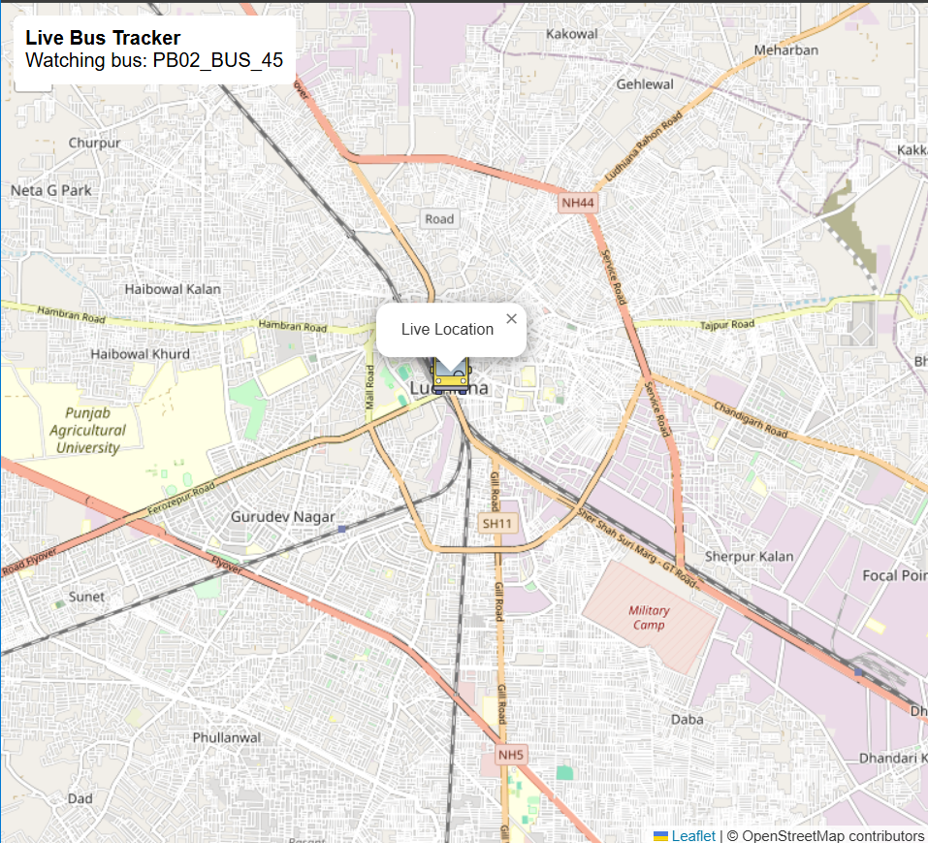
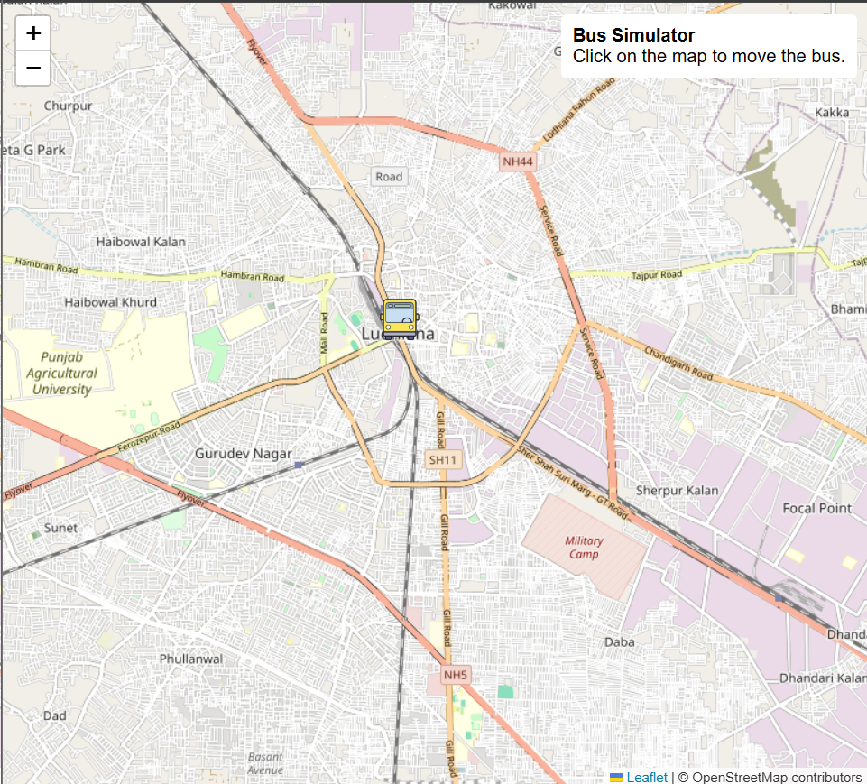
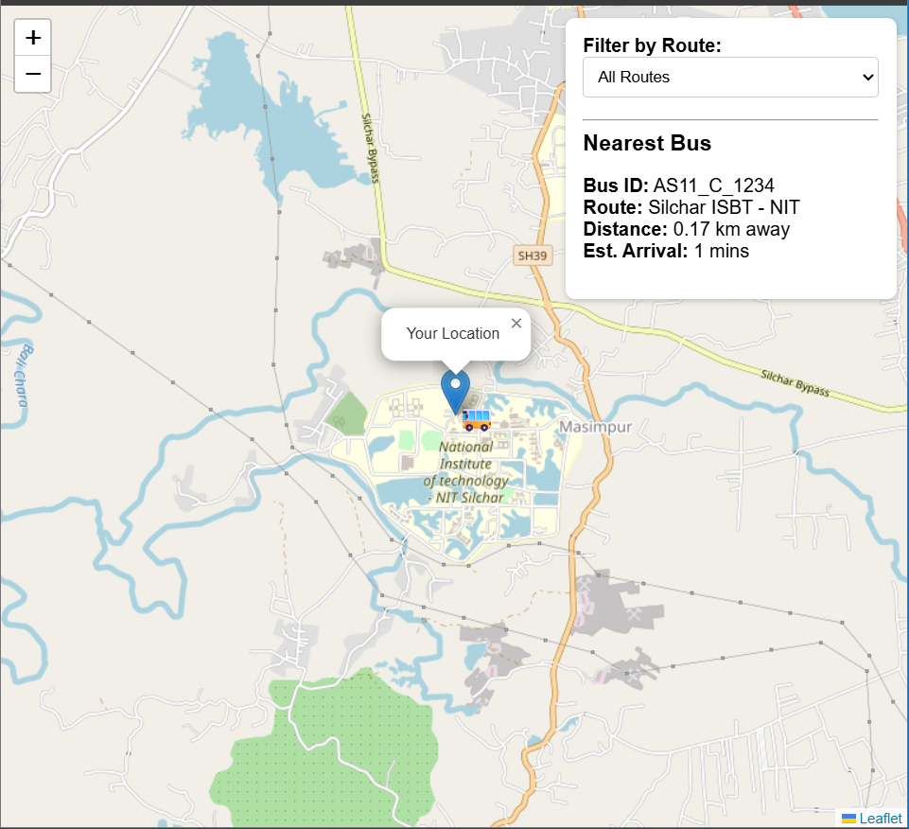
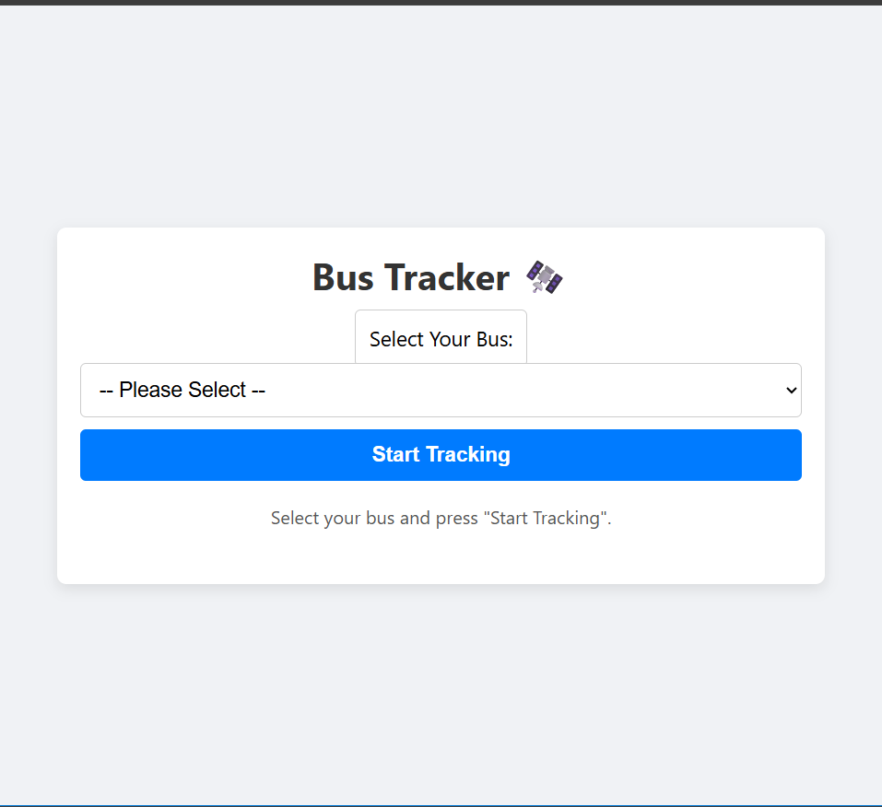

Tech Hawks’
Working Prototype Review
User Interface
Conductor Interface
User Interface
Conductor Interface
User fetch the real time location of bus from Database
Bus Conductor sends its real time location to Database
User fetch the data of Bus and sent it’s location back
Live location of bus is sent to database through GPS
Firebase Firestore Database
Firebase Firestore Database
Prototype - 1
Prototype - 2
Video explanation of Prototype - 1
Video explanation of Prototype - 2

Slide 4


TECHNICAL APPROACH
Tech Hawks’
System Architecture
Driver app - GPS (location) -bus id -route
Drivers’s app
Used for tracking bus
Tech Stack:
Frontend: HTML, CSS, Javascript (Web UI).
Backend & Database: Firebase (handles real-time GPS data & authentication).
Maps: OpenStreetMap API for live bus tracking.
Firebase(database) -Bus id -collect location -timestamp -route name
Prototype 1
Conductor side app
User side app
Passenger app
-nearest bus filter -bus location on map real time update -estimate time of arrival
User interface/app show bus location on map and ETA
Prototype 2
Conductor side app
User
side app

Slide 5
IMPACT AND BENEFITS
Tech Hawks’
Benefits
Impacts
Improved Accessibility & Convenience Real-time bus tracking reduces waiting and uncertainty.
Cost-Effective Solution Uses driver/conductor mobile phones as GPS devices, avoiding expensive hardware.
Efficient Travel Planning ETA and nearest bus features help commuters save time.
Better Fleet Management Operators can optimize routes and schedules using live data.
Sustainable & Smart City Support Encourages public transport use, reducing traffic congestion and pollution.
Boosts Public Transport in Tier-2 Cities – Affordable smart public transportation where infrastructure is limited.
Enhanced Commuter Experience Reliable and convenient public transport.
Increased Public Transport Usage Helps reduce congestion and emissions.
Data-Driven Insights Transport authorities can optimize planning and services.
Scalable & Adaptable Low-cost solution that can extend to other cities and transport modes.
Support for Tier-2 Cities Provides affordable smart transit where infrastructure is limited.
Environmental Sustainability Encourages eco-friendly mobility, reducing carbon footprint.

Slide 6
RESEARCH AND REFERENCES
Tech Hawks’
Future ideas
1.Multiple buses location shown to user according to route selected.
2. Details of bus driver included with bus id.
3.Location of all the near by buses shown to driver side app
4. Able to book seat online and know about vacant sheets
Firebase: It serves as the central backend and real-time database for the bus tracking system.
For Details : Click Here
GPS: Global Positioning System.
For Details : Click Here
OSM: OpenStreetMap
For Details : Click Here
API: Application Programming Interface
For Details : Click Here
!! THANK YOU !!

