Slide 1

QUICKEN LOANS DATA SOLUTION ASSESSMENT Bank Marketing Dataset
Presented By:
Yashraj Swarnkar

Slide 2
ABOUT DATA
The data is related with direct marketing campaigns of a European banking institution.
The dataset contains 41188 records with 20 inputs variable, ordered by date (from May 2008 to November 2010).
Explanation of input variable are provided below:
age (numeric)
job : type of job (categorical: “admin.”, “unknown”, “unemployed”, “management”, “housemaid”, “entrepreneur”, “student”, “blue-collar”, “self-employed”, “retired”, “technician”, “services”)
marital: marital status (categorical: “married”, “divorced”, “single”; note: “divorced” means divorced or widowed)
education (categorical: “unknown”, “secondary”, “primary”, “tertiary”)
default: has credit in default? (binary: “yes”, “no”)
housing: has a housing loan? (binary: “yes”, “no”)
loan: has a personal loan? (binary: “yes”, “no”)
contact: contact communication type (categorical: “unknown”, “telephone”, “cellular”)
day: last contact day of the month (numeric)
month: last contact month of the year (categorical: “Jan”, “Feb”, “Mar”, …, “Nov”, “Dec”)
duration: last contact duration, in seconds (numeric)
campaign: number of contacts performed during this campaign and for this client (numeric, includes the last contact)
pdays: number of days that passed by after the client was last contacted from a previous campaign (numeric, -1 means the client was not previously contacted)
previous: number of contacts performed before this campaign and for this client (numeric)
poutcome: outcome of the previous marketing campaign (categorical: “unknown”, “other”, “failure”, “success”)
emp.var.rate: employment variation rate — quarterly indicator
cons.price.idx: consumer price index — monthly indicator (numeric)
cons.conf.idx: consumer confidence index — monthly indicator (numeric)
euribor3m: euribor 3-month rate — daily indicator (numeric)
nr.employed: number of employees — quarterly indicator (numeric)
ModelPerformance : Results from a current model used to predict whether a client will subscribe (‘yes’) to a term deposit (probability of subscribing to term deposit)
Output Variable (desired target):
y : has the client subscribed a term deposit? (binary: 'yes','no')

Slide 3
AGENDA
Find data patterns and clean the data for further modeling to help this banking institution determine, in advance, clients who will be receptive to such marketing campaigns.
Evaluate performance of existing model
Identify building new classifier and the goal of classifier is to predict if the client will subscribe (yes/no) a term deposit(variable y).
Often, more than one contact to the same client was required, in order to access if the product (bank term deposit) would be (‘yes’) or not (‘no’) subscribed.
To improvise the marketing campaign of bank by analyzing the past sampling data and recommending right target customer.
Tool used for analytics
Python
Google Colab

Slide 4
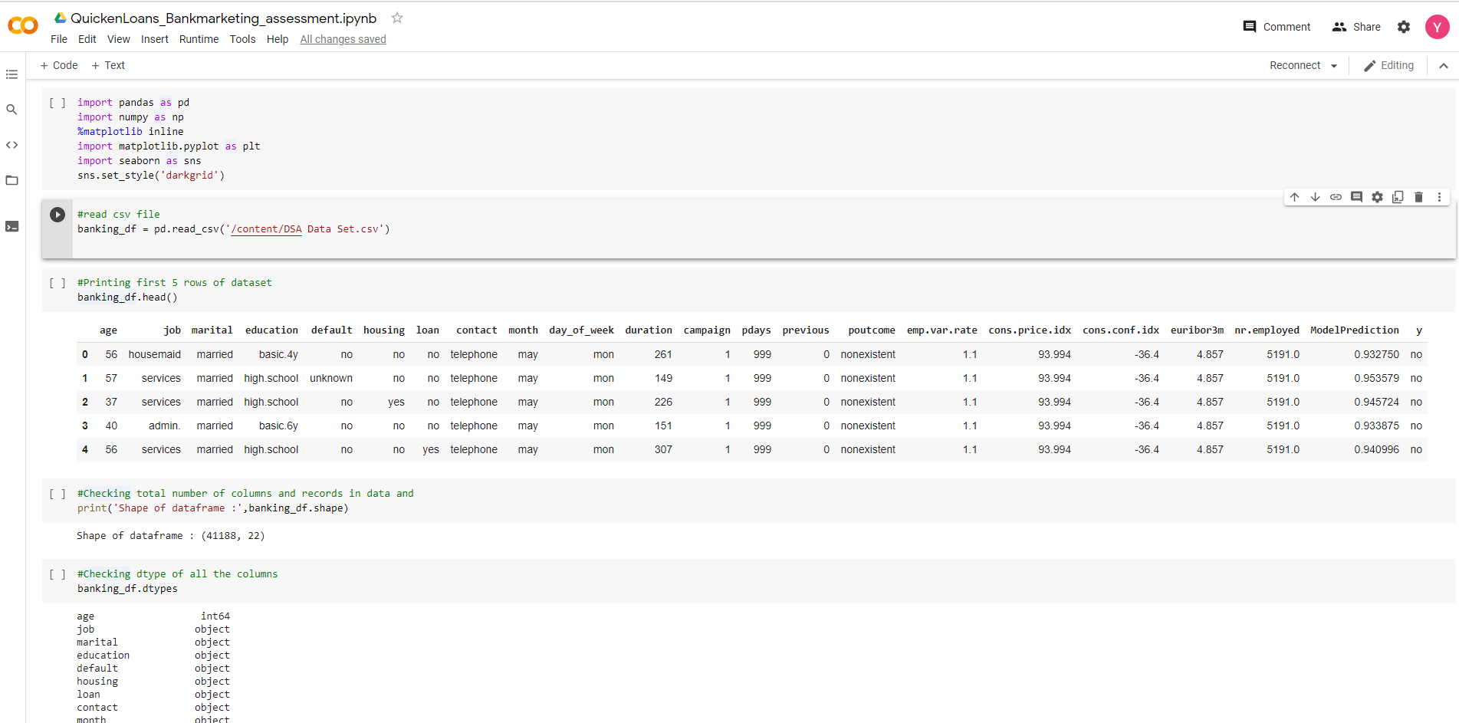
DATA PREPROCESSING
As a part of data-preprocessing, we have imported necessary python libraries, dataset and checked dimension and data type of input variable in data set

Slide 5
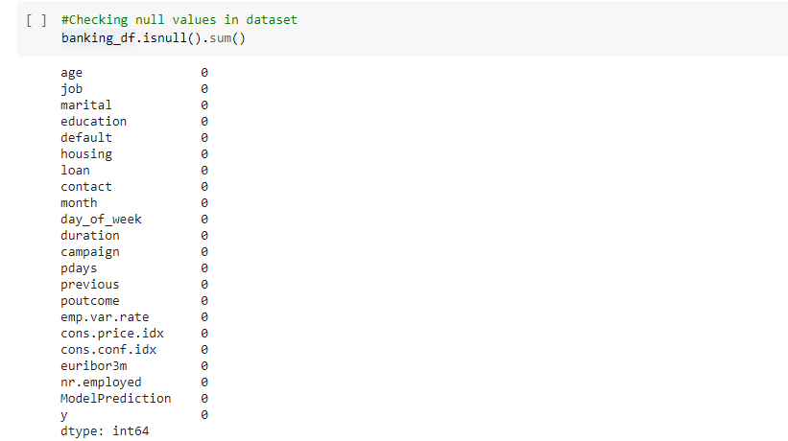
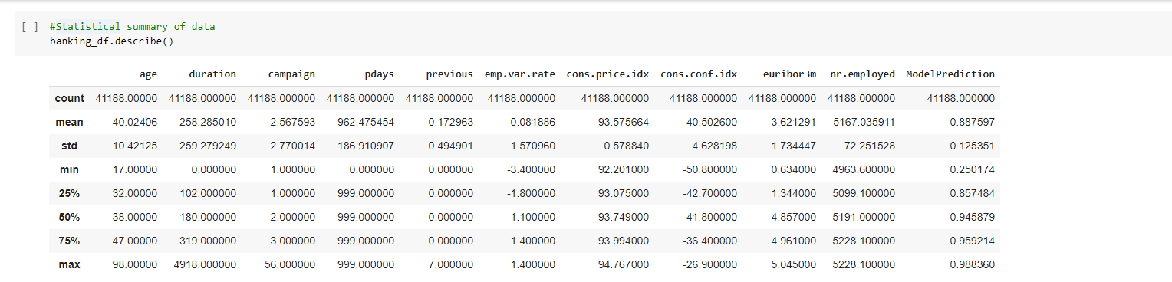
EXPLORATORY DATA ANALYSIS
As a part of initial data, I have checked, is there any null values in the data. For our dataset we don’t have any null values. But if there is any null values in data we treat them using different method based on the kind of missing values we have.
After checking null values, I have checked statistical description of the data using pandas describe() function

Slide 6
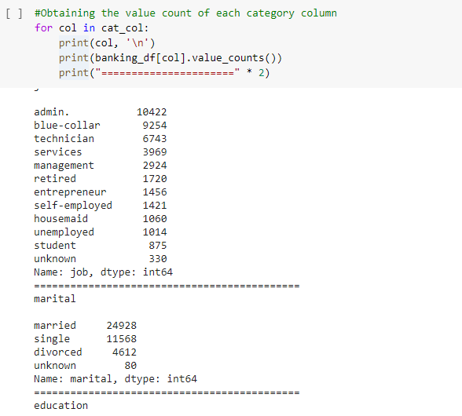
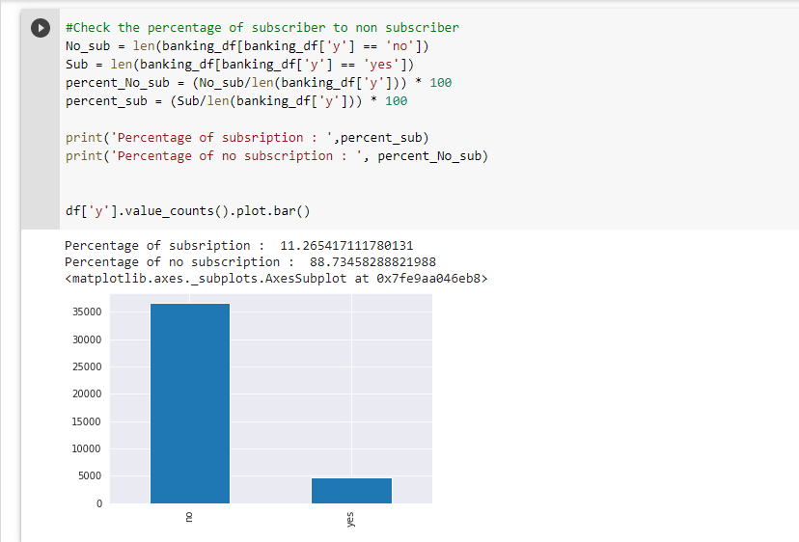
EXPLORATORY DATA ANALYSIS(cont.)
Identified all the column having categorical data and iterate through it to get the value count of each categorical data column.
Analytics on the dependent variable to check how much percentage are subscriber or nonsubscriber, from this we can see there is imbalance in data i.e. approx. 90% no subscription and 10 % subscription.

Slide 7
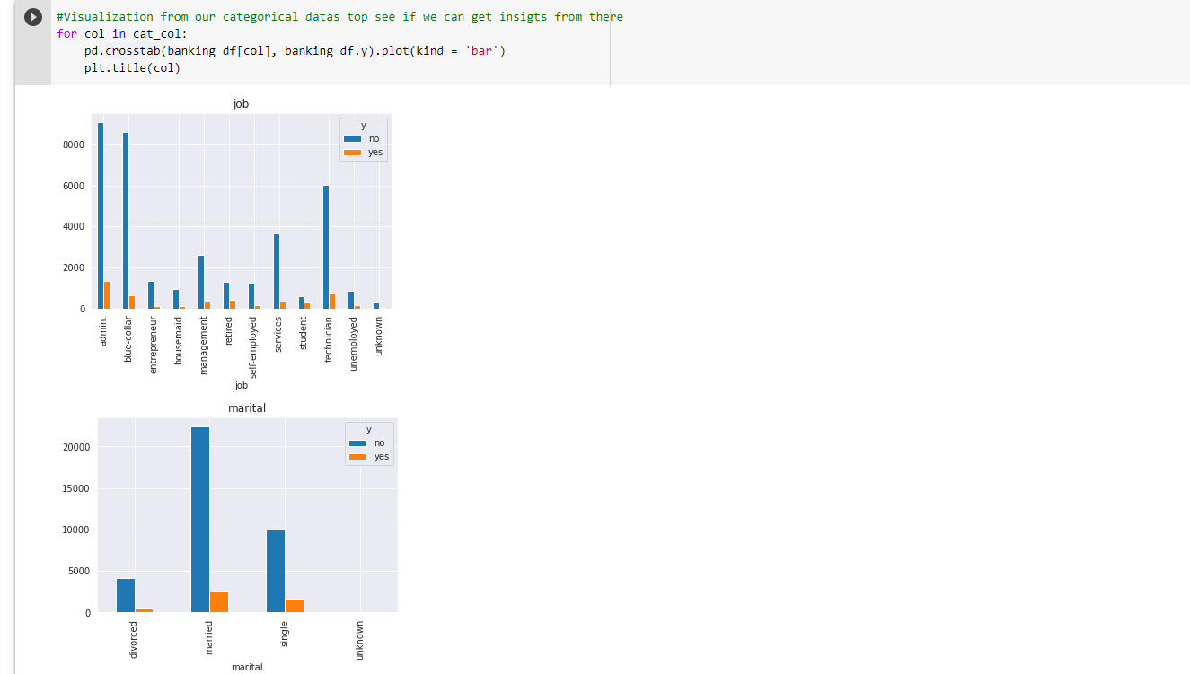
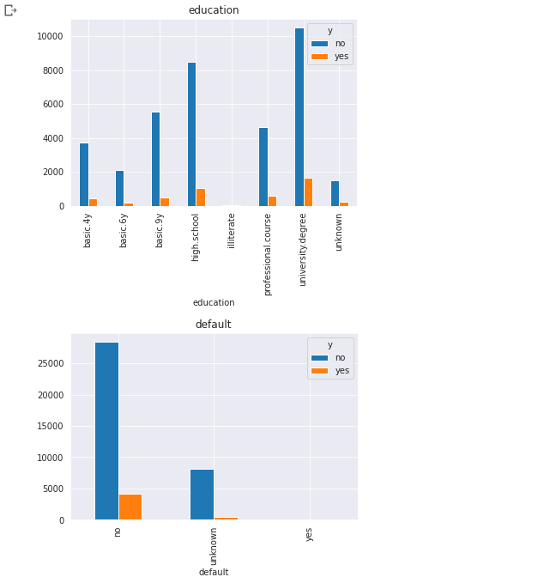
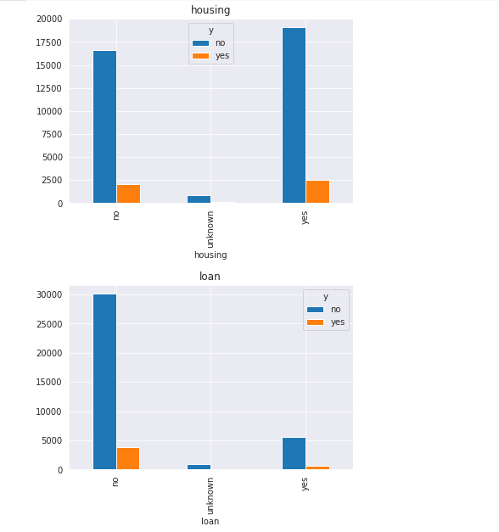
DATA VISUALIZATION
Data visualization is key in data analysis and science as it helps to detect skewness, outliers etc
Visualize categorical variables to check their impact on dependent variable.
Findings from above visualizations
Users having job as admin or blue-collar has a high tendency of subscribing to the next campaign than an unemployed person
Education of the user is also an influence to dependent variable, it is clear from plot university degree has both the most user with both sub and no_sub

Slide 8
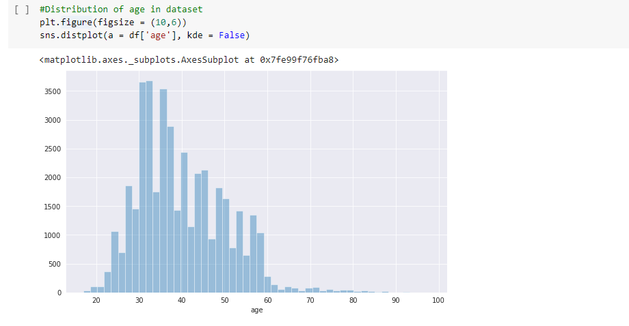
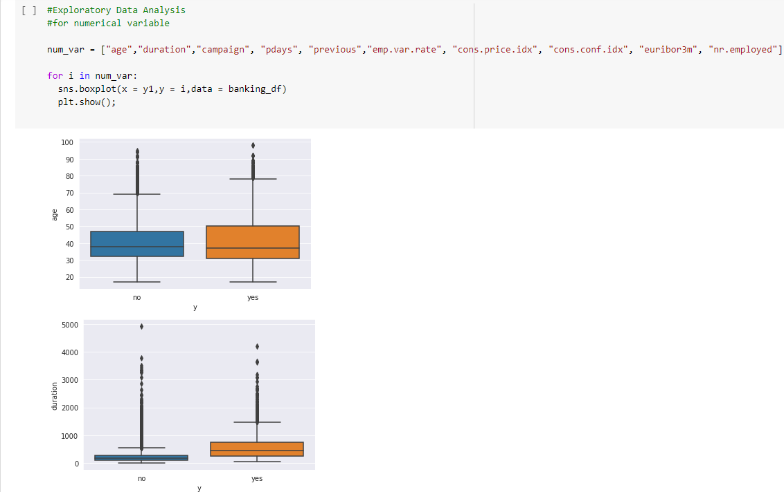
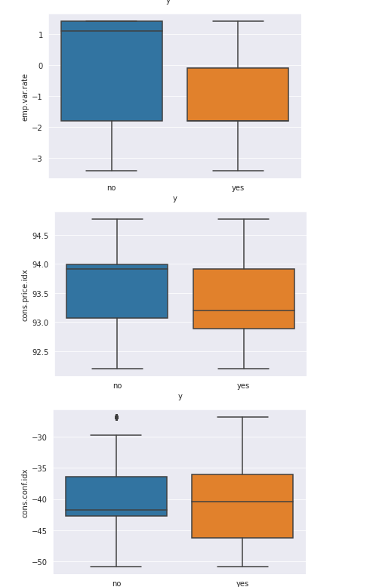
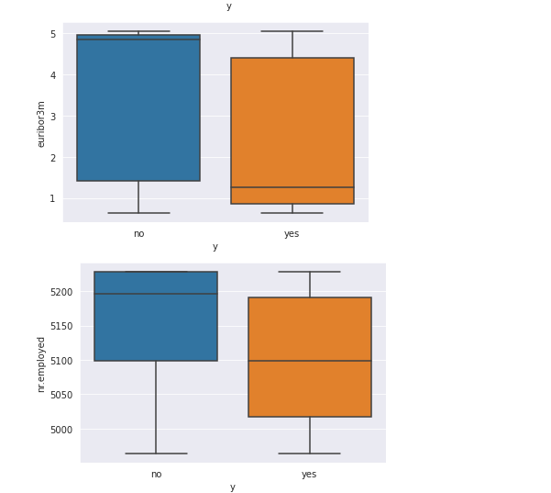
DATA VISUALIZATION(cont.)
Visualizing age distribution in data. From the below distribution make a conclusion most of the users are within the age 30 - 45. and we have less users from 60 upward
Visualize continuous variable on box plot as it can be helpful in getting summary of data like identifying outliers, mean values, the dispersion of the data set, and signs of skewness

Slide 9
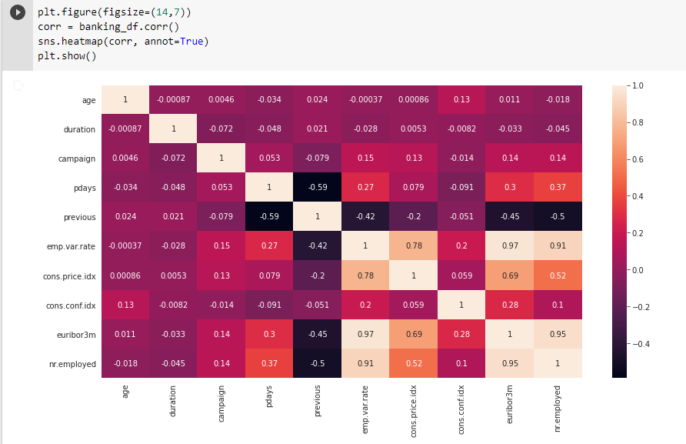
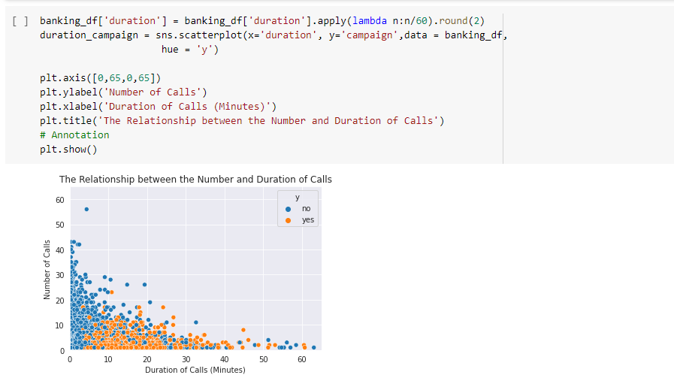
DATA VISUALIZATION(cont.)
Visualize data in Correlation matrix to identify correlation in dataset
Visualize scatter plot of y between number of call and duration of call: conclusion we can make from is if more than 25 call is made to a user he will not subscribe. Call duration of most subscriber is 10-20 mins.

Slide 10
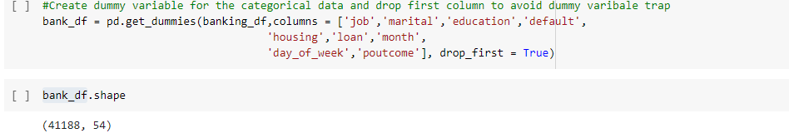
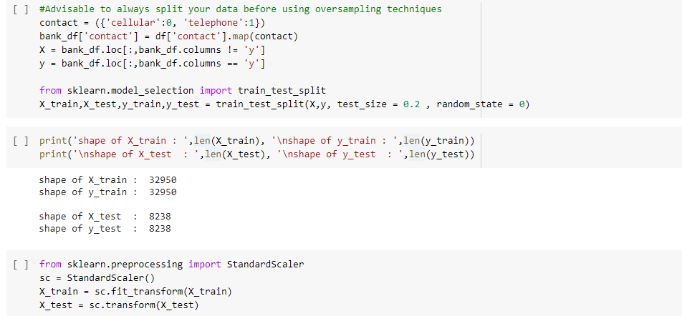
FEATURE ENGINEERING
Encoded categorical variables using pandas get_dummies. After encoding size of dataset got increased.
Split the data into 80% train and 20% test. And normalize data using standard scalar

Slide 11
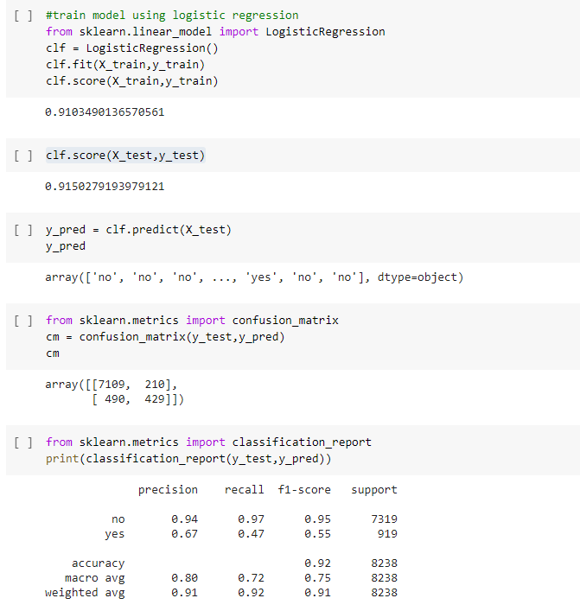
MODELLING
As this is a binary classification, using sklearn library I build a Logistic regression model for training with all parameter as default.

Slide 12
Conclusion
Achieved accuracy as below from Logistic Regression:
Training Accuracy: 0.910
Test Accuracy: 0.915
Model evaluation metrices used is Confusion matrix
Existing model is having an accuracy of 88.75% and model which I have build have accuracy of around 91% with 7538 correct prediction out of 8238 values.

Slide 13
THANK YOU

