Slide 1

Mutual Fund Analytics Capstone Project
Bluestock Fintech Internship Program
Prepared By: Yash Ridla June 2026

Slide 2
Problem Statement & Objectives
Problem Statement
The mutual fund industry generates large volumes of financial and investor-related data. Analyzing fund performance, risk metrics, investor behavior, and market trends manually is difficult and time-consuming. A data-driven analytical solution is required to transform raw data into meaningful insights for investors and financial analysts.
Project Objectives
Collect and integrate mutual fund datasets
Perform ETL (Extract, Transform, Load) operations
Conduct Exploratory Data Analysis (EDA)
Calculate advanced performance and risk metrics
Develop interactive Power BI dashboards
Generate actionable insights for investment analysis

Slide 3
Data Sources
Raw Data Sources
Fund Master
NAV History
AUM by Fund House
Monthly SIP Inflows
Category Inflows
Industry Folio Count
Scheme Performance
Investor Transactions
Portfolio Holdings
Benchmark Indices
Key Processed Datasets
clean_performance.csv
clean_nav.csv
clean_transactions.csv
fund_scorecard.csv
cagr_report.csv
sharpe_values.csv
sortino_values.csv
var_cvar_report.csv

Slide 4
Architecture
Raw CSV Datasets Data Ingestion (Python) ETL Process
Analytical Datasets Feature Engineering (Cleaning + Transformation)
(14 Processed Files)
Advanced Analytics Power BI Dashboard Business Insights
(CAGR, Sharpe, Sortino,
VaR, CVaR, Drawdown)

Slide 5
Exploratory Data Analysis (EDA)
Dataset Overview
10 raw datasets collected from multiple mutual fund data sources.
Data includes NAV history, AUM, SIP inflows, scheme performance, transactions, and benchmark indices.
ETL pipeline generated 14 analytical datasets for reporting and analysis.
Data Quality Improvements
Missing values handled.
Duplicate records removed.
Column formats standardized.
Data validated using AMFI codes and scheme identifiers.
Key Statistics
Analysis covered multiple fund houses and schemes.
Historical NAV and return data used for performance evaluation.
Investor transaction and SIP datasets used for behavioral analysis.

Slide 6
EDA Key Findings
Major Findings
Higher-return funds generally exhibited higher risk (Std. Deviation).
Large AUM funds were concentrated among a few leading fund houses.
Equity-oriented schemes delivered stronger long-term returns.
SIP inflows showed consistent growth across most periods.
Significant variation was observed in Sharpe Ratio and Risk Metrics among schemes.
Analytical Insights
Strong relationship observed between return and risk.
Fund performance differed across categories and fund houses.
Investor activity trends supported long-term SIP investment behavior.

Slide 7
Performance Metrics
Fund Growth Metrics
CAGR (Compound Annual Growth Rate)
1-Year Return
3-Year Return
5-Year Return
Risk-Adjusted Performance Metrics
Alpha
Beta
Sharpe Ratio
Sortino Ratio
Key Insights
CAGR was used to measure long-term growth consistency.
Alpha and Beta evaluated benchmark outperformance and market sensitivity.
Sharpe and Sortino ratios measured risk-adjusted returns.
These metrics helped identify high-performing and consistent mutual fund schemes.

Slide 8
Performance Metrics (Advanced Risk Analysis)
Risk Metrics Evaluated
Standard Deviation
Maximum Drawdown
Tracking Error
Value at Risk (VaR)
Conditional Value at Risk (CVaR)
Key Insights
Standard Deviation measured fund volatility.
Maximum Drawdown identified the largest historical decline.
Tracking Error evaluated deviation from benchmark performance.
VaR and CVaR estimated potential downside losses under adverse market conditions.
These metrics supported comprehensive risk assessment and portfolio evaluation.

Slide 9
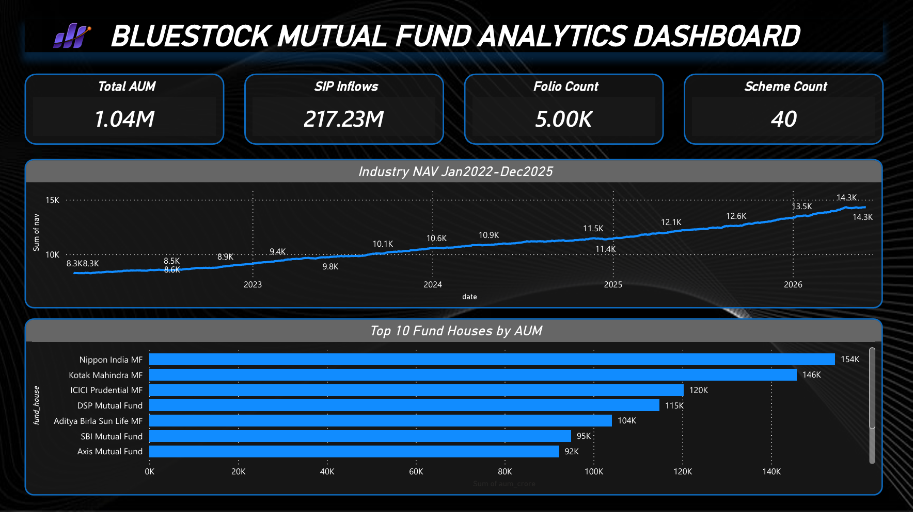
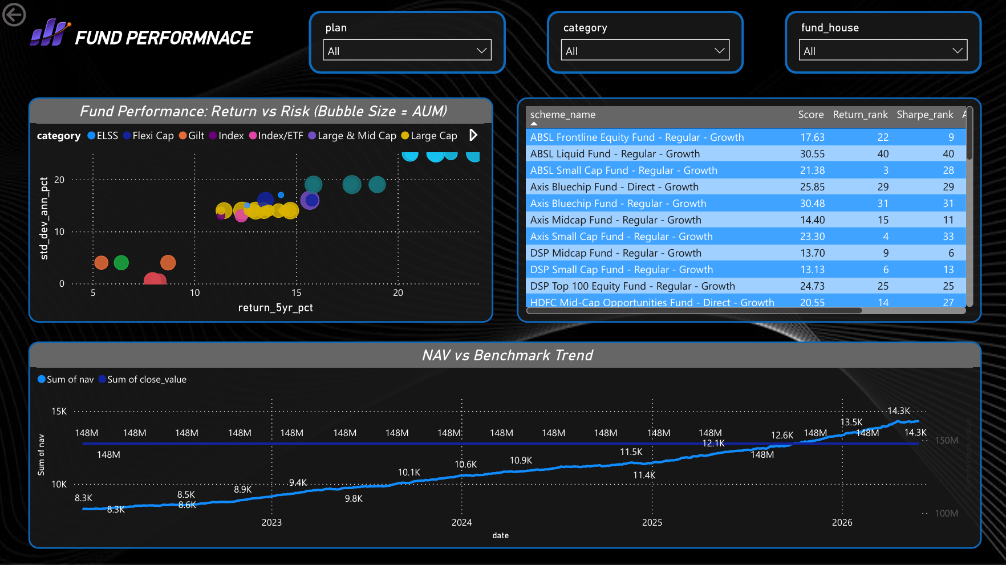
Dashboard

Slide 10
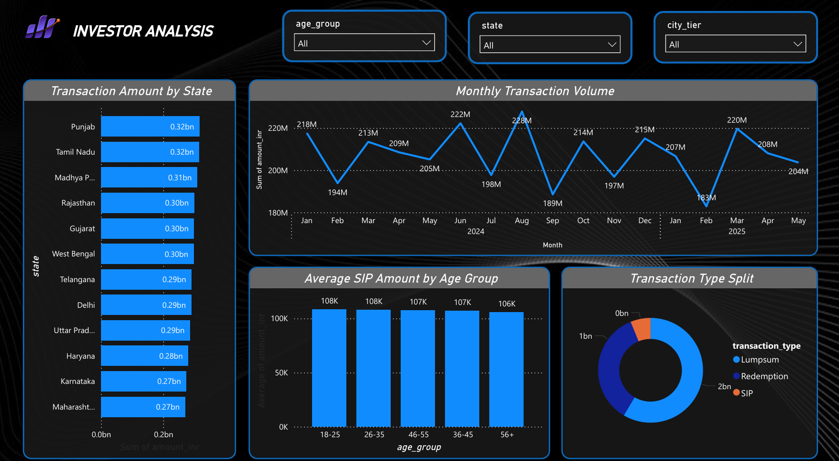
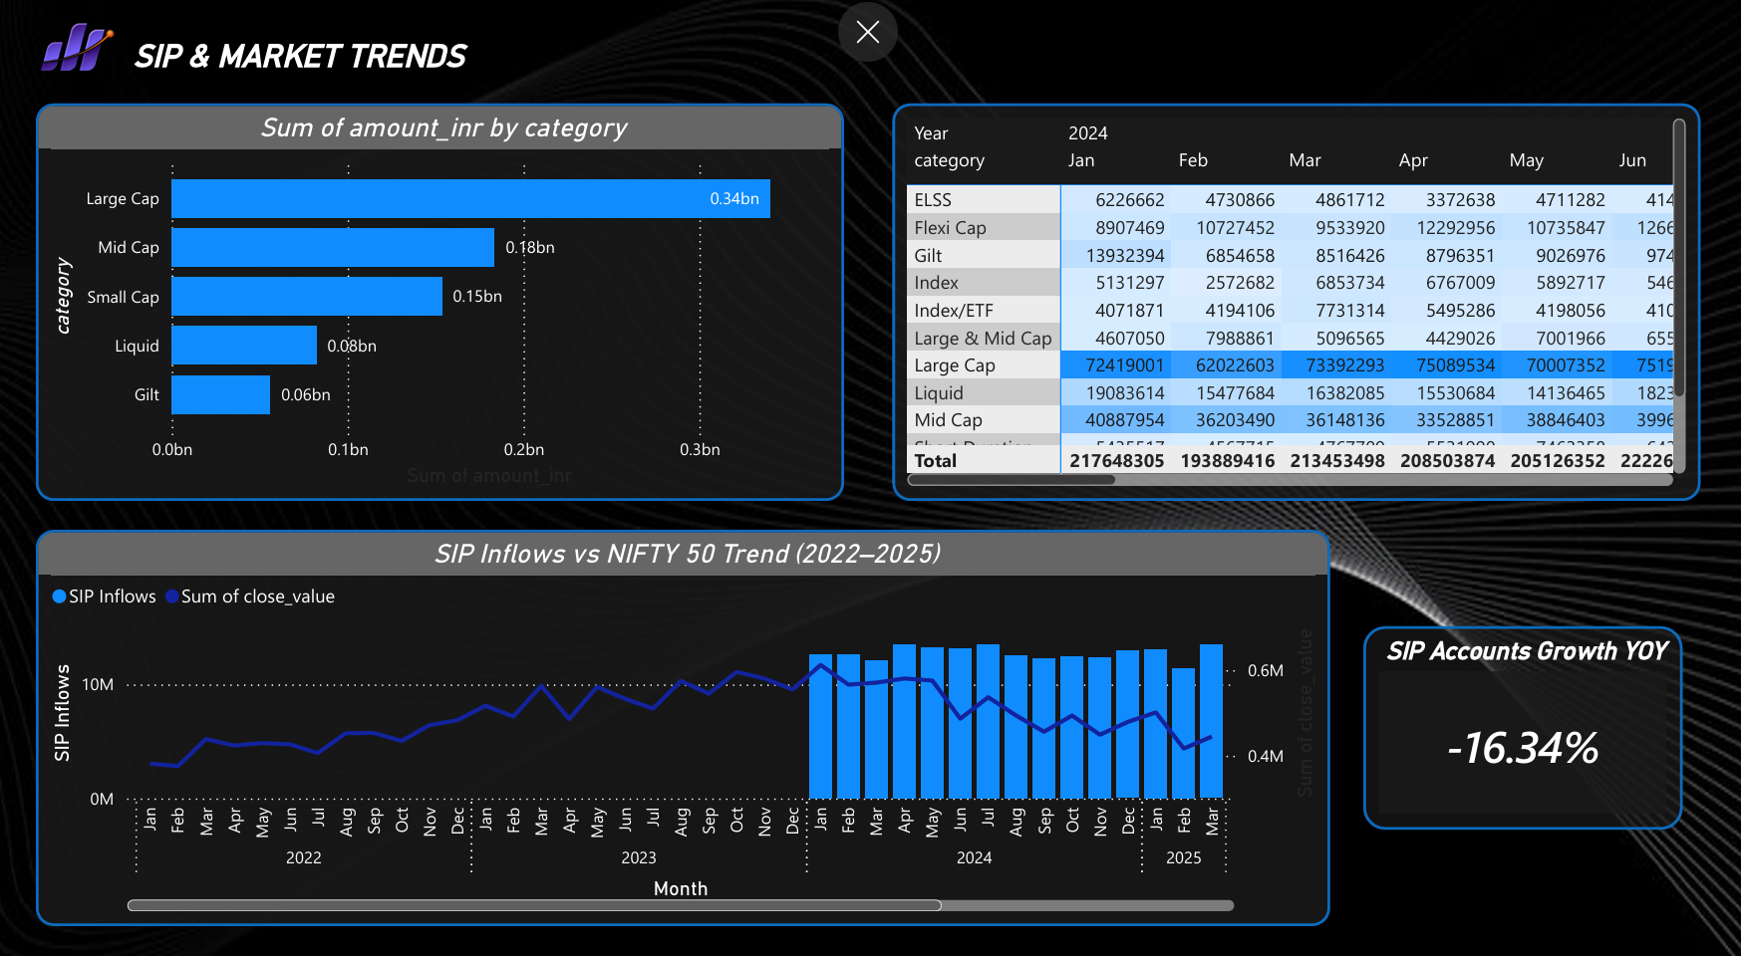

Slide 11
Key Findings
Equity-oriented mutual fund schemes demonstrated stronger long-term return potential.
SIP inflows showed consistent growth across multiple periods, indicating sustained investor participation.
Risk-adjusted performance metrics revealed significant differences among mutual fund schemes.
Large Assets Under Management (AUM) were concentrated within a few leading fund houses.
A positive relationship was observed between return potential and risk exposure.
Advanced risk measures such as VaR, CVaR, and Maximum Drawdown provided deeper insights into downside risk.
Data-driven analysis enabled effective comparison of schemes based on performance and risk characteristics.
Overall, the project successfully transformed raw mutual fund data into meaningful analytical insights for investment evaluation and decision-making.

Slide 12
THANK YOU

