Slide 1
PBL
PROJECT

Slide 2

OUR TEAM
ROLL.NO
OMKAR CHOUGULE
TEJAL NIKAM
YASH JADHAV
PRAGATI PATIL
ISHA JADHAV
F21111008
F21111012
F21111013
F21111016
F21111025

Slide 3




Attendance Management System
This Project describes a method for Student’s Attendance System which will integrate with the face recognition technology using Python. The system will record the attendance of the students in class room environment automatically and it will provide the facilities to the faculty to access the information of the students easily by maintaining a log for clock-in and clock-out time.

Slide 4

Motivation
The Main motivation for this project was:
Slow and Inefficient Traditional Manual Attendance System
More of Paperwork
Less Accurate
Less Secure
Wastage of actual Lecture time
No Proper Data Management
Less Reliable

Slide 5
Idea Concept
1
3
Uses face recognition technology to track attendance
Capturing the face of the employee or student entering the designated area
2
4
Integrating software applications with hardware devices such as cameras and biometric scanners
Matching the captured face against a pre-registered database
5
6
Eliminating the need for manual attendance tracking
Providing real-time monitoring of attendance

Slide 6


Project Objectives
01
Accurate and efficient tracking of attendance: The system aims to accurately and efficiently track attendance by using advanced facial recognition technology.
03
Cost savings: The attendance management system using face recognition technology can reduce costs associated with manual attendance tracking, such as paper-based systems, and improve overall operational efficiency.
02
04
Decreasing the workload of teachers by saving time of lecture hours
Reduction in attendance fraud: Face recognition technology can help to reduce attendance fraud such as proxy attendance.

Slide 7
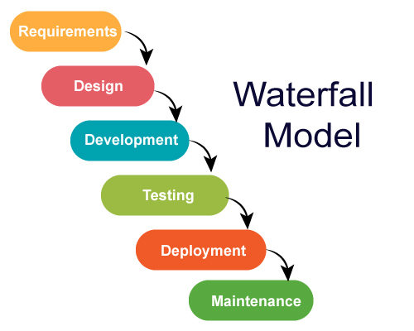
Methodology
Waterfall model is a sequential approach, where each fundamental activity of a process represented as a separate phase, arranged in linear order.
In the waterfall model, you must plan and schedule all the activities before starting. working on them(plan-driven process).

Slide 8





Project Flow
Student
Face Recognition
Camera/Webcam
Attendance

Slide 9
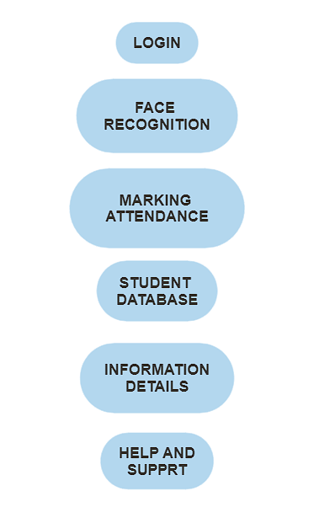


Use case diagram
STUDENT
ADMIN
TEACHER

Slide 10
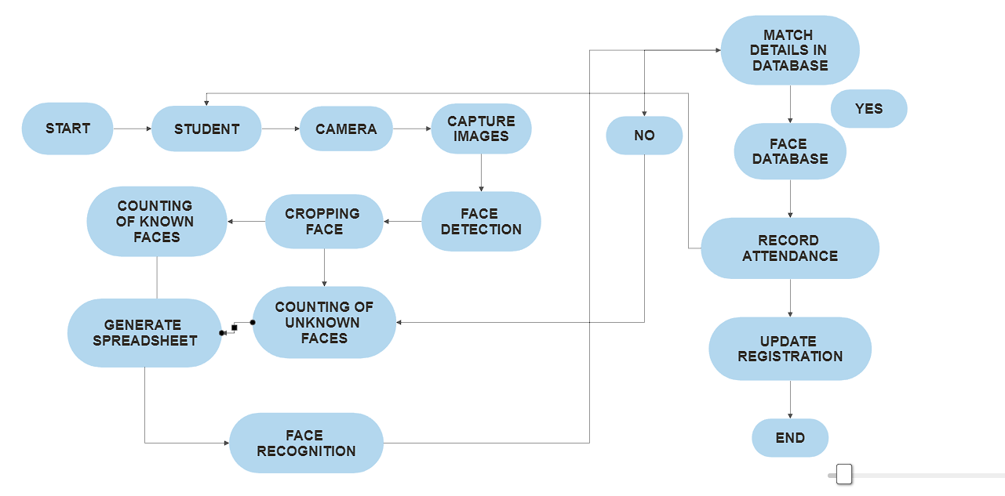
FLOWCHART
2

Slide 11

SOFTWARE REQUIREMENTS
HARDWARE
REQUIREMENTS
Computer/Laptop/Pc(i5 8th gen,8GB Ram)
Camera
SSD or HDD
Python 3.10
Pycharm/Visual Studio code
PIP
Pillow
Tkinter
PIL(Python Imaging Library)
OPENCV

Slide 12






IMPLEMENTATION​
Step 1
Tools and Technologies
Step2
Face Detection and Recognition
Step 3
GUI Design
Step 4
Step 5
Testing and Debugging
Data Integration

Slide 13

1.Tools and Technologies
List of the tools and technologies used in this project are :
Python 3.10
Pycharm/Visual Studio code
PIP
Pillow
Tkinter
PIL(Python Imaging Library)

Slide 14

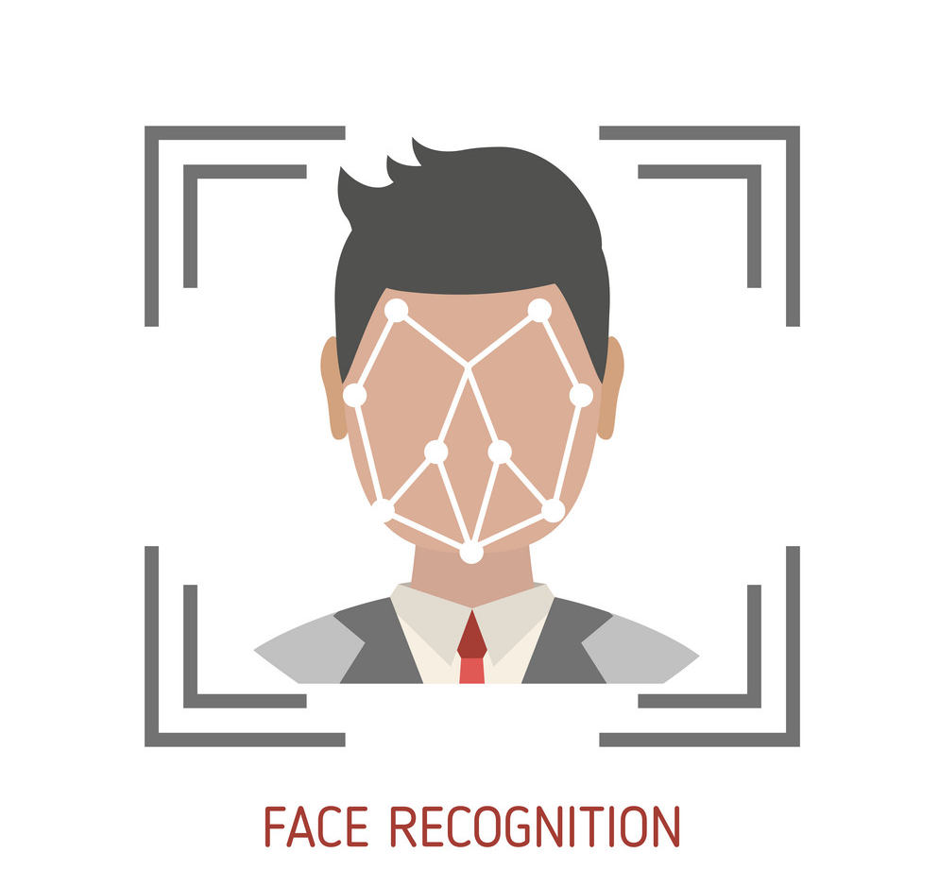
2.Face Detection and Recognition
The face detection process is an essential step in detecting and locating .
The face capture process transforms analog information(a face) into a set of digital information(data or vectors) based on the persons facial features.
The face match process verifies if two faces belong to the same person.
Next time whenever the registered person enters the premises the system recognizes the person and mark his attendance along with the time.
Here the PIL and Pillow plays and important role of incorporating lightweight images processing tools that aids in editing ,creating and saving images.

Slide 15


GUI Design
Python Tkinter is the standard Graphical User Interface (GUI) that is supported in Python.
When Tkinter is used alongside Python ,it results in creation of GUI very conveniently and quite fast.
The main advantage of using Tkinter is that it has an object-oriented interface.
The success of any application or website depends on how well it interacts with the user i.e an attractive graphical interface helps to create a good application .well ,Python Tkinter does that for us.

Slide 16

Data Integration
In this attendance management system using python for data integration or data management we will be using MySQL Database.
MySQL Database is a client/server system that consists of a multithreaded SQL server that supports different back ends ,several different client programs and libraries ,administrative tools, and a wide range of application programming interfaces.

Slide 17

Testing
Ensure that the camera is working properly and can capture clear images of faces.
Verify that the face recognition model is accurate and can correctly identify people.
Test the data base connection to ensure that the attendance records are being stored correctly.
Check that the GUI is functioning correctly and all the buttons and fields are working as expected.
Conduct testing with different lightning conditions ,angles , and distances to ensure that the system works in variety of situations

Slide 18

Debugging
Check for errors in the code and ensure that all libraries are installed correctly.
Verify that the image files are being loaded and processed correctly.
Ensure that the database credentials are correct and that the database scheme is set up correctly.
Check that all the variables are being passed correctly between functions and that there are no typos or syntax errors.
Use print statements or a debugger to troubleshoot any issues and identify where the code is breaking.

Slide 19
Result
As an automated attendance management system, facial recognition provides precise time records, reducing costly mistakes. As a result, accurate data assists managers in providing specific productivity and payroll details
This system will be able to recognize individual faces and automatically mark the attendance of each student in a class.
www.yourwebsite.com

Slide 20
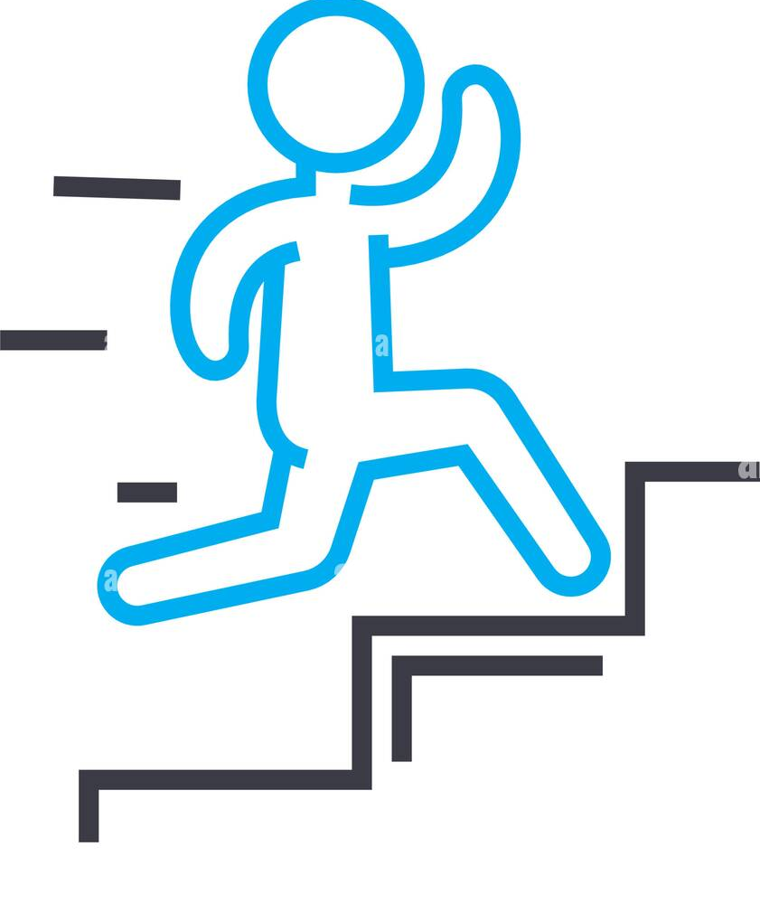
As the range of application is expanding day by day, the complexity of the system is increasing as well. This in fact affects the efficiency of the system. 1. Intrinsic factors: It is due to the physical nature of the face and not dependent on the observer. Intrinsic factors are further divided into intrapersonal and interpersonal. Intrapersonal is caused due to variation in face appearance of an individual, for example ageing, facial expression and facial paraphernalia (facial hair, cosmetics, glasses etc.) 2. Extrinsic factors: This is caused due to the variation in face appearance due to the interaction of light with the face and the observer. This will include illumination, pose, scale and imaging parameters (resolution, focus, imaging, noise etc.). Following are the common challenges seen in face recognition system can have while detecting a face
Challenges

Slide 21

Conclusion & Future Scope
Before the development of this project. There are many loopholes in the previous method while taking attendance using old method which caused many troubles to most of the institutions. Therefore, the facial recognition feature method is secure enough, reliable and available for use. It saves time and lot of effort, especially if it is a lecture with huge number of students
Some of the future enhancements that can be done to this system are as follows: Facility of Defaulter list in which system update the defaulter student. For students, we can develop a dedicated login page in which they can see their details and attendance record In future we can update the modules like notices for student and many more.

Slide 22
</END>

Slide 23
THANK YOU

