Slide 1
All Weather Fundamental Surprise Enhanced Momentum Strategy With Hidden Markov Model Regime Detection
Montreal McGillians
Florentin Belfio
Henry Tang
Rick Yabuki-Soh
Yash Sethi
Arturo Medina
October 2024

Slide 2
Executive Summary
Investment Philosophy
Momentum strategies work well in the long term but less in turning points, especially for Mid and Small Market Enterprises (MSME). We use fundamental surprises (detected by AI Random Forest) and a Macro regime detection model to solve this weakness.
Investment Process
Dynamic
4 Stage
Portfolio
Construction
Process
Stage1 Identify market regimes: Momentum or Defensive (Hidden Markov Chains)
Momentum Regime (Alpha-Weighted)
Stage2 Momentum factors: Rank the stocks and obtain a Momentum subset
Stage3 Earnings surprise: Rank stocks in the Momentum subset
Defensive Regime (Risk-Weighted)
Stage2 Quality factors*: Rank the stocks and obtain a Quality subset
Stage3 Earnings surprise: Rank stocks in the Quality subset
Stage4 Dynamic weighting: 4-month holding, monthly rebalance
*Asness, C., Frazzini, A., Israel, R., Moskowitz, T. J., & Pedersen, L. H. (2018). Size matters, if you control your junk. Journal of Financial Economics, 129(3), 479-509.

Slide 3
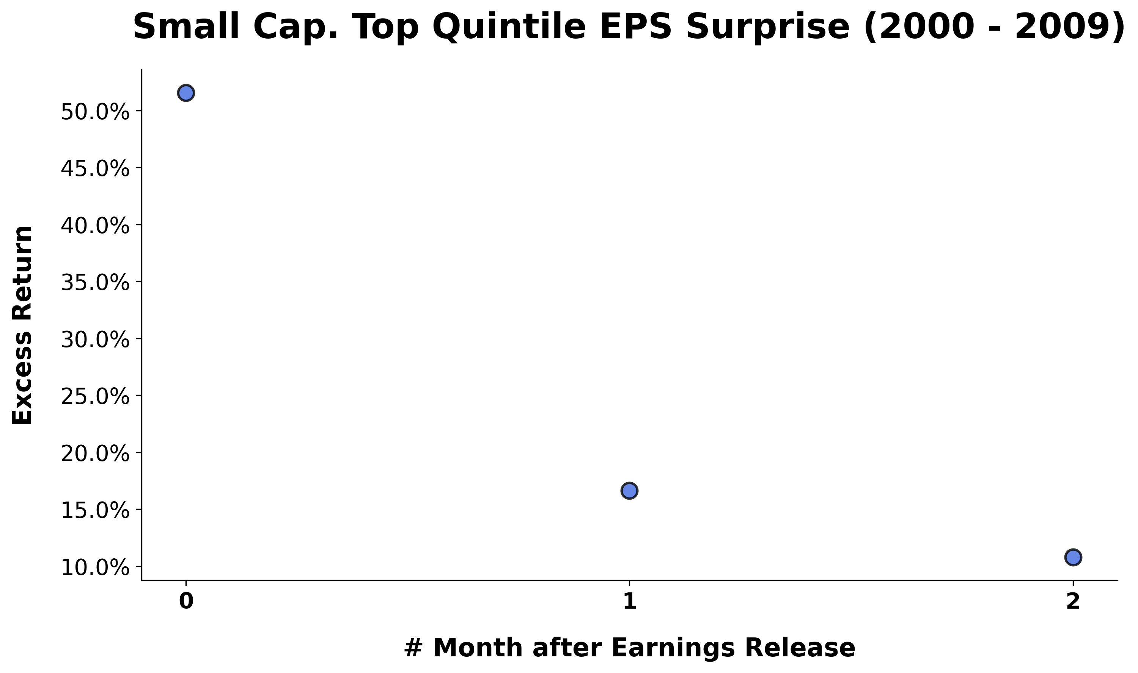
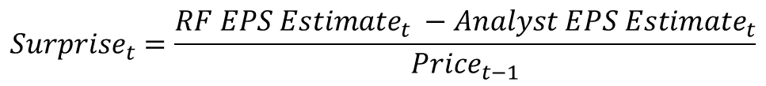
Earnings Surprises Power Small Cap Gains
Firm Specific Data
Macro Specific Data
Analysts EPS Estimates
Random Forest
Average Annualized Return
M.Cap. > $1B
ML EPS Forecast
Market Cap. < $1B
$${Surprise}_{t}=\frac{{RF EPS Estimate}_{t} −{Analyst EPS Estimate}_{t}}{{Price}_{t−1}}$$
Notes:
As we explored the data, we noticed that small cap stocks respond especially well to earnings surprises
And this graph where we plotted the average return of stocks in the top quintile of earnings surprise stocks is the perfect illustration of that as
How did we do that?
Predict the EPS using a random forest model
Calculate the Surprise variable defined as…
Invest in stocks with the largest surprise varibale the month before the earnings release and we hold these stocks for 4 months to try and capture these

Slide 4
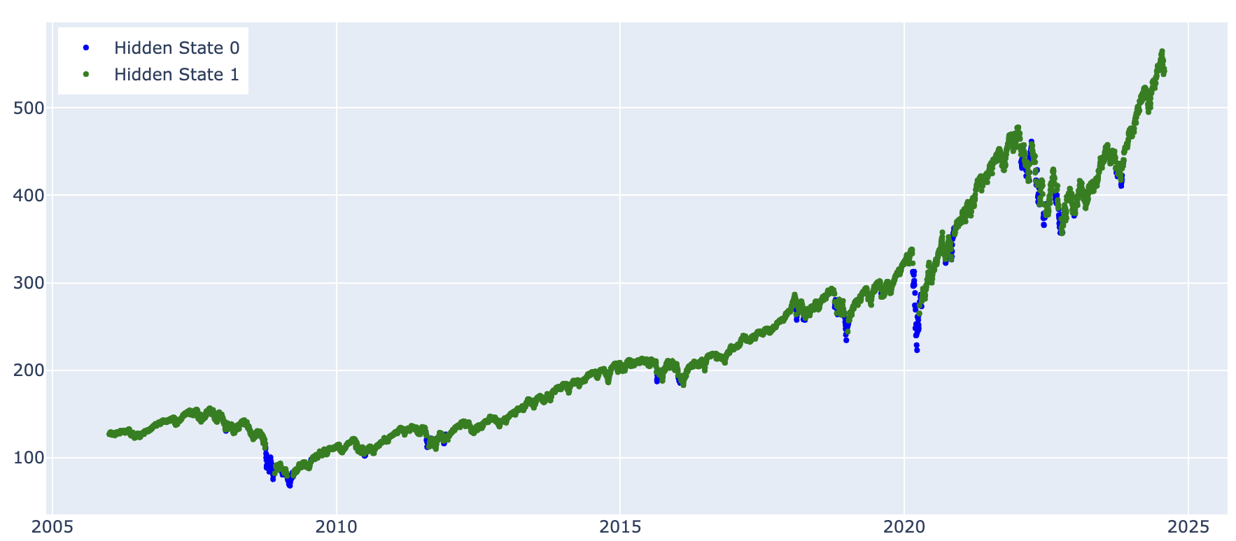
Optimizing Investment Strategies through Regime Detection with HMM
SP500
Regime 1:
Momentum screening
Select 25 stocks with EPS
Alpha weighted
Regime 0:
Cash/Asset screening
Select 25 stocks with EPS
Risk weighted
Decreased volatility and reduced downside tracking error
Notes:
On top of that we really wanted to work on a method to reduce the losses during a crisis, and to do so we implemented a out of sample hidden Markov model to identify changes in regimes of returns, and this way we were able to identify upward trend

Slide 5
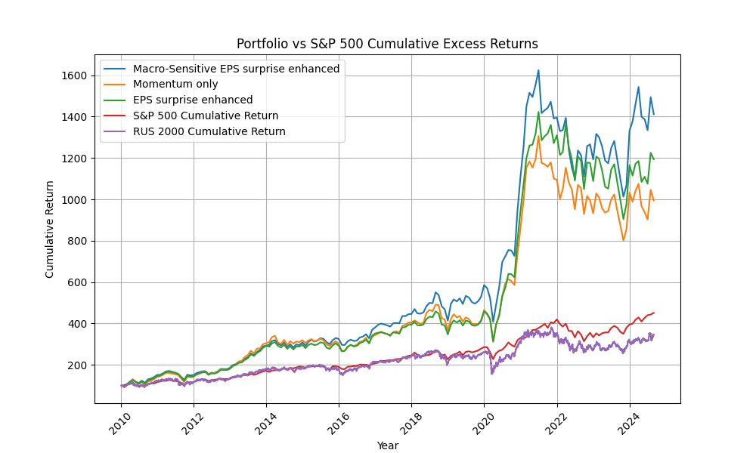
Performance Overview
Small cap outperformed post COVID
Volatility is high post COVID
Portfolio always adhere to the 50-100 position limit, long only, no leverage
Top 10 Holdings | Total Months
1. Franklin Covey Co (FC) | 88
2. REX American Res. (RSC) | 76
3. 93397 – file missing ticker | 69
4. AngioDynamics Inc (ANGO) | 68
5. Hooker Furnishing (HOFT) | 60
6. Quanex Building Prod. (NX) | 58
7. Movado Group Inc (MOVA) | 56
8. 85040 – file missing ticker | 54
9. CFI Holding SA (CFI) | 54
10. 64785 – file missing ticker | 52
Notes:
Low volatility at first, then crazy volatility. Why?
Stocks with more optimistic earning forecasts earn lower returns in the subsequent periods
Small cap performed well.
26201 (missing)
R

Slide 6
Overperformed the S&P 500 and Russell 2000
 | All Weather | Surprise-Enhanced | Momentum-Only | S&P 500 | Russell 2000
Average annualized portfolio returns | 23.2% | 21.7% | 20.9% | 11.7% | 8.5%
Annualized portfolio standard deviation | 0.25 | 0.25 | 0.27 | 0.14 | 0.24
Annualized Alpha (market risk-adjusted return) | 6.9%* | 4.7%* | 4.2%* | N/A | N/A
Sharpe Ratio (annualized) | 0.84 | 0.78 | 0.72 | 0.6 | 0.4
Information Ratio (annualized) | 0.41 | 0.3 | 0.23 | N/A | N/A
Maximum drawdown | 47% | 45% | 48% | 34% | 43%
Maximum one-month loss | 21.8% | 25% | 26% | 12.5% | 21%
Annualized Portfolio Turnover | 279% | N/A | N/A | N/A | N/A

Slide 7
Strategy Discussion & Next Steps
Performance Overview
Our Strategy outperformed surprise-enhanced momentum strategy, momentum-only strategy, Russell 2000 and SP500. The enhancement during recovery of COVID and meme stock craze was encouraging.
Future Improvement Strategies
1. Risk Management: diversify the sectors and apply stop loss
2. Defensive Strategy: adding weights to defensive sectors
3. Multi-Factor Model: in small cap universe, value has done better than growth in small cap universe, even though it is opposite in large cap universe.
4. More fundamental surprise: sales, cash flow etc
5. Can be scaled for institutional grade product.
Notes:
H

