Slide 1
Fundamental-Surprise-Enhanced Momentum Strategy A Random Forest Detected Overlay
Montreal McGillians
Florentin Belfio
Henry Tang
Rick Yabuki-Soh
Yash Sethi
Arturo Medina
October 2024

Slide 2
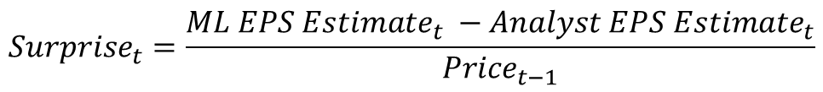
Executive Summary
Rationale
Momentum strategies work well in long term but not in turning points. We use fundamental surprises to enhance this price-based strategies.
$${Surprise}_{t}=\frac{{ML EPS Estimate}_{t} −{Analyst EPS Estimate}_{t}}{{Price}_{t−1}}$$
 | Surprise-Enhanced | Momentum-Only | S&P 500
Excess Returns* (Annualized) | 14.4% | 13.2% | 11.2%
Sharpe Ratio (Annualized) | 0.75 | 0.64 | 0.72
CAPM Alpha (Annualized) | 2.0% | 0.4% | N/A
Maximum Drawdown | 28% | 35% | 29%
Methodology
A Dynamic
2-Stage
Portfolio
Construction
Process
Stage1: use momentum factors to rank the stocks and get a Momentum-subset
Stage2: use machine learning to predict earnings surprise, and apply it to rank stocks in the Momentum-subset to get the final selected stocks
Trading Rule: Equal-weighted, 2-month holding, monthly rebalance
*Excess return over risk-free rate

Slide 3
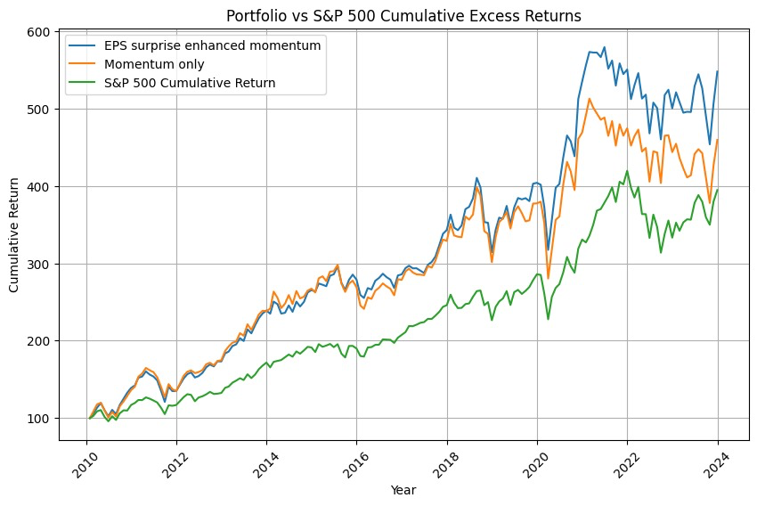
Fundamental-Surprise-Enhanced Momentum Strategy (FSEM)
Only consider companies in their pre-earnings-release month
Use Momentum factors like 1-Year momentum to pre-screen companies
Predicted earnings surprises before the release and rank them accordingly
Every month, long additional top 25 stocks in terms of earnings surprise and hold for 2 months
Top 10 Holdings | Total Months
1. Nike (NKE) | 56
2. Copart (CPRT) | 54
3. General Mills (GIS) | 52
4. First Republic Bank (FRC) | 52
5. Paychecx (PAYX) | 50
6. RPM International (RPM) | 48
7. Brown-Forman Corp. (BF) | 48
8. Darden Restaurants (DRI) | 46
9. Dollar General (DG) | 46
10. Progressive Corp (PGR) | 44
Notes:
Stocks with more optimistic earning forecasts earn lower returns in the subsequent periods

Slide 4
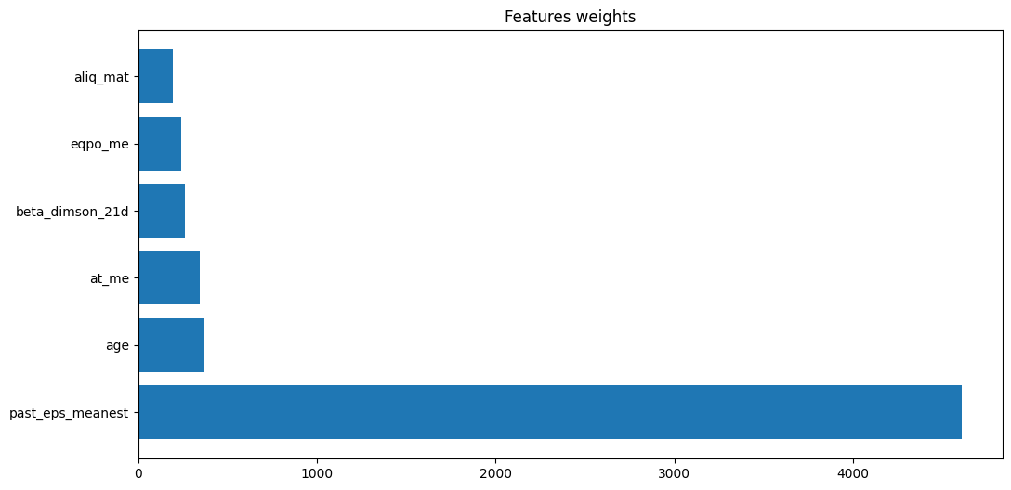
Data Integration and Model Selection for EPS Prediction
EPS Prediction with Random Forest
Achieved an R² of 87% when predicting EPS using random forest --- suitable for high-dimensional dataset (feature selection capability & robustness to irrelevant features) and easy to get feature importance. We train the model in a rolling window.
Additional Data Integration
Supplemented the original 147 factors with 67 financial ratios from WRDS and macroeconomic indicators from the Federal Reserve Bank of Philadelphia, also considered their interaction
Innovative Investment Strategy to Capture Surprise Overlay
Focus on locating the last month of each fiscal quarter, utilizing the latest data, and investing over a 2-month period to capture gains from earnings surprises
Surprisingly the added data didn’t give much signal

Slide 5
Overperformed the S&P 500 and Momentum-only strategy
 | Surprise-Enhanced | Momentum-Only | S&P 500
Average annualized portfolio returns | 14.4% | 13.2% | 11.2%
Annualized portfolio standard deviation | 18.0% | 19.6% | 14.8%
Annualized Alpha (market risk-adjusted return) | 2.0% | 0.4% | N/A
Sharpe Ratio (annualized) | 0.75 | 0.64 | 0.72
Information Ratio (annualized) | 0.24 | 0.04 | N/A
Maximum drawdown | 28% | 35% | 29%
Maximum one-month loss | 15% | 20.3% | 13%
Annualized Portfolio Turnover | 580% | 570% | N/A
These results are based on excess returns

Slide 6
Strategy Discussion & Next Steps
Performance Overview
Our FSEM Strategy outperformed both momentum-only strategy and SP500. The improvement post-COVID was encouraging but needs more enhancement. Please see attached in appendix.
Future Improvement Strategies
2-direction improvements:
1. To capture more fundamental surprise info: incorporate other fundamental surprises like sales, cash flow etc
2. To develop a multi-factor model: incorporate factors like quality, minimum volatility etc. instead of using only price-based factors
Since factor performance cycle depends on market regimes, we can use machine learning to identify these regimes and develop a dynamic weighting schemes
Unexpected Model Behaviors
Features of importance to predict EPS do not match the ones from van Binsbergen et al. in the random forest model
CAPM alpha's t-statistics is only 0.837

Slide 7
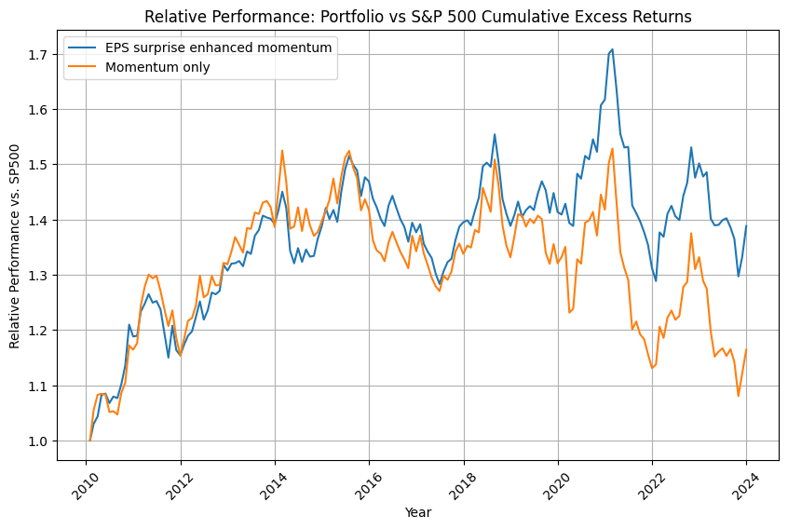
Appendix

