Slide 1
Software Development Fundamentals
Gerry O’Brien| Technical Content Development Manager
Paul Pardi| Senior Content Publishing Manager

Slide 2
Meet Gerry O’Brien| ‏@gerryob
Technical Content Development Manager, Microsoft
Focused on developer and database platforms
Content author
Over 18 years of industry experience
Microsoft
Microsoft Certified Trainer
Software developer and consultant
Book and course author
Visual Basic, C#, Java, Objective-C
Life-long learner

Slide 3
Meet Paul Pardi| @paulpardi
Content Development Lead, Microsoft
Lead team of content developers focused on software development technologies
Working on internal app development
Software and content development professional
Managed Windows Store merchandising team for Windows 8
Managed team and wrote content for Internet Explorer
Technical trainer and book author
Published Windows 8 app called Movie Notes

Slide 4


Course Topics
Software Development Fundamentals
01 | General Software Development | 06 | Understanding Databases
02 | Core Programming | 07 | Is This for Me?
03 | Object-Oriented Programming
04 | Web Applications
05 | Desktop Applications

Slide 5
Setting Expectations
Target Audience
Desire to get started in software development
Technically savvy
Suggested Prerequisites
Logical thinkers
Have some experience with scripting or beginner programming tasks
Ability to understand patterns
Grasp of mathematical concepts such as sets and numbering systems

Slide 6

Join the MVA Community!
Microsoft Virtual Academy
Free online learning tailored for IT Pros and Developers
Over 1M registered users
Up-to-date, relevant training on variety of Microsoft products

Slide 7
01 | General Software Development
Gerry O’Brien | Technical Content Development Manager
Paul Pardi | Senior Content Publishing Manager

Slide 8
Module Overview
Application Life-Cycle Management
Interpret Application Specifications

Slide 9
Application Lifecycle Management
Requirements
Design
Development
Test
Maintain

Slide 10
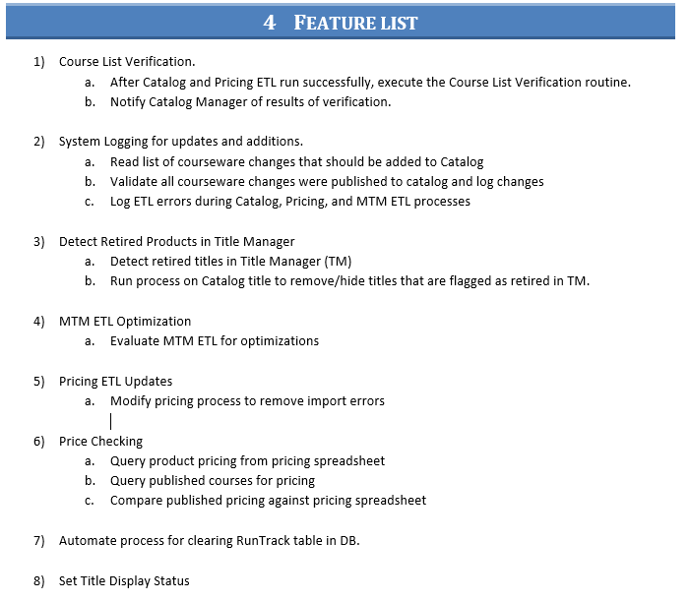
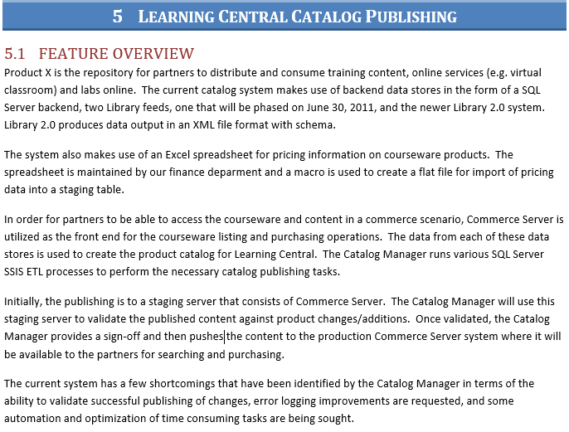
Application Specification
Notes:
Briefly discuss how this functional specification is translated into technical specifications and code components by the developers

