Slide 1
Physics-Informed Neural Networks for Black–Scholes PDE
Vidit Tank (B24409)
Yatharth Mehta (B24398)

Slide 2
Solving Option Pricing without Grids (why pinn)
Traditional methods rely on finite difference or Monte Carlo approaches
These methods suffer from discretization errors and computational cost
We use Physics-Informed Neural Networks (PINNs) to directly learn the solution. It naturally incorporates physical constraints
Handles high-dimensional problems efficiently
Objective is to approximate option price as a continuous function

Slide 3
Black–Scholes Equation
Core governing equation:
∂V/∂t + 0.5 σ² S² ∂²V/∂S² + r S ∂V/∂S − rV = 0
Defines evolution of option price over time
Subject to terminal and boundary conditions

Slide 4
Boundary Conditions
Terminal payoff: V(S,T) = max(S − K, 0)
At S = 0: option value approaches 0
At large S: option behaves like intrinsic value
These constraints guide the neural network training

Slide 5
Neural Network Approximation
Input variables: Stock price (S), Time (t), Volatility (σ)
Output: Option price V(S,t,σ)
Fully connected neural network approximates solution
Automatic differentiation used for derivatives

Slide 6
Physics-Constrained Loss Function
Loss = PDE Residual + Boundary Loss
PDE Residual enforces Black–Scholes equation
Boundary Loss ensures payoff and constraints are satisfied
Optimization aligns model with both data and physics

Slide 7
Model Training
Random sampling of points in domain
Optimizer used : Adam
Backpropagation with automatic differentiation
Model learns solution without labeled data

Slide 8
Validation with Exact Solution
Closed-form Black–Scholes formula used for validation
Model predictions compared against analytical values
Ensures correctness and robustness of PINN approach

Slide 9
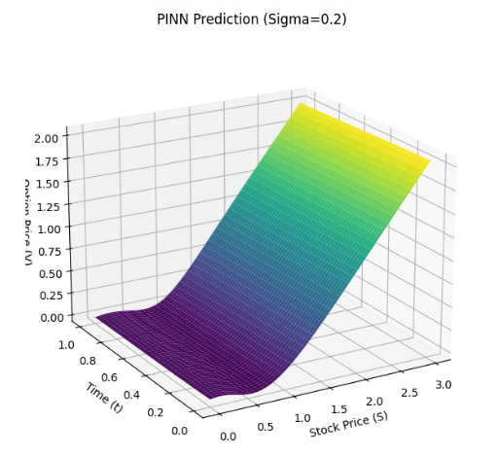
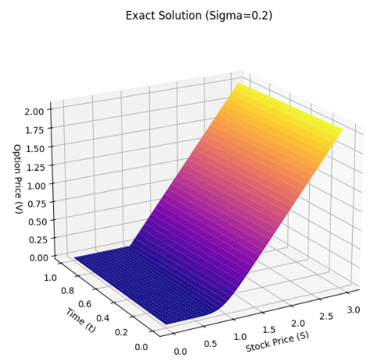
Model Outputs & Visualizations

Slide 10
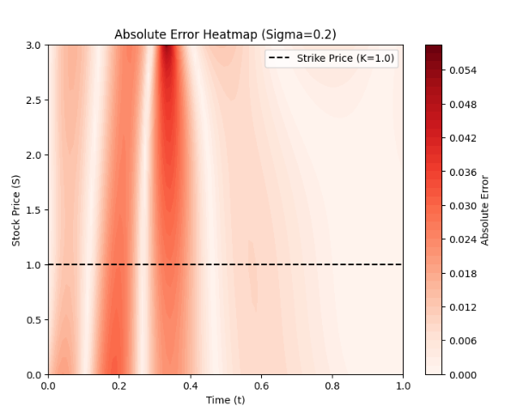
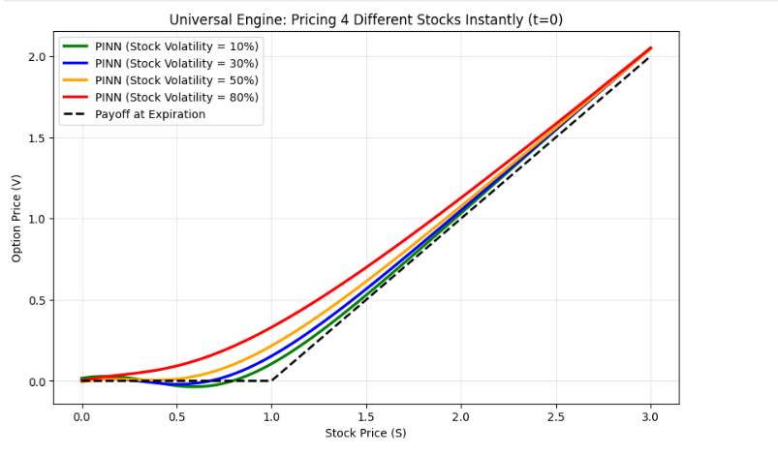
Absolute Error Heat Map
Pricing 4 different stocks instantly (T=0)

Slide 11
Futuristic ideas
Build real-time adaptive models using live market data for dynamic pricing & hedging
Expand to advanced models (Heston, stochastic volatility, jumps) for realistic market behavior

