Slide 1
UniClubs

Slide 2
Usage and Target Audience
UniClubs is designed for university students.
Students can:
Join clubs
Create clubs
Chat in the club pages
Post images
Meet new friends with similar interests

Slide 3
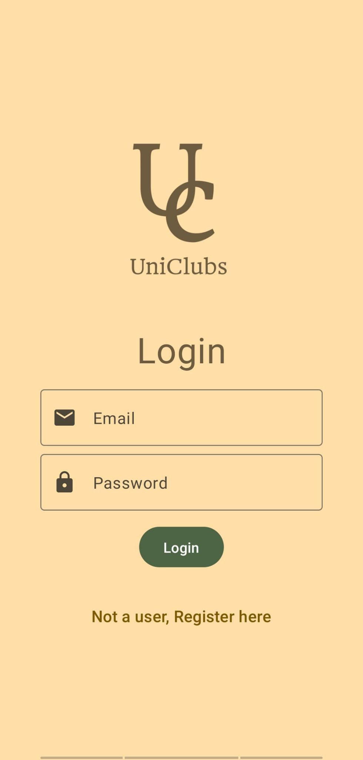
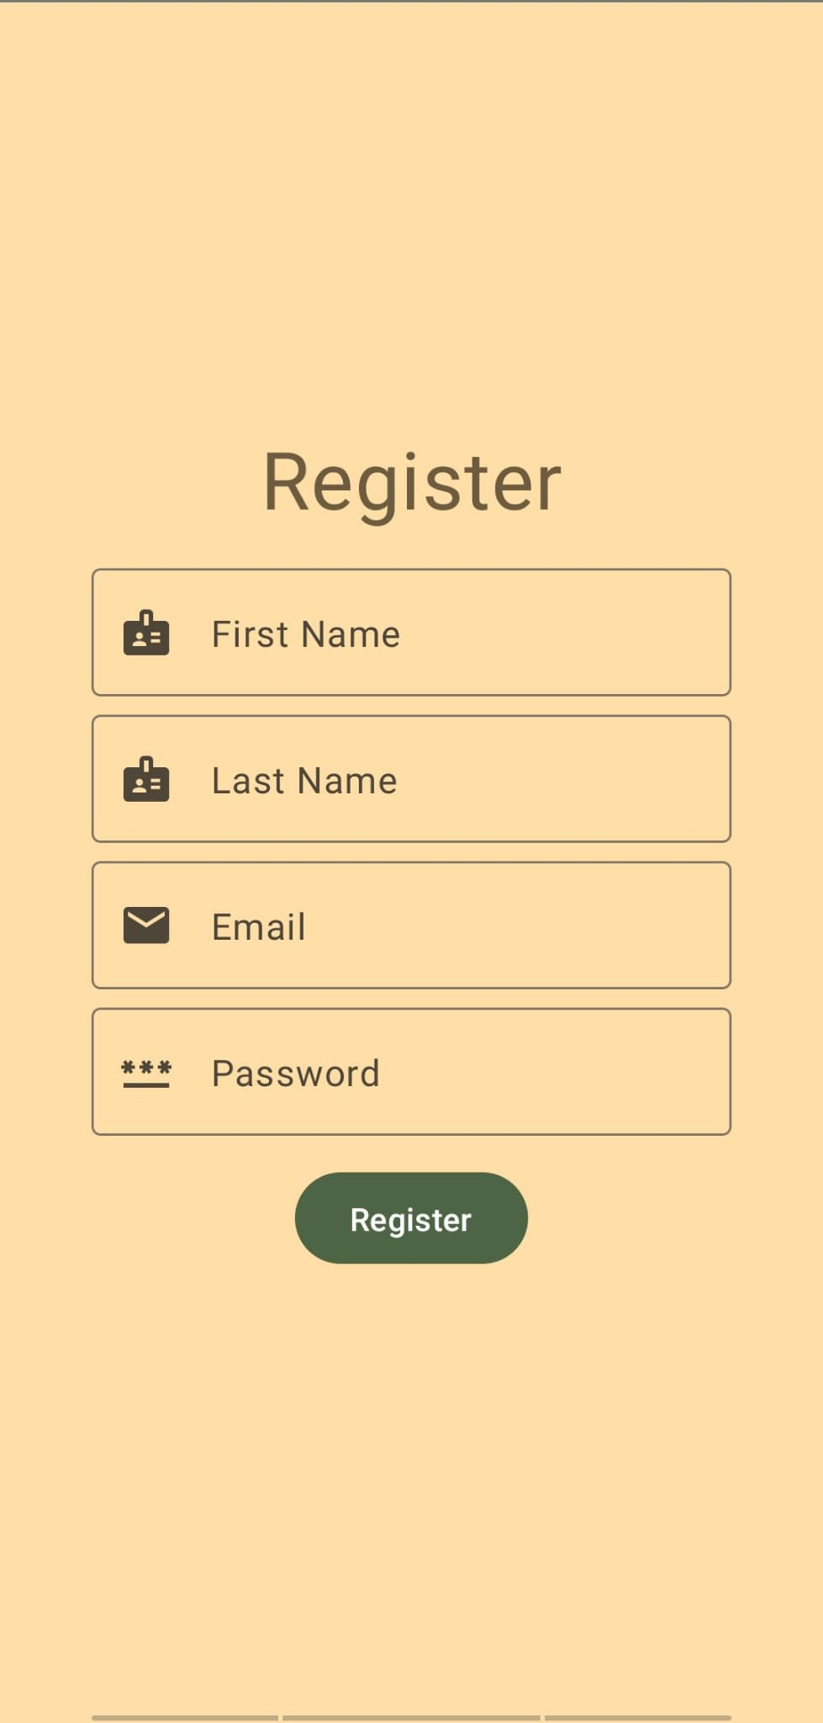
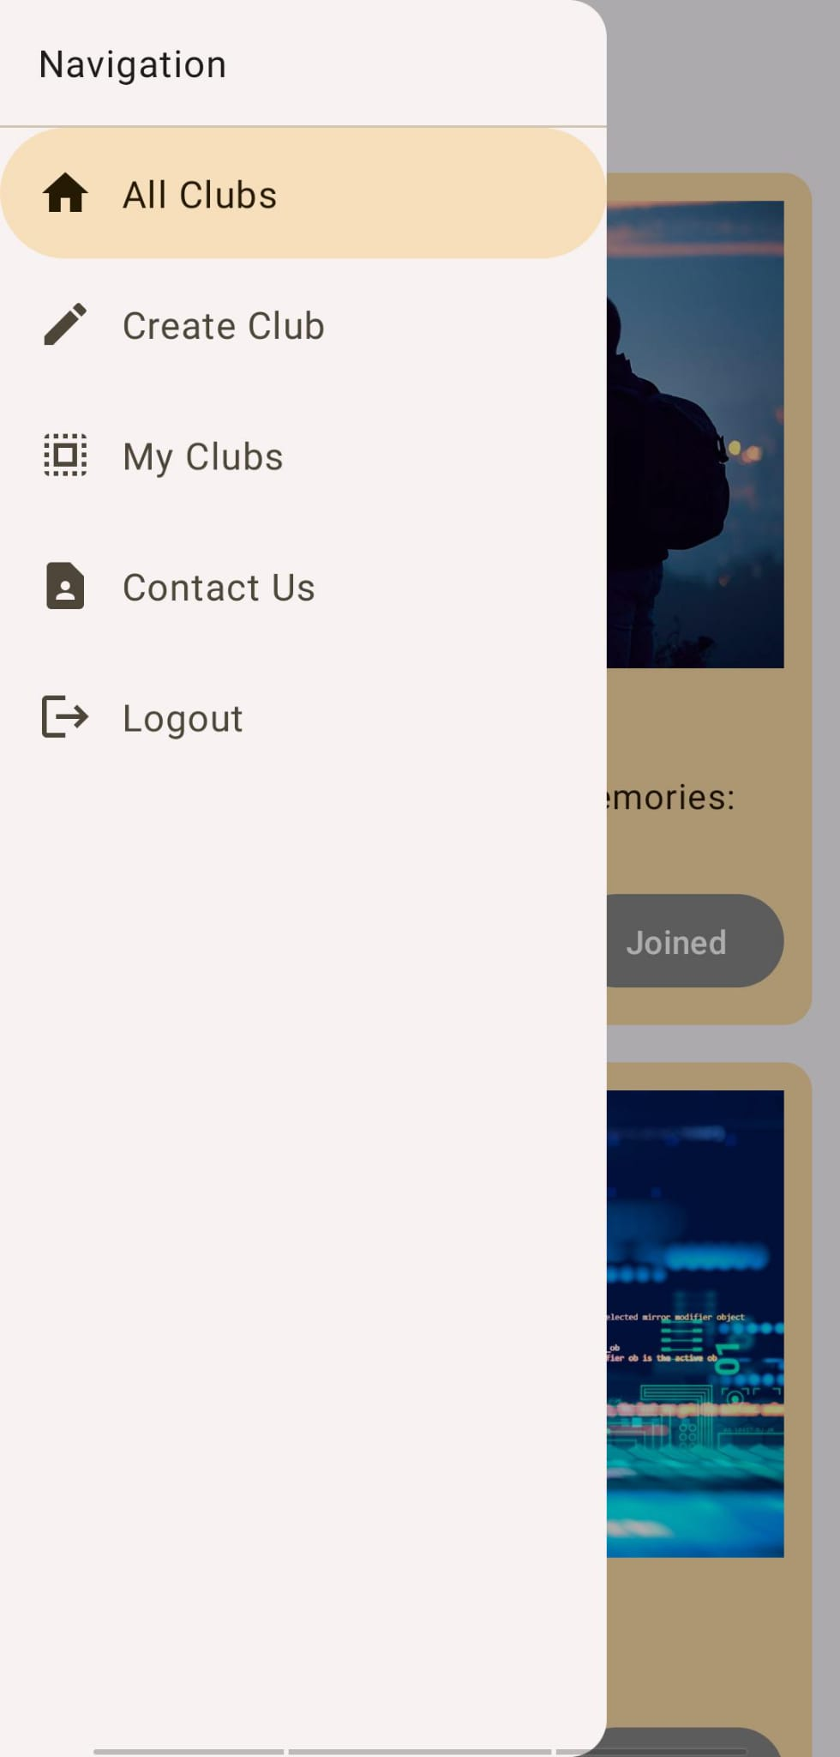
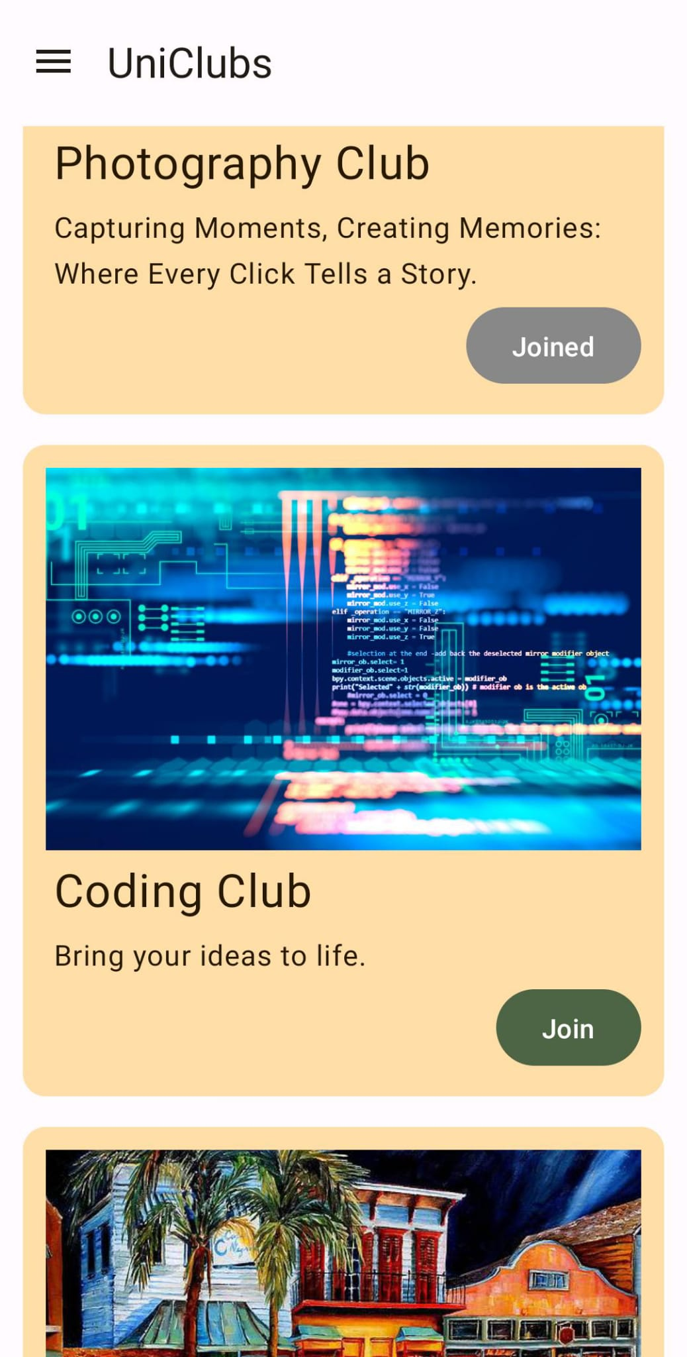
App Demo
Users can login with their account. If they don’t have an account, they can register.
The home page has all clubs and a navigation bar.

Slide 4
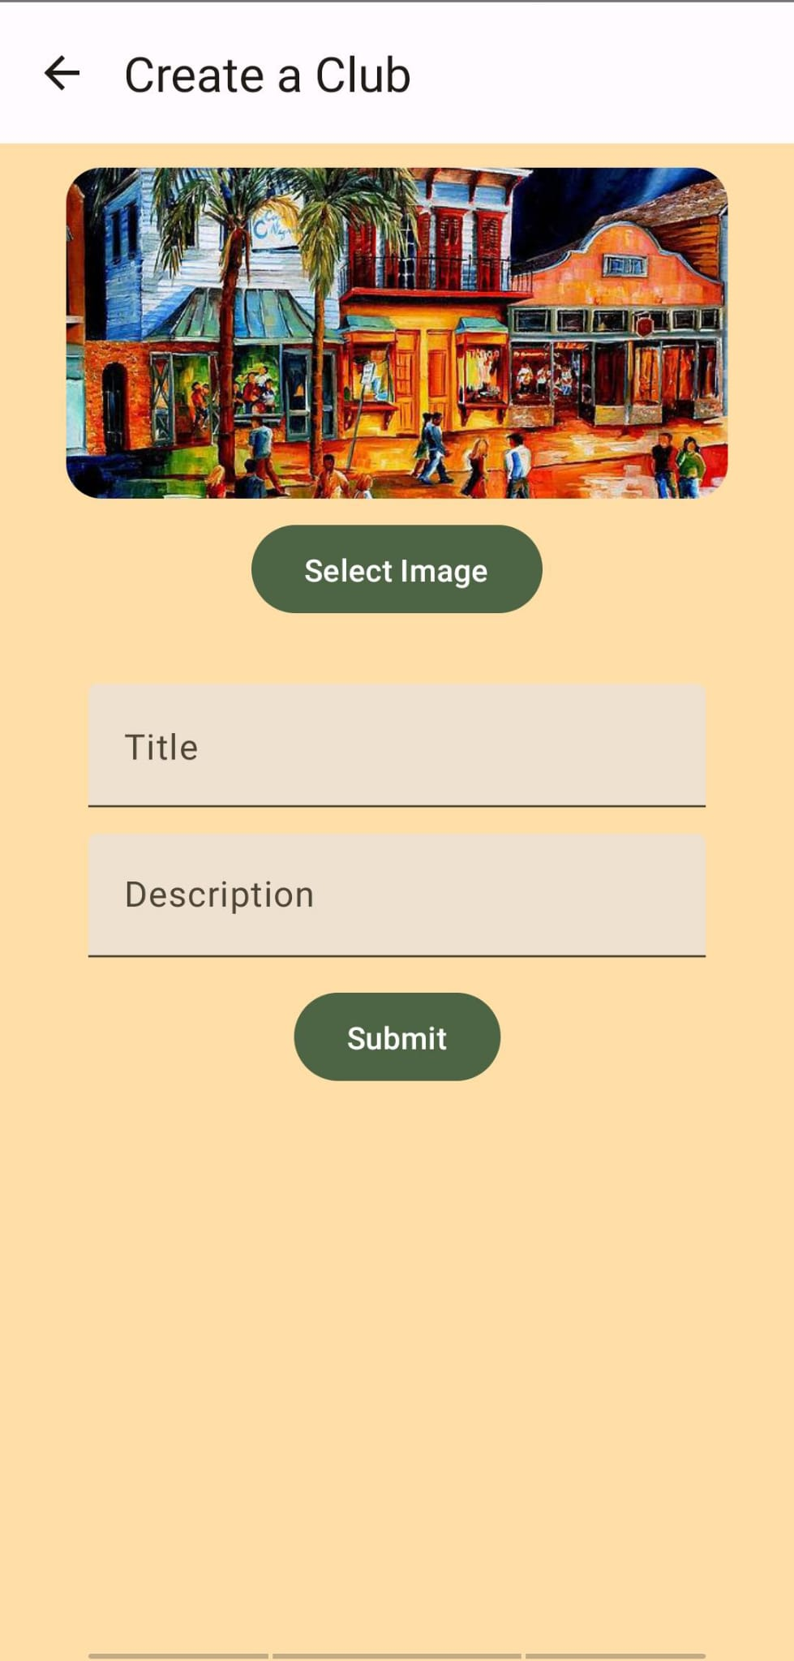
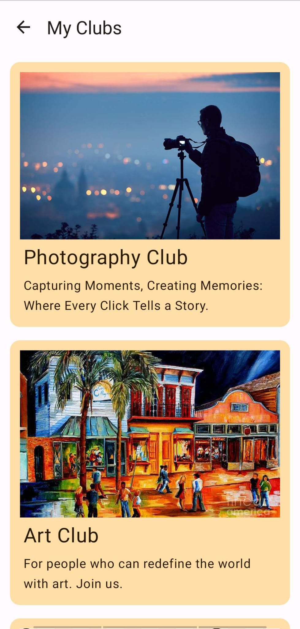
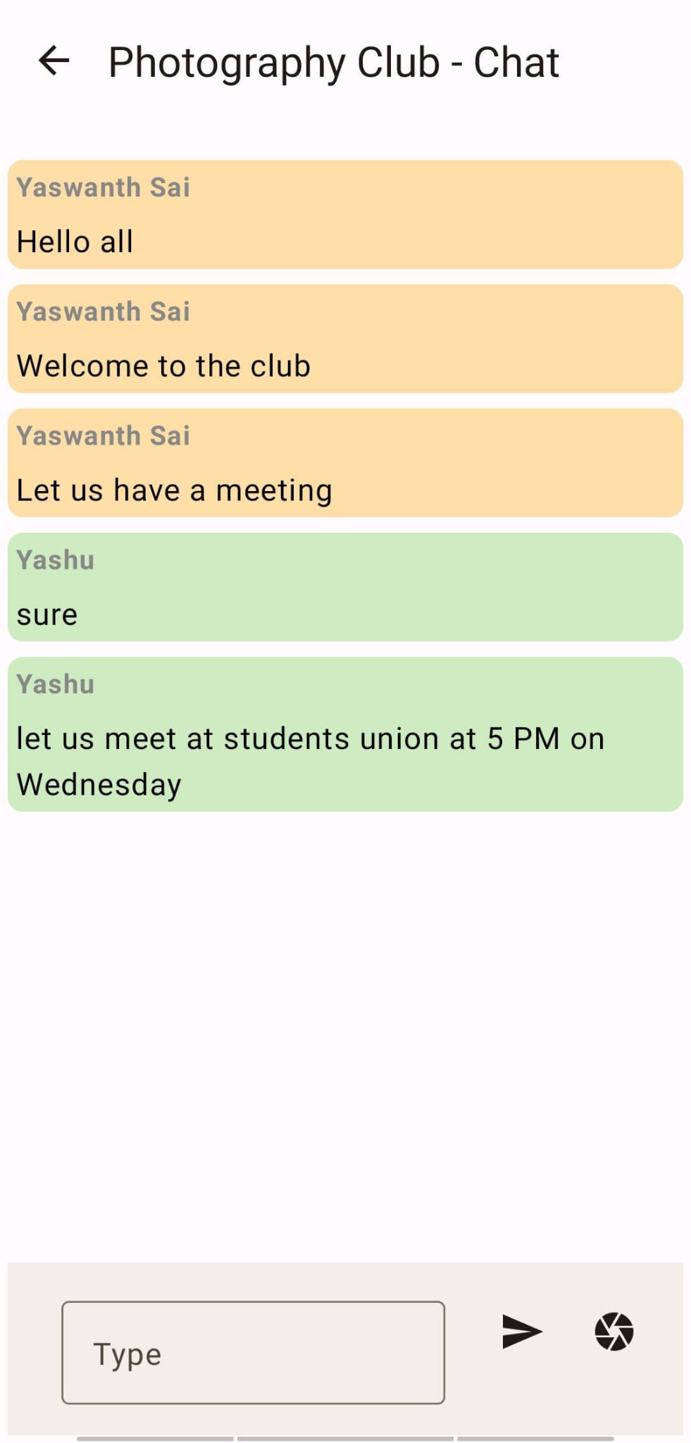
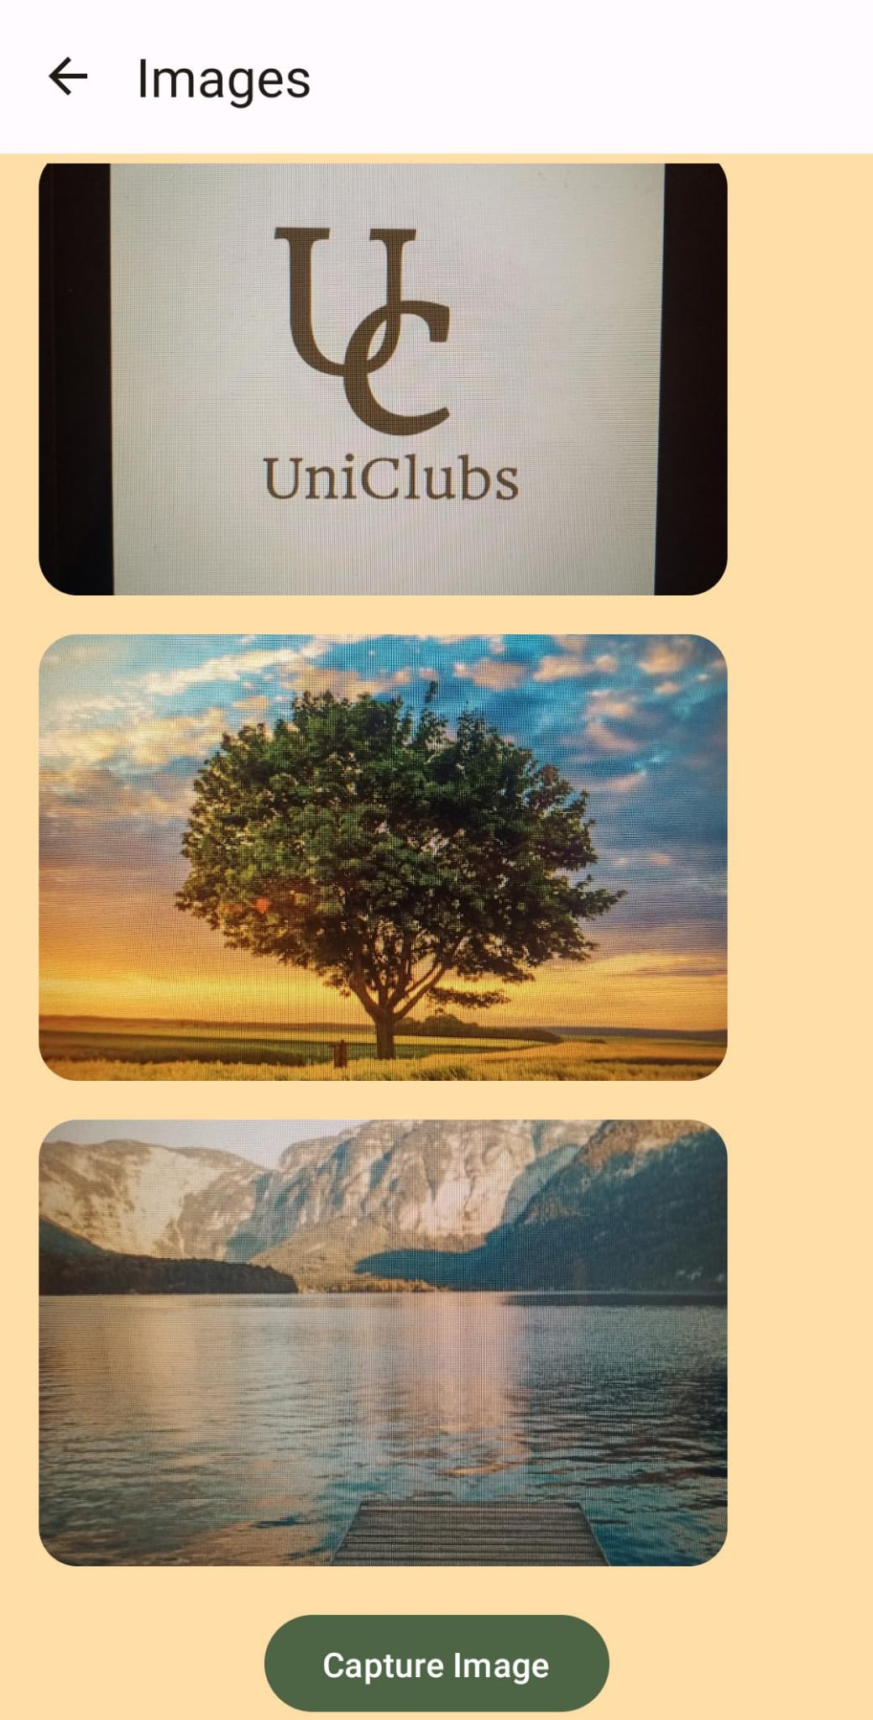
Club Features
Users can create and Join Clubs. Joined Clubs are shown in My Clubs page, Every club has a chat page. The camera page is to share the images.

Slide 5
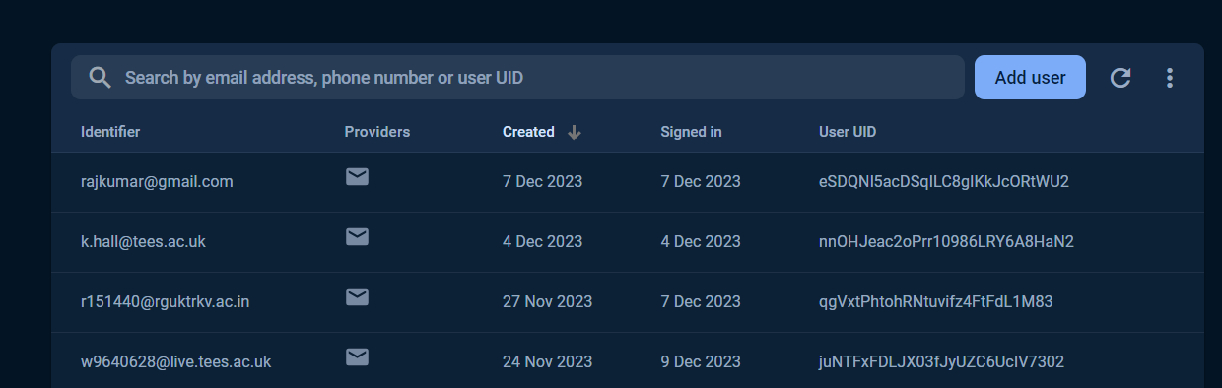
Authentication
Google Firebase is used for authentication.

Slide 6
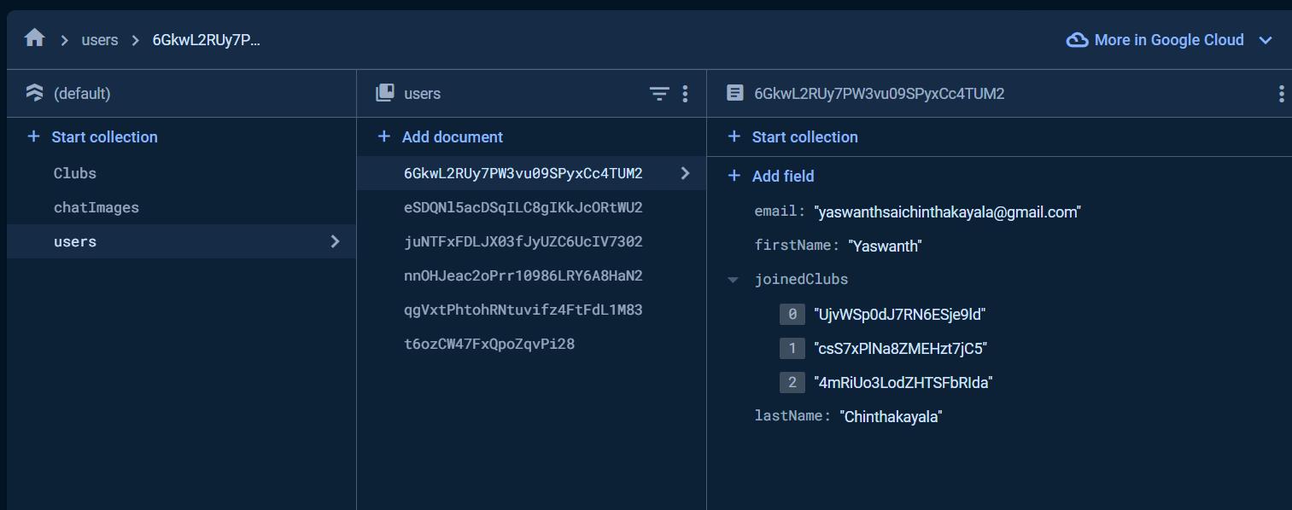
Database
Firestore is used to store and handle data.

Slide 7
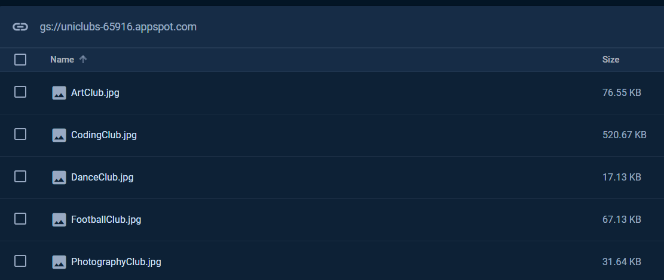
Firebase Storage
Firebase storage is used to store the images instead of local data which enhances app’s performance.

Slide 8
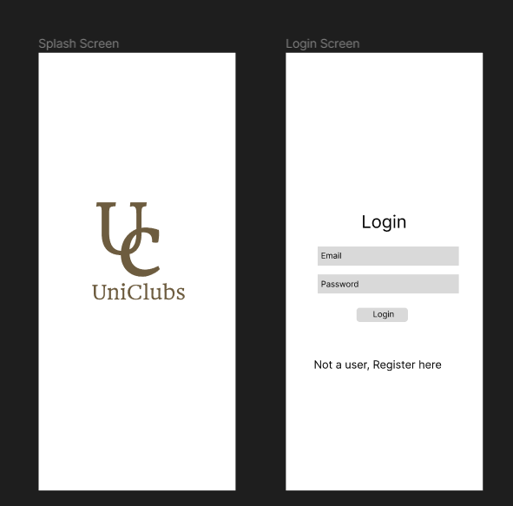
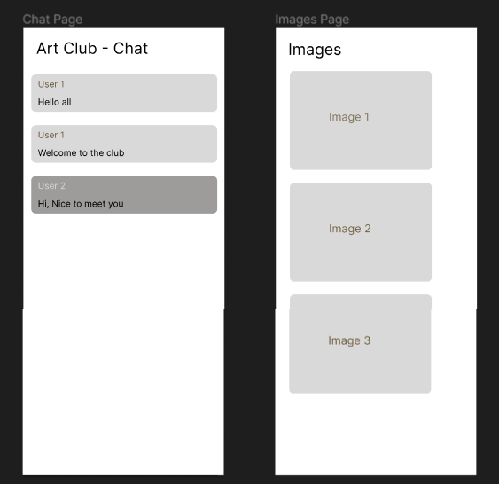
Figma for Design

Slide 9
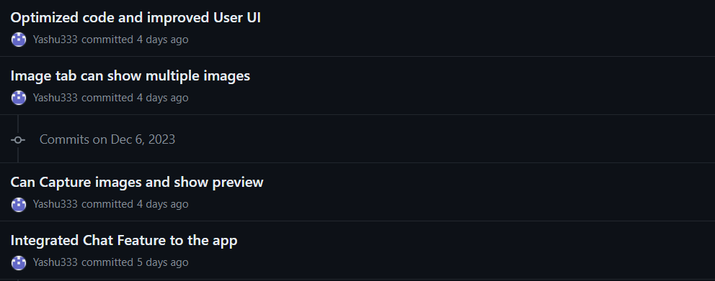
GitHub for Version Control
GitHub is used for version control.

Slide 10
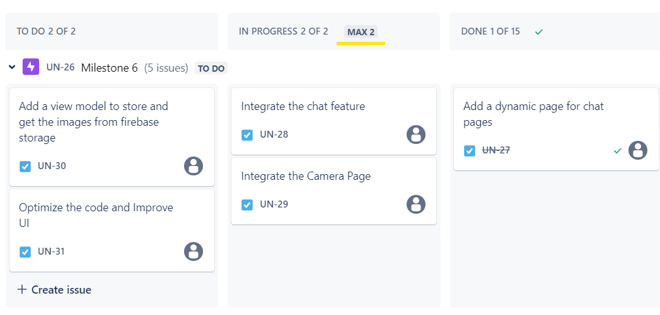
Jira for Project Management
Jira is used for managing the project. Kanban board agile methodology is used in this project.

Slide 11
Issues
Legal Issues
Data protection
Following GDPR
Social Issues
No discrimination
Professional Issues
Following industry standard coding practises
Updating app
Security Issues
Data breach
Third party disadvantage

Slide 12
Thank You
Name: Yaswanth Sai Chinthakayala
Student ID: W9640628

