Slide 1
Implementing text to sql for NLIDB Systems
Presented by – Gopal Seshadri, Raja Rajeshwari Premkumar, Yashaswini Dhatrika
Guided by – Prof. Damir Cavar

Slide 2
What is the problem?
Natural Language Interface to Database (NLIDB) system takes a natural language query as an input, processes it and then gives the required executable query.
The aim of NLIDB systems is to break the barriers for non-technical users and make information easily accessible.
NLIDB systems can come in handy in many ways like:
Help Desk: NLIDBs can be useful at help desks in different domains.
At restaurant: A customer may want to query about the dishes in the restaurant.
At university: A person might need some information about the availability of seats in each branch
At an airport: A tourist might need some information about flight

Slide 3
How is this related to nlp
Requirement of information alias data is a very important part of life. And one of the major sources of information is Databases.
Users of any background can analyze large amounts of data if they are able to use natural language processing to query databases.
Hence we need a system that is able to yield SQL or SPARQL queries automatically by simply interpreting the user questions given to it.
The scope of this project is limited to providing SQL queries for relational databases with input natural language which is English.

Slide 4
pAST VS Current Approach
Previously people approached this problem by creating SQL query templates and filling it with the most probable words.
Recently, the deep learning approaches to the problem using LSTM/GRU became popular. Most common architectures used are Encoder Decoder Architecture and the Attention Based architecture.
In this project, we are trying to implement all the above three methods.
The dataset we are using has about 4k rows. It is obtained from the NLP Progress Sebastian Ruder git hub page.

Slide 5
Data Processing
The words in the input NLP queries are paraphrased if the below conditions are satisfied:
It is the first word of the sentence.
It is not a noun object, direct object or a compound word
It is not a stop word
It is not NOUN
For each word, the first three synsets from wordnet are taken. The synsets also take into account the corresponding POS tag of that word.
This data along with the original data is the final dataset after paraphrasing. The new dataset has about 41k rows.

Slide 6
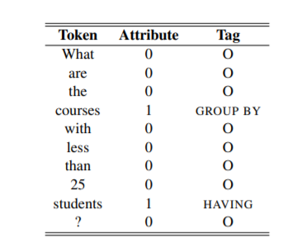
Data Processing
Template creation: We have generated templates by finding the patterns in the SQL query, we came up with 9 such templates.
Example: [SELECT', 'DISTINCT', 'FROM', 'WHERE']
Labels and feature creation for the Probabilistic model:
Here the features are Grammatical Features (POS) and Contextual Features Tokens preceding and following (local context) the current token were also considered as features.

Slide 7
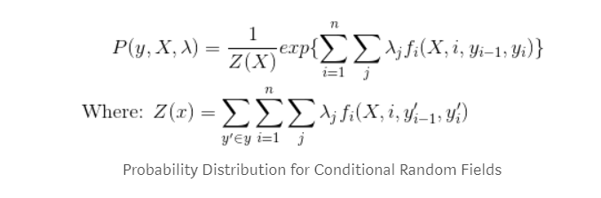
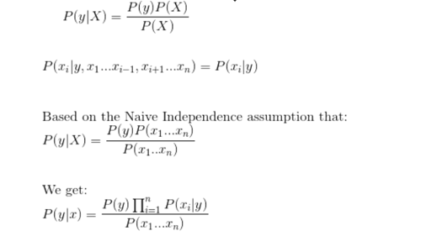
Probabilistic APPROACH-CRF Model
Conditional Random Fields are a discriminative model, used for predicting sequences. They use contextual information from previous labels.
CRFs don’t rely on the independence assumption (that the labels are independent of each other) unlike the HMMs are based on Naive Bayes.
Naïve Bayes
CRF model

Slide 8
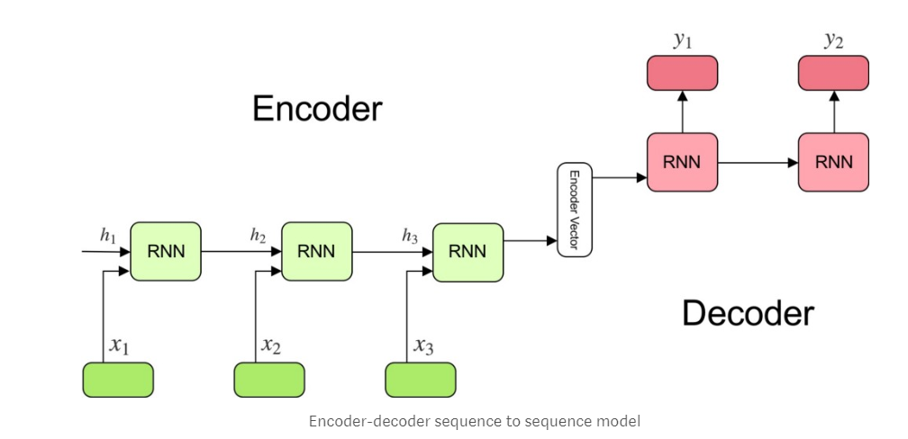
ENCODER DECODER MODEL
This model consists of two main parts called an encoder and a decoder.
The final hidden state vector encapsulates the information from encoder inputs in order to help the decoder make accurate predictions.

Slide 9
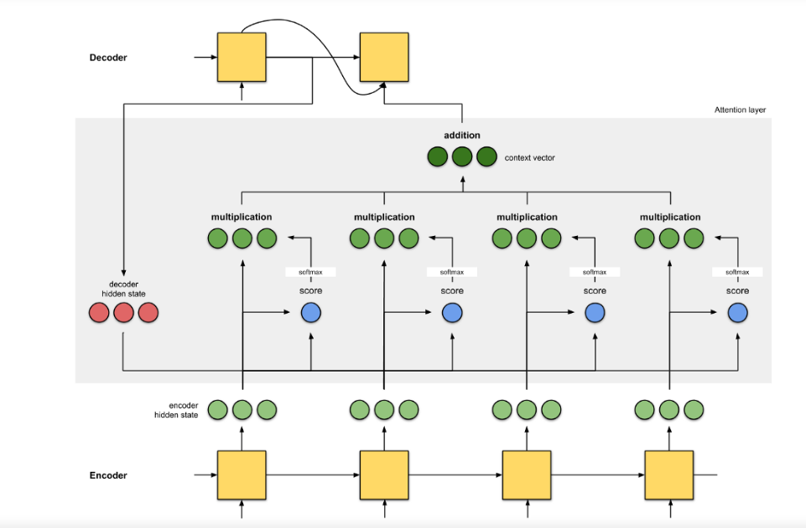
ATTENTION BASED MODEL
This model consists of three main parts called an encoder, an attention layer and a decoder.
The attention is considered as an interface between the encoder and the decoder that provides decoder a hidden state vector from each unit of encoder
DECODER
ENCODER

Slide 10
Evaluation METRIC
Since our task is not a simple machine translation, we cannot use Bleu Score.
We are currently using the accuracy metric in Keras to train our model.
In future, we plan to change this accuracy metric into a metric that shows the percentage of executable query generated.

Slide 11
Results
Currently our Encoder-Decoder model and Attention model generates SQL like querier.
For most of the examples, the Encoder-Decoder model can identify the correct relations for a feature for now. The results are expected to improve after incorporating the steps enlisted under data processing.
<SOS> SELECT DISTINCT <UNK> FROM flight WHERE ( <UNK> <UNK> ( SELECT <UNK> FROM airport_service WHERE <UNK> <UNK> ( SELECT <UNK> FROM city WHERE <UNK> = 'DALLAS' <UNK> AND <UNK> <UNK> ( SELECT <UNK> FROM airport_service WHERE <UNK> <UNK> ( SELECT <UNK> FROM city WHERE <UNK> = 'PHOENIX' <UNK> ) <EOS>
SELECT DISTINCT flight_1.flight_id FROM flight flight_1 , airport_service airport_service_1 , city city_1 , airport_service airport_service_2 , city city_2 WHERE flight_1.from_airport = airport_service_1.airport_code AND airport_service_1.city_code = city_1.city_code AND city_1.city_name = 'BOSTON' AND flight_1.to_airport = airport_service_2.airport_code AND airport_service_2.city_code = city_2.city_code AND city_2.city_name = 'BALTIMORE' <EOS>
<SOS> SELECT DISTINCT <UNK> FROM ground_service WHERE <UNK> <UNK> ( SELECT <UNK> FROM city WHERE <UNK> = 'DENVER' ) <EOS>
SELECT DISTINCT ground_service_1.transport_type FROM ground_service ground_service_1 , city city_1 WHERE ground_service_1.city_code = city_1.city_code AND city_1.city_name = 'ATLANTA' <EOS>

Slide 12
THANK YOU !

