Slide 1
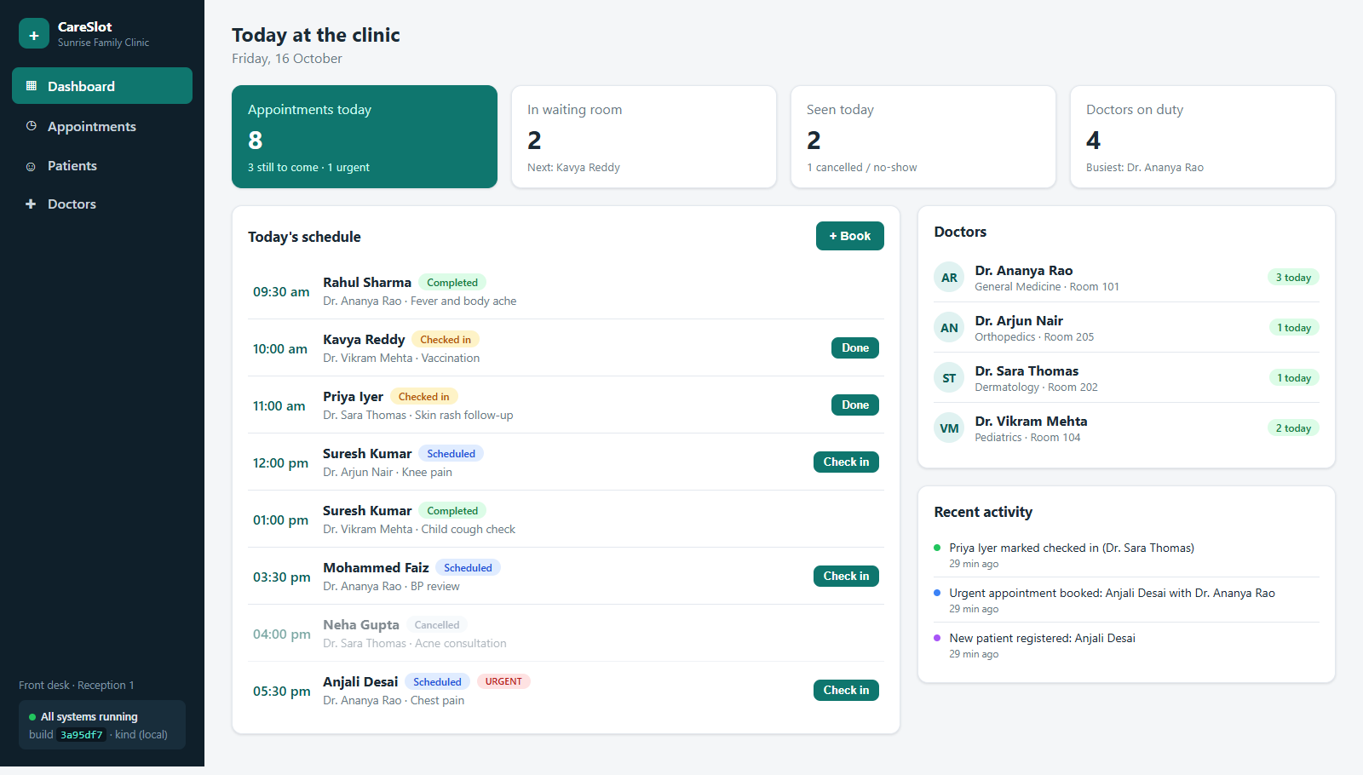
DevOps Project · Session 21
CareSlot
A clinic appointment system, built, tested, scanned, deployed and monitored through a complete DevOps pipeline
FastAPI
React
PostgreSQL
Docker
GitHub Actions
Trivy
GHCR
Terraform
Kubernetes
Helm
Prometheus
Grafana
Live dashboard running on Kubernetes (kind) behind an NGINX Ingress
Yashu Kiran
github.com/Yashukiran/careslot-devops
Notes:
Introduce CareSlot: a front-desk appointment system for a small multi-doctor clinic. The app is intentionally simple; the focus of the project is the DevOps pipeline that takes every commit from GitHub to a running, autoscaled and monitored Kubernetes deployment.

Slide 2
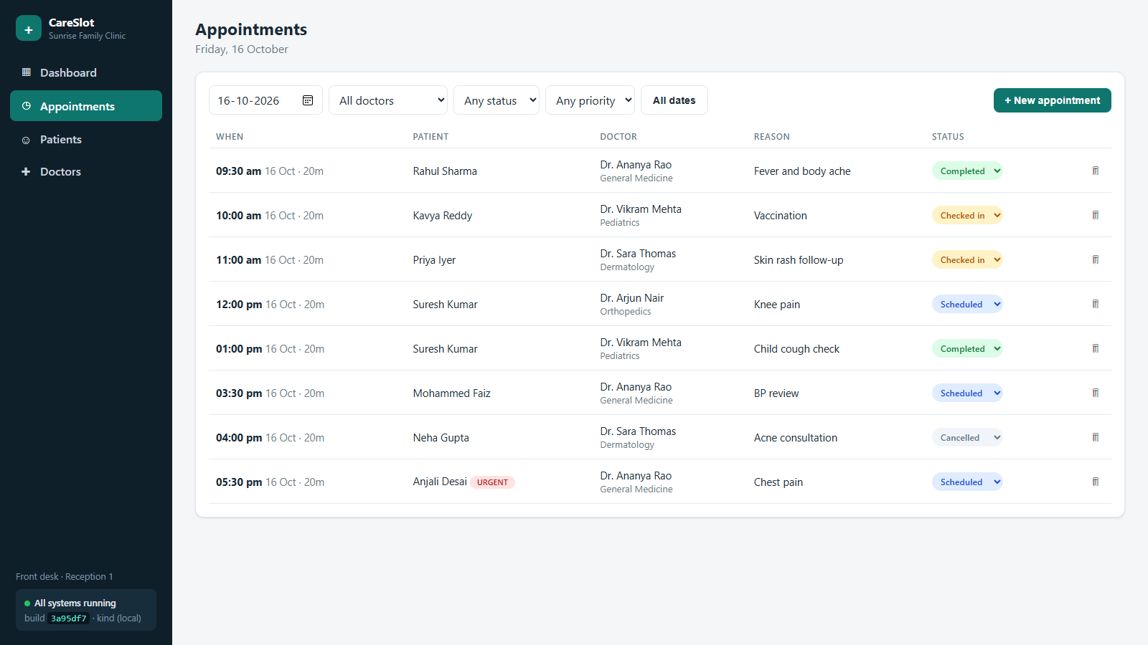
The application: a clinic front desk
Small clinics still run on paper registers and Excel. CareSlot lets a receptionist book, check in and track every patient visit in one place.
1
Dashboard
Today's KPIs, schedule, waiting room and live activity feed
2
Appointments
Book, filter, check in, complete; urgent priority badges
3
Patients & doctors
Register patients, search, set doctors on or off duty
4
Business rules in the API
No double-booking, no off-duty bookings, unique phones
Appointments page: filters by date, doctor, status and priority
Notes:
Walk through the four pages. Point out that the booking rules (double-booking, off-duty doctors) are enforced by the backend, not just the UI, and are covered by tests.

Slide 3
Architecture
DELIVERY
Developer
git push
GitHub
source + PRs
GitHub Actions
test · build · scan
GHCR
images tagged by SHA
Helm
upgrade --install
KUBERNETES CLUSTER · namespace careslot (kind locally, EKS via Terraform)
Frontend
React + nginx · 2 pods
Prometheus
ServiceMonitor
Grafana
dashboards
NGINX Ingress
/ → frontend
/api → backend
Browser
scrapes /metrics
Backend API
FastAPI · 2–6 pods (HPA)
PostgreSQL
StatefulSet + PVC
metrics-server
CPU → HPA
Notes:
Two lanes: delivery (top) and runtime (bottom). The browser never knows internal hostnames: the Ingress routes / to the frontend and /api to the backend. Prometheus discovers backend pods through a ServiceMonitor, metrics-server feeds CPU to the HPA.

Slide 4
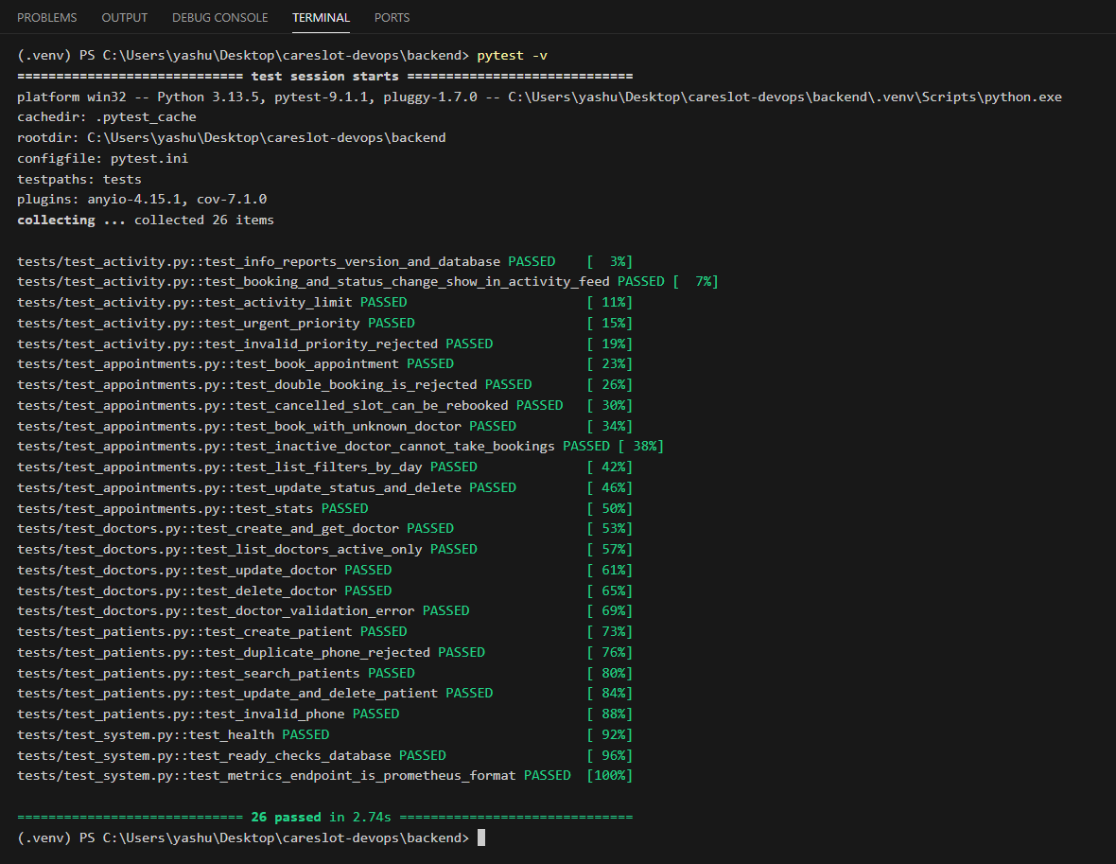
Backend API & automated tests
17
26
REST endpoints (FastAPI, Swagger at /docs)
pytest tests, all passing
Endpoint | Why it exists
/health | Liveness: is the process alive?
/ready | Readiness: can it reach the database?
/metrics | Prometheus request metrics
/api/doctors, /patients | CRUD with validation
/api/appointments | Booking + double-booking guard
/api/stats, /activity | Dashboard KPIs and feed
pytest -v: the first quality gate. A failing test stops the pipeline before any image is pushed
Notes:
Explain /health vs /ready: a container can be alive while unable to serve traffic. Kubernetes uses both probes. Tests run against SQLite in CI and cover booking rules, validation, priority and the activity feed.

Slide 5
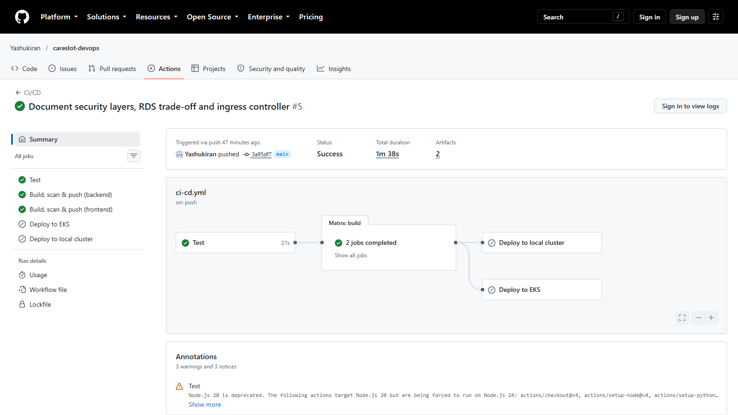
CI/CD pipeline with GitHub Actions
Push
commit to main
Test
pytest + npm build
Build
2 Docker images
Scan
Trivy HIGH/CRITICAL
Publish
GHCR, tag = git SHA
Deploy
helm upgrade
Quality gates
Each stage needs the previous one, so broken or vulnerable code never reaches the registry.
Traceability
Images are tagged with the commit SHA: commit A → image A. The running build shows its SHA in the app's sidebar.
Deploy
EKS via OIDC (no stored AWS keys) or the local kind cluster via a self-hosted runner.
A real green run: Test → Build, scan & push (backend, frontend)
Notes:
Show the pipeline stages. Emphasise that tests and the security scan are gates: a failure stops the job, so nothing broken is published. SHA tags give traceability from production back to source.

Slide 6
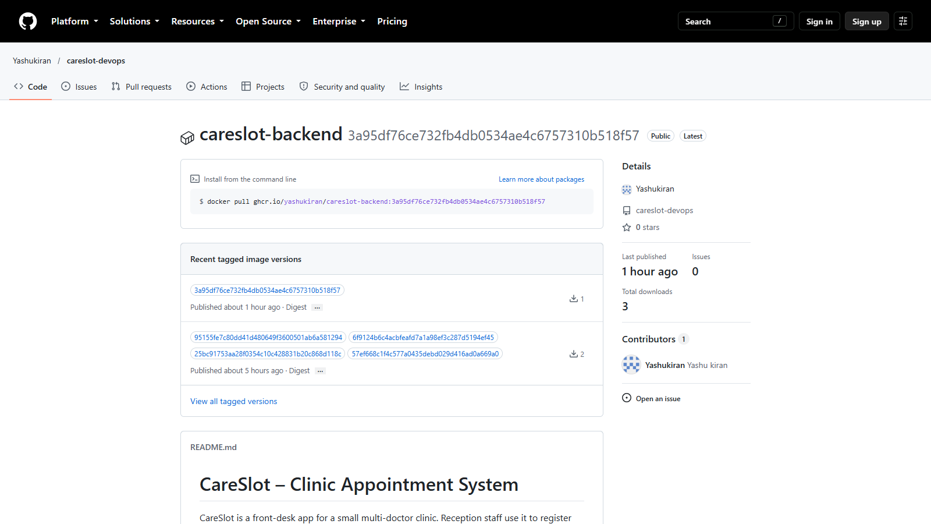
Docker images & Trivy security scan
Backend image
Frontend image
python:3.12-slim
Runs as non-root (uid 10001)
Alembic migrations on start
pip removed from runtime
Multi-stage: Node → npm build
Served by nginx-unprivileged
No build tools in the final image
Trivy found 4 HIGH CVEs, then the fix
First scan flagged vulnerable pip/setuptools wheels bundled in the Python base image. Removing pip after install made both scans clean. The job fails on any fixable HIGH or CRITICAL.
GHCR: every version tagged with its commit SHA
Notes:
Docker best practices: slim base, non-root users, multi-stage frontend. Trivy is one security layer among SAST, dependency, secret and runtime scanning (see docs/trivy.md). Tell the story of the 4 HIGH findings and the fix.

Slide 7
Infrastructure as Code with Terraform
AWS · ap-south-1 (Mumbai)
Why Terraform
Infrastructure is described in code and reviewed like code, instead of clicking through the AWS console.
Workflow
VPC 10.0.0.0/16
Public subnets ×2
NAT gateway · load balancer
Private subnets ×2
no direct internet access
terraform init
terraform plan
terraform apply
terraform destroy
EKS cluster
managed control plane · IRSA · EBS CSI driver
Status: terraform validate passes. Not applied, since I don't have a paid AWS account; the same Helm chart runs on a local kind cluster instead.
Managed node group
worker nodes in private subnets
Notes:
Kubernetes manages workloads, not the network or the cluster itself. Terraform creates the VPC, subnets, NAT and EKS. Be upfront that it was validated but not applied for cost reasons, and that the pipeline already has an EKS deploy job ready.

Slide 8
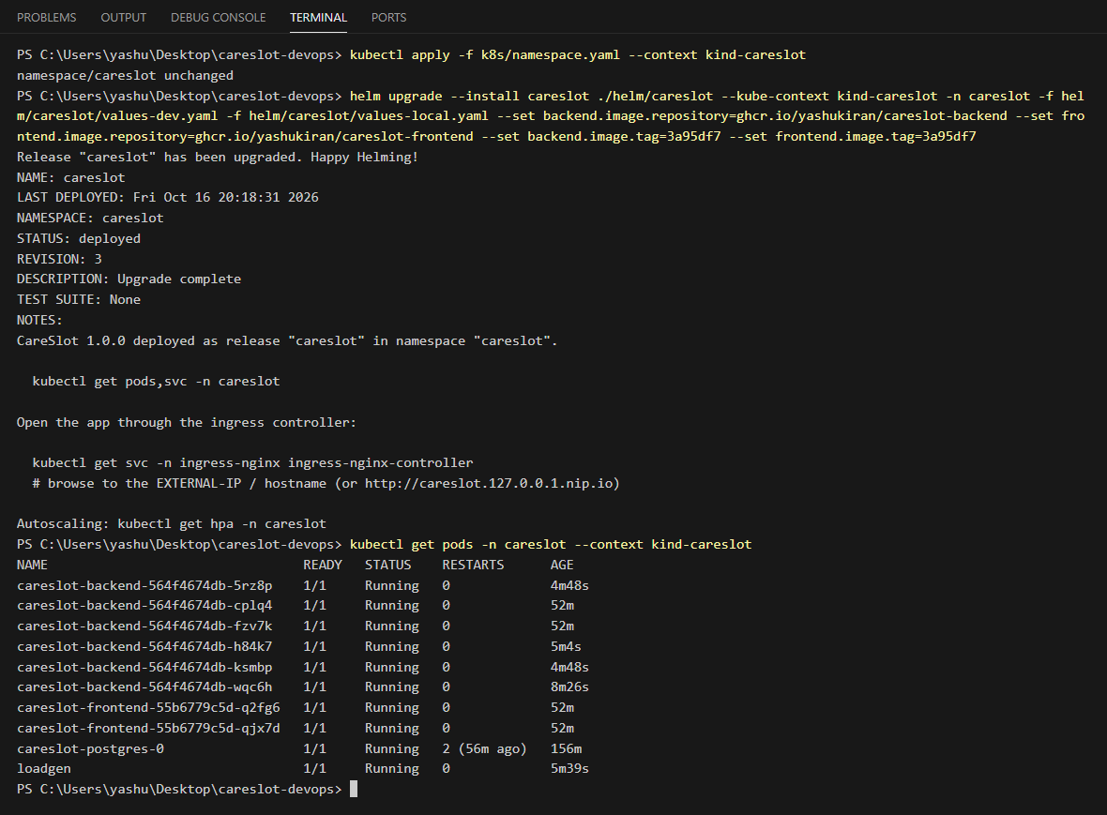
Kubernetes deployment with Helm
1
Deployments self-heal
A crashed pod is replaced automatically
2
Services give stable networking
Pods come and go; the Service selects them by label
3
Probes
/health = liveness, /ready = readiness (checks DB)
4
PostgreSQL StatefulSet + PVC
Data survives pod restarts
5
One Helm chart
values for dev, local and EKS; upgrade and rollback
helm list: release careslot · revision 3 · deployed
helm upgrade --install, then every pod Running
Notes:
The whole app is one Helm chart (templates + values). Show the release revisions: every deploy is a revision you can roll back to. Explain probes and why Postgres is a StatefulSet; in production I'd use Amazon RDS (trade-off in the README).

Slide 9
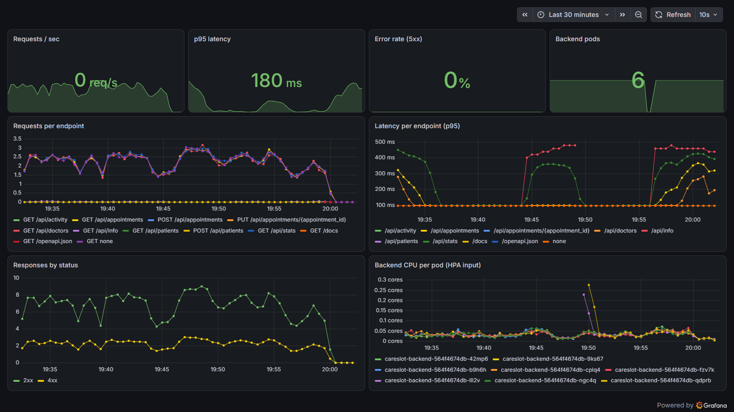
Autoscaling & monitoring
2 → 6
backend pods under load (HPA, CPU target 60%)
6 / 6
Prometheus targets UP via ServiceMonitor
How it works
metrics-server reports pod CPU; the HPA adds pods above 60% and removes them when load drops. Prometheus scrapes /metrics from every pod and Grafana answers: is traffic arriving, which endpoint is slow, are errors rising?
Grafana dashboard: requests, p95 latency, 5xx rate, pods and CPU per pod
Notes:
Demo: run scripts/loadtest.sh and watch kubectl get hpa -w scale the backend from 2 to 6. In Grafana show the request rate rising and the pod count panel following. HPA needs resource requests plus metrics-server.

Slide 10
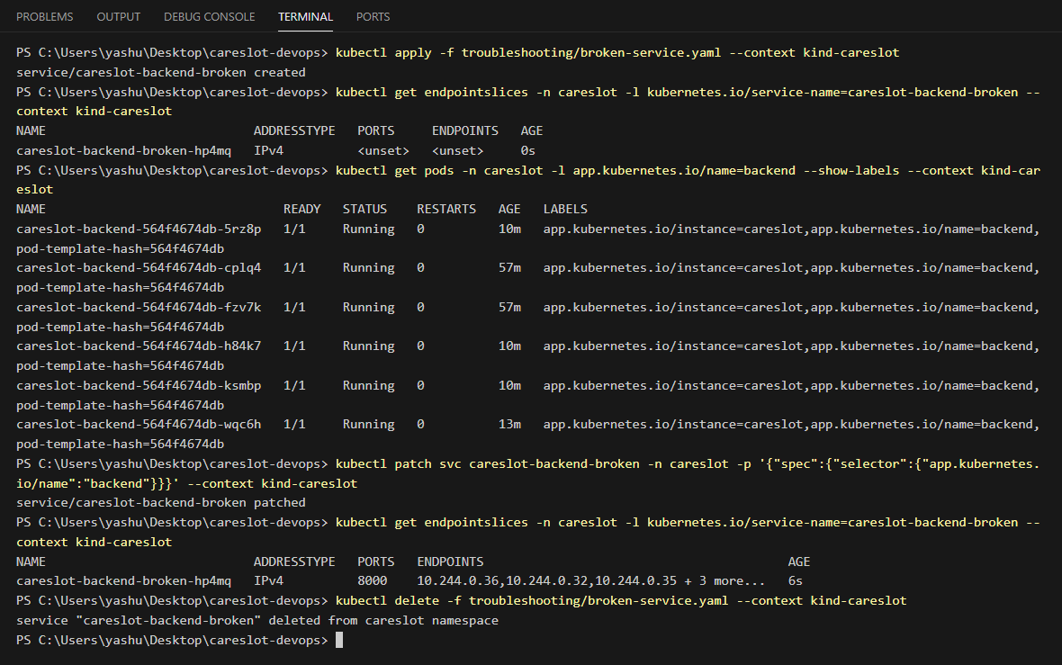
Troubleshooting lab & takeaways
Two failure drills
Broken image → ImagePullBackOff → describe pod → fix tag
Broken Service → no endpoints → compare labels → fix selector
What I learned
Automate the quality gates: tests and scans before every push
Readiness vs liveness, and DB migrations under concurrent pods (advisory lock)
Observability first: metrics made the HPA and the bugs visible
Next: apply Terraform on AWS, move Postgres to RDS, add SAST (Bandit/Semgrep)
Broken Service: wrong label selector → no endpoints → patch the selector → endpoints appear
Slides: docs.google.com/presentation/d/1gozq9zRrB_hWzUNHuiw40d-w5joAO3xT
Thank you · github.com/Yashukiran/careslot-devops
Notes:
Run the broken-service lab live if time allows. Close with the learnings and honest next steps.

