Slide 1


Cricket Data Revolution: Unlocking the Secrets of T20 World Cup
The T20 World Cup is the pinnacle of cricket entertainment, and with web scraping, Python, and Power BI we can capture and analyze the game's data at its best .

Slide 2
Cricket Data Revolution: Unlocking the Secrets of T20 World Cup
1
Introduction & Problem statement
Introduction:
The T20 Cricket World Cup recently concluded with England claiming victory over Pakistan. Now, we embark on a cricket data analytics journey using the same tournament data. Through web scraping, Python, and Pandas, we will collect and process the data, and then leverage Power BI to create engaging dashboards. The project aims to find the best players for different roles while analyzing key performance metrics for strategic decision-making.
Problem Statement:
The objective is to extract relevant information from ESPN cricinfo, clean and transform the data, and build interactive dashboards to gain insights into player performance and team strategies.
2
Web Scraping: Capturing Precious Data
Scraping relevant data from the ESPN cricinfo website .
The scraping is performed using Parsehub Data collector, which uses a smart proxy network for seamless data collection.
Cleaning and transforming scraped data using Pandas to remove null values, format data types, and address data issues.
Creating visualizations and dashboards in Power BI based on different player categories like power hitters and anchors.
Data Modeling and DAX Measures
Using DAX measures in Power BI to perform further transformations and calculations to build the actual visuals for analysis.
T20 World Cup: Data-Driven Insights
1
Overview of T20 World Cup
Providing an overview of the T20 World Cup, including recent winners and key statistics.
Match Analysis
2
Performing match analysis using the scraped data to gain insights into team performance and player contributions.
3
Player Analysis
Conducting player analysis to identify key players, their strengths and weaknesses, and their impact on team performance.
Power BI: Building Insightful Dashboards
1
Dashboard Design Principles
Exploring the principles of effective dashboard design, including layout, color, and interactivity.
Creating Dashboards
2
Building insightful dashboards using Power BI, including interactive visualizations and filters.
3
Sharing and Collaborating
Sharing and collaborating on dashboards with team members and stakeholders using Power BI.
Demonstrating Insights & Findings
1
Presenting Insights
Presenting data-driven insights and findings in a clear and compelling manner to stakeholders and decision-makers.
Creating Reports
2
Building comprehensive reports to document the entire data analytics process, including methodology, data sources, and key findings.
Beyond T20 World Cup: Future Applications
1

Slide 3
Cricket Data Revolution: Unlocking the Secrets of T20 World Cup
3
Data Extraction and Cleaning
The extracted data is stored in JSON files for further processing.
The JSON files contain information such as match summaries, batting summaries, bowling summaries, and player info.
4
Data Transformation and Modeling
Dataframes are processed to create a unified list of all matches.
Unnecessary columns are dropped, and data issues like special characters in player names are addressed.
A dictionary is created to capture match information, including teams and match IDs.
5
Data Analysis and Visualization
Further transformations and calculations are performed using DAX measures in Power BI.
Visualizations and dashboards are created based on different player categories like power hitters and anchors.
Data modeling and DAX measures help in building the actual visuals for analysis.
6
Dashboard Refinement and Final Steps
The created dashboards are refined by adding additional features and functionality.
The viewer can interact with the dashboards and make player selections based on specific criteria.

Slide 4
T20 World Cup: Data-Driven Insights
Key Performance Indicators (KPIs)
Player Performance Analysis
Tactics & Strategies
Analyze the batting orders, bowling rotations, field placements, and tactical decisions that determine a team's success.
Find out which team, player, and match stats have the greatest impact on winning or losing.
Learn the strengths and weaknesses of key players through advanced metrics such as batting, bowling, and fielding.

Slide 5
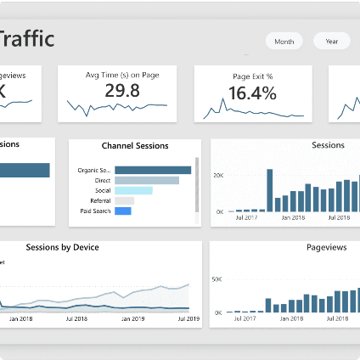
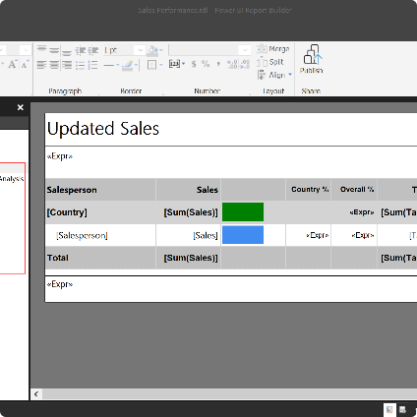
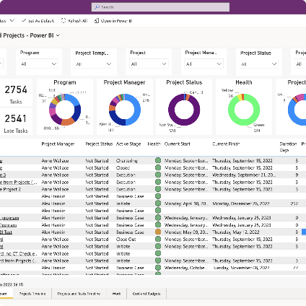
Power BI: Building Insightful Dashboards
Power BI
Report Design
Report Distribution

Slide 6
Beyond T20 World Cup: Future Applications
1
2
3
Cricket Leagues
Other Sports
Business Analytics
Applying data analytics in Indian Premier League (IPL), Vitality Blast, Big Bash League (BBL), and other cricket leagues.
Exploring opportunities in other sports such as soccer, basketball, baseball, and football.
Utilizing Python and Power BI for various business analyses, including sales, marketing, and financial data.

Slide 7
Conclusion: The Winning Edge
Data is Powerful
A Roadmap to Success
Utilizing data analytics can provide actionable insights that can help in decision-making, from sports to business.
Web scraping, data cleansing, and transformation, Python, and Power BI are powerful tools for any data analytics project.

