Slide 1
Address-Book
Done by
S.YASHVANTH

Slide 2
Objectives
Apply fundamental concepts of C programming in a real-world project
Implement CRUD operations (Create, Read, Update, Delete) effectively
Persist data using File Handling with CSV storage for reliability
Practice problem-solving through input validation & error handling
Develop modular programming skills with functions and header files
Build a strong foundation for System-level & Embedded Programming

Slide 3
Foundational Requirements
C Programming Fundamentals → Variables, Loops, Functions
Structures & Pointers → Managing and accessing complex data
Arrays & Strings → Handling Names, Phone Numbers, and Emails
File I/O Operations → Using fopen, fclose, fscanf, fprintf for persistence
Modular Programming → Organizing code with .c and .h files

Slide 4
features
Add a new contact ( with validation for phone and email)
Search contacts by name, phone number and Email
Edit and update the existing contact details
Delete a contact
List all contacts (with sorting by name)
Save and retrieve data from the CSV file for persistence

Slide 5
PROGRAM Flow
User Interaction → Menu-driven console interface for navigation
Input Validation → Ensures correct phone format (10-digit), valid email, and unique entries
In-Memory Storage → Contacts stored in structure arrays during execution
Persistent Storage → Data saved to and loaded from a CSV file
Modular Functions → Each operation handled separately:
create() – Add new contact
search() – Find contact by name/phone/email
edit() – Modify existing contact
delete() – Remove a contact
List() – Display all contacts
save_exit() – Save and close program
fetch_enter() – Load contacts at startup

Slide 6
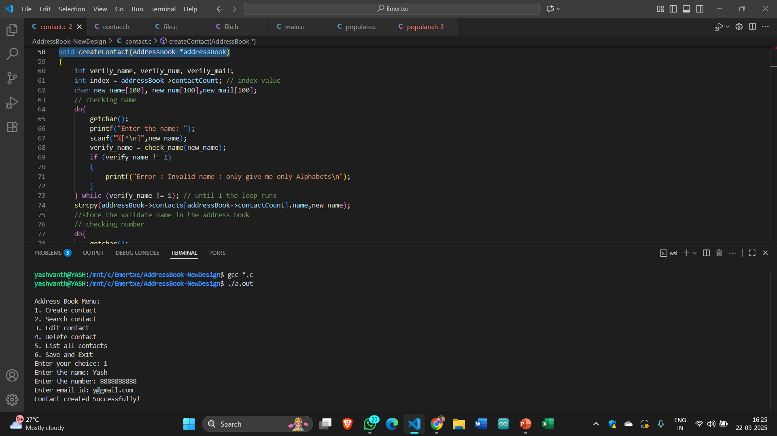
Creating a Contact

Slide 7
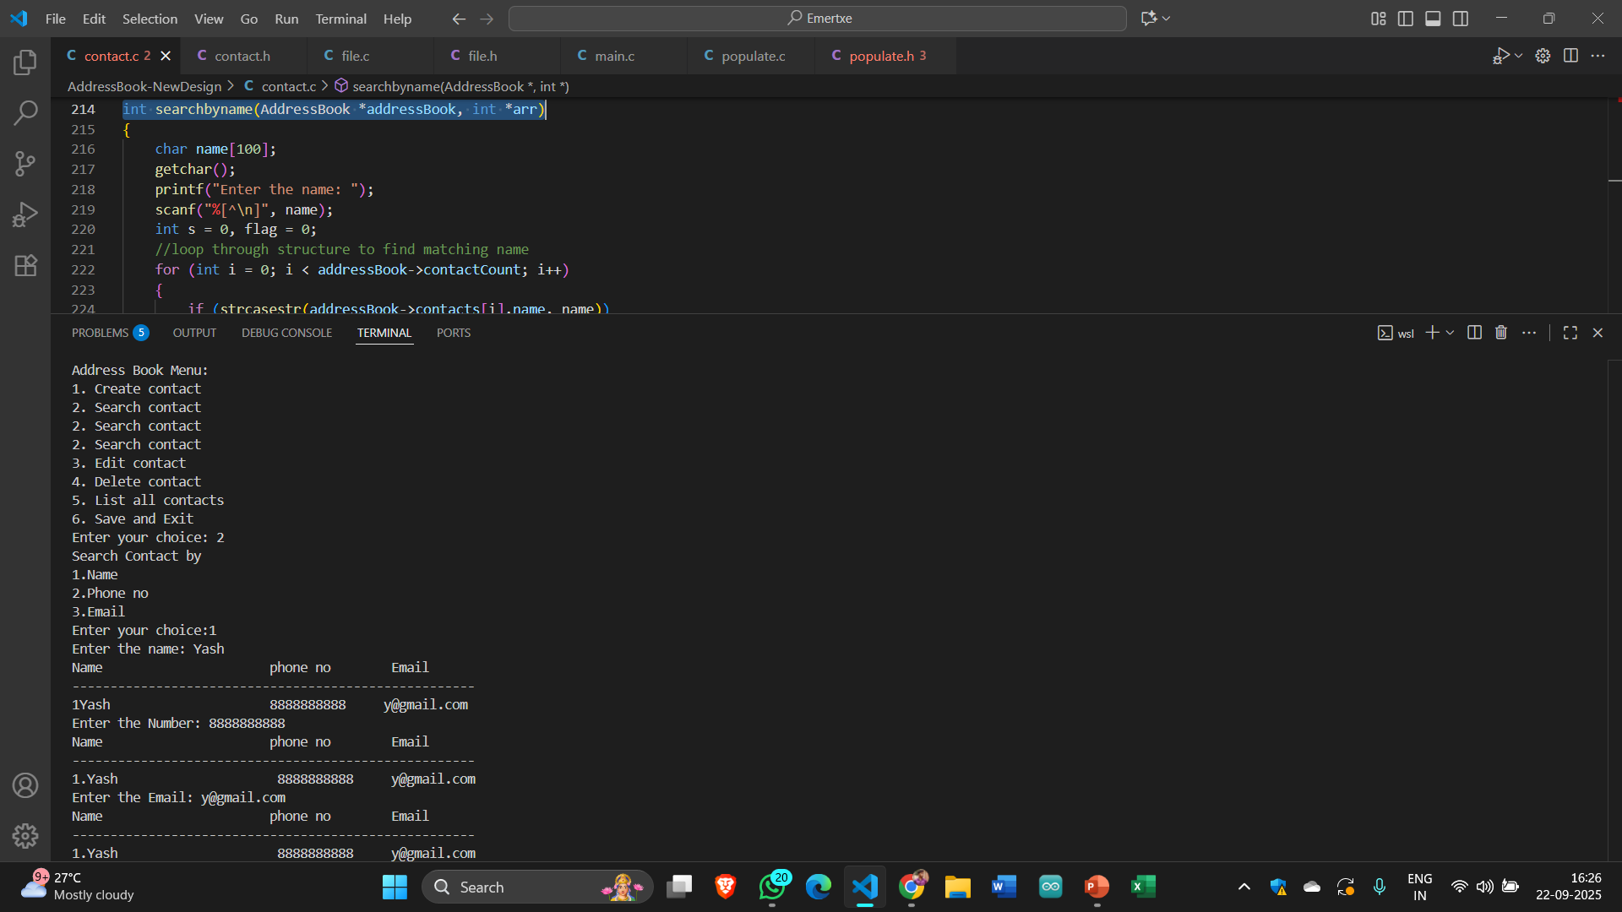
Searching a contact

Slide 8
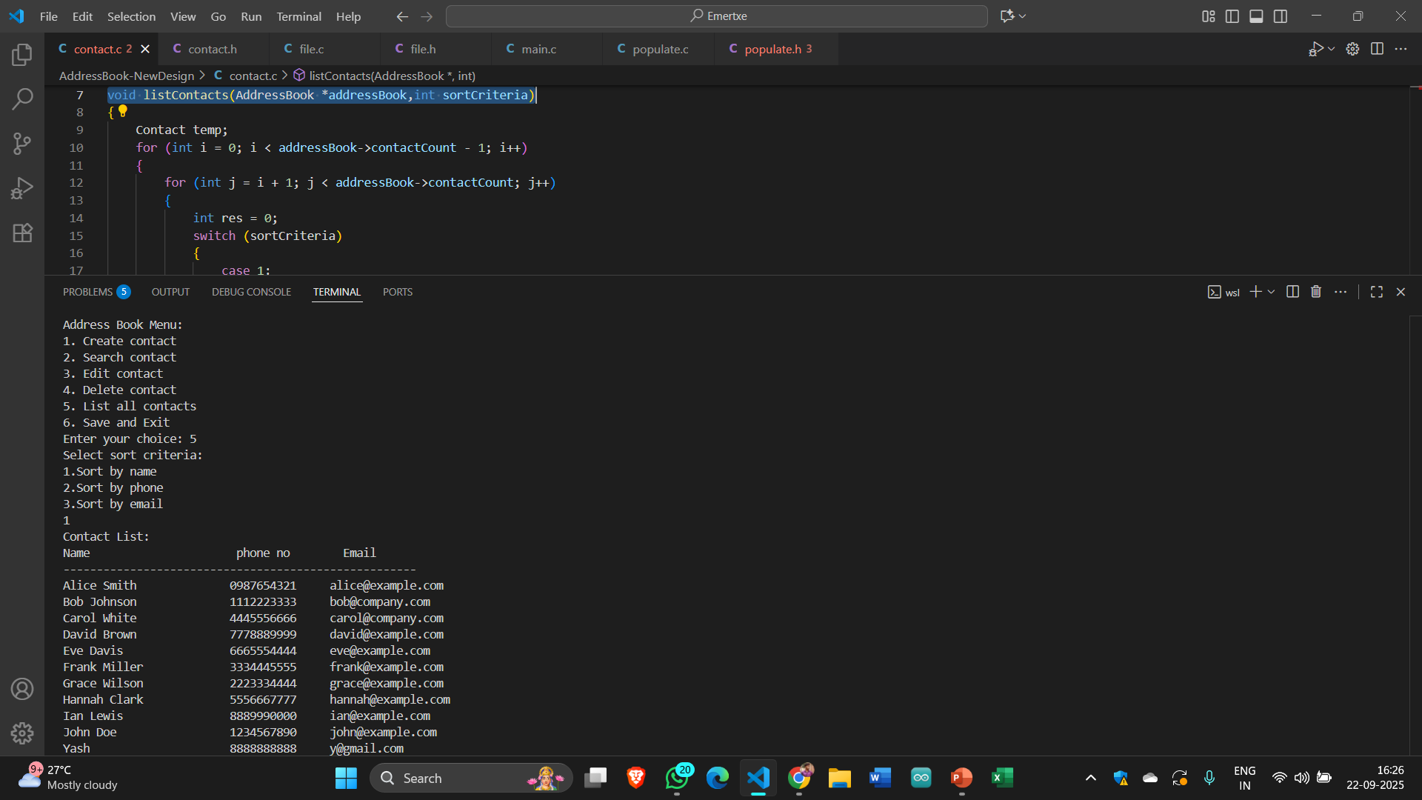
Listing A Contact

Slide 9
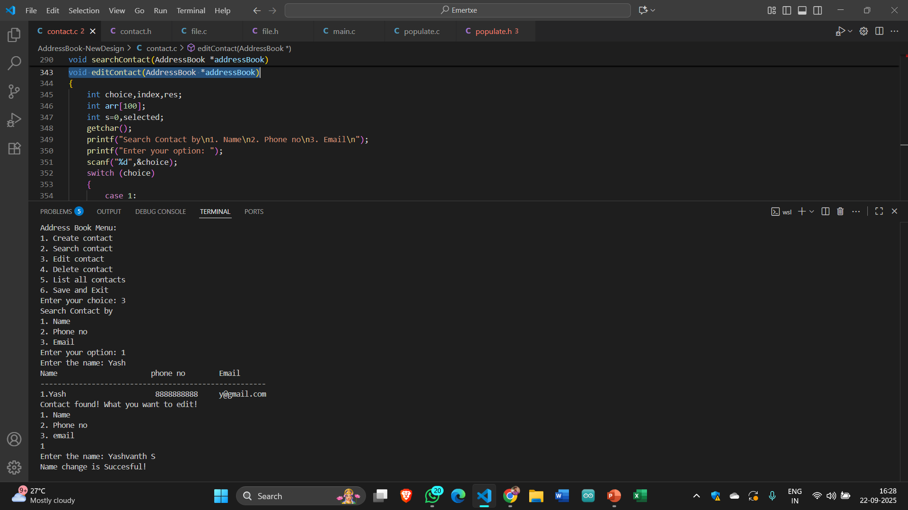
Editing a Contact

Slide 10
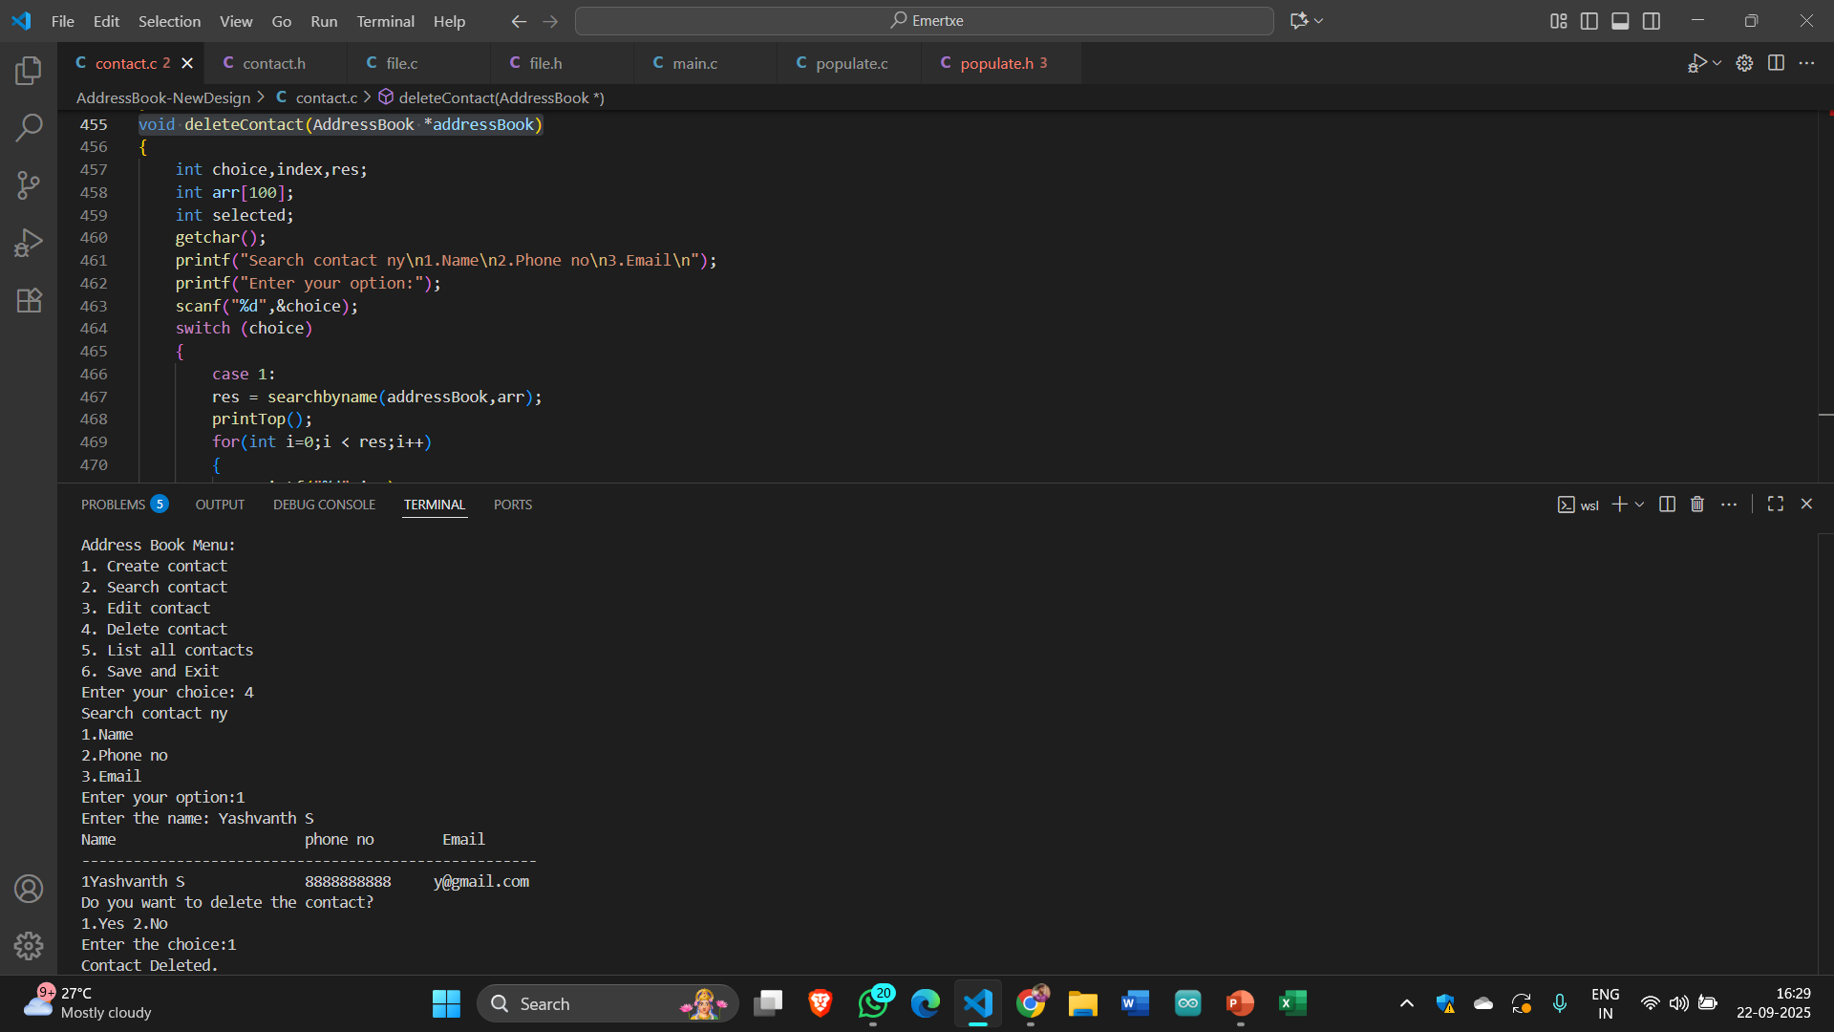
Deleting a contact

Slide 11
Core Takeaways
Solidified C Fundamentals : Deepened understanding of core C concepts and their practical applications.
Modular Programming : Learned to design projects using modular approaches for better organization and maintainability.
Error Handling & Input Validation : Applied robust techniques to manage user inputs and prevent runtime errors in real-world scenarios.
File Handling & Data Persistence : Gained hands-on experience in using file operations to store and retrieve data, ensuring long-term persistence.
Scalable Code Structuring : Developed skills to structure code effectively for scalability and easier future enhancements.

