Slide 1

Human Development Index
Understanding Various Development Indicators
PPOC Summer Project’22

Slide 2
Definition
The Human Development Index (HDI) is a summary measure of average achievement in key dimensions of human development: a long and healthy life, being knowledgeable and have a decent standard of living. The HDI is the geometric mean of normalized indices for each of the three dimensions.

Slide 3
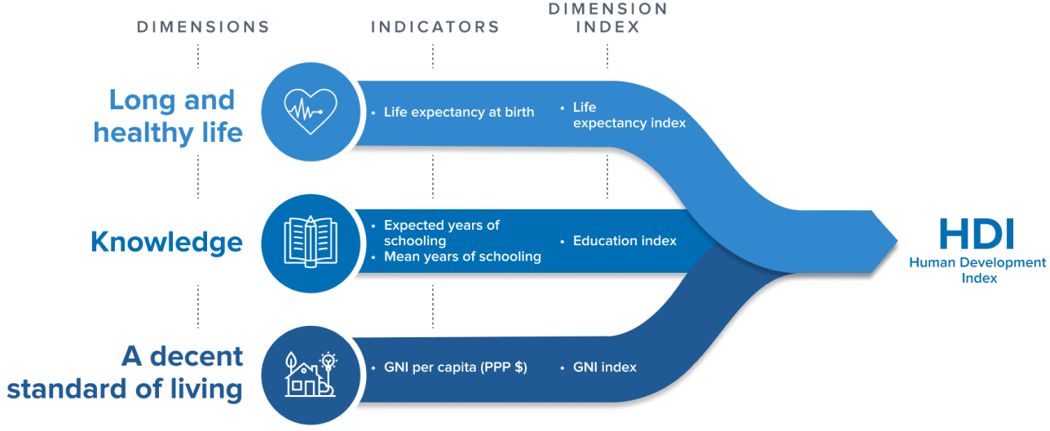
Dimensions, Indicator & Dimension Index
Long & Healthy
Life
Knowledge
A decent
standard of living

Slide 4
Components of HDI
Health
Education
Standard of Living
Life expectancy at birth
The average (mean) number years of adult education adults over 25 have received and the number of expected years of education children attending school can expect
Gross National Income per capita (PPP)

Slide 5
Methods of Calculation
There are two steps to calculating the HDI:
1. Forming indices for each of the three metrics
Values of each of the three metrics are first normalized to an index value of 0 to 1. To do this, “goalposts” of the maximum and minimum limits on each metrics are set by the UNDP, as shown in the table.
With the actual value for a given country, and the global maximum and minimum, the dimension (indices) value for each metric is calculated as:
Dimension Index =
The dimension index is therefore 1 in a country that achieves the maximum value and it is 0 for a country that is at the minimum value.
actual value - minimum value
maximum value - minimum value

Slide 6
2. Aggregating the three metrics to produce the HDI
Once each of the individual indices have been calculated, they are aggregated to calculate the HDI.
The HDI is calculated as the geometric mean (equally-weighted) of life expectancy, education, and GNI per capita, as follows:
HDI = (I_{Health} X I_{Education} X I_{Income} )^{1/3}
The education dimension is the arithmetic mean of the two education indices (mean years of schooling and expected years of schooling).

Slide 7

Organisations Responsible
The United Nations Development Programme releases reports annually for each of the 3 indicators, which in turn is further used to calculate the Human Development Index.

Slide 8
History
The origins of the HDI are found in the annual Human Development Reports produced by the Human Development Report Office of the United Nations Development Programme (UNDP). These were devised and launched by Pakistani economist Mahbub ul Haq in 1990, and had the explicit purpose "to shift the focus of development economics from national income accounting to people-centered policies". Haq believed that a simple composite measure of human development was needed to convince the public, academics, and politicians that they can and should evaluate development not only by economic advances but also improvements in human well-being.
The method of calculating the HDI was slightly changed in the year 2010, with respect to the education part of it.

Slide 9
Advantages
It provides us with a much fuller picture of how well developed a country is, allowing for fuller comparisons to be made.
It shows us that while there is a general correlation between economic and social development, two countries with the same level of economic development may have different levels of social development.
Some argue that this is a more human centred approach, concerned more with actual human welfare than just mere economics. It gets more to ‘the point’ of economic development.

Slide 10
Limitations & Criticisms
Relying on the HDI score alone may disguise a lack of social development in a country – for example a very high GNI can compensate for poor life-expectancy, as is the case in the United States.
It is still only provides a fairly limited indication of social development – only few indicators of health and education are covered – there are many other ways of measuring health and education.

Slide 11
Sources of Data Error
Economists Hendrik Wolff, Howard Chong and Maximilian Auffhammer discuss the HDI from the perspective of data error in the underlying health, education and income statistics used to construct the HDI. They identified three sources of data error which are due to (i) data updating, (ii) formula revisions and (iii) thresholds to classify a country's development status and conclude that 11%, 21% and 34% of all countries can be interpreted as currently misclassified in the development bins due to the three sources of data error, respectively. The authors suggest that the United Nations should discontinue the practice of classifying countries into development bins because: the cut-off values seem arbitrary, can provide incentives for strategic behavior in reporting official statistics, and have the potential to misguide politicians, investors, charity donors and the public who use the HDI at large.
In 2010, the UNDP reacted to the criticism and updated the thresholds to classify nations as low, medium, and high human development countries. In a comment to The Economist in early January 2011, the Human Development Report Office responded to a 6 January 2011 article in the magazine which discusses the Wolff et al. paper. The Human Development Report Office states that they undertook a systematic revision of the methods used for the calculation of the HDI, and that the new methodology directly addresses the critique by Wolff et al. in that it generates a system for continuously updating the human-development categories whenever formula or data revisions take place.
In 2013, Salvatore Monni and Alessandro Spaventa emphasized that in the debate of GDP versus HDI, it is often forgotten that these are both external indicators that prioritize different benchmarks upon which the quantification of societal welfare can be predicated. The larger question is whether it is possible to shift the focus of policy from a battle between competing paradigms to a mechanism for eliciting information on well-being directly from the population.

Slide 12
RESOURCES
https://revisesociology.com/2017/01/31/human-development-index/
https://hdr.undp.org/data-center/human-development-index#/indicies/HDI
https://en.wikipedia.org/wiki/Human_Development_Index
https://ourworldindata.org/human-development-index
https://hdr.undp.org/content/improving-measurement-human-development

Slide 13
THANKS!
Submitted By
Alok Kumar (200095)
Ananya Jain (200118)
Yashvardhan Rathore (201154)

