Slide 1




MINOR PROJECT
Smart System for
Inventory Management and User Management
Under The Guidance Of – Dr. Gurminder Kaur
Presented by
Yashvardhan & Sourav

Slide 2
MINOR PROJECT
LIORA
Presented by
Yashvardhan & Sourav

Slide 3
LIORA
Client
Users
Our system provides clients with real-time inventory updates and automated alerts, ensuring timely product restocking and minimizing losses due to expired goods.
Users enjoy a seamless shopping experience with features like automatic cart addition, personalized product information, and quick, NFC-enabled payments.

Slide 4
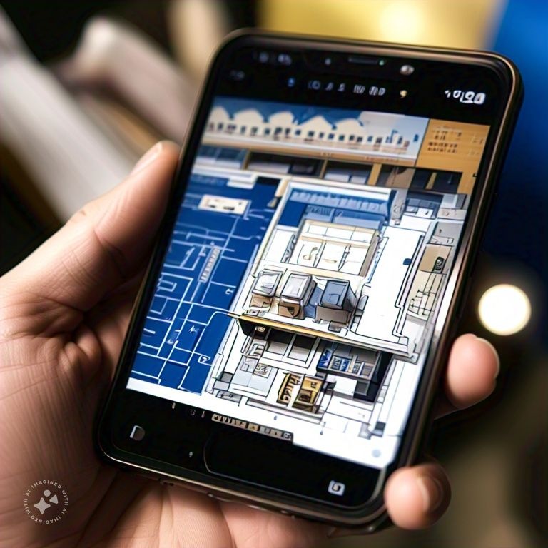
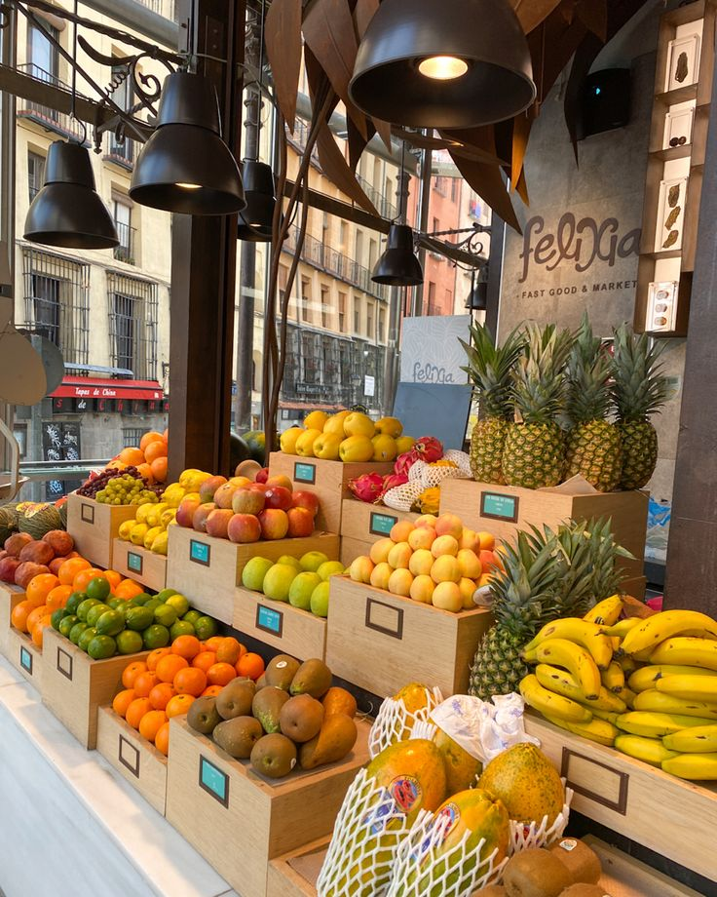
What is ?
LIORA

Slide 5

LIORA
Imagine walking into a store where the shelves automatically track inventory, identify products, and even suggest recipes based on your selections. Using advanced object detection and NFC technology, our smart system not only streamlines inventory management but also enhances the overall shopping experience.

Slide 6
OBJECT
RECOGNITION
Object recognition is a computer vision technique for identifying objects in images or videos. Object recognition is a key output of deep learning and machine learning algorithms. When humans look at a photograph or watch a video, we can readily spot people, objects, scenes, and visual details.

Slide 7
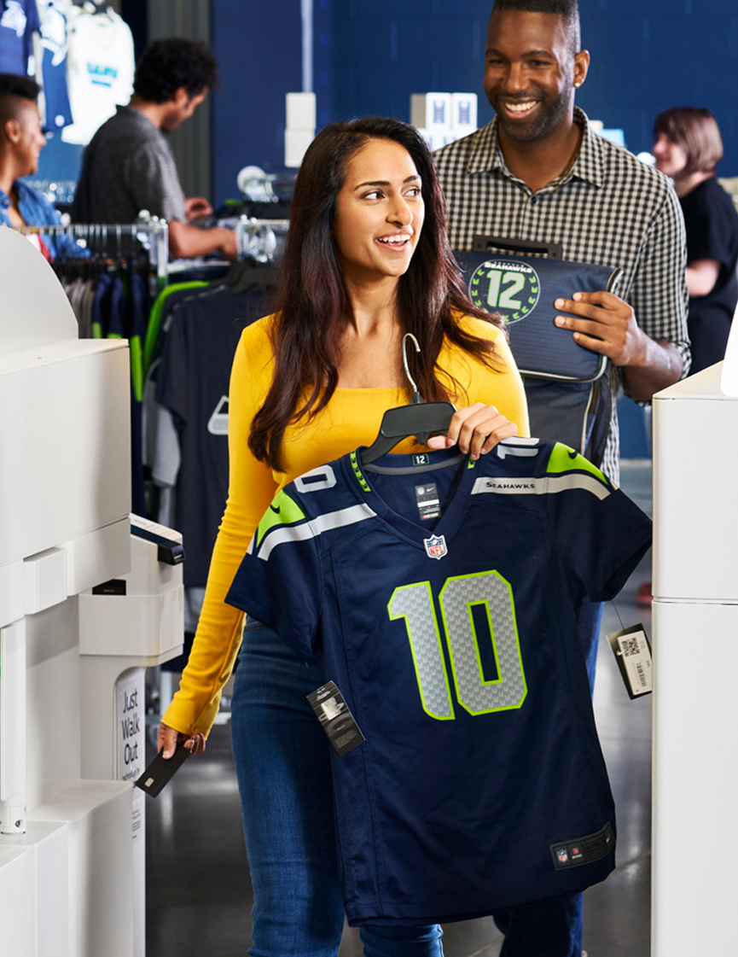

OBJECT
RECOGNITION
Object recognition is a computer vision technique for identifying objects in images or videos. Object recognition is a key output of deep learning and machine learning algorithms. When humans look at a photograph or watch a video, we can readily spot people, objects, scenes, and visual details.
Apples +1
20.00 RS

Slide 8
CHECK OUT
Our system streamlines the checkout process with automatic payment deductions as customers leave the store. Using NFC-enabled devices, customers can securely complete transactions with a simple tap. The system also generates an electronic receipt, which is sent directly to their app or email, ensuring a fast and hassle-free experience

Slide 9

LIORA
Our system helps store owners by automating inventory management, reducing the risk of human error, and providing real-time updates on stock levels and product expiration. It streamlines operations, minimizes losses from expired items, and ensures timely restocking. Additionally, the system enhances overall efficiency, allowing store owners to focus on improving customer service and growing their business.

Slide 10
LIORA
Our system helps store owners by automating inventory management, reducing the risk of human error, and providing real-time updates on stock levels and product expiration. It streamlines operations, minimizes losses from expired items, and ensures timely restocking. Additionally, the system enhances overall efficiency, allowing store owners to focus on improving customer service and growing their business.

Slide 11
LIORA
Our system helps store owners by automating inventory management, reducing the risk of human error, and providing real-time updates on stock levels and product expiration. It streamlines operations, minimizes losses from expired items, and ensures timely restocking. Additionally, the system enhances overall efficiency, allowing store owners to focus on improving customer service and growing their business.

Slide 12

LIORA
Our system helps store owners by automating inventory management, reducing the risk of human error, and providing real-time updates on stock levels and product expiration. It streamlines operations, minimizes losses from expired items, and ensures timely restocking. Additionally, the system enhances overall efficiency, allowing store owners to focus on improving customer service and growing their business.

Slide 13
LIORA
Our system helps store owners by automating inventory management, reducing the risk of human error, and providing real-time updates on stock levels and product expiration. It streamlines operations, minimizes losses from expired items, and ensures timely restocking. Additionally, the system enhances overall efficiency, allowing store owners to focus on improving customer service and growing their business.

Slide 14
LIORA
Our system helps store owners by automating inventory management, reducing the risk of human error, and providing real-time updates on stock levels and product expiration. It streamlines operations, minimizes losses from expired items, and ensures timely restocking. Additionally, the system enhances overall efficiency, allowing store owners to focus on improving customer service and growing their business.

Slide 15
LIORA
Our system helps store owners by automating inventory management, reducing the risk of human error, and providing real-time updates on stock levels and product expiration. It streamlines operations, minimizes losses from expired items, and ensures timely restocking. Additionally, the system enhances overall efficiency, allowing store owners to focus on improving customer service and growing their business.

Slide 16
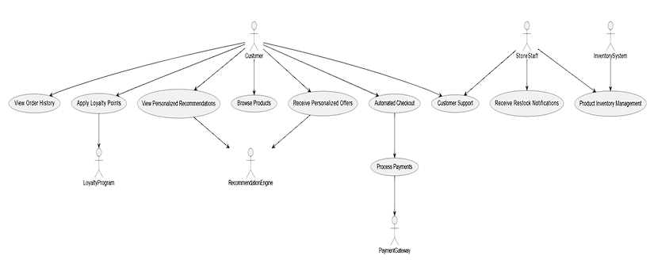
LIORA
Our system helps store owners by automating inventory management, reducing the risk of human error, and providing real-time updates on stock levels and product expiration. It streamlines operations, minimizes losses from expired items, and ensures timely restocking. Additionally, the system enhances overall efficiency, allowing store owners to focus on improving customer service and growing their business.

Slide 17
LIORA
Our system helps store owners by automating inventory management, reducing the risk of human error, and providing real-time updates on stock levels and product expiration. It streamlines operations, minimizes losses from expired items, and ensures timely restocking. Additionally, the system enhances overall efficiency, allowing store owners to focus on improving customer service and growing their business.

Slide 18
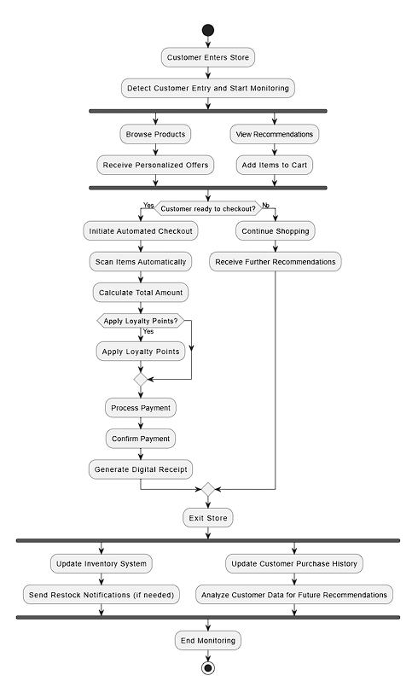
LIORA
- USE CASE DIAGRAM
Our system helps store owners by automating inventory management, reducing the risk of human error, and providing real-time updates on stock levels and product expiration. It streamlines operations, minimizes losses from expired items, and ensures timely restocking. Additionally, the system enhances overall efficiency, allowing store owners to focus on improving customer service and growing their business.

Slide 19
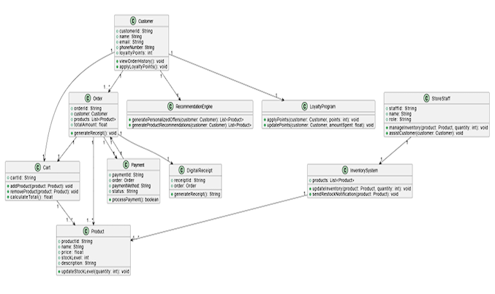
LIORA
ACTIVITY DIAGRAM
Entry: Customer enters, and the system starts monitoring.
Shopping: Customers browse, get recommendations, and add items to the cart.
Checkout: If ready, automated checkout begins with scanning, payment, and receipt generation.
Exit: Inventory and customer data are updated, and monitoring ends

Slide 20
LIORA
ACTIVITY DIAGRAM
Entry: Customer enters, and the system starts monitoring.
Shopping: Customers browse, get recommendations, and add items to the cart.
Checkout: If ready, automated checkout begins with scanning, payment, and receipt generation.
Exit: Inventory and customer data are updated, and monitoring ends

Slide 21
LIORA
- CLASS DIAGRAM

Slide 22
LIORA
Our system benefits everyone by creating a more efficient and convenient shopping experience, automating key tasks for store owners while providing customers with quick, seamless checkout and personalized product insights.

Slide 23
Thank You
Presented by
Yashvardhan & Sourav

