Slide 1
IBM University Engagement Project Submission
“Exploring the Power of Agentic AI with IBM Granite and IBM Bob”

Slide 2

Project Tile – [NutriAI – Smart Nutrition Agent]
Domain of Project – [Healthcare / Nutrition & Wellness]
Student Name | Recent Passport Photo | Email ID | Mobile number [WhatsApp]
Yashveer Singh |  | yashveersingh0785@gmail.com | 9315002967
Recommended font style and size: Font Style: Arial Font Size (Heading): 28
Font Size (Content): 20

Slide 3
Problem Statement -
Problem Statement : Nutrition Agent
The Challenge
Good nutrition is the foundation of health, but individuals often struggle with diet planning, portion control, and tracking nutritional intake. Information about healthy diets, disease-specific nutrition, and food composition is scattered across unreliable sources. Without personalized, real-time guidance, many fail to maintain balanced diets or make informed food choices.
The Objective
Build an AI-powered Nutrition Agent that delivers personalized dietary insights and guidance for individuals, families, and health professionals. The solution should:
Personalized Diet Plans – Recommend meals based on age, health conditions, allergies, cultural preferences, and fitness goals.
Food Data RAG Retrieval – Fetch and summarize nutritional values (calories, macros, vitamins) from reliable sources.
Diet Tracking & Feedback – Allow users to log meals via text, images, or voice, and provide instant nutritional analysis.
Preventive Health Focus – Suggest diets for chronic disease management (e.g., diabetes-friendly or heart-healthy plans).
Multi-Agent System –
Nutrition Knowledge Agent (fetches nutritional data)
Diet Recommendation Agent (personalized meal plans)
Health Advisory Agent (preventive health suggestions)
Food Log & Feedback Agent (meal tracking + analysis)
Visualization Dashboard – Show daily/weekly nutrient intake, deficiencies, and progress toward health goals.

Slide 4
Proposed Solution -
Proposed Solution: AI-Powered Nutrition Agent
The proposed solution is an AI-powered Nutrition Agent built using IBM Cloud Lite, IBM watsonx.ai, and Llama models to provide personalized nutrition guidance.
The system helps users with diet planning, calorie estimation, BMI calculation, food recommendations, and personalized meal suggestions based on their profile, dietary preferences, activity level, and health goals.
The application uses a conversational AI interface where users can ask nutrition-related questions and receive contextual responses. User profile information is used to make recommendations more relevant and personalized.
The system provides features such as:
Personalized Diet Planning – Generates meal plans according to user goals and dietary preferences.
Nutrition Assistance – Answers food and nutrition-related questions using the AI model.
BMI & Calorie Estimation – Calculates BMI and estimates daily calorie requirements.
Personalized Recommendations – Considers age, height, weight, activity level, diet type, and fitness goals.
Interactive Web Interface – Provides chat, quick prompts, profile management, diet planning, and health calculation features.
IBM Cloud Integration – Uses IBM watsonx.ai for AI-powered responses and integrates the application with IBM Cloud services.
Overall, the solution provides a personalized digital nutrition assistant that helps users make better-informed dietary choices.

Slide 5
Technology Used
IBM Bob platform -For designing and orchestrating multi-agent workflows visually
IBM Grainte model - for eg – ibm-granite-3-2-8b – For natural language understanding, reasoning, and personalization
IBM Cloud – It provides the infrastructure to build, deploy, and scale the Nutrition Agent efficiently. IBM Cloud enables a reliable, secure, and scalable environment for deploying the Nutrition Agent.
RAG– RAG to fetch real data first, then generate intelligent answers, making the Nutrition Agent more trustworthy and effective.
IBM Watsonx.ai - For model deployment, embeddings, and AI governance
Vector Database (FAISS/Chroma) – For RAG-based nutritional data retrieval

Slide 6
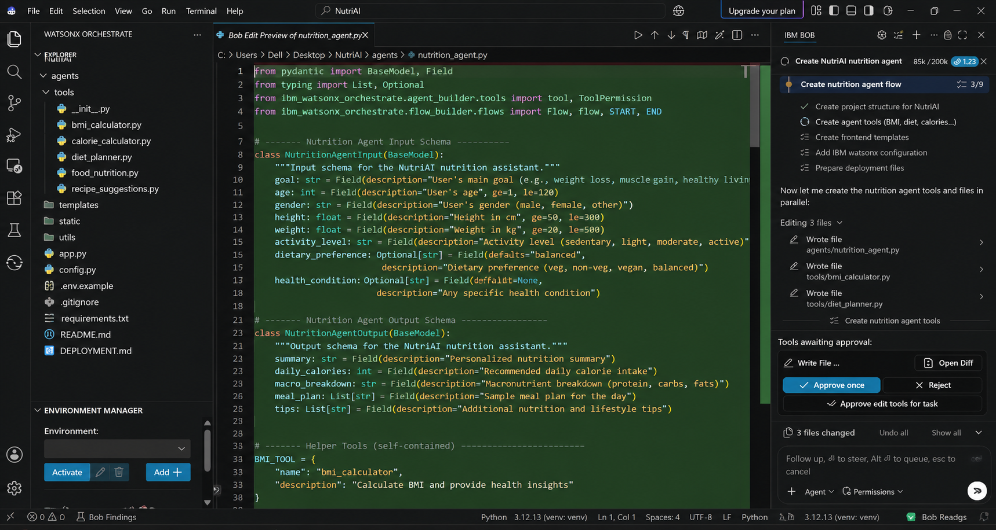
Required Files created using IBM bob -

Slide 7
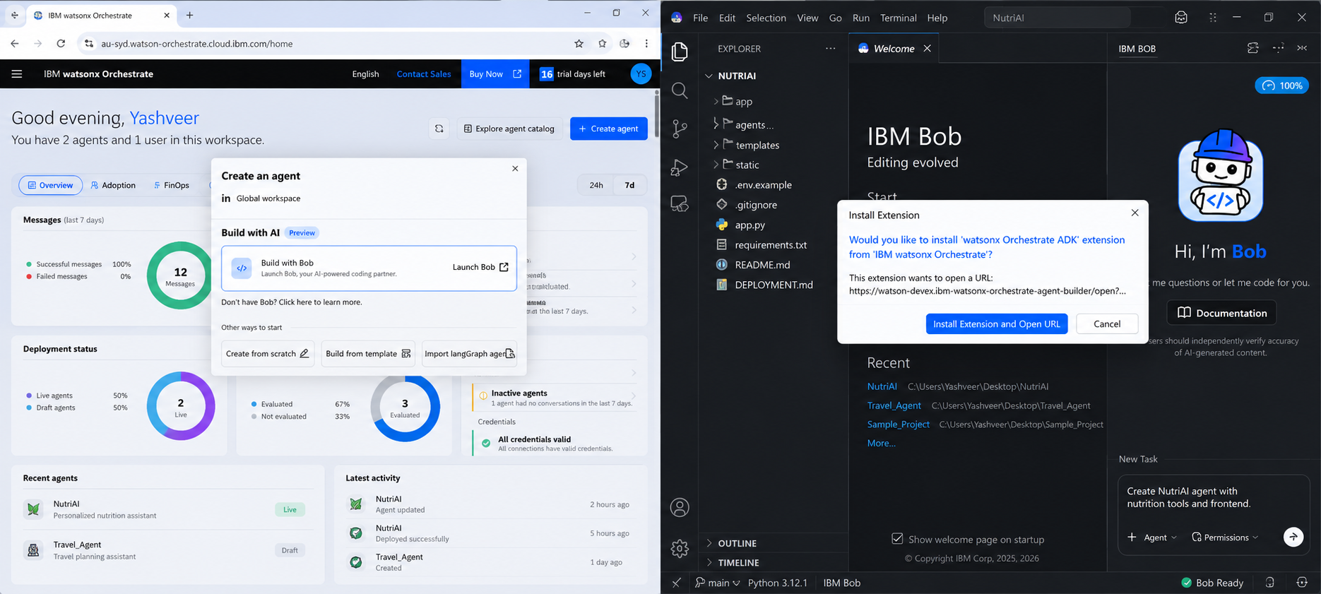
IBM Bob Screenshots:

Slide 8
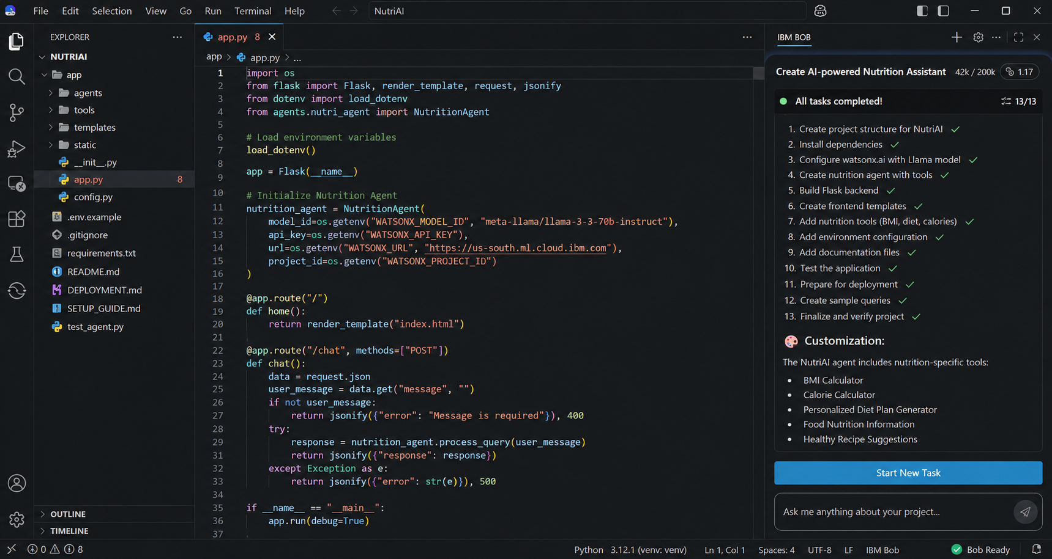

Slide 9
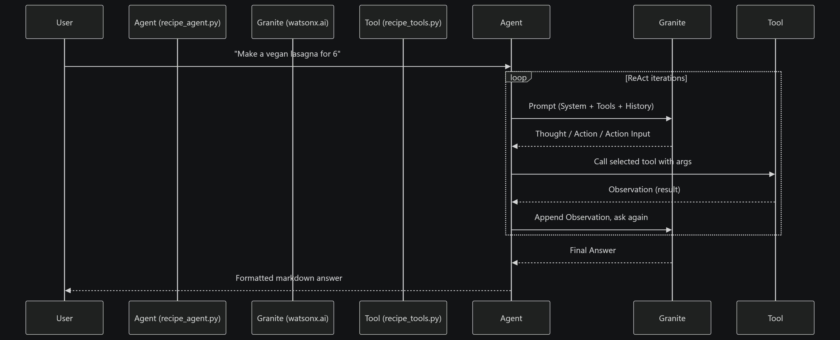
Architecture blueprint for IBM bob:

Slide 10

Role of Agentic AI in the solution
Role of Agentic AI in Nutrition Agent
Agentic AI enables the Nutrition Agent to function as an intelligent, autonomous system rather than a simple chatbot. Using IBM watsonx.ai and IBM Granite models, it coordinates multiple specialized agents to deliver personalized nutrition guidance.
Each agent performs a specific role—such as retrieving nutritional data, generating diet plans, providing health advice, and analyzing food logs—while working collaboratively. This multi-agent approach ensures efficient task execution and accurate results.
Agentic AI also brings context awareness, understanding user details like age, health conditions, and fitness goals to generate tailored recommendations. It supports real-time adaptation, continuously updating suggestions based on user inputs like daily meals.
Additionally, agents communicate with each other, enabling better decision-making and improved outcomes.
Overall, Agentic AI makes the system proactive, personalized, and goal-driven, acting like a smart digital nutritionist that helps users maintain a healthy lifestyle.

Slide 11
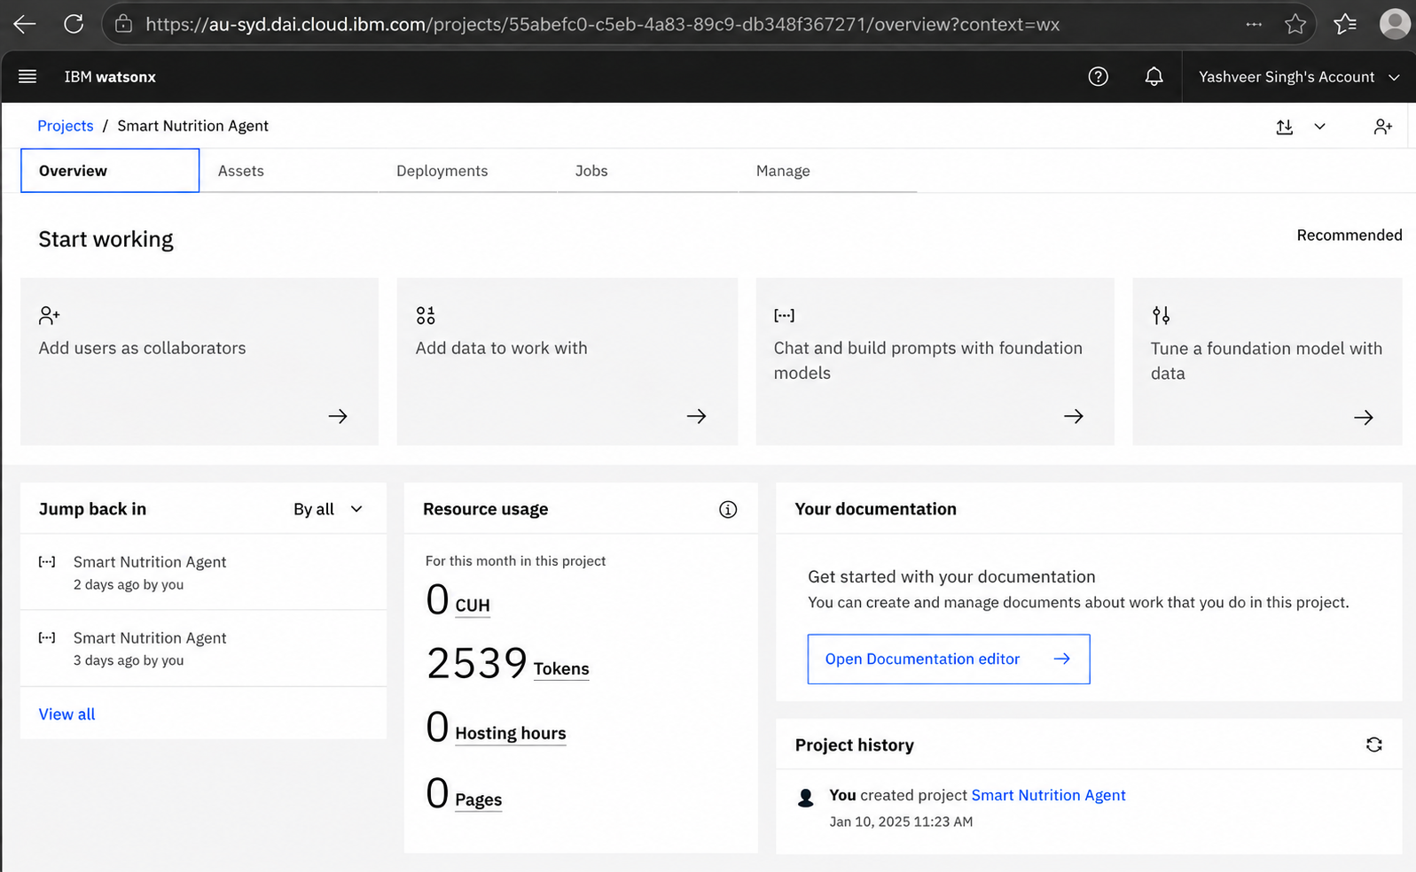
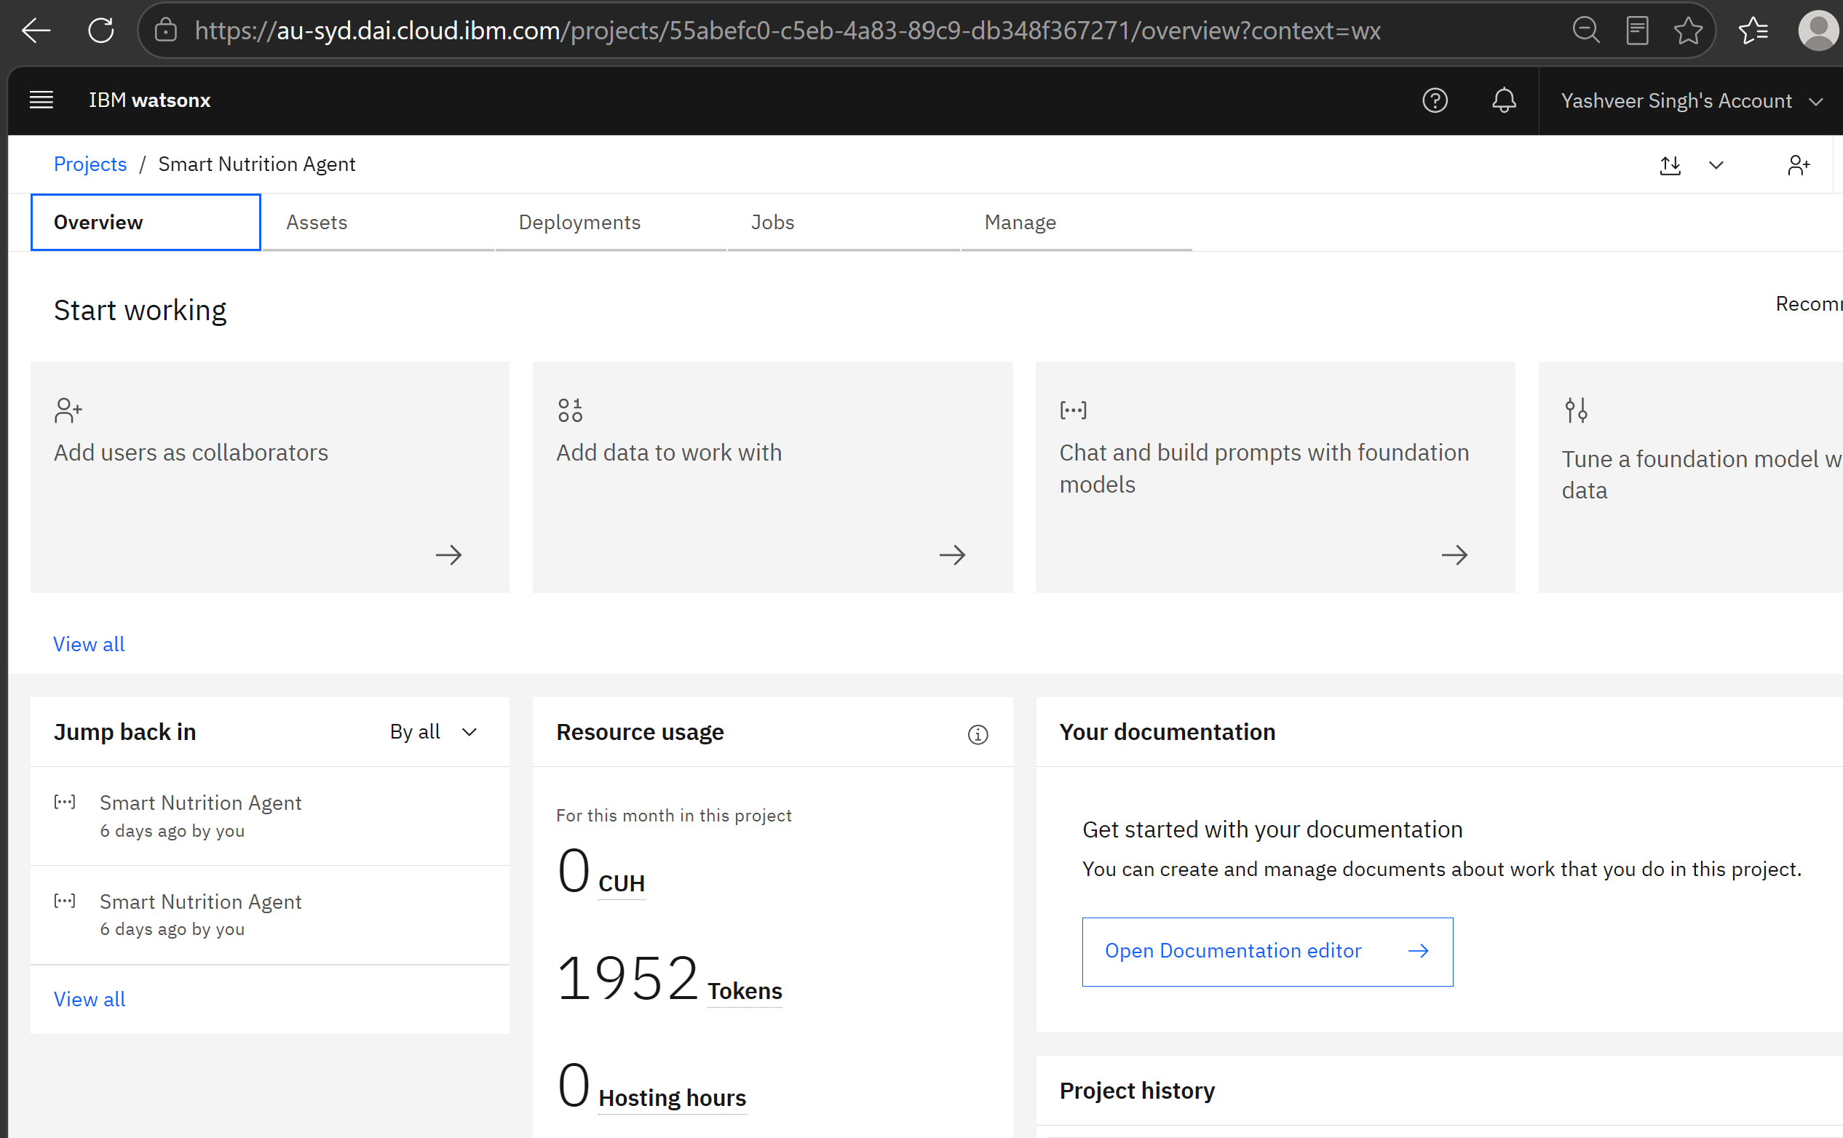
Token Usage
11,761 token are used
Before Prompt
After the Prompt
·
·
·

Slide 12
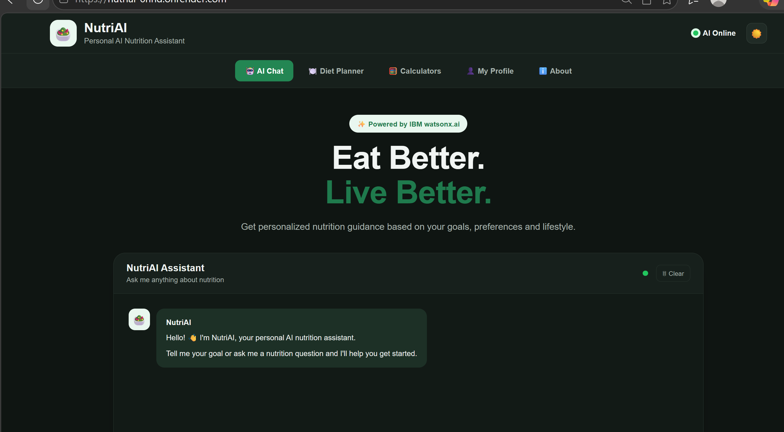
Project Output Screenshot
·
·
·

Slide 13
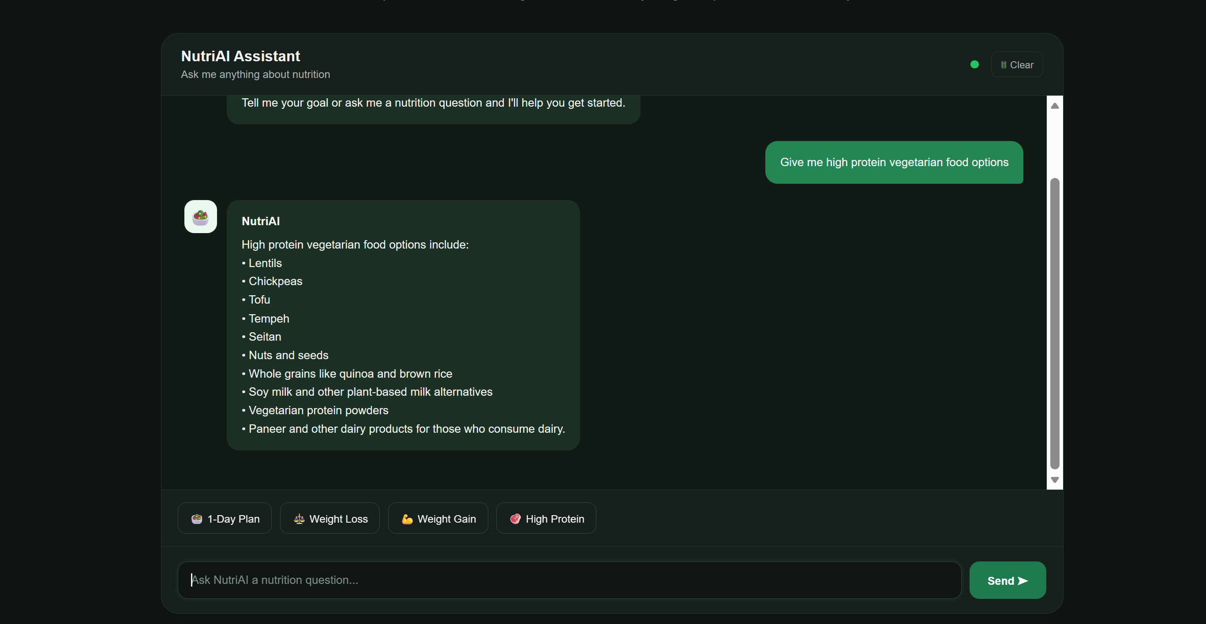
Project Output Screenshot
·
·
·

Slide 14
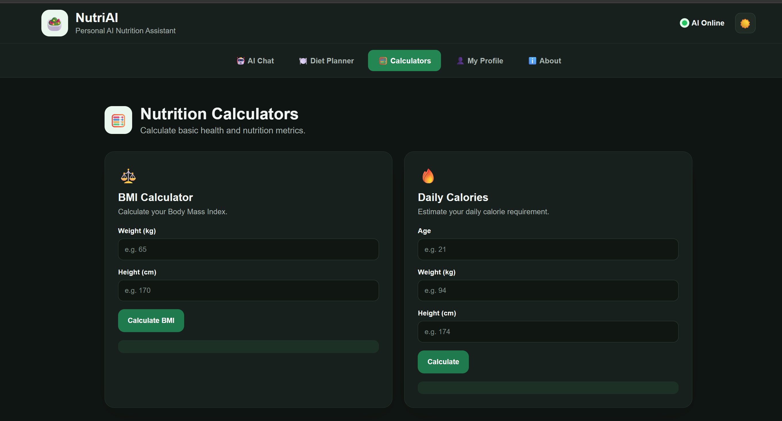
Project Output Screenshot
·
·
·

Slide 15
Novelty and Uniqueness
NutriAI stands out by combining AI-powered nutrition assistance, personalization, and practical health calculations into a single intelligent web application.
AI-Powered Nutrition Assistance – Uses IBM watsonx.ai with an LLM to provide conversational nutrition guidance.
Personalized Recommendations – Generates diet suggestions based on the user's age, height, weight, activity level, dietary preference, and fitness goal.
Integrated Health Calculations – Provides BMI and daily calorie estimation to support personalized nutrition planning.
Interactive Diet Planning – Helps users generate one-day, weight-loss, weight-gain, and high-protein meal recommendations.
User Profile & Context – Uses the user's saved profile information to make responses more relevant and personalized.
Modern Web Interface – Provides an interactive, responsive interface with chat, quick prompts, profile management, and theme support.
IBM Cloud Integration – Built using IBM watsonx.ai for AI-powered responses.
This makes NutriAI a practical and personalized digital nutrition assistant, rather than a simple static diet recommendation tool.

Slide 16
Git Hub Link
Github URL – Click Here
https://github.com/Yashveer005/NutriAI
·

Slide 17
Future Scope
Integration with Wearables & Health Devices – NutriAI can be integrated with smartwatches and fitness trackers to collect health and activity data such as steps, calories burned, heart rate, and sleep patterns. This can help generate more dynamic and personalized nutrition recommendations.
2. AI-Powered Voice Assistant & Multilingual Support – Future versions can include voice-based interaction and multilingual support, allowing users to communicate with NutriAI in their preferred language and improving accessibility.
3. Advanced Nutrition Knowledge Base – A larger and regularly updated nutrition database can be integrated to provide more accurate information about foods, nutrients, calories, and meal recommendations.
4. Meal Image Analysis – Computer vision can be added to identify food items from meal images and estimate their nutritional values.
5. Progress Tracking & Adaptive Recommendations – Future versions can track users' nutrition and fitness progress over time and automatically adapt diet recommendations according to their changing goals and activity levels.
·
·
·

Slide 18
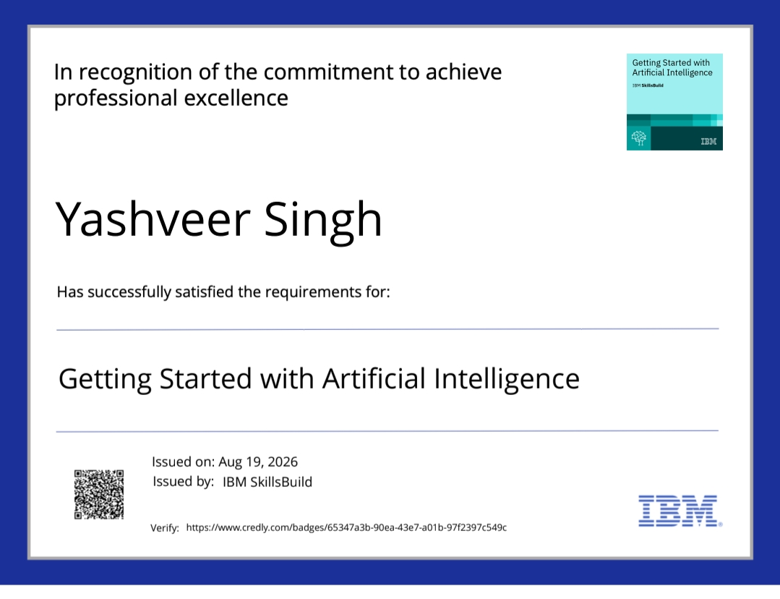
Certificates Earned:
Please add your credly certificate(Getting Started with Artificial Intelligence)

Slide 19
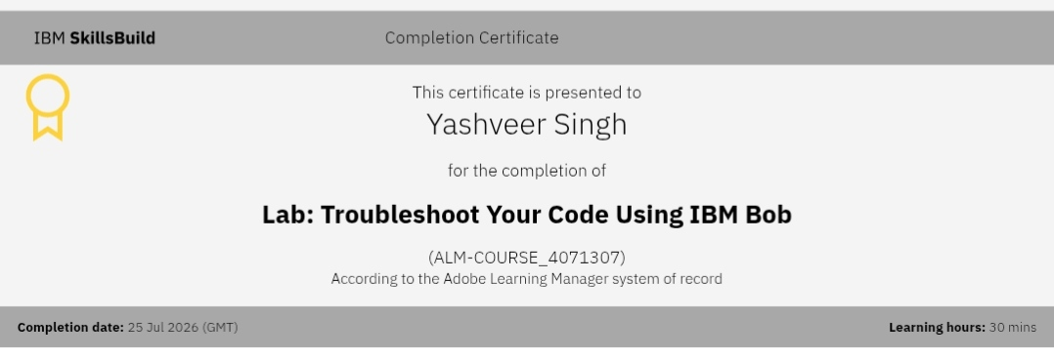
Certificates Earned:​
Add your IBM BOB Certificate

Slide 20


