Slide 1
FABPULSE
FAB BOTTLENECK, DELIVERY-IMPACT & SUPPLY-CHAIN RISK DASHBOARD
IBM Bob AI Innovation Hackathon · Team Alchemist
Astha Makwana | Yashvi Bhadani | Manthan Chavda | Radhika Dholakiya
WaferStart
Lithography
Etch
CVD
CMP
Ion Implant
Metallization
Test & Pack
8-station line · live risk per machine · updated every 3 seconds

Slide 2






THE PROBLEM: CASCADING RISK
A bottleneck at one station is never a local event.
One slow machine builds a queue, delay ripples down the line, and the buffer between the team’s deadline and the customer’s disappears — while critical materials sit behind a single supplier country.
WIP queue builds at the slow station
Fragile materials
Delay propagates to every downstream station
Gallium, germanium, neon, photoresist and cobalt each depend on one dominant supplier country — from 60% to 90% share.
Internal deadline slips, external buffer shrinks
A decision in ten seconds
Customer commitment becomes AT_RISK
A manager needs to see which station is critical, how many hours are at stake and how much buffer is left — at a glance.

Slide 3



OUR SOLUTION: ONE DECISION LAYER
Detect → Score → Propagate → Buffer → Suggest → Trace supply
DETECT
SCORE
Live WIP, utilization and health for all 8 stations, streamed every 3 seconds
A 0–100 risk score per machine in four bands: Low, Medium, High, Critical
PROPAGATE
BUFFER
Delay cascades downstream, softened by stations that have spare capacity
Internal vs external deadline shows how many days remain before the customer is hit
SUGGEST
TRACE SUPPLY
Spare-capacity speed-ups; one click applies them and re-renders the line
Per-material risk from country concentration, export control and single-sourcing

Slide 4
TECHNICAL ARCHITECTURE
React client + Node/Express server, streaming simulated MES/WIP data
React client
Express server
API contract
Single-page app
Single server.ts
POST /api/auth/login
React + TypeScript + Vite
REST /api
Node.js + Express + TypeScript
GET /api/order
Bearer JWT
TailwindCSS + shadcn/ui
JWT middleware on every /api route
POST /api/order
GET /api/machines
React Flow — conveyor line
In-memory store, seeded at start
Socket.IO
GET /api/flow
Recharts — drill-down modal only
‘tick’ every 3s
3-second tick loop (setInterval)
GET /api/supply
Zustand — client state
Socket.IO push to clients
GET /api/suggestions
POST /api/suggestions/:id/apply
Lucide icons
Seeded supply-chain JSON
WS /socket → tick
Zero ML models, no database, no external APIs. Every score is a deterministic formula you can verify by hand.

Slide 5
DEADLINE BUFFER: INTERNAL VS EXTERNAL
Day 0
Day 1
Day 2
Day 3
Day 4
Day 5
Buffer math
Internal deadline
2d
internal_buffer =
internal_deadline - projected_completion
Projected completion
Projected: 4d
2-day slip
external_buffer =
external_deadline - projected_completion
buffer_status = external_buffer > 0
External deadline
Promised to customer: 5d
1d buffer
? "SAFE" : "AT_RISK"
Worked example
Internal slip: 2 days
1d buffer left
Status: SAFE
internal_buffer = 2 − 4 = −2d
external_buffer = 5 − 4 = 1d
Amber chip: “1d buffer left”
Both deadlines are entered in the Order Setup modal on first load.

Slide 6
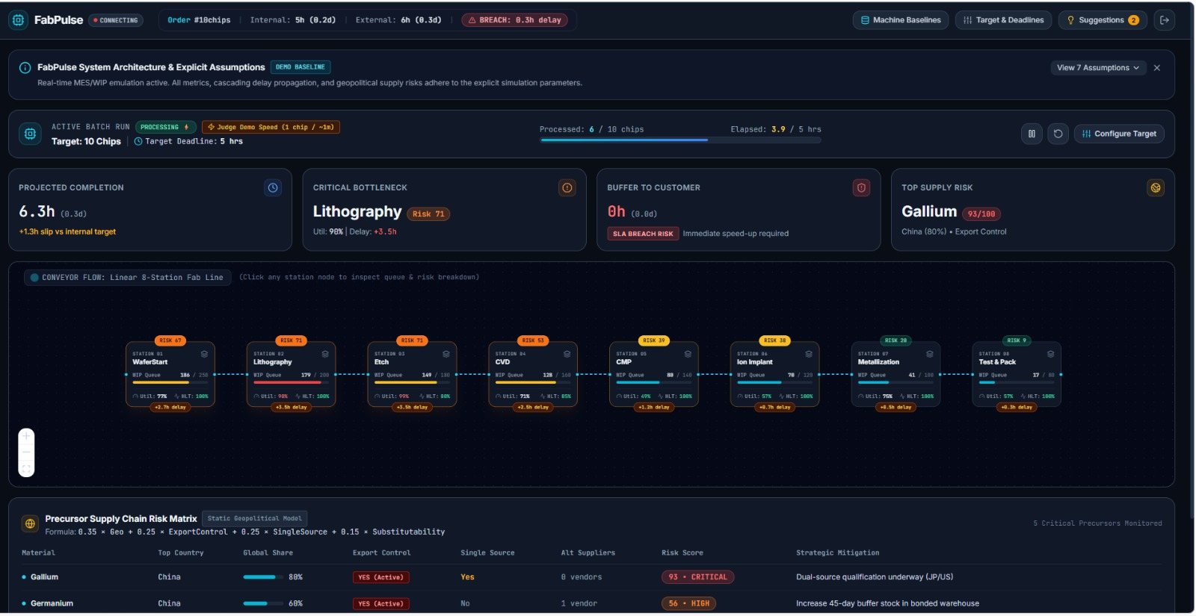
LIVE DEMO: FROM SPIKE TO ACTION
What if the Etch tool goes down?
1
Spike detected
Etch flips to CRITICAL and its node pulses red
2
Delay cascades
Delay chips appear downstream, softened by spare capacity
3
Drill in
Click a node for the five-part risk breakdown
4
Apply a fix
Speed up CMP; the line re-renders with lower risk

Slide 7
ASSUMPTIONS & SCOPE
Stated up front in a README banner on first login
1
All data is simulated and streamed every 3 seconds to mimic live MES/WIP feeds
Out of scope
2
The process is a linear chain of 8 stations, with no re-entrant loops
✕
Signup, forgot password, OAuth or role management
3
Each station has one machine; multi-tool stations are out of scope
✕
A real database or external APIs
4
Demo order size is 200 chips, with cycle times defined in the seed data
✕
Charts, gauges or sparklines on the main dashboard
5
Everything is measured in hours; currency, calendar days and timezone are abstracted
✕
Marketing copy or onboarding tours
6
Geopolitical risk is a static material → supplier-country lookup, refreshed manually
✕
More than 8 stations in the demo flow
7
No supplier API integration: supply-chain data is seeded JSON

Slide 8
TEAM ALCHEMIST: BUILT FOR THE FAB
Four engineers, one integrated system
AM
YB
MC
RD
Astha Makwana
Yashvi Bhadani
Manthan Chavda
Radhika Dholakiya
24DIT030
24DIT004
24DIT009
26MCA042
Bottleneck Detection & Outage Simulation
Supply Chain Risk Intelligence
Impact Engine & Dashboard
Project Management & Presentation Lead
Tech Stack
All data used in this system is simulated. No real-world operational facts are claimed.
Frontend: React · TypeScript · Vite · TailwindCSS · shadcn/ui
Visuals & state: React Flow · Recharts · Lucide · Zustand
Backend: Node.js · Express · Socket.IO · JWT · in-memory store

