Slide 1
FAB BOTTLENECK & SUPPLY CHAIN RISK ADVISOR
IBM Bob AI Innovation Hackathon · Team Alchemist
Astha Makwana | Yashvi Bhadani | Manthan Chavda | Radhika Dholakiya
Notes:
1

Slide 2

THE PROBLEM: CASCADING RISK
A manufacturing bottleneck is not an isolated event.
When one process step fails, the consequences ripple across the entire fab floor and into the supply chain — compounding risk at every layer.
Material demand spikes
Unplanned surges expose supplier dependencies
Production backlog accumulates
Supplier concentration becomes critical
Inventory coverage shrinks
Downstream processes delay
Buffer stock depletes faster than procurement can respond
Operational risk compounds
Notes:
2

Slide 3






OUR SOLUTION: ONE DECISION LAYER
Detect → Quantify → Simulate → Trace → Assess → Recommend → Explain
DETECT
QUANTIFY
Identify manufacturing bottlenecks and supply risks instantly
Calculate utilization, WIP pressure, capacity pressure, backlog
SIMULATE
TRACE
Model outage duration, recovery time, downstream impact
Follow process and material dependencies end-to-end
ASSESS
RECOMMEND & EXPLAIN
Fuse manufacturing risk (55%) + supply-chain risk (45%)
Deterministic mitigations narrated by IBM Bob in natural language
Notes:
3

Slide 4
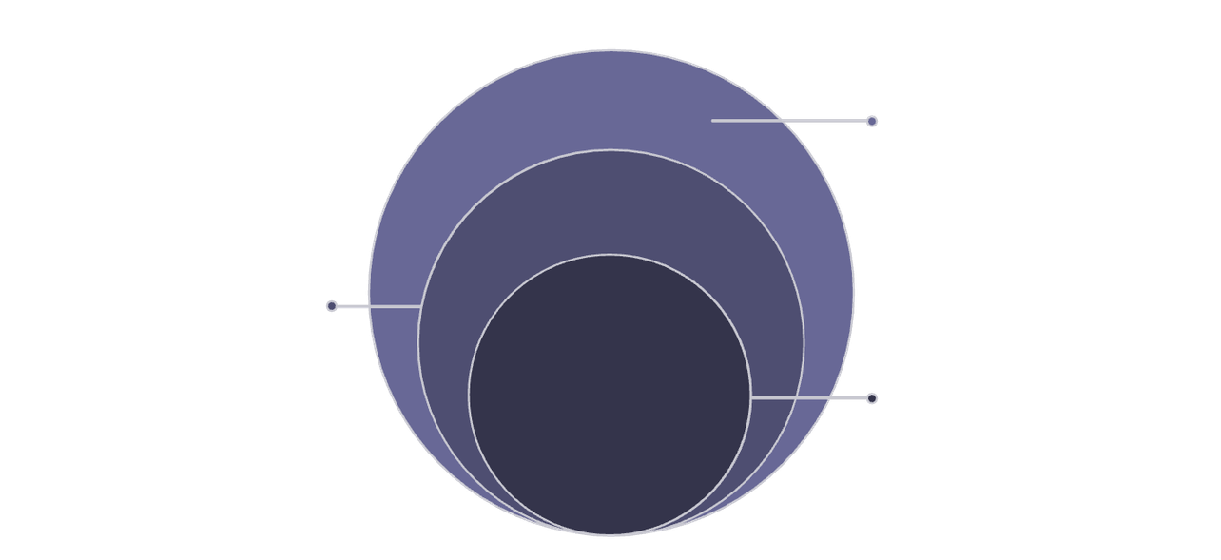

TECHNICAL ARCHITECTURE
Deterministic backend + IBM Bob explanation layer
Deterministic Engines
Bottleneck Score
50% Utilization + 30% WIP + 20% Capacity Pressure
API & UI Layer
FastAPI backend + React dashboard; persisted in Postgres
Outage Backlog
Queuing theory — independently verifiable
ML Explanation
HHI Concentration Index
IBM Bob (watsonx.ai) converts JSON to narrative
Supplier market concentration measurement
Core Engine
Deterministic scoring and risk fusion engines
SPOF Detection
Flags single-supplier dependency ≥ 70%
Inventory Coverage
Days of coverage remaining per material
Zero ML models. All calculations are deterministic and independently verifiable.
Notes:
4

Slide 5

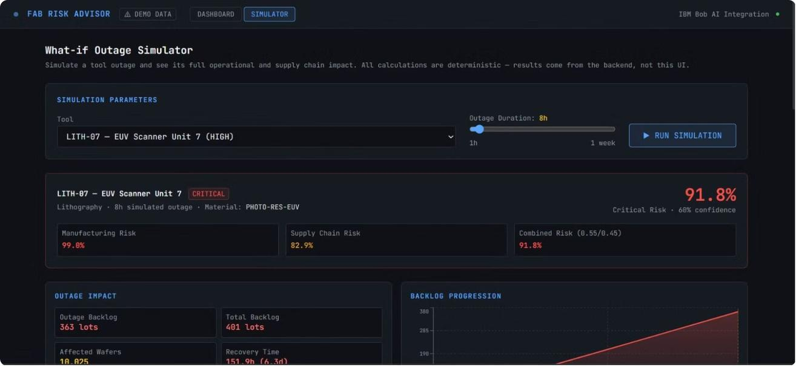
LIVE DEMO: FROM OUTAGE TO ACTION
What-if Outage Simulator: LITH-07 Tool Failure Scenario
1
Bottleneck Detection
LITH-07 identified as critical — 91.8% combined risk score
2
Outage Impact
8-hour outage modeled → backlog accumulation and recovery time calculated via queuing theory
3
Supply Risk Trace
Material dependencies traced, supplier concentration assessed automatically
4
Recommendations
Alternate tool routing, lot scheduling adjustments, inventory action plan
All data shown is synthetic/demo data.
Notes:
5

Slide 6
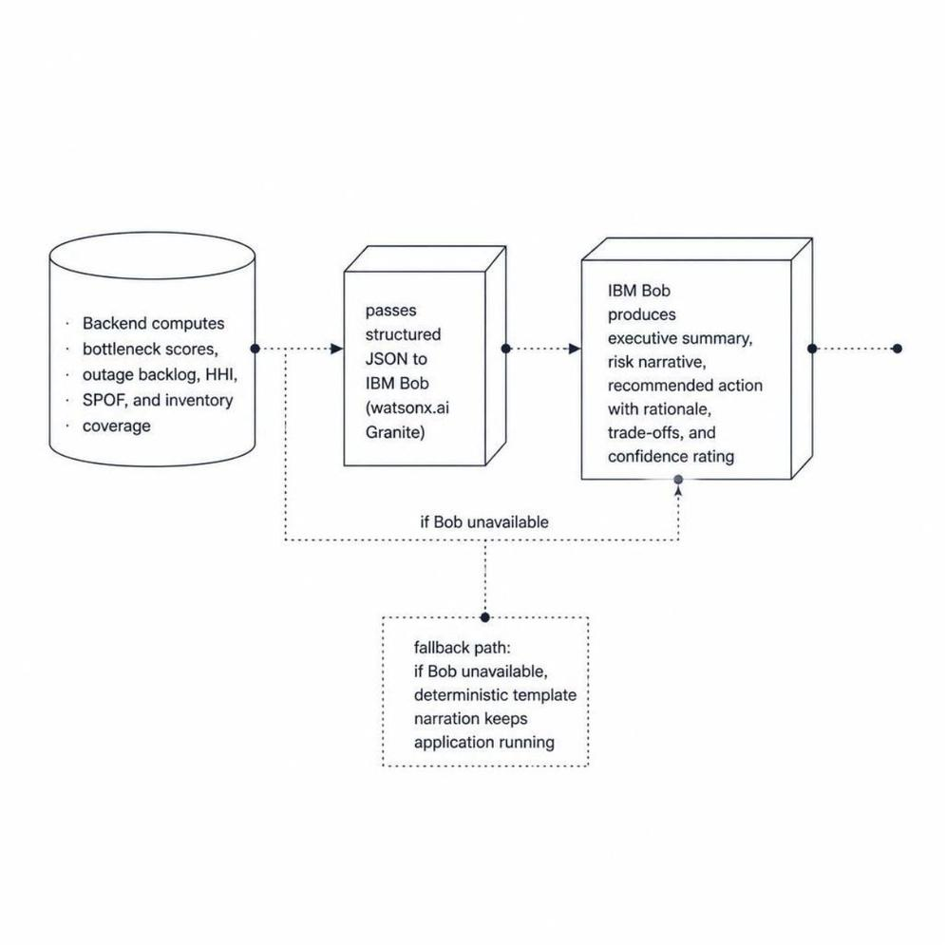





IBM BOB: DECISION EXPLANATION LAYER
Deterministic calculations → Structured JSON → IBM Bob → Executive Brief
BACKEND COMPUTES
IBM BOB RECEIVES
Bottleneck scores, outage backlog, HHI, SPOF, inventory coverage, combined risk fusion
Structured JSON containing all calculated operational facts
IBM BOB PRODUCES
RESILIENT FALLBACK
Executive summary, risk narrative, recommended action + rationale, trade-offs, confidence rating
If Bob unavailable → deterministic template narration. Application continues working.
IBM Bob is load-bearing. It transforms raw operational facts into human-readable decisions that ops teams can act on immediately.
Notes:
6

Slide 7
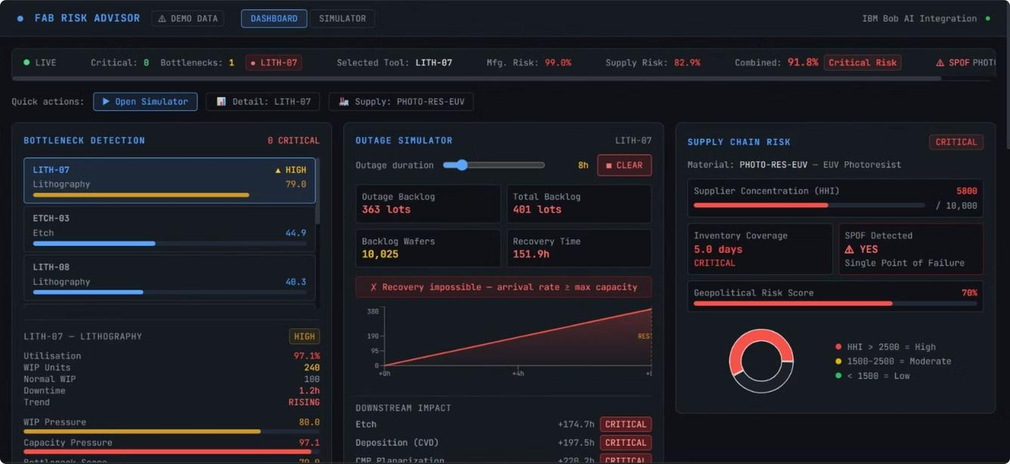
WHAT SUCCESS LOOKS LIKE
Complete risk dashboard: bottleneck detection, outage simulation, supply-chain analysis, combined risk assessment
Bottleneck Detection
Outage Simulation
Composite scoring with utilization, WIP & capacity pressure
Backlog accumulation & recovery time via queuing theory
Supplier Risk
Risk Fusion
HHI concentration index & SPOF detection at ≥70%
Combined 55% mfg + 45% supply-chain score with IBM Bob brief
Result: Turn operational signals into explainable, actionable decisions in seconds.
Notes:
7

Slide 8

TEAM ALCHEMIST: BUILT FOR THE FAB
Four engineers, one integrated system
Astha Makwana
Yashvi Bhadani
Manthan Chavda
Radhika Dholakiya
24DIT030
Bottleneck Detection & Outage Simulation
24DIT004
Supply Chain Risk Intelligence
24DIT009
Impact Engine & Dashboard
26MCA042
Project Management & Presentation Lead
Tech Stack
All data used in this system is synthetic/demo data. No real-world operational facts are claimed.
Python 3.11+ | FastAPI | React 18 | TypeScript | PostgreSQL | IBM Bob (watsonx.ai Granite 13B)
Notes:
8

