Slide 1
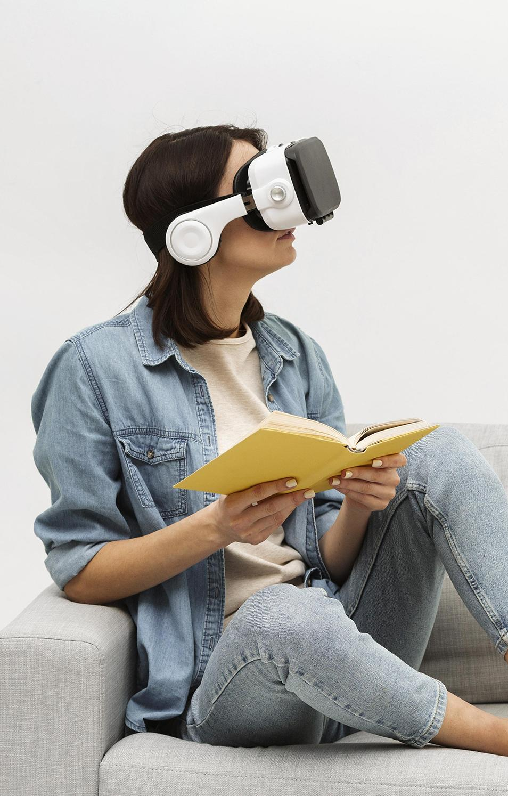
ExplorAR Glasses
ExplorAR
2026
Here is where your presentation begins

Slide 2
MEET THE TEAM
RIDA SADIQA
SARAYU ANAND GONGADA
MOHAMMED SUFYAN
MOHAMMAD ARMAAN
YASHVI RAJIV VYAS

Slide 3
INTRODUCTION
Augmented Reality (AR) enhances the real world by overlaying digital information.
Unlike VR, AR allows users to stay aware of their surroundings.
In travel, users depend on multiple apps for navigation, translation, and weather.
This leads to a fragmented and less immersive experience.
ExplorAR Glasses aim to provide a unified AR-based travel assistant.
EXPLORAR GLASESS

Slide 4
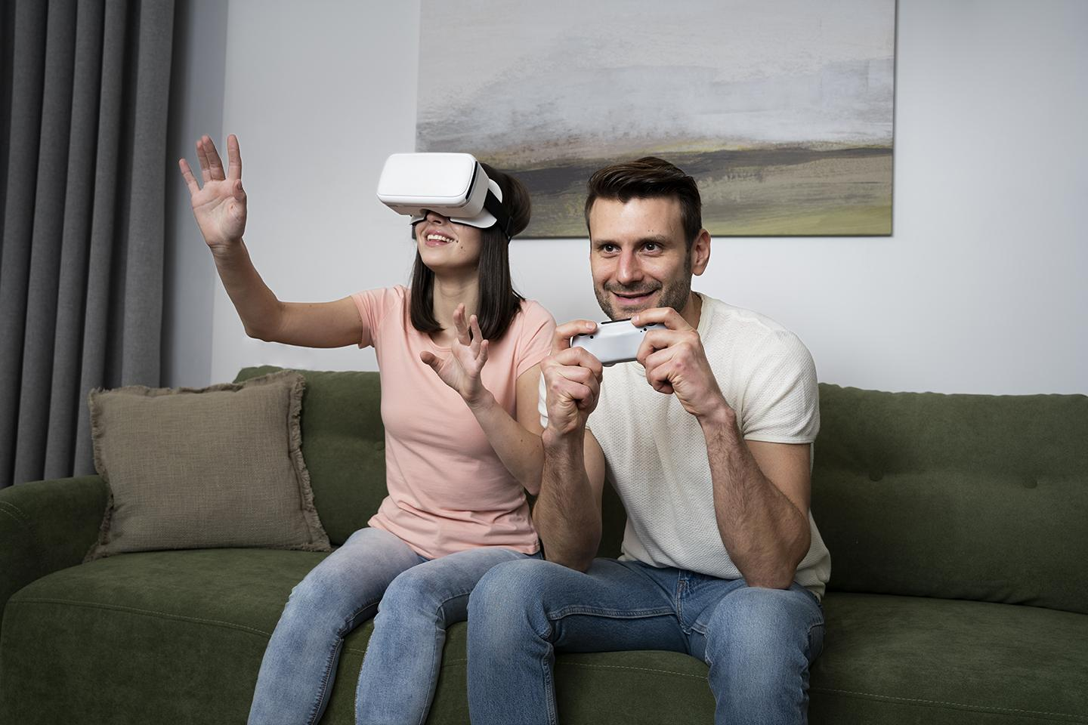
ABSTRACT
ExplorAR Glasses is an intelligent AR-based travel assistance system.
It integrates geolocation, AI (LLMs), navigation APIs, weather services, and translation.
Provides real-time contextual information about surroundings.
Supports voice interaction for hands-free usage.
Uses cloud-based APIs for scalability and lightweight performance.
Extended AR

Slide 5
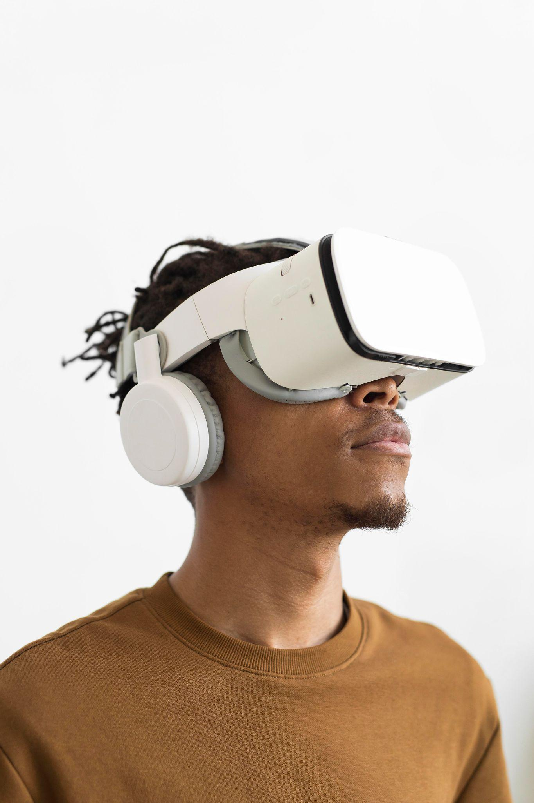
LITERATURE REVIEW
AR has been successfully applied in navigation, tourism, and maintenance systems.
Studies show improved efficiency, visualization, and user interaction.
Integration of AI and NLP enhances contextual understanding.
However, most systems lack:
Integration of multiple features
Scalability for real-world usage
Real-time intelligence

Slide 6
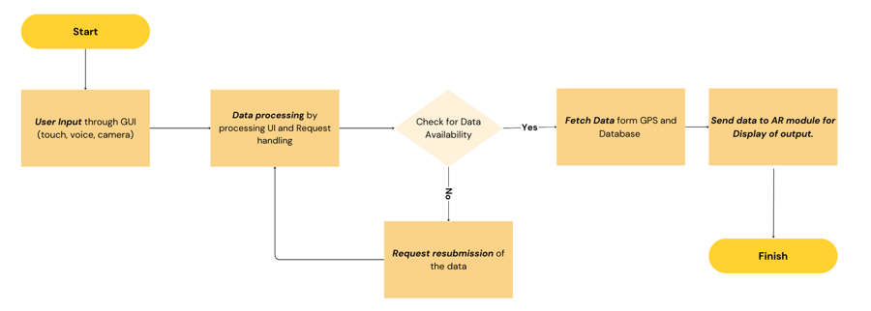
PROPOSED SYSTEM
ExplorAR Glasses provide a unified intelligent travel platform
Combines AR, AI, ML, and API-based services
Key Features:
Real-time location-based insights
Smart navigation assistance
Text recognition & translation
Real-time weather updates
Voice-based interaction
Modular design supports future enhancements like personalization and offline mode

Slide 7
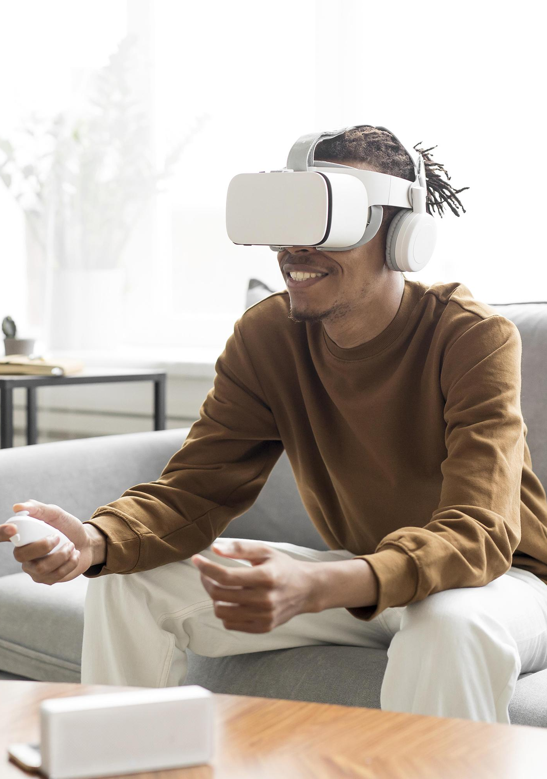
EXISTING SYSTEM
EXTENDED
AR AGENCY
Popular AR systems include:
Google Glass
Microsoft HoloLens
Magic Leap
Vuzix Blade
Features:
Hands-free interaction
Basic navigation and notifications
Limited AR visualization
2026

Slide 8
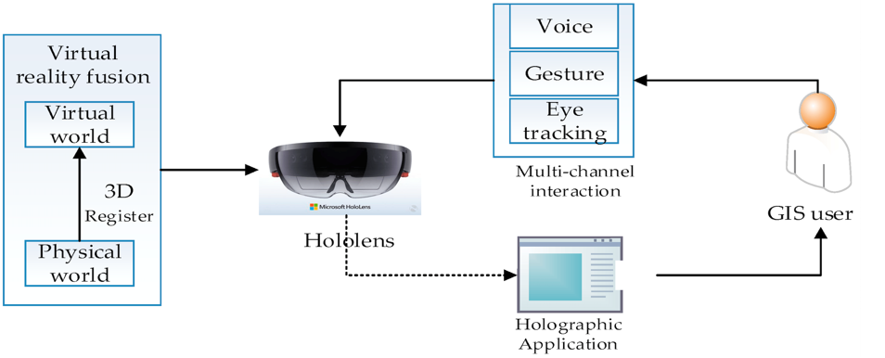
EXISTING SYSTEM
EXTENDED
AR AGENCY
2026
High cost and limited accessibility
Bulky and not suitable for travel use
Limited contextual AI capabilities
Dependence on multiple applications
Limited offline support
Lack of integrated features like translation and weather

Slide 9
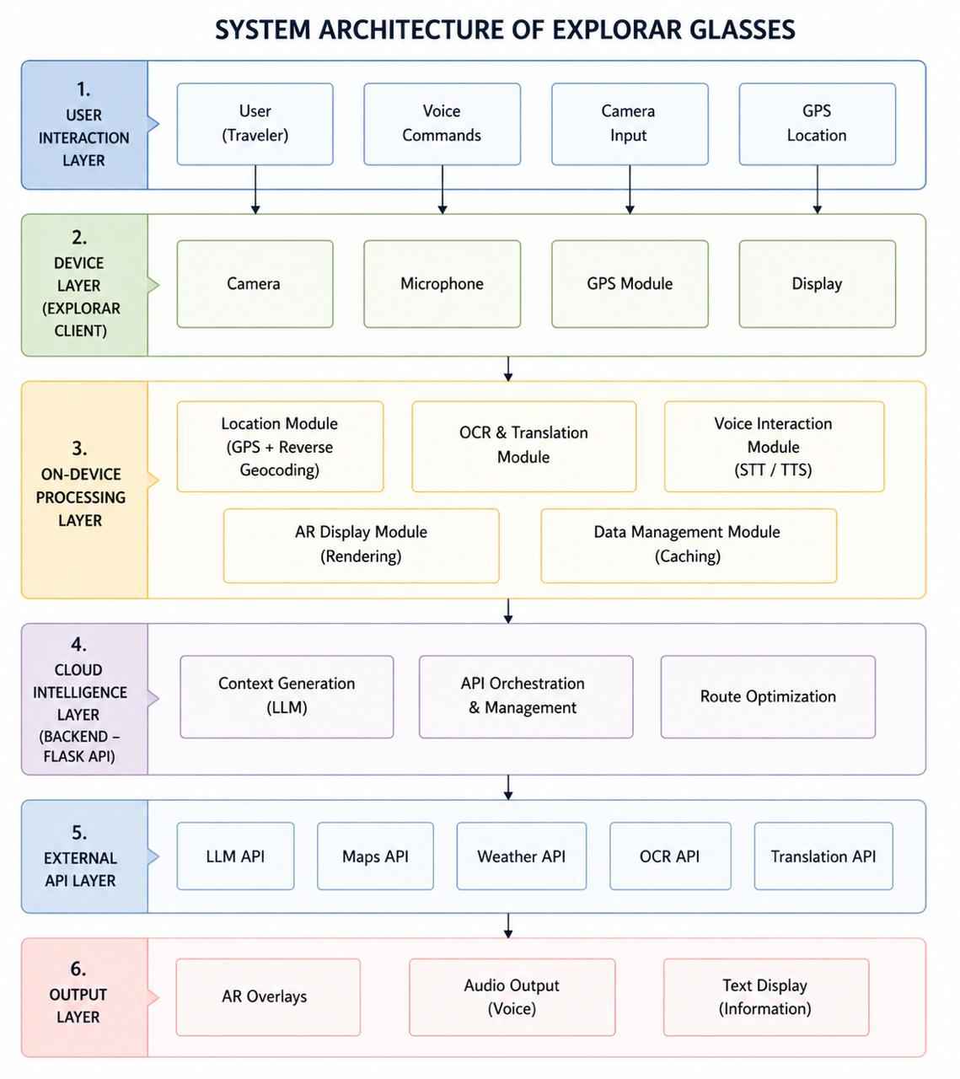
SYSTEM REQUIREMENTS
Hardware:
Camera, GPS, Microphone
Accelerometer, Gyroscope
AR device / Laptop (prototype)
Software:
AR Framework (ARCore/ARKit)
ML tools (TensorFlow, OpenCV)
APIs for navigation, weather, translation
Internet connectivity (Wi-Fi/Bluetooth)
EXTENDED AR AGENCY

Slide 10
CONCLUSION
ExplorAR Glasses solve the issue of fragmented travel applications.
Provide a smart, unified, and interactive travel experience.
Enhance navigation, communication, and learning during travel.
Future scope includes:
Wearable deployment
Offline functionality
Personalized recommendations
The system has strong potential in smart tourism and AR-based assistance systems.
EXTENDED AR AGENCY

Slide 11
THANKS!
EXTENDED AR AGENCY
2026

