Slide 1
Problem Statement & Understanding
PROBLEM STATEMENT
How big this is official Government of India data
What we understood
Real-Time Speech Emotion Analysis for Cybercrime Investigation
24.0 lakh
₹22,495 cr
01
Callers speak Hinglish
Amounts, phone numbers and UPI IDs arrive as words. Plain keyword search on a transcript misses most of them.
financial-fraud complaints on NCRP in 2025, 9.1× the 2021 count
reported lost by citizens to cyber fraud in 2025 (NCRP / CFCFRMS)
Cyber cells take calls from scared victims, informants and people with recordings of suspected fraudsters. While one officer listens, calms the caller, types and judges urgency, signs of fear or distress are easy to miss.
Asked for: a speech emotion system for live or recorded calls that spots fear, anger, distress and nervousness, helps rank calls, and keeps every output an indicative signal, never proof of honesty, intent or guilt.
86,420
68.9%
02
Minutes decide recovery
The 1930 / NCRP report and the call to the bank have to happen fast. Time since the loss is the real urgency signal.
cyber-crime cases registered in 2023, up 31% on 2022
of those 2023 cases had fraud as the motive (59,526)
33.9%
5.2 lakh
03
Some victims are still trapped
In “digital arrest” calls the scammer may still be on video with the victim. That needs an alert, not a score.
all-India chargesheeting rate for cyber crime, 2023
suspected fraud calls, SMS and WhatsApp reported on Chakshu, 2025
What a fraud call actually sounds like
04
Each call is handled alone
The same UPI ID can show up in Pune, Nashik and Indore with nobody connecting them.
Training scenario AV-2026-T0001 (scripted, labelled synthetic)
Caller 00:02
Sir mujhe ek call aaya nau eight seven six five four three two one zero se, bole CBI se hain, mere naam pe parcel mein drugs mile hain customs mein
05
A bare emotion label misleads
“Fear 0.81” gives no next step, and on a suspect it can be misread as guilt.
Caller 00:13
unhone video call pe rakha aur bola kisi ko mat batana, warna arrest kar lenge
06
Crisis needs a person
Lines like “sab khatam ho gaya” call for a trained human hand-over.
Caller 00:19
maine dedh lakh rupaye bhej diye cbi.verification at the rate ybl pe, State Bank se, aadha ghanta pehle
Caller 00:27
sir abhi bhi video call pe hain woh, please help
Amount reported, ₹ crore: 551 → 2,290 → 7,465 → 22,848 → 22,495
Our reading of the problem
Urgency should come from what happened: how long ago, how much, and whether someone still controls the caller. Voice emotion helps, but as a separate signal that is switched off for suspects and is allowed to say “not sure”.
Money said in words
dedh lakh = ₹1,50,000
Number in two languages
nau eight seven… = 98765…
Complaints in 2025 average about 6,580 a day. Each one begins as a conversation, and most of the facts police need are spoken, not typed.
UPI ID spelled aloud
at the rate ybl = @ybl
Victim still on the call
possible active coercion
Where it concentrates (2023): Karnataka 21,889 · Telangana 18,236 · Uttar Pradesh 10,794 · Maharashtra 8,103 cases
Sources (byte-identical copies in backend/anvesh/data/official, SHA-256 verified at start-up): NCRB Crime in India 2023, Tables 9A.1 and 9A.3; Rajya Sabha USQ 1341 (11 Feb 2026, I4C NCRP/CFCFRMS); Rajya Sabha USQ 647 (5 Feb 2026, DoT Chakshu). data.gov.in, GODL.
Notes:
Start with the call on the left: this is one of our labelled training scenarios. Point out the four things a plain transcript misses. Then the national numbers, all from data.gov.in files we ship with hashes. End on our reading: urgency from facts, emotion as a separate gated signal.

Slide 2




















Technical Approach
01
02
03
04
05
06
07
Capture
Speech to text
Hinglish layer
Fact extraction
Signals
Decide
Officer in control
Browser mic streams 16 kHz mono PCM16 over a signed-in WebSocket, cut into ~5 s chunks at a natural pause. Uploads (wav, mp3, m4a, ogg, webm) work too. SHA-256 taken on ingest.
faster-whisper small, int8 on CPU, Hindi mode, VAD, beam 5, word timestamps. After hang-up, large-v3-turbo re-transcribes the full call. Filters drop Whisper hallucinations.
Devanagari is transliterated to Roman Hinglish. The normaliser turns spoken numbers, “at the rate” and time phrases into values and keeps a character map back to the words.
12 fields: amount, time, UPI, phone, account, IFSC, UTR, bank, app, agency, platform, email. Each keeps its segment, character span and audio second.
8 scam playbooks drive next questions. Safety scan finds coercion and crisis phrases. Live fear, anger, distress and nervousness from voice, plus a synthetic-voice check.
Three separate engines: golden-hour triage on facts, a role-gated distress track, and the Ring Linker across all cases (details below).
Next.js workspace: verify or correct every field, Hindi read-back to the caller, complaint draft. Every view, AI output and edit goes into the audit chain.
Hinglish normaliser real outputs:
saadhe paanch hazaar → ₹5,500
dedh lakh → ₹1,50,000
ramesh at the rate okaxis → ramesh@okaxis
nau aath saat… → 987…
aadha ghanta pehle → a clock time
Distress track (victim, informant)
Golden-hour triage (open rules)
Ring Linker
Tech stack (all in the repo)
Voice emotion: emotion2vec+ per spoken line
weights fear 1.0 · sad 0.85 · angry 0.6 · disgust 0.4
Reported fact | Score
Loss reported within 24 h | +60
Loss within 7 days | +35
Older loss, or time not yet known | +20
Loss of ₹1,00,000 or more | +15
A critical field still missing | +5
Crisis language (call ≤ 6 h old) | → 90
Possible active coercion | → 85
Identifier match · score 1.0
Same UPI, phone, account, IFSC or UTR, matched through an HMAC blind index (plaintext never indexed).
Python
FastAPI
PyTorch
HF Hub
Acoustic change vs the caller’s own first 20%
pitch variability 0.35 · energy 0.25 · pace 0.2 · pauses 0.2
scikit-learn
NumPy
SQLAlchemy
Pydantic
Scam script · ≥ 0.40
Char 3–5-gram TF-IDF within the same scam type, or a multilingual MiniLM if configured.
window = 0.55 × emotion + 0.45 × acoustic
voice = 0.7 × top-25% windows + 0.3 × last 3
PostgreSQL
SQLite
Next.js
React
Caller voice · ≥ 0.62
ECAPA speaker embeddings, cosine. Suspect recordings only, always a lead.
TypeScript
Tailwind
d3-force
Docker
+0.12 per distress phrase (max 0.36), +0.15 coercion, +0.08 money lost, +0.25 crisis. Sustained, not one spike.
High ≥ 0.70
Elevated ≥ 0.45
Low
IMMEDIATE ≥ 60
HIGH ≥ 30
STANDARD
GH Actions
pytest
Ruff
Web Audio
Voice abstains outside en/hi, below 8 dB SNR or with no usable audio; words still count. Off for suspect recordings by policy.
Distress is shown to the officer but never added to this score. No claim is made about whether money can be recovered.
Connected cases form a ring. Every link stays a candidate until an officer confirms or rejects it.
faster-whisper
emotion2vec+ / FunASR
SpeechBrain ECAPA
AES-256-GCM
HKDF · HMAC
Fernet
Thresholds and weights are copied from backend/anvesh/distress.py, triage.py and linker.py. Models load lazily in the background; /api/health reports what is loaded, and a missing model is reported, never simulated.
Notes:
Walk left to right through the pipeline. Stop on step 6: three engines that are kept apart on purpose. Facts drive triage. Distress is gated by role and can abstain. The Ring Linker turns one call into a search across all cases.

Slide 3
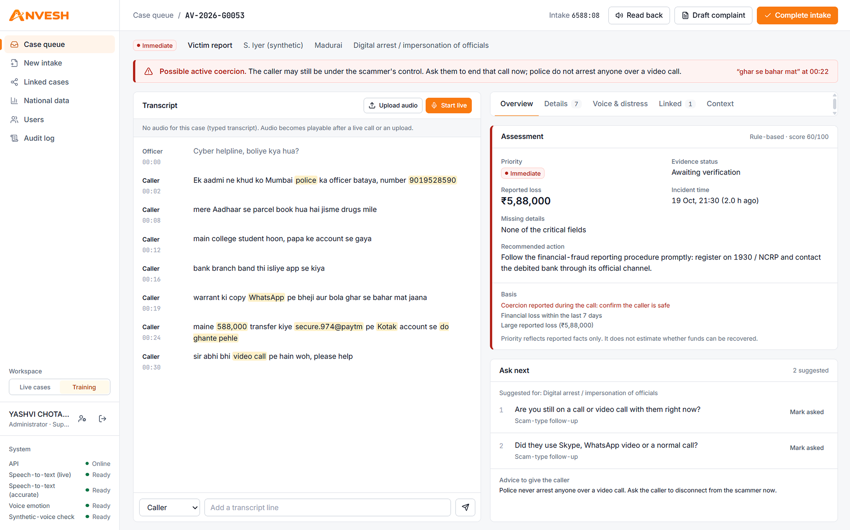
Feasibility & Viability
FEASIBILITY
It already runs
Feasible on three fronts
Quality gate on every push
Technical
Operational
Legal & ethical
1
Ruff lint
backend
Open models: faster-whisper, emotion2vec+, ECAPA
Runs on a laptop CPU (int8); “base” model for low RAM
Live text every ~5 s; full re-transcribe after the call
Models load in the background; /api/health shows status
Officer stays in charge: verify, edit or reject any field
Fits today’s 1930 / NCRP and bank-reporting steps
Three roles: operator, supervisor, administrator
One-click setup.bat; docker compose for servers
Outputs are indicative only, never evidence of guilt
Emotion scoring off for suspects by design
Controls shaped around the DPDP Act 2023
Only GODL open data; licence of every model listed
2
pytest: 87 tests (unit, API, live, security)
backend
3
Extraction eval: 38/38 field checks*
backend
4
bandit: no medium or high findings
security
5
pip-audit + npm audit (production)
security
6
TypeScript typecheck
frontend
7
Next.js production build
frontend
5,322 lines of backend Python
10 app pages, Next.js 15
6 official datasets, SHA-256 checked
Runs on every push and pull request
Risks we planned for, and the fix in the code
VIABILITY
From one laptop to the 1930 desk
Noisy phone audio
VAD, Whisper hallucination filter; voice track abstains below 8 dB SNR
Hindi–English mixing
Hindi-mode ASR, transliteration, spoken-number normaliser
Cyber-cell laptop
District server
State / 1930 desk
setup.bat, CPU, SQLite. Offline once models are downloaded.
docker compose: PostgreSQL 16 + API + web, own keys.
Telephony for live calls, NCRP-format export, multi-tenant.
Emotion model untested on a language
Voice scoring only for validated en / hi; word cues still shown
Misuse against suspects
No emotion or stress score for suspects; voice match is a lead only
Now
Ready
Roadmap
Leak of victim data
AES-256-GCM per field, master key outside the data folder, blind index
Evidence edited later
SHA-256 per recording, encrypted evidence, HMAC-signed audit chain
Why it stays affordable
Core stack is MIT, BSD or Apache-2.0: no licence or per-minute cloud speech fees
Runs on hardware a cyber cell already has; data never leaves it
Models are swappable adapters; emotion2vec+ licence to be cleared before any sale
We will measure, not guess
ASR delay per 5 s chunk on a laptop
Field accuracy on 15–20 recorded role-play calls
False coercion / crisis alerts on 5 control calls
Intake time: manual form vs Anvesh, same call
Insider snooping
Named logins, scrypt, lockout after 5 tries, need-to-know roles
No public victim-call data
Labelled training calls built from Chakshu and NCRB data, kept apart
*38/38 is a development set written with the code (20 phrases, 38 field checks): it shows spoken forms are handled, not accuracy on real calls. Sources: .github/workflows/ci.yml, EVALUATION.md, SECURITY.md, LICENSES.md, README.md.
Notes:
Top half is feasibility: it already runs, it is feasible technically, operationally and legally, and every push has to pass seven checks. Bottom left: the eight risks we expected and the fix for each. Bottom right: viability, from a single laptop today to the 1930 desk, why it stays cheap, and what we will measure live instead of guessing.

Slide 4
Impact & Benefit
Victim on the line
One call, a whole ring
Told to hang up on the scammer at once: “Police never arrest anyone over a video call.”
Facts read back in Hindi, so they can say yes or correct them.
Crisis language prompts a hand-over to Tele-MANAS 14416.
T0001
Pune · ₹1.5 L
T0003
Indore · ₹2.0 L
Call-taking officer
Case file builds itself while the caller talks; each field links to the exact second of audio.
Co-pilot asks the next question for the scam type and for missing fields.
One clear priority with its reasons, instead of a raw emotion score.
T0002
Nashik · ₹85K
T0004
Pune · recording
shared identifier
victim report
recording
RING-T0001 (training data): 4 cases, 3 districts, ₹4.3 L, linked by 9876543210 and cbi.verification@ybl; 4 links waiting for officer review.
Investigator / supervisor
Today
With ANVESH
Rings across districts with shared identifiers and the total reported loss.
Editable complaint draft where every fact points to its evidence.
41% of 2025 Chakshu reports are in a category with its own playbook
52% if the job / lottery / loan category is counted too
Officer types while listening
Facts captured as the caller speaks
Urgency felt, not written down
Priority with the reasons shown
SDG 16
DPDP Act 2023
Tele-MANAS 14416
Hidden coercion can be missed
Coercion alert with the quoted words
Department and courts
Peace, justice and strong institutions: faster, evidence-backed complaints
Field encryption, need-to-know roles, erasure and retention built in
Crisis language triggers a human hand-over prompt
Each complaint stands alone
Linked to earlier cases as rings
Tamper-evident audit of every view, AI output and human correction.
Personal data encrypted field by field, with erasure and retention rules.
Hard to show what changed
Every action in a signed audit chain
Chakshu figures: Rajya Sabha USQ 647 (5 Feb 2026, DoT), data.gov.in, GODL. Playbook mapping from backend/anvesh/nlp/playbooks.py (digital arrest, investment, KYC, courier, sextortion, job, utility, plus a general playbook). Ring shown is synthetic training data.
Notes:
Impact by who benefits. The chart ties our playbooks to what citizens actually report: 41% directly, 52% with job offers. The ring on the right is the core idea: one victim call can surface three more cases.

Slide 5
Comparison with Existing Platforms
Capability | Pindrop voice fraud & deepfake defence | Behavioral Signals voice emotion & deepfake API | Hume AI expression measurement API | Verint + Cogito contact-centre analytics & coaching | I4C 1930 / NCRP national fraud reporting (India) | ANVESH call → case file for cyber cells
Main job | Trust the caller | Score the voice | Measure expression | Coach agents | Take complaints | ✓ Build the case
Works on live calls | ✓ Yes | ✓ Yes | — | ✓ Yes | Phone helpline | ✓ Yes
Voice emotion / distress | — | ✓ Yes | ✓ Yes | ◐ CX/EX score | — | ✓ Role-gated
Deepfake / synthetic voice check | ✓ Yes | ✓ Yes | — | — | — | ✓ Flags for verification
Hinglish amounts, numbers, UPI IDs → fields | — | — | — | — | — | ✓ Yes
Each fact tied to the second of audio | — | — | — | — | — | ✓ Yes
Links complaints into fraud rings | ◐ Bad-actor network | — | — | — | — | ✓ ID · script · voice
Coercion (“digital arrest”) & crisis alerts | — | — | — | — | — | ✓ Yes
Emotion off for suspects; can abstain | — | — | — | — | — | ✓ Yes
Can run on-premises | — | ✓ Cloud / on-prem / edge | ✓ API or own env. | — | Run by I4C | ✓ Laptop / server
Built around Indian police steps | — | — | — | — | ✓ Yes | ✓ Feeds 1930 / NCRP
✓ stated on the product’s own public website ◐ related, narrower capability — not stated publicly, so not claimed (checked 24 Oct 2026)
Where ANVESH fits
The market tools above answer “is this voice real?” or “how does this customer feel?”. A cyber cell needs a case file it can act on in the golden hour. ANVESH is built for that, flags voices that may be synthetic, and feeds 1930 / NCRP instead of replacing them.
01
02
03
04
Call → case file
Amount, time, UPI, bank, phone, UTR and scam type, each linked to its second of audio.
Ring Linker
Identifier, script and suspect-voice links turn one complaint into a search over all earlier ones.
Priority from facts
Golden-hour rules with every reason shown. Emotion is shown, never added to the score.
Safe by design
Emotion off for suspects, abstains on bad audio, field encryption, HMAC-signed audit.
Sources: pindrop.com, behavioralsignals.com, hume.ai, verint.com and verint.com/cogito (product pages read 24 Oct 2026); I4C NCRP / CFCFRMS as cited in the repo’s sources.json. ANVESH claims are from README.md and the backend source.
Notes:
We compared against five real products. Read across the ANVESH column, and note that our synthetic-voice check only asks the officer to verify identity; it never decides someone is lying. Everything marked with a dash simply is not claimed on that product's public site, so we did not claim it either.

