Slide 1

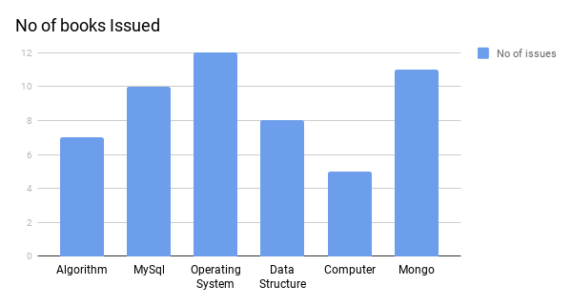
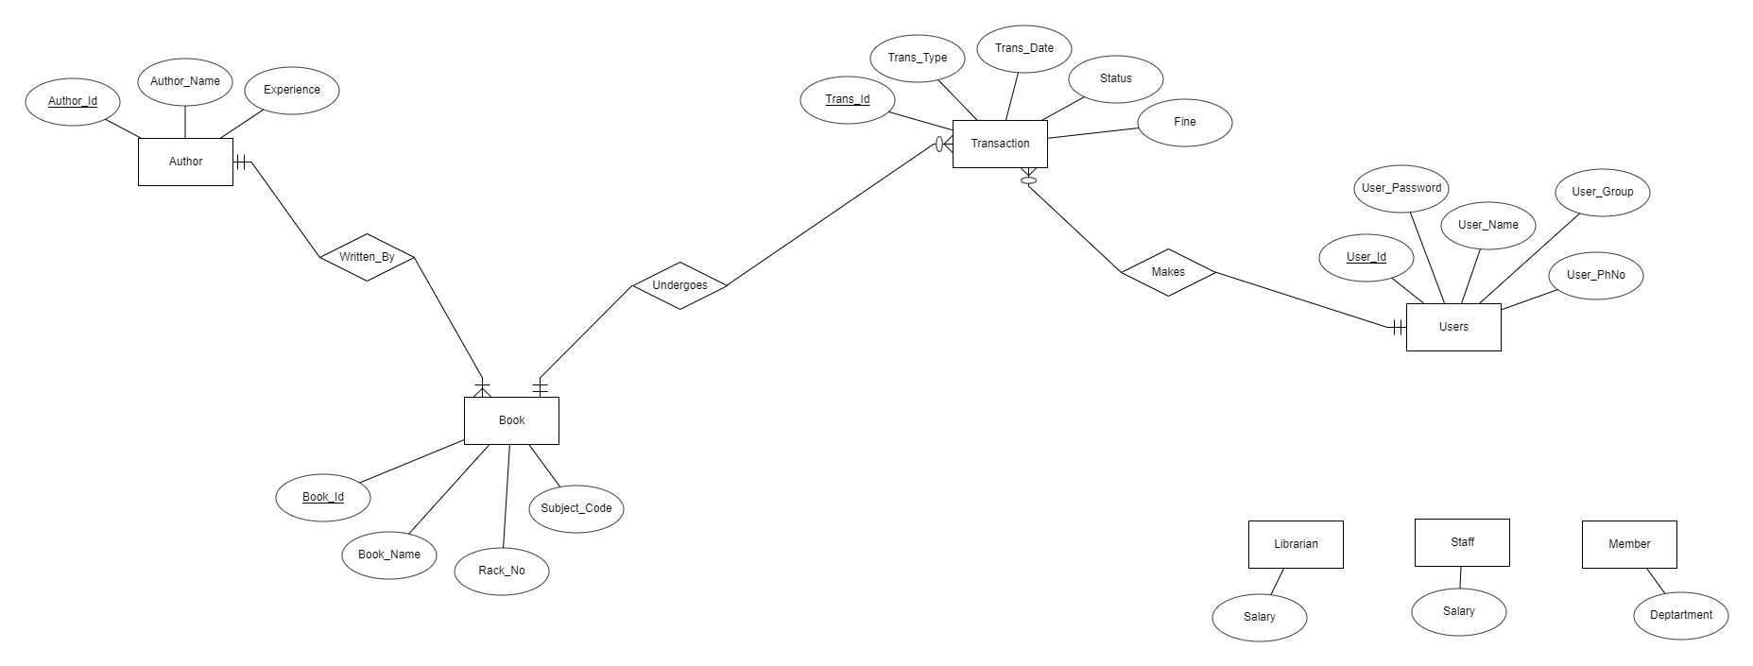

LIBRARY MANAGEMENT SYSTEM
Ayushi Desai, Yashvi Desai, Parth Dosani
Sardar Patel Institute of Technology
Abstract
Objectives
Technologies Used
The purpose of Library Management System is to provide the members an easy access to the books of the library. It enables users to easily catalogue books and keep the record of books issued and returned. It simplifies the working of the library by keeping all the required data of users as well as books.
To create ease of operation.
To calculate the total fine collected every year.
To manage issue and return of books
Front-end: HTML, CSS, JavaScript, Bootstrap
Middle-tier: PHP
Back-end: MySQL
Outcomes
Results
The Librarian would be able to keep track of all the books and users of the library.
The staff will be able to easily manage the fine.
Reducing the manual work significantly thus saving time.
Motivation
The Library Management System operated manually is too tedious for the Librarian to maintain as he has to enter all the data and values manually and also keep track of the books issued, returned, fine to be paid, etc. This is a complex and tiresome task. Thus the motivation behind this project is to ease and automate the entire process of Library Management System.
Project Scope
This application is exclusively made to lessen the load on the librarian and staff and make the operations more efficient, Therefore, the scope of this project spreads to large extend as all the libraries can use this system.
Problem Statement
To replace manually operated Library management System with a new computerized, user friendly and robust system which will make it easier for librarian to keep track of all the users and for users to easily check on the book availability and other required things.
References
Phpmyadmin
Stackoverflow.com
W3school.com
ERDplus.com
This presentation poster was designed by FPPT.
Notes:
You can add your presentation notes here. This presentation template for research posters is fully editable so text, graphics and content can be updated to fit your own research needs.
Download more poster presentation templates from FPPT.com

