Slide 1

Cyclistic Bike-Share Data Analysis
Yashvi Pandya
28th March,2024

Slide 2
Introduction of Datasets
The data contains 2 years of bike trips data of a company. This data includes trip duration, trips on weekend and weekdays, memberships and casual rides, station names and ids. The main agenda of this presentation is to articulate difference between anual members and casual riders.

Slide 3
Data Cleaning process
Reviewed two data files for the year 2019 and 2020.
Renamed columns and changed data types in the 2019 data corresponding to the 2020 data.
Eliminated a few columns that have no bearing on the conclusions.
Made corrections to a few entries in the member_casual column that go from subscriber to member and customer to casual.
Calculated ride_length using the provided trip start and endpoints.
Summarized data and found patterns.

Slide 4
Data Analysis
Purpose: To find out how members and casual riders use bikes differently.
Through careful examination of the dataset, we have identified several notable trends, patterns, and correlations. To provide actionable insights, here are some graphs:
Average ride length by members_casual
Average ride length by day of week and members_casual
Average ride length by day of week

Slide 5
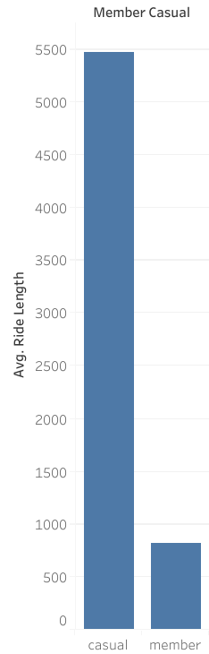
Average Ride Length by Member_Casual

Slide 6
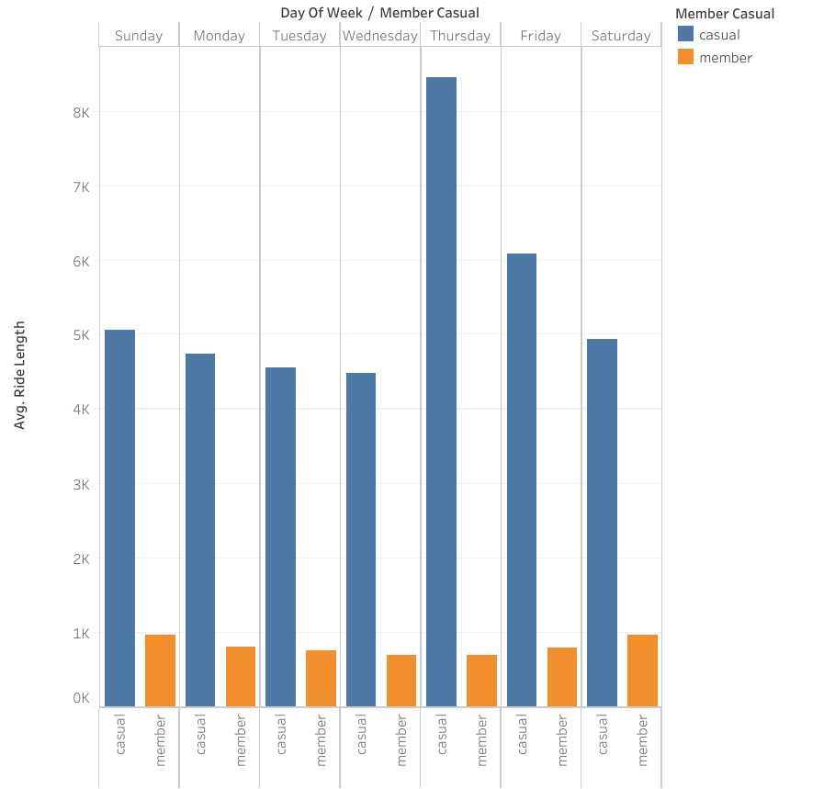
Average Ride Length by Day of Week and Member_casual

Slide 7
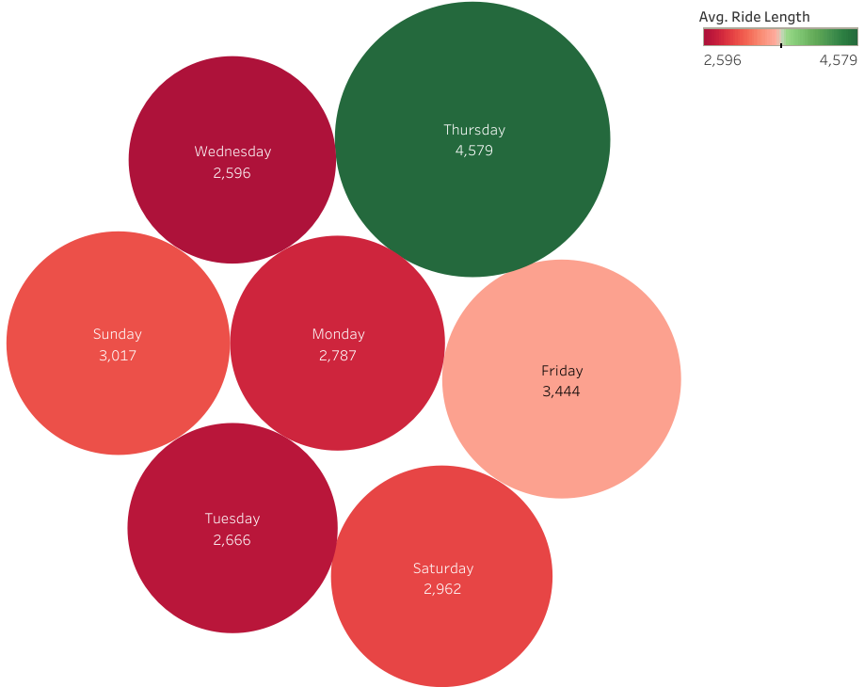
Average Ride Length by Day of Week

Slide 8
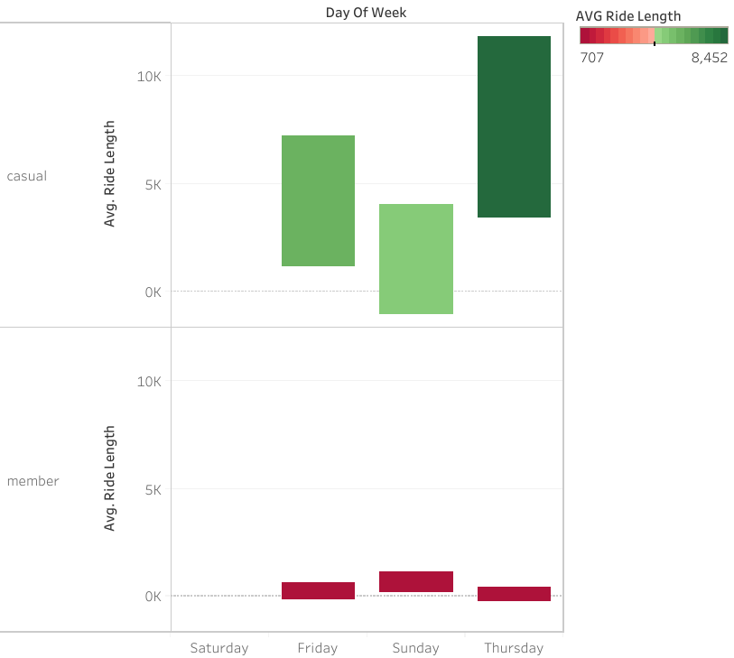
Average Ride Length by Member_Casual and Peak Days

Slide 9

Key Findings
The average ride distance of casual riders significantly exceeds that of members.
Casual riders typically cover an average distance of around 4.5K per week.
Thursdays and Fridays are the days when casual riders are most active.

Slide 10

Recommendations
Based on the data survey, I suggest implementing a one-time offer where members can enjoy a complimentary ride of up to 0.5 kilometers upon purchasing a membership during the current promotional period.
Additionally, we can provide a convenient discount for purchasing memberships specifically on Thursdays and Fridays.

Slide 11

Conclusion
Key Insights: Identified trends and patterns in data analysis, highlighting areas of opportunity.
Recommendations: Proposed actionable strategies to capitalize on insights and drive business growth.
Impact: Implementation of recommendations expected to enhance performance and achieve organizational objectives.
Next Steps: Plan for further exploration and execution of recommendations to maximize results.
Summary: The analysis underscores the importance of data-driven decision-making in achieving success.
Yashvi Pandya
Junior Data Analyst at Cyclistic Bike-share

