Slide 1
Digital India
Vision and Impact

Slide 2
Introduction
• Launched in 2015 by Government of India
• Aim: Transform India into digitally empowered society
• Improve online infrastructure and services

Slide 3
Vision of Digital India
• Digital Infrastructure for every citizen
• Governance and services on demand
• Digital empowerment of citizens

Slide 4
Impact Flowchart
Online Payments Growth
Easy Government Services
Impact of
Digital India
Digital Literacy Increase
Rural Development
Startup Growth
Transparency

Slide 5
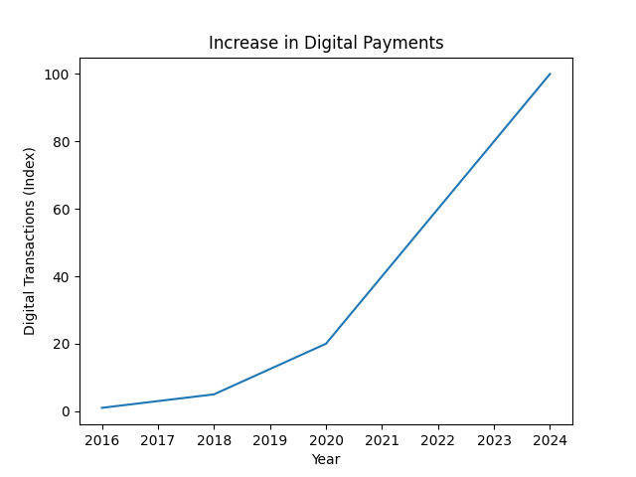
Growth in Digital Payments

Slide 6
Conclusion
Digital India is transforming India into a smart and modern nation.
It improves transparency, efficiency, and connectivity.

