Slide 1
CSE3501- Information Security Analysis and Audit

Slide 2
CSE3501- Information Security Analysis and Audit
Assessment Configuration
Quiz-1
Quiz-2
Digital Assignment
CAT-1
CAT-2

Slide 3
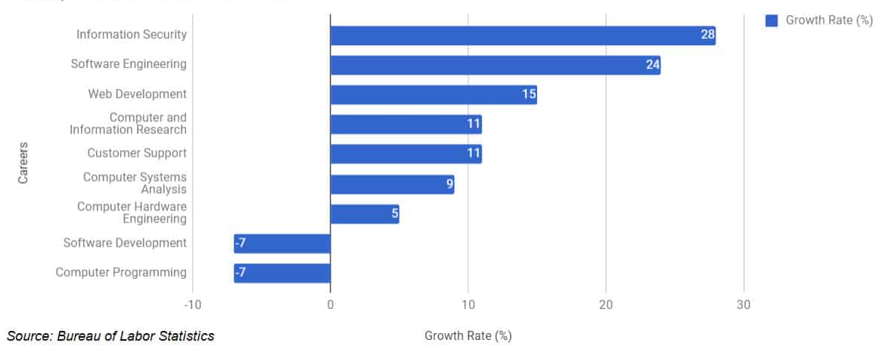
Computer Career Growth Rate

Slide 4
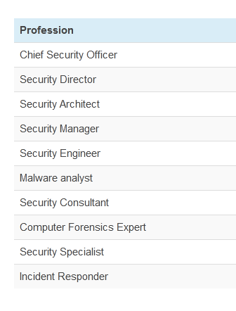

Slide 5
CSE3501- Information Security Analysis and Audit
Module-1: Information Security Fundamentals
Module-2: System Security
Module-3: Information Security Management
Module-4: Incident Management
Module-5: Incident Response
Module-6: Conducting Security Audits
Module-7: Information Security Audit Preparation
Module-1: Self and Work Management

Slide 6
Module-1: Information Security Fundamentals
Definitions & challenges of security
Attacks & services
Security policies
Security Controls and Access control structures
Cryptography
Deception
Ethical Hacking
Firewalls
Identify and Access Management (IdAM).

Slide 7
Module-2: System Security
System Vulnerabilities
Network Security Systems
System Security
System Security Tools
Web Security
Application Security
Intrusion Detection Systems

