Slide 1
Sales Prediction Analysis
Using Multiple Linear Regression
Advertising Impact on Sales

Slide 2
Dataset Overview
- Data from Advertising Sales Campaign
- Features: TV, Radio, Newspaper, Sales
- Missing values handled (Radio filled with median)

Slide 3
Correlation Analysis
- Correlation between TV, Radio, Newspaper & Sales
- Highest Impact: TV Ads
- Correlation Matrix Computed

Slide 4
Model Training
- Multiple Linear Regression Model
- Data Split: 80% Training, 20% Testing
- Features: TV, Radio, Newspaper

Slide 5
Model Performance
- MAE, MSE, and R² Evaluated
- R² Score Indicates Model Fit
- Comparison: Normalized vs Original Data

Slide 6
Sales Prediction Example
- Given: TV = $200, Radio = $40, Newspaper = $50
- Predicted Sales Output
- Useful for Ad Budget Optimization

Slide 7
Conclusion & Insights
- TV Ads have the highest impact on sales
- Model helps predict future sales
- Businesses can optimize ad spending

Slide 8
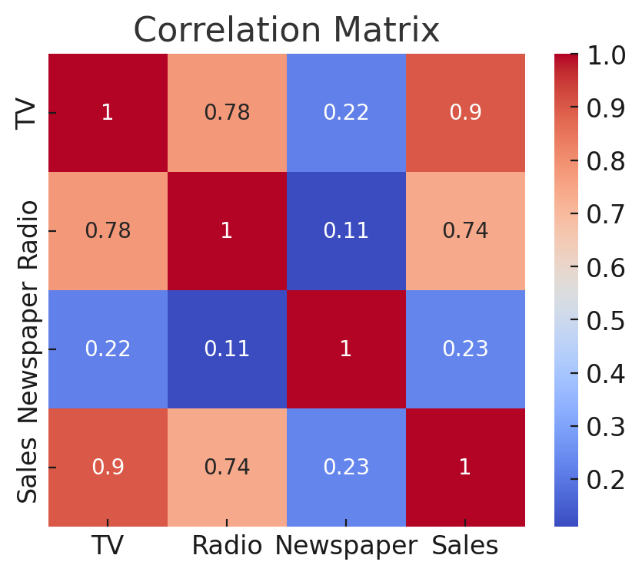

Slide 9
