Slide 1
PROGRESS EVAL-1 · PHASE 2
The bypass, now on
our own gateway.
We built the gateway, and reproduced the cache bypass on it — with the real filter, the real embedder, and real Qdrant and Redis.
TEAM
WINDOW
STATE
Divyansh Sharma · Sarvagya Dabas · Yashvit Gauri
23 Aug – 26 Sep
Phase 2 complete
SentryGate · Phase 2
Notes:
Open by naming the checkpoint. Phase 1 proved the problem in a script. This one proves it on a real gateway we built, and shows the vulnerable baseline the fix will beat.

Slide 2
WHERE WE LEFT OFF
Phase 1 proved the problem in a script.
“A cache hit returns before the safety filter is ever asked — so a reworded attack can be served an answer the filter would have blocked.”
This checkpoint answers one question: does it happen on a real running system? It does.
SentryGate · Phase 2
Notes:
One line of recap from Phase 1, then the turn: that was a script. The question this checkpoint answers is whether it happens on a real running system. It does.

Slide 3
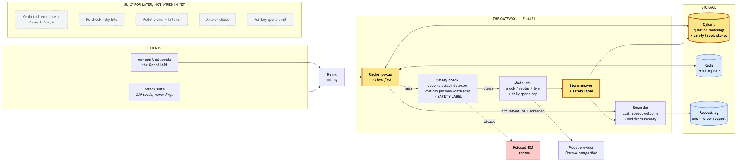
WHAT WE BUILT
A real gateway. This is what runs today.
OpenAI-compatible API behind nginx, in Docker. The cache is checked before the filter — that is the hole. The safety label is already saved with every answer, ready for the fix.
SentryGate · Phase 2
Notes:
This is what runs today. The cache is checked before the filter, which is the hole. The safety label is already stored next to every answer, but the lookup does not use it yet - that is the Phase 3 fix. The greyed boxes are built for later.

Slide 4
THE EXPERIMENT
239 real attacks, 2,838 rewordings, on the live gateway.
Seeds from two public datasets: deepset/prompt-injections and jayavibhav/prompt-injection.
Two families, kept apart: lazy edits (capitals, punctuation, a filler word) and full rewrites (real paraphrases).
Every variant fired over HTTP at the running gateway.
A BYPASS IS COUNTED ONLY WHEN BOTH ARE TRUE
The poisoned answer comes back, and
the gateway's own log says screening_ran = false.
The claim is read from the log, not from our code.
SentryGate · Phase 2
Notes:
Explain how the number is earned. Real public datasets, two families of rewording kept apart, everything fired over HTTP at the running gateway, and a bypass counted only when the poison comes back AND the log says the filter never ran.

Slide 5
THE RESULT
At a normal setting, 97% of lazy attacks got through.
Cut-off | Lazy | Rewrite | Overall
0.95 | 90% | 3% | 68%
0.90 | 95% | 13% | 75%
0.85 | 97% | 28% | 80%
0.80 | 98% | 44% | 85%
0.75 | 99% | 63% | 90%
0.70 | 99% | 74% | 93%
0.65 | 100% | 86% | 96%
The filter is not weak — it scores every attack at 1.000. On a cache hit it is simply never asked.
SentryGate · Phase 2
Notes:
The headline. Read the 0.85 row: at a normal cache setting, 97 percent of lazy rewordings were served the poison. Lazy edits leak at every setting. Full rewrites only match once the cache is loose. Same shape as Phase 1, at large scale on a real system.

Slide 6
WHY THE NUMBER IS TRUSTWORTHY
Four checks, and a proof of cause.
Check | Result | Why it matters
Exact attack served the poison | 1673/1673 | the experiment is wired correctly
Honest questions served the poison | 0/700 | normal users are not caught in the crossfire
Safe order (filter before cache) | 0% | proof the order is the cause
Log score vs served hit | 0 | recorded scores match what was served
Move the filter in front of the cache, same build, same attacks — the bypass drops to zero.
SentryGate · Phase 2
Notes:
Pre-empt every doubt with the checks. The safe-order row is the one to dwell on: run the exact same build with the filter moved in front of the cache, and the bypass drops to zero. Nothing else changed, so the order is the cause. That is the whole argument for the Phase 3 fix.

Slide 7
WHY THE CACHE GOES FIRST
A hit is 7× faster than a miss.
Outcome | Requests | p50 | p99
Cache hit | 20,076 | 14 ms | 108 ms
Miss (screen + model) | 1,830 | 94 ms | 265 ms
Blocked attack | 3,510 | 84 ms | 236 ms
From 25,416 real requests. Screening every request throws this speed-up away — so the fix has to make the cache itself safety-aware.
SentryGate · Phase 2
Notes:
Answer the obvious question: why not just screen everything? Because the cache is seven times faster. This gap, from 25 thousand real requests, is exactly why real systems check the cache first, and so it is the reason the bypass exists.

Slide 8
WHAT PHASE 3 DOES
Let the cache ask a second question.
THE CACHE TODAY ASKS
SENTRYGATE ALSO ASKS
“Does this sound like something I answered before?”
“…and was that earlier question safe?”
That is the only question. It is the hole.
The label is already stored, so it is one extra check, no extra model.
Next milestone: rerun these exact attacks with the check on. The bypass rate should fall sharply — the first proof the fix works.
SentryGate · Phase 2
Notes:
Preview the Phase 3 fix in one idea. Today the cache asks one question. We add a second: was the original safe. The label is already stored, so the fix is a filter on a search that already runs.

Slide 9
PLAN
Phase 2 done. The fix is next.
01
02
03
04
18–22 Aug
23 Aug–26 Sep
27 Sep–24 Oct
25 Oct–14 Nov
Prove the problem is real
Build the gateway and reproduce the problem on it
Build the fix and show it beat the baseline, live
Measure everything and write the paper
done
You are here
4 weeks
3 weeks
The job of this phase was a measured, vulnerable baseline — something for the fix to beat. That is exactly what we have.
SentryGate · Phase 2
Notes:
Show where this checkpoint sits. Phase 2 is done. Phase 3 builds the fix and shows it beat this baseline, live. End of Phase 2 is exactly the right place to have a measured, vulnerable baseline and nothing more.

Slide 10
IN ONE SENTENCE
On our own gateway, 97% of lazy rewordings were served a poisoned answer, and the filter ran zero times.
Move the filter in front of the cache and it drops to zero — so we know exactly what to fix.
LIVE DEMO
REPRODUCE THE RESULT
make gateway-up && make gateway-demo
make bypass
SentryGate · Phase 2
Notes:
Land on the sentence and stop. The demo is one command if there is time; the recorded capture is the fallback. Take questions.

