Slide 1

Analyzing Consumer Trends in Protein Supplements Using Exploratory Data Analysis
By
Yash Jadhav

Slide 2

About Me
I am Yash Jadhav , Aspiring Data Scientist, graduated from Government College of Engineering Jalgaon in 2024 with B.Tech Computer Engineering Degree
Connect with me !!
LinkedIn
GitHub
Medium

Slide 3
Agenda
Problem Statement
Flow of Web Scraping
Intro to Dataset
Protein Price Distribution
Protein Prices w.r.t Brands
Top Protein Brands
Top Protein Flavors
Top Brands and their Flavors
Most Rated Flavors and their Brands
Best Value for Money Products
Top Sellers depending upon their ratings
Relation between Scoops and Serving Size
End Users
Future Scope
Conclusion

Slide 4

Problem Statement
“Understanding Consumer Trends and Optimizing Product Insights in the Protein Supplement Market”
This analysis aims to uncover actionable insights by exploring various aspects of protein supplements, such as pricing, flavor preferences, serving sizes, and brand ratings. By leveraging data-driven visualizations, we strive to:
Identify popular brands and flavors that resonate with consumers.
Analyze product pricing and value for money.
Evaluate customer preferences based on ratings and reviews.
Provide recommendations for businesses to align their offerings with consumer expectations

Slide 5
Web Scraping
Import Libraries
Parse HTML Content
Extract the Data
Store and Process the Data
4
Important Steps
To Follow :
Data Frame Creation
Regx patterns
Requests.get()
Parsing
find_all()
Requests
Beautiful Soup
Regx

Slide 6
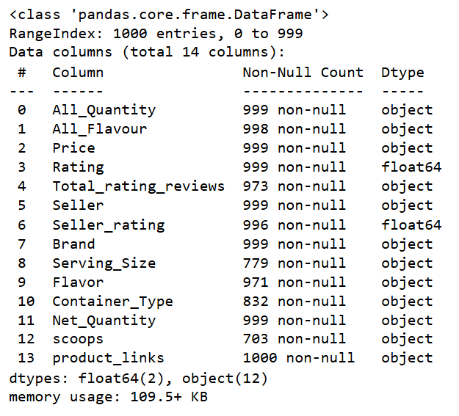
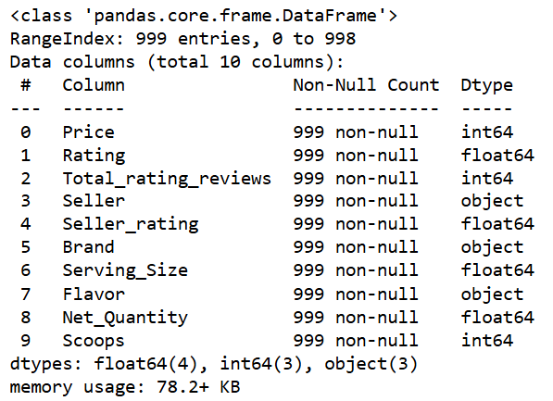

Intro to Dataset
CLEANED DATA
RAW DATA

Slide 7
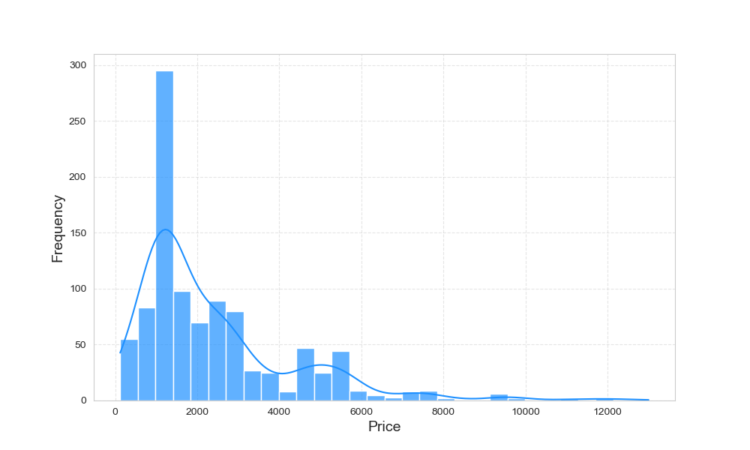
Protein Price Distribution
As we see from plot , Most of the protein prices lies in range of
1000 - 3000

Slide 8
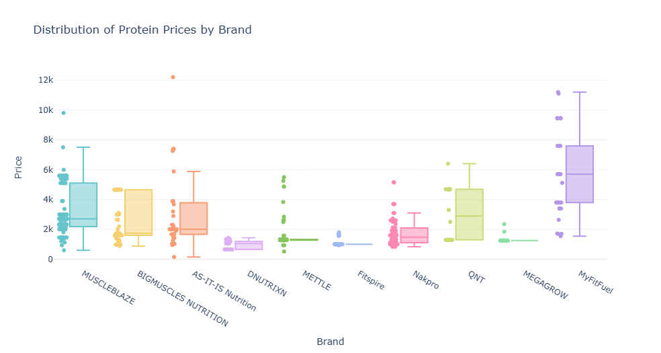
Protein Price Distribution w.r.t Brands

Slide 9
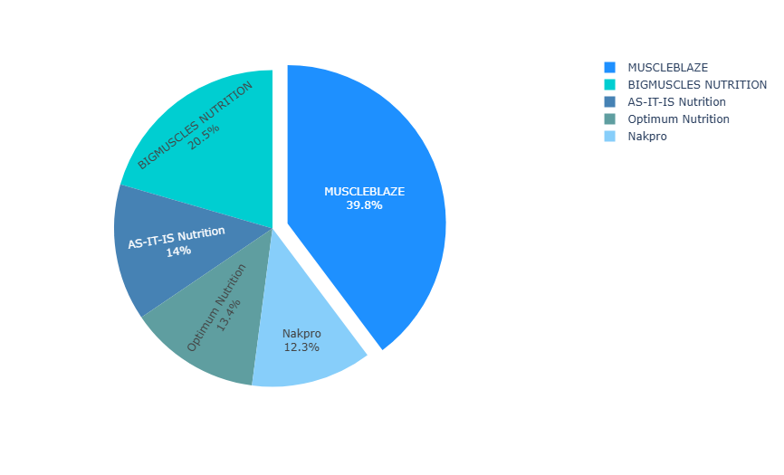
Popular Brands
As we see , MUSCLEBLAZE is top brand which is dominating protein market

Slide 10
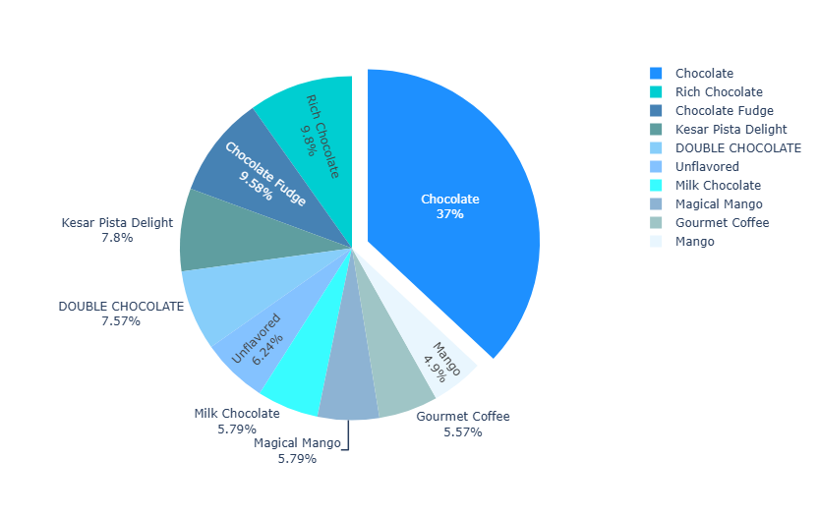
Popular Protein Flavors
As we see , CHOCOLATE
is famous flavor within protein market

Slide 11
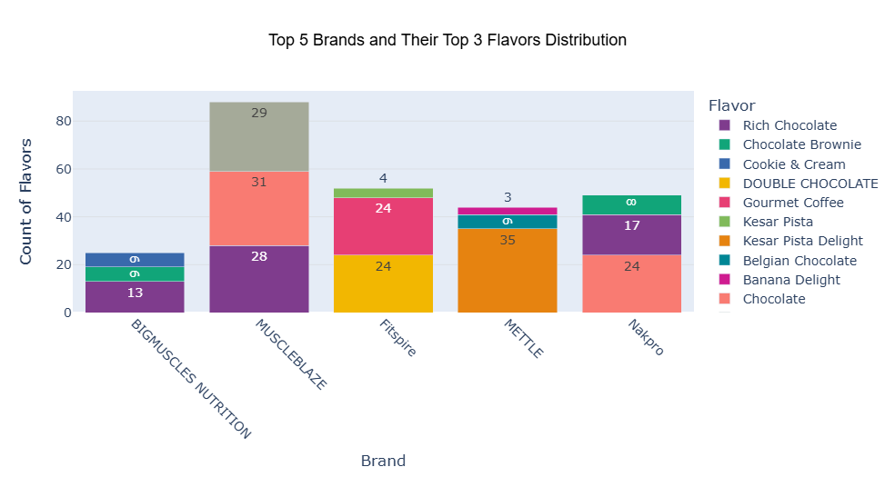
Top 5 Brands and their Flavors
MUSCLEBLAZE brand uses CHOCOLATE flavor combinations more , that’s why it is most popular brand

Slide 12
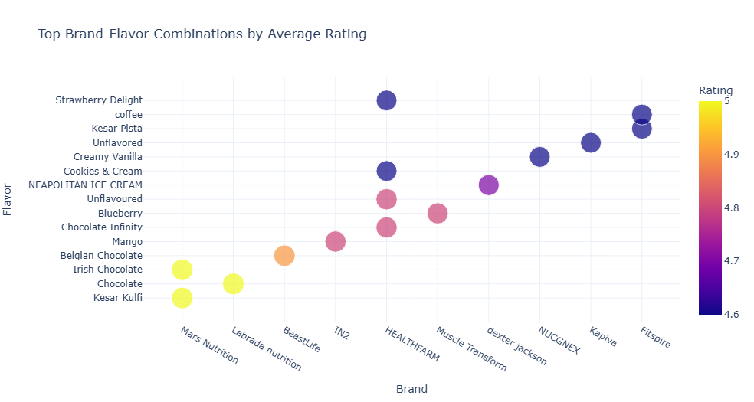
Most Rated Flavors and their Brands
Users who always go for their favorite flavors instead of brands, this analysis gives information about most rated flavors within brands

Slide 13
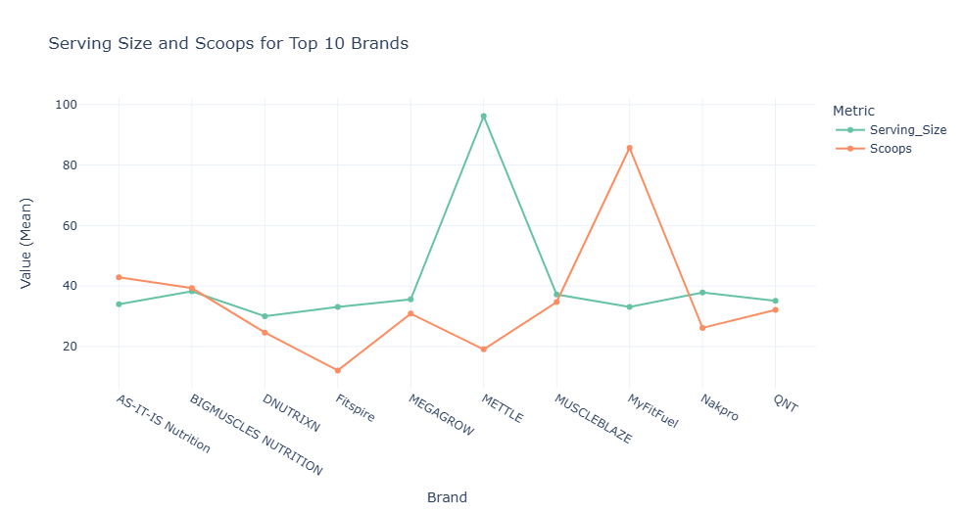
Relation between Serving Size and Scoops
Top brands like Muscle Blaze , Big Muscles, AS-IT-IS ,etc. maintain scoops and serving size same, means they don’t use bigger scoops size and which is preferable to users also, New brands can interpret from this analysis

Slide 14
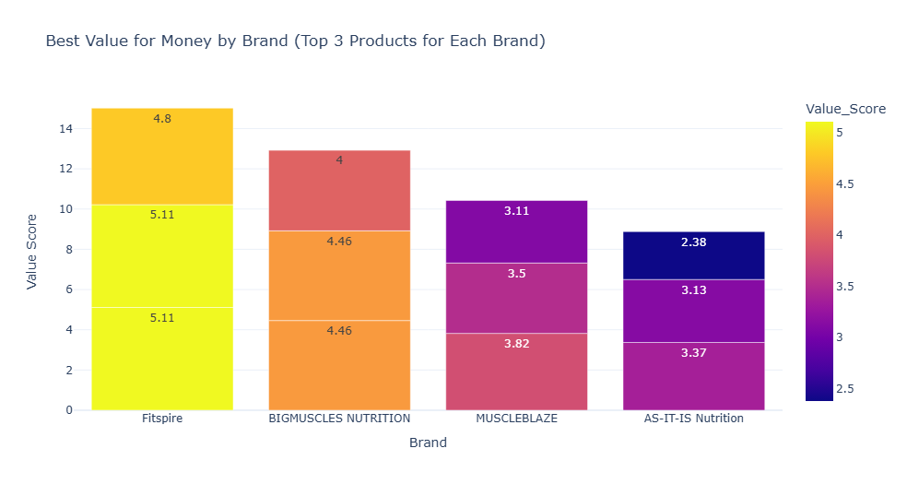
Best Value for Money within Brands
Best Value for money products calculated based on Net Quantity, Price and Ratings

Slide 15
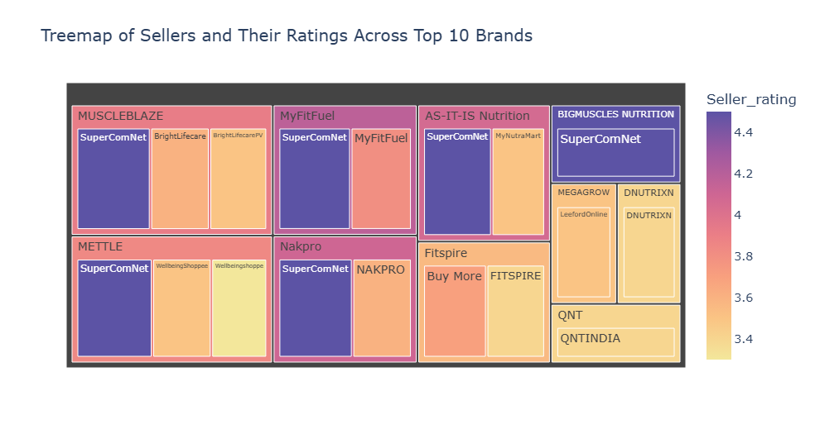
Top Sellers depending upon their Ratings
“SuperComNet” Seller is most rated seller within top protein brands

Slide 16
End Users
Fitness Enthusiasts:
Help them find the best products for their fitness goals.
Supplement Brands:
Provide insights for product development and marketing strategies.
Retail Platforms:
Assist e-commerce platforms in optimizing their product recommendations.
Researchers:
Offer valuable data for studying trends in fitness and health.

Slide 17
Future Scope
Fitness Industry Collaboration:
Share insights with fitness brands to optimize their product offerings.
Use findings to guide influencer collaborations and targeted marketing.
Customer Education:
Help customers make informed decisions by highlighting cost-efficient, high-quality products
Expansion to Other Categories:
Extend the analysis to related categories like mass gainers, pre-workouts, or BCAA supplements
Health-Focused Research:
Partner with nutritionists to explore the impact of specific ingredients on health outcomes

Slide 18
Conclusion
Our analysis of the protein supplement market reveals:
Consumer Preferences: Top brands and flavors that resonate with customers are linked to higher ratings and reviews.
Value for Money: Brands offering a balance between price, serving size, and quality gain competitive advantage.
Market Trends: Insights into flavor popularity and price distribution highlight opportunities for targeted marketing.
Actionable Recommendations: Businesses can optimize offerings by focusing on consumer-preferred flavors, improving product quality, and offering competitive pricing

Slide 19
Any Questions ?

Slide 20
Thank You !!

