Slide 1
IBM University Engagement Project Submission
“Exploring the Power of Agentic AI with IBM Granite and LangFlow”

Slide 2

Project Title – Travel Planner Agent
Domain of Project – Travel & Tourism
Yash Vyas | Recent Passport Photo | Email: v77vyas@gmail.com | Mobile: 8005748561 [WhatsApp]

Slide 3
Problem Statement -
Problem Statement : Travel Planner Agent
The Challenge
Planning a trip is often overwhelming, as travelers struggle with choosing destinations, building itineraries, and finding suitable transport and stays. Information about destinations, weather, hotels, and local attractions is scattered across multiple unreliable sources. Without personalized, real-time guidance, many travelers end up with poorly planned, stressful trips.
The Objective
Build an AI-powered Travel Planner Agent that delivers personalized travel itineraries and recommendations for individuals, families, and groups planning trips. The solution should:
Personalized Itineraries – Build day-wise travel plans based on budget, duration, interests, and travel dates.
Travel Data RAG Retrieval – Fetch and summarize destination info, weather, hotels, and attractions from reliable sources.
Booking & Schedule Management – Manage hotel and transport bookings, and alert users to schedule changes.
Local Insights & Safety Tips – Provide local guides, safety advisories, and cultural etiquette tips for each destination.
Multi-Agent System –
Destination Knowledge Agent (fetches destination & weather data)
Itinerary Planner Agent (personalized day-wise itineraries)
Booking Advisory Agent (hotel & transport suggestions)
Trip Tracker & Feedback Agent (schedule tracking + alerts)
Visualization Dashboard – Show itinerary timeline, budget breakdown, and trip progress on a map.

Slide 4
Technology Used
Tech Stack (Mandatory)
Use any one of the following approaches:
LangFlow + IBM watsonx.ai + Granite Models
IBM Cloud Agentic Lab with IBM Granite Models
Replicate with LangChain + RAG + IBM Granite Models
I used LangFlow + IBM watsonx.ai + Granite Models

Slide 5
Proposed Solution -
Proposed Solution: AI-Powered Travel Planner Agent
The proposed solution is a multi-agent AI-powered Travel Planner Agent built using LangFlow, IBM watsonx.ai, and Granite Models to provide personalized, real-time trip planning. The system addresses challenges in destination discovery, itinerary building, and booking management through an intelligent, modular architecture.
At its core, the solution uses a Retrieval-Augmented Generation (RAG) pipeline to fetch accurate travel data from trusted sources such as tourism boards and weather APIs. This data is embedded and stored in a vector database, enabling the system to retrieve and summarize destination details (attractions, hotels, weather) using Granite models.
The system consists of four key agents:
Destination Knowledge Agent retrieves and summarizes destination and weather information using RAG.
Itinerary Planner Agent generates personalized day-wise itineraries based on user inputs such as budget, duration, and interests.
Booking Advisory Agent suggests suitable hotels and transport options based on budget and preferences.
Trip Tracker & Feedback Agent tracks the trip schedule, manages bookings, and alerts users to changes or delays.
The solution includes a user-friendly dashboard (built with Flask or React) that visualizes the itinerary timeline, hotel/flight options on a map, and budget breakdown.
LangFlow is used to orchestrate agent workflows, while watsonx.ai ensures scalable model deployment, embeddings, and AI governance. Granite models power reasoning, summarization, and personalization.
Overall, this solution delivers an end-to-end intelligent travel planning assistant that makes trip planning seamless through personalized itineraries, real-time updates, and curated recommendations.

Slide 6
Langflow component Used -
1) Chat Input – Interface where users enter trip details such as destination, dates, budget, and preferences.
2) IBM watsonx AI Agent - Processes user input using Granite models to generate personalized itineraries and travel recommendations.
3) Name of IBM Granite model - Granite-4.0-8B-Instruct → Fast, efficient for real-time itinerary generation
4) Chat output -Displays AI-generated responses such as day-wise itineraries, hotel suggestions, and travel tips.
5) File component - Stores and retrieves user preferences, trip history, and destination datasets for analysis.
6) API Request component – Fetches real-time weather and hotel pricing data.

Slide 7
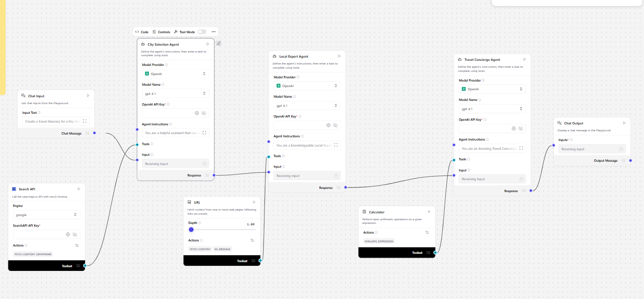
Langflow workflow -

Slide 8

Architecture blueprint

Slide 9

Role of Agentic AI in the solution
Role of Agentic AI in Travel Planner Agent
Agentic AI enables the Travel Planner Agent to function as an intelligent, autonomous system rather than a simple chatbot. Using IBM watsonx.ai and IBM Granite models, it coordinates multiple specialized agents to deliver personalized travel planning.
Each agent performs a specific role—such as retrieving destination data, generating itineraries, suggesting bookings, and tracking the trip schedule—while working collaboratively. This multi-agent approach ensures efficient task execution and accurate results.
Agentic AI also brings context awareness, understanding user details like budget, travel dates, and interests to generate tailored itineraries. It supports real-time adaptation, continuously updating plans based on weather changes or user feedback.
Additionally, agents communicate with each other, enabling better decision-making and improved outcomes.
Overall, Agentic AI makes the system proactive, personalized, and goal-driven, acting like a smart personal travel agent that helps users plan and enjoy stress-free trips.

Slide 10
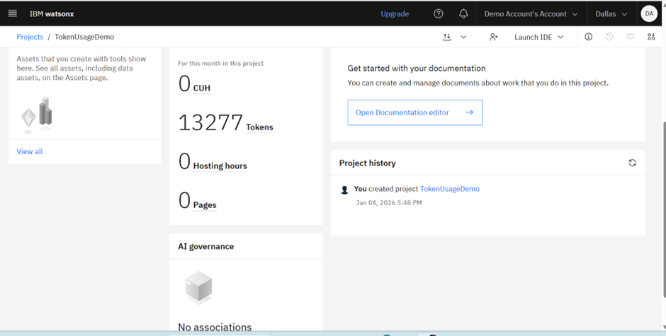
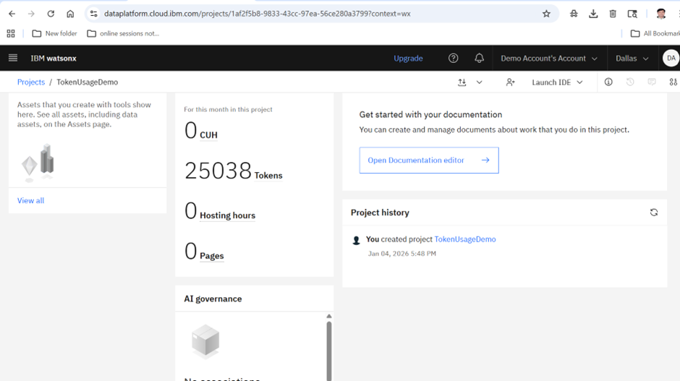
Token Usage
11,761 token are used
·
·
·

Slide 11
Novelty and Uniqueness
The proposed Travel Planner Agent stands out by combining Agentic AI, RAG, and personalization into a single intelligent system.
Multi-Agent Intelligence – Instead of a single chatbot, multiple specialized agents collaborate to deliver accurate, context-aware travel plans.
RAG-Based Accuracy – Integrates real-time data retrieval with AI generation, ensuring up-to-date and trustworthy travel recommendations.
Hyper-Personalization – Tailors itineraries based on budget, travel dates, and personal interests.
Real-Time Feedback Loop – Continuously adapts the itinerary based on weather updates and user feedback.
Multi-City Itineraries – Supports planning trips across multiple destinations in a single itinerary.
Hiking & Adventure Integration – Goes beyond hotel booking to connect users with verified hiking and trekking partner agencies.
Scalable & Enterprise-Ready – Built on IBM watsonx.ai with IBM Granite models, ensuring reliability and governance.
This makes the solution a smart, adaptive, and proactive digital travel agent, not just a static itinerary generator.

Slide 12
Git Hub Link
· Please create public github repository (Enable Add README button while creating repository) with format –
Please test and Paste the working Github URL – https://github.com/Yashvyas001/Travel-planner-agent
Make sure you have Uploaded following three files into your github repository 1) app.json file , 2) yourproblemstatement.pdf file 3) your projectpresntation.pptx file 4)any other files
·
·
·

Slide 13
Future Scope
1. Integration with Live Booking APIs –
The system can be integrated with real hotel, flight, and transport booking APIs (e.g., MakeMyTrip, Booking.com) to provide live pricing and instant booking, instead of indicative data.
2.AI-Powered Voice Assistant & Multilingual Support –
Enhancing the system with a voice-enabled assistant and support for multiple regional languages will improve accessibility, allowing travelers across India to plan trips in their preferred language.
·
·
·

Slide 14


