Slide 1

DEPARTMENT OF CSE (ARTIFICIAL INTELLIGENCE AND MACHINE LEARNING) ACADEMIC YEAR 2025 - 2026 SEMESTER III ARTIFICIAL INTELLIGENCE LABORATORY MINI PROJECT REVIEW PREDICTING HOUSE PRICES USING LINEAR REGRESSION
REGISTER NUMBER | 2117240030165
NAME | YASHWANTH.M.C.
YEAR | 2025-26
SECTION | C
FACULTY IN-CHARGE | MRS BHAVANI M

Slide 2
PROBLEM STATEMENT
House price prediction is a common problem in real estate analysis.
The goal is to estimate property prices using past data and features
such as area and number of rooms.
The project uses Linear Regression, a supervised learning algorithm,
to predict continuous values.
Expected result: Accurate price prediction based on given features.

Slide 3
THEORETICAL BACKGROUND
Linear Regression finds a best-fit line through data points by minimizing prediction error.
Equation:
y=b0+b1x1+b2x2+...+bnxny = b_0 + b_1x_1 + b_2x_2 + ... + b_nx_ny=b0​+b1​x1​+b2​x2​+...+bn​xn​
Other approaches: Decision Trees, Random Forests, Neural Networks.
Chosen algorithm: Linear Regression — simple, interpretable, and efficient for small datasets.

Slide 4
IMPLEMENTATION AND CODE
Link to code in Git-hub Repository
List | Git-hub Repository Links
Implementation of Code Link | https://github.com/Yashwahthmc/PREDICTING-HOUSE-PRICES-USING-LINEAR-REGRESSION-AI-MINI-PROJECT-3rd-sem/blob/c63f55eb931907148ab2a00f2dc73d207be5500c/code
Word Document Report Link | https://github.com/Yashwahthmc/PREDICTING-HOUSE-PRICES-USING-LINEAR-REGRESSION-AI-MINI-PROJECT-3rd-sem/blob/311d951802acca66244fbb0c75b4070905a44663/AILAB_MINI_PROJECT_TEMPLATE_AIML.docx
PPT Link

Slide 5
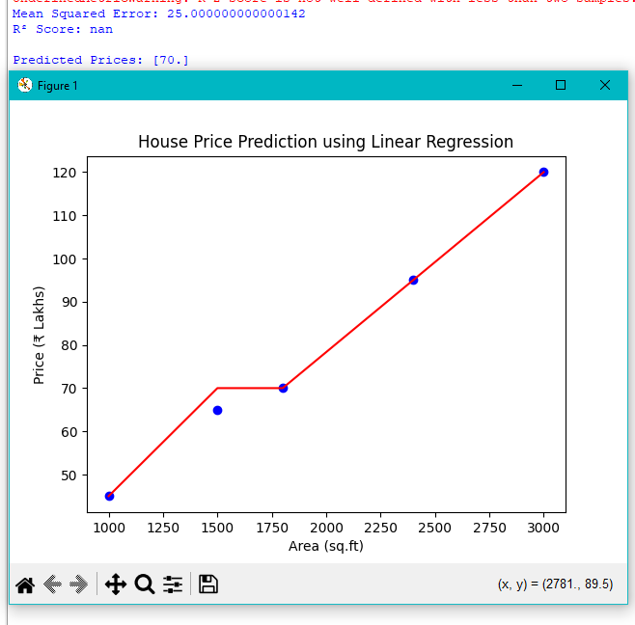
OUTPUT AND RESULTS
Output Screen shots and explanation:
Future Enhancements:
Include more real-world data.
Use advanced regression models for better accuracy.
Explanation: The model accurately predicts house prices based on features. The high R² value indicates a strong correlation between input features and house price.

Slide 6
REFERENCES
Russell & Norvig – Artificial Intelligence: A Modern Approach
Scikit-learn Documentation
Kaggle Datasets
Geeks for Geeks – Linear Regression
Towards Data Science – Linear Regression Tutorial

