Slide 1
SAVITRIBAI PHULE PUNE UNIVERSITY · MCA-I (SEM-I) · APPLICATION DEVELOPMENT · 2026-27
SmartLibrary
College Library Management System
Turning the college’s handwritten issue register into a boring, reliable, self-hosted web app —
catalogue · circulation · fines · print-ready registers.
Yashwant Santosh Ahire
Guide: Mrs. Priyanka M. Jagtap
Dr. B.V. Hiray College of Management and Research Centre, Malegaon (Nashik)
REVIEW 3
21 November 2026
FINAL REVIEW
19 December 2026

Slide 2
AGENDA
What we will walk through — in ten minutes
01
The problem
06
Live demo
why the paper register had to go
dashboard, issue & return flows
02
Objectives & scope
07
Reports
v1.0 goals, in/out of scope
five registers, ≥ 5 valid records each
03
Users & use cases
08
Testing evidence
librarian vs member, one page map
12/12 automated + 8 manual scenarios
04
Architecture & data
09
Timeline & deliverables
Flask + SQLite, ERD, constraints
review track, effort, artefacts
05
Modules & circulation rules
10
Future work & Q&A
3 books · 14 days · ₹2/day fine
enhancements E-1 … E-10
AT A GLANCE
12
8
15
16
5
12/12
books seeded
members
transactions
screens
print registers
tests passing
SmartLibrary — College Library Management System · SPPU MCA-I (Sem-I) Application Development · 2026-27
2 / 16

Slide 3
01 · CONTEXT
The register is the database
What the college lives with today
WHY NOT THE USUAL ANSWERS?
— Handwritten issue register — entries in pencil and ink; torn, smudged, missing pages.
— Fines computed by hand — ₹2 × days overdue, argued row-by-row at the desk.
— No live stock figure — “how many copies of Database System Concepts?” = walk the shelves.
— Overdues by eyeball — identification of defaulters is memory-based, not systematic.
— Register lost = data lost — no backup; a misplaced ledger erases years of history.
— SOUL / Koha / Virtua — enterprise ILS: licence cost, server, dedicated admin.
— Excel sheets — multi-user corruption, broken formulas, no audit trail.
Right-sized answer: a focused, self-hosted web app that runs on the library PC — zero licence, zero server.
Requirement elicited on-site with the college librarian, November 2026 — the rules on slide 9 are the college’s, not invented.
SmartLibrary — College Library Management System · SPPU MCA-I (Sem-I) Application Development · 2026-27
3 / 16

Slide 4
02 · OBJECTIVES & SCOPE
What v1.0 sets out to do
OBJECTIVES
IN SCOPE — v1.0
O1
Searchable catalogue of 12+ titles, category & availability at a glance
• Catalogue CRUD with ISBN regex + uniqueness
• Member CRUD with roll-no / e-mail uniqueness, 10-digit phone
• Issue / return with atomic stock restore
• Fine ledger + ₹-denominated reports, print CSS
• Single admin role; password change; session auth
O2
Student & faculty membership — add, edit, (de)activate, delete with guards
O3
Circulation engine enforcing the college’s real rules, atomically
O4
Automatic fine computation and a permanent fine ledger
OUT OF SCOPE — v1.0 (each maps to an enhancement)
O5
Five print-ready registers: issued · overdue · fine history · stock · member activity
• Multi-branch / inter-library loan (E-5, E-8)
• Member self-service OPAC (E-3, E-8)
• SMS / e-mail reminders (E-2)
• Online fine payment / receipts (E-4)
• Barcode / RFID scanning (E-1)
• Marathi / Hindi UI (E-9 territory)
O6
Seeded demo + reset workflow — reproducible viva, every time
SmartLibrary — College Library Management System · SPPU MCA-I (Sem-I) Application Development · 2026-27
4 / 16

Slide 5
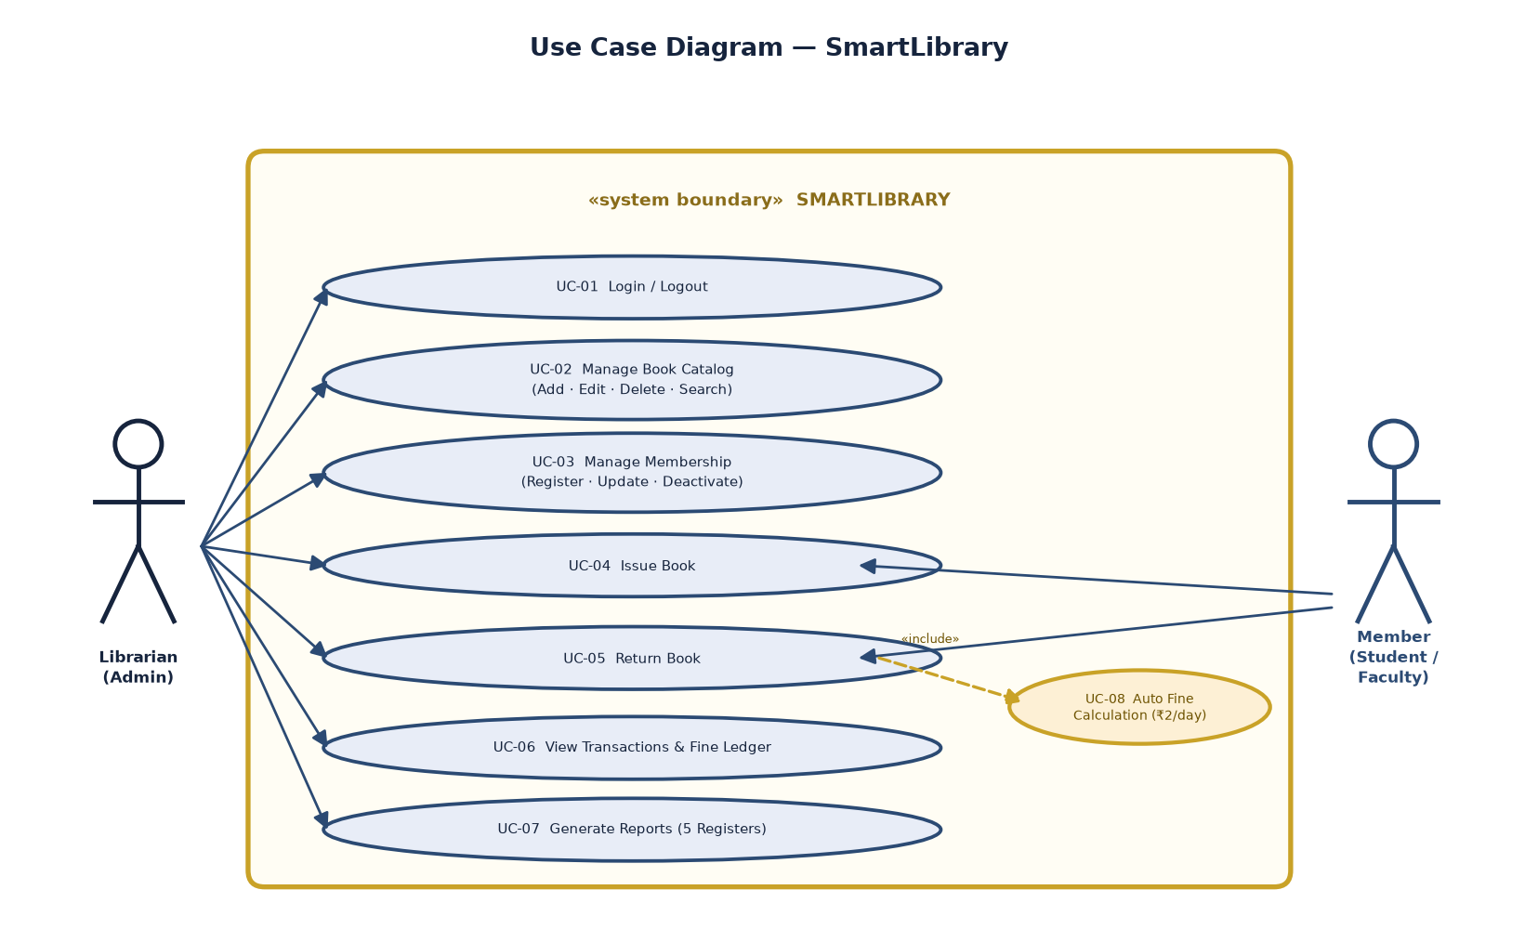
03 · USERS & USE CASES
One librarian, many capabilities
ACTOR 1 — LIBRARIAN / ADMINISTRATOR
The single human role (v1.0)
Catalogue, members, circulation, fines, registers, credentials — the desk operator for every screen in the demo.
ACTOR 2 — MEMBER (STUDENT / FACULTY)
Identified, never logged in (v1.0)
The subject of every transaction — identified by roll number at the desk; no self-login until the OPAC phase (E-3).
RACI SNAPSHOT
Librarian = Accountable & Responsible · Principal = Consulted · Members = Informed
Use-case diagram — report §3.5; 40+ use cases in two swimlanes
SmartLibrary — College Library Management System · SPPU MCA-I (Sem-I) Application Development · 2026-27
5 / 16

Slide 6
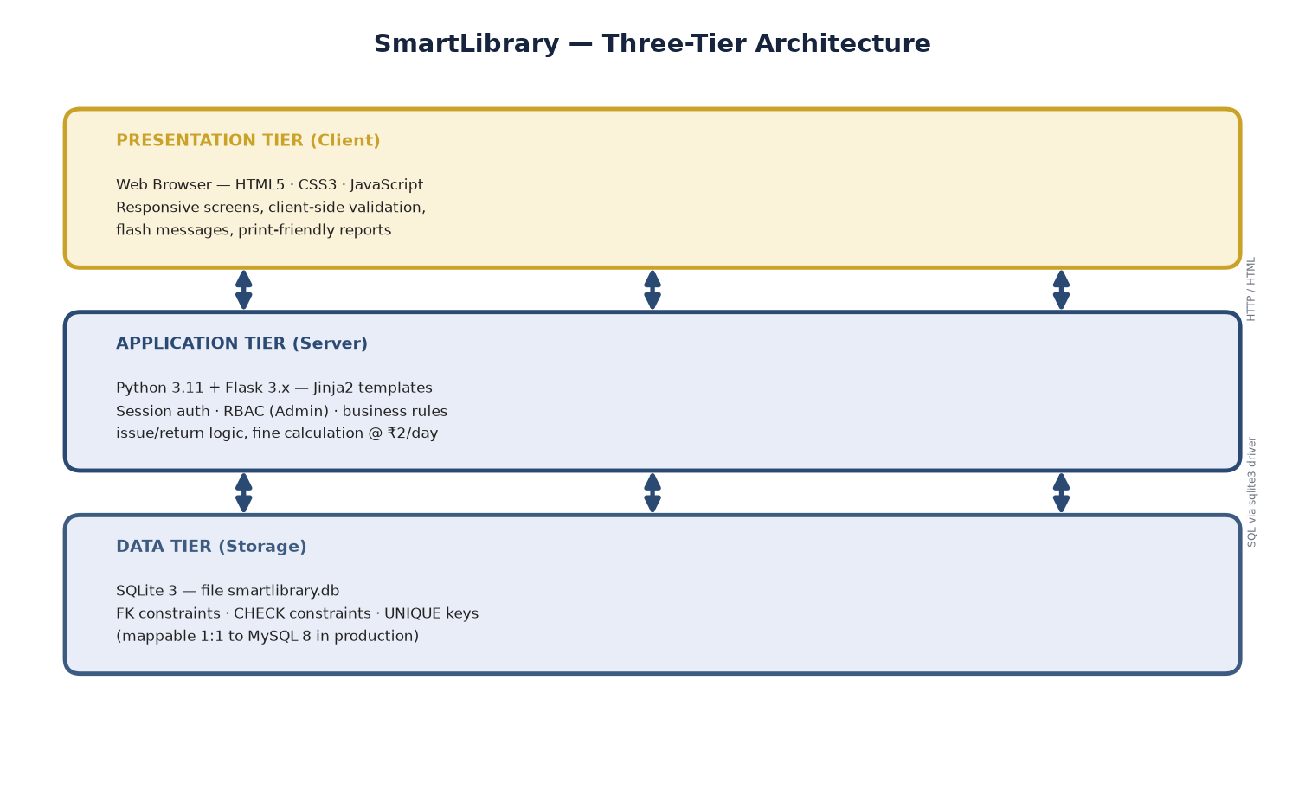
04 · ARCHITECTURE
Boring technology, deliberately
WHY THIS STACK
— Flask 3.1 — server-rendered Jinja; no SPA build step, no hydration, no version drift.
— SQLite — one file = the whole database; 20k+ txns comfortably; backup = copy the file.
— Vanilla JS — progressive enhancement mirroring server validation (ISBN, phone, roll no.).
— Print CSS — @media print hides chrome; the registers file straight to the principal’s tray.
Python
Flask 3.1
Jinja
SQLite 3
Three tiers on one machine — scale-out path: gunicorn + nginx + MySQL (E-5 / E-10)
vanilla JS
pytest
print CSS
PBKDF2
SmartLibrary — College Library Management System · SPPU MCA-I (Sem-I) Application Development · 2026-27
6 / 16

Slide 7
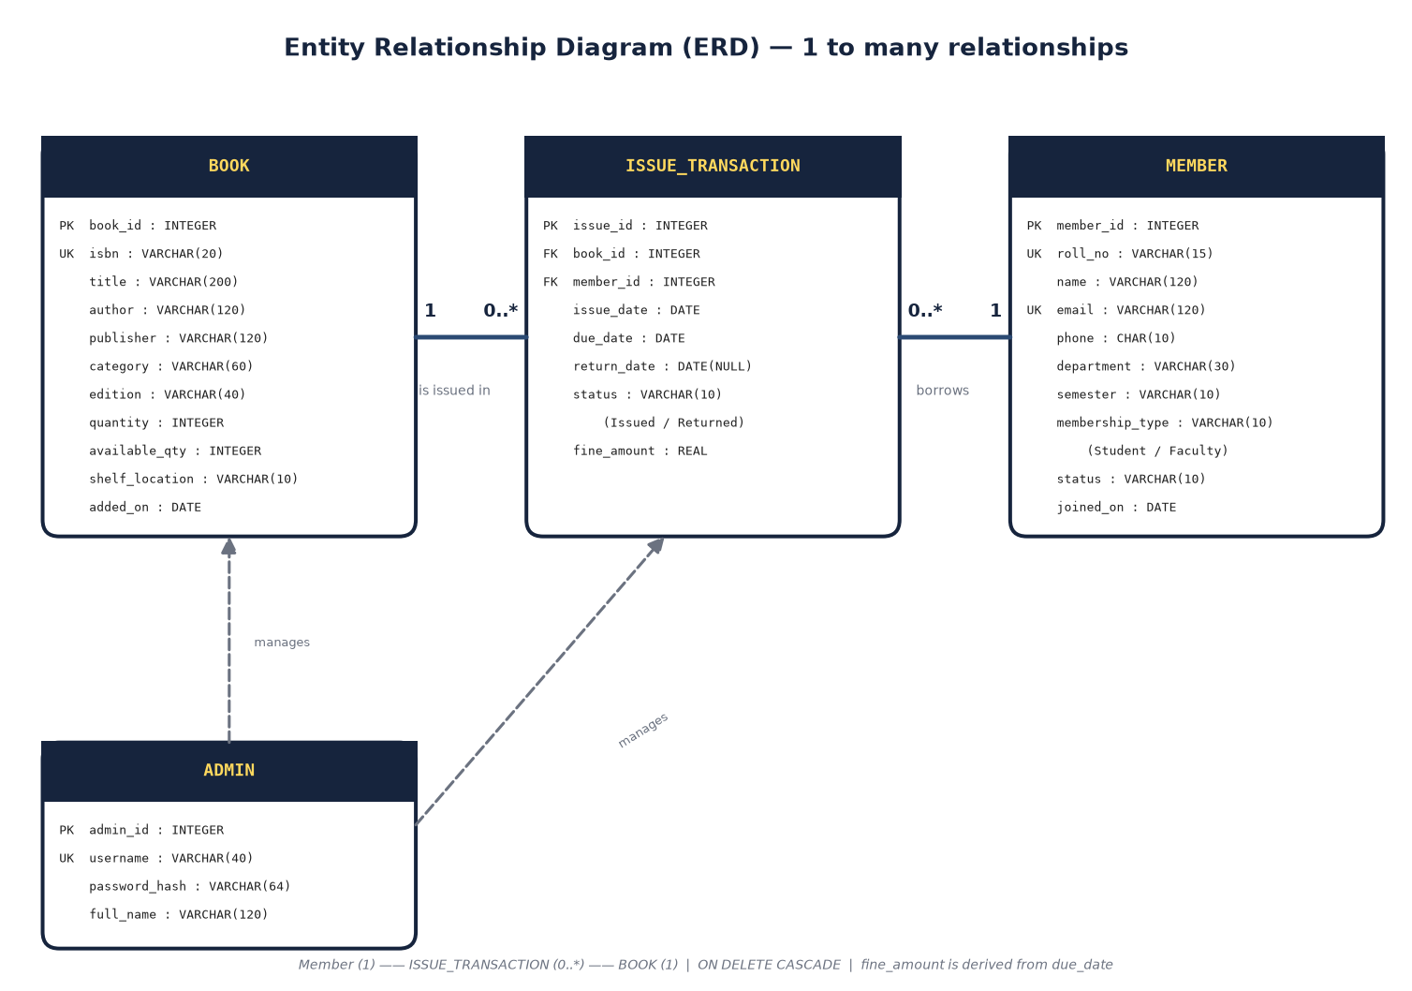
04 · DATA MODEL
Four tables, no cleverness
admin
id · username UNIQUE · PBKDF2 hash · full_name
book
isbn UNIQUE · category · quantity · CHECK (qty ≥ 0, avail ≥ 0)
member
roll_no UNIQUE · email UNIQUE · phone · status CHECK · type CHECK
issue_transaction
FK book / member · dates · status CHECK · fine ≥ 0
— Derived availability — available_quantity recomputed from open issues; never hand-set.
— ON DELETE CASCADE — transactions removed with parent (limitation L-4, documented).
ERD — report §3.2; crow’s-foot cardinalities
SmartLibrary — College Library Management System · SPPU MCA-I (Sem-I) Application Development · 2026-27
7 / 16

Slide 8
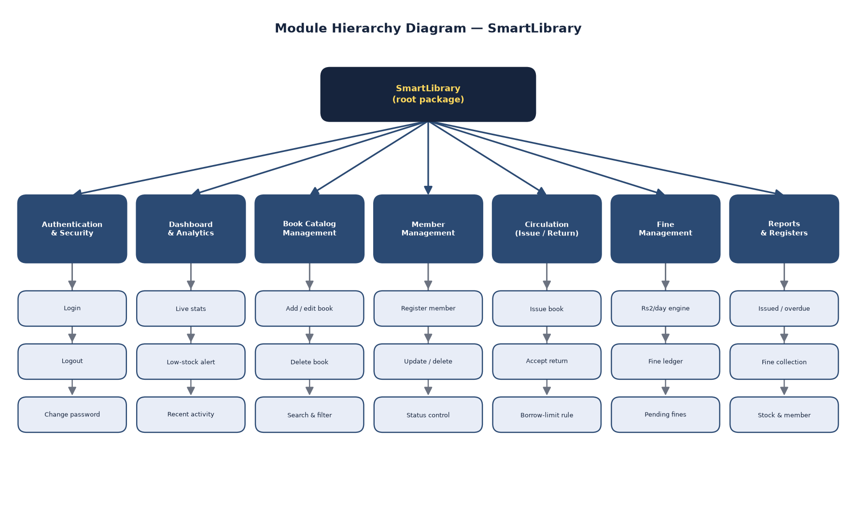
05 · MODULES
Seven modules, one root package
auth_bp
login · logout · change-password
books
/books + /add /edit /delete /search
members
/members + /add /edit /delete /search
circulation
/issue · /return/<id> · /transactions
fines
/fines — collected vs pending, per defaulter
reports
/reports?report=issued|overdue|fine|stock|member
Module hierarchy — report §3.8; each leaf maps to a Flask route group
SmartLibrary — College Library Management System · SPPU MCA-I (Sem-I) Application Development · 2026-27
8 / 16

Slide 9
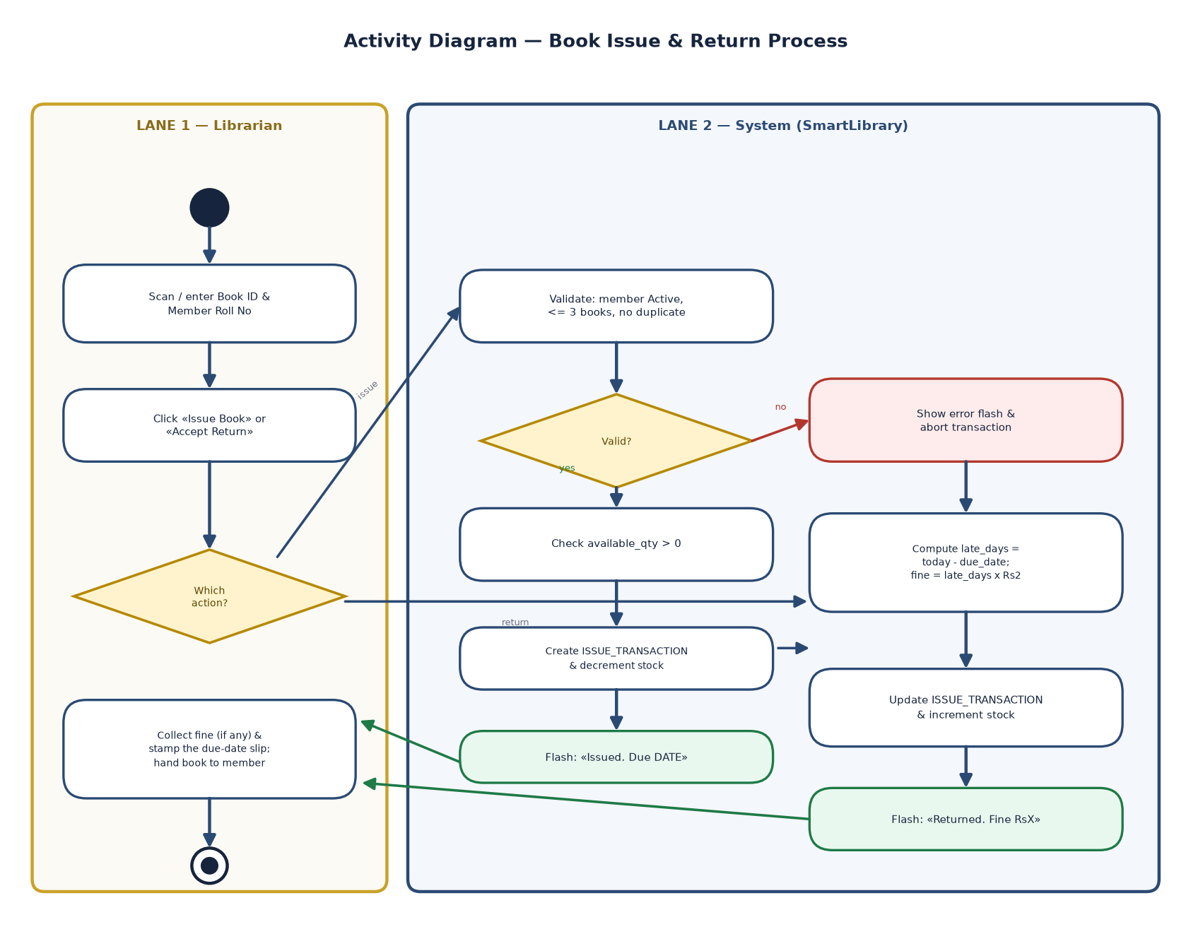
05 · BUSINESS RULES
The rules are the product
3
14
₹2
0
books max
days
per day
borrows while
per member
per loan
overdue
member inactive
ISSUE — FAIL FAST, THEN COMMIT
→ Member exists and is Active
→ availability > 0 · holds < 3
→ No duplicate open issue of this title
→ Insert txn + decrement stock — one commit
RETURN — ONE DECISION
→ late = max(0, today − due_date)
→ fine = late × ₹2 — stored on the txn
→ Restore stock — same commit
Swimlane — issue & return paths with fine engine — report §3.6
SmartLibrary — College Library Management System · SPPU MCA-I (Sem-I) Application Development · 2026-27
9 / 16

Slide 10
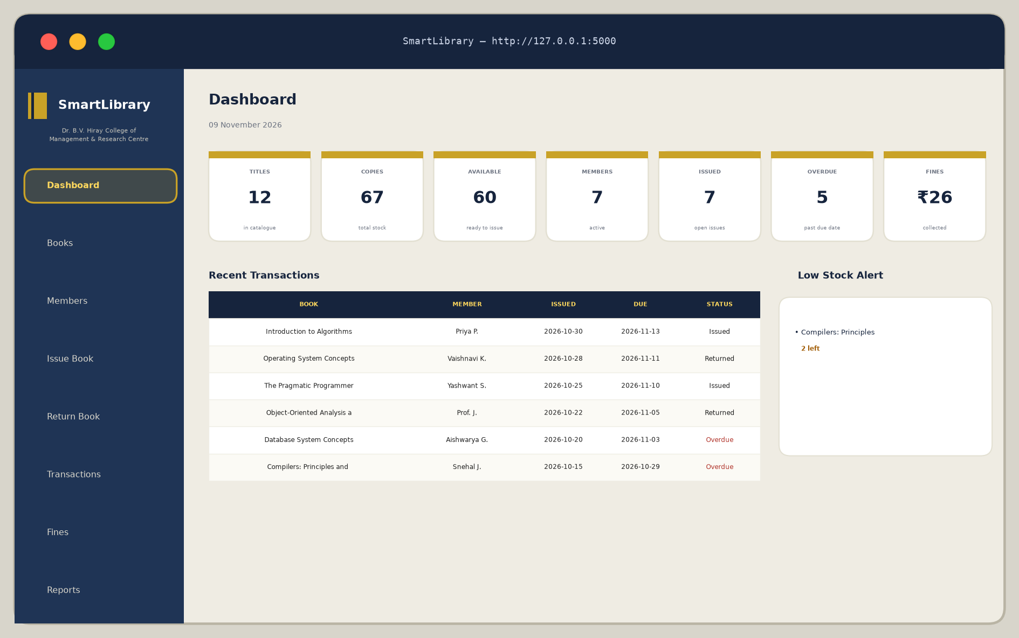
06 · LIVE DEMO (1/3)
Dashboard — the librarian’s morning glance
WHAT TO NOTICE
— KPIs live from the DB — 12 titles · 67 copies · 60 available · 7 active members · ₹26 fines pending.
— Recent transactions — six latest borrows with status pills (Issued / Returned).
— Low-stock alert — titles at ≤ 2 copies: “Compilers: Principles and Techniques” is flagged amber.
— Session-gated — everything sits behind admin login; anonymous hits bounce to /login (TC-04).
DEMO LOGIN admin / admin123
Rendering of the running app at http://127.0.0.1:5000 — seeded data, 09-11-2026
SmartLibrary — College Library Management System · SPPU MCA-I (Sem-I) Application Development · 2026-27
10 / 16

Slide 11
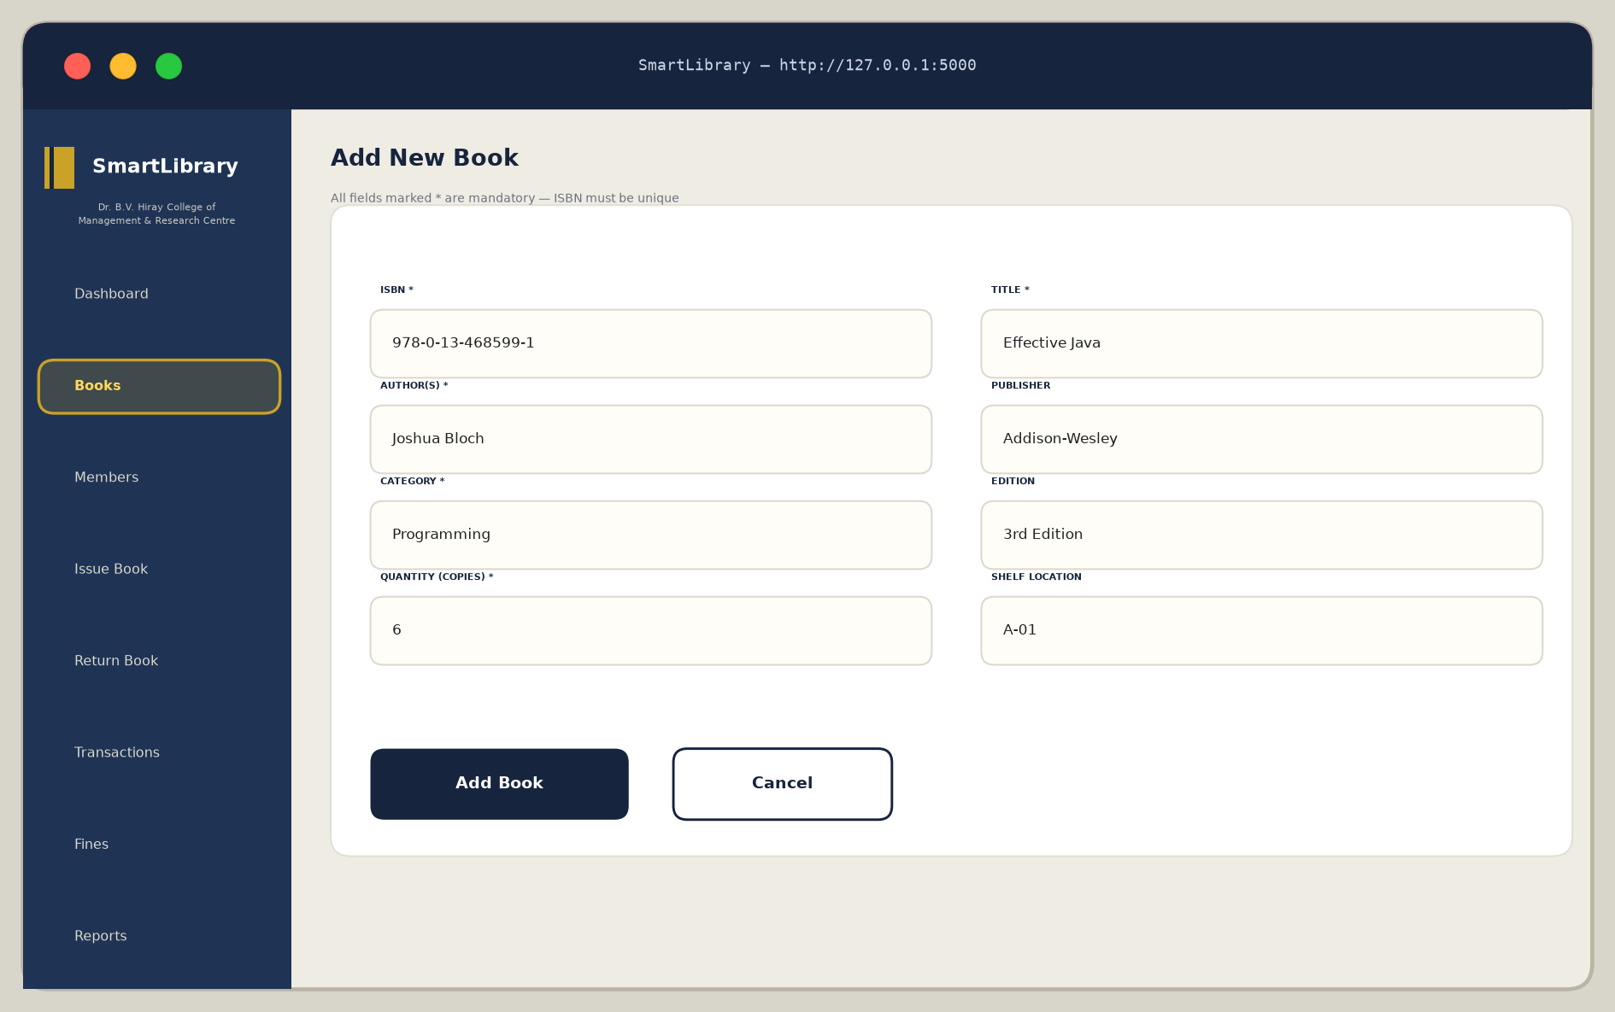
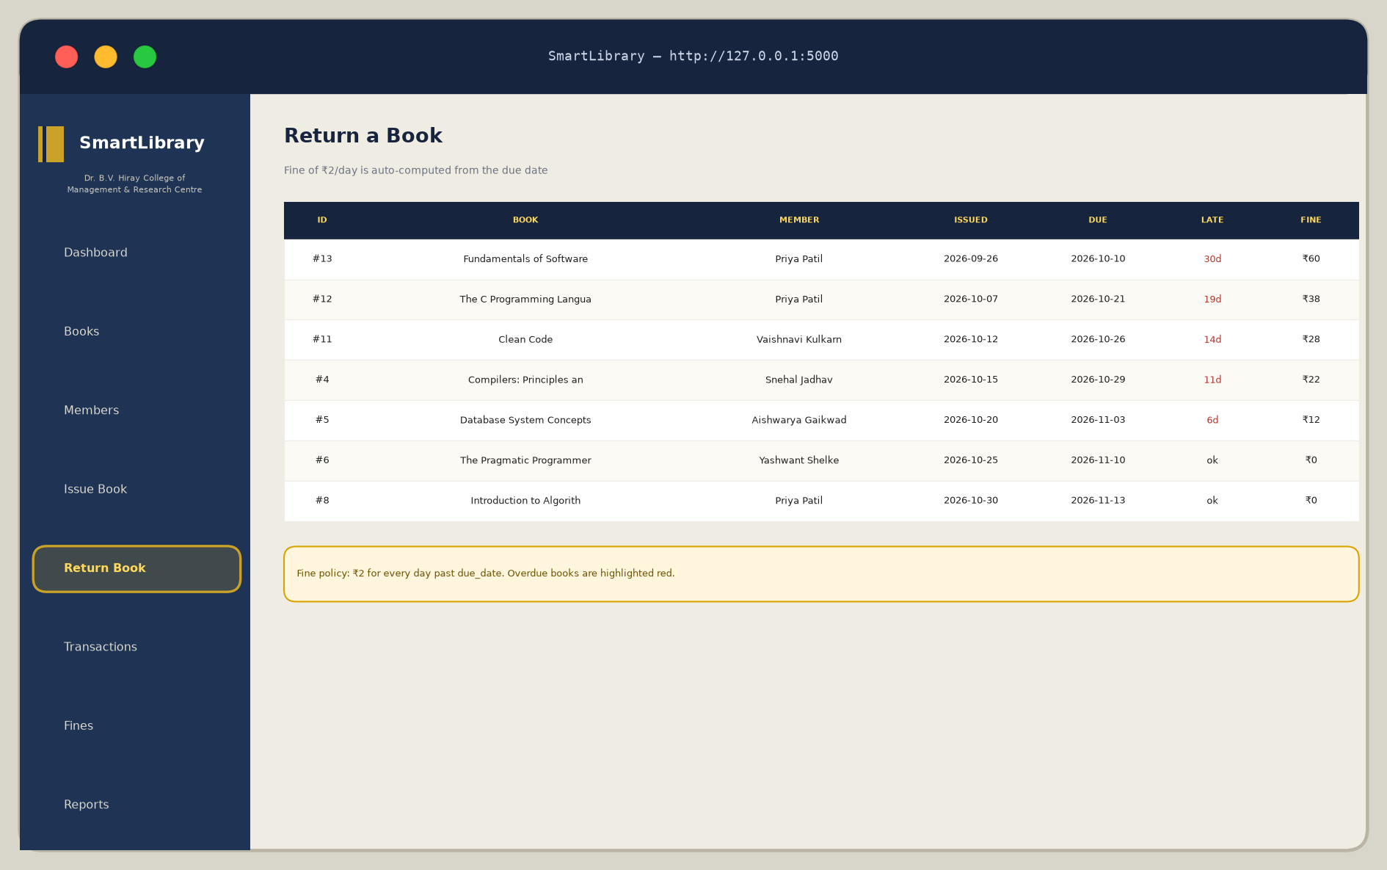
06 · LIVE DEMO (2/3)
Write paths — add book · return book
Add book — ISBN regex + uniqueness; qty 0–10 000
Return — late days & fine rendered per row
DEMO SCRIPT (what the panel watches)
1 Add a duplicate ISBN → inline error, nothing written · 2 Issue to a member already at 3 books → refused · 3 Return two days late → fine ₹4 posts to the ledger · 4 Open /reports?report=overdue → 5 flagged rows
SmartLibrary — College Library Management System · SPPU MCA-I (Sem-I) Application Development · 2026-27
11 / 16

Slide 12
07 · REPORTS
Five registers, straight to the principal’s tray
Register | Question it answers | Live rows | Totals
Issued books | Who holds what right now? | 7 | ≥ 5 records ✓
Overdue books | Who is late — and by how much? | 5 | ₹60 · ₹38 · ₹28 · ₹22 · ₹12 = ₹160 pending
Fine history | What was collected, when, from whom? | 6 | ₹26 collected (0 defaulters waived)
Stock register | Category-wise holdings & availability | 6 groups | 67 copies · 60 available
Member activity | Per-member issues, open loans, fines | 8 members | incl. members with zero issues (LEFT JOIN)
≥ 5 valid records per report — the Review 3 acceptance bar, met from the seed itself.
— Print-ready — Ctrl+P: navigation and filters vanish via @media print; rows break cleanly across A4 pages.
SmartLibrary — College Library Management System · SPPU MCA-I (Sem-I) Application Development · 2026-27
12 / 16

Slide 13
08 · TESTING
Evidence, not adjectives
TRACK A — AUTOMATED (pytest)
TRACK B — MANUAL (LIVE, 09-11-2026)
12 / 12 passing · 0.36 s · isolated temp DB
8 / 8 scenarios PASS · TC-13 … TC-20
• Auth: login page, wrong password → 401, anonymous → /login
• Catalogue: 12 titles listed · duplicate ISBN rejected · bad ISBN rejected
• Circulation: ₹4 fine after 5 days · issue blocks at capacity
• Reports & settings: CSV-able output · wrong current password rejected
• TC-13/14 login & anonymous bounce (401 / 302)
• TC-15 search ‘java’ → Effective Java + The Complete Reference
• TC-16/17 overdue & fine ledgers — rows verified vs hand-computed
• TC-18/19 duplicate ISBN & phone validation · TC-20 password guard
$ python -m pytest tests/test_app.py -v
$ curl -i -X POST …/login → HTTP/1.1 401
DEFECTS FOUND & FIXED DURING TESTING
— Three, all re-verified — (1) Jinja duplicate-block error in base.html · (2) available_quantity drift after seeding — availability now derived by SQL · (3) test_10 assertion mismatch on flash wording.
— Regression — full suite re-run: 12 passed in 0.36 s; manual TC-16 re-check matched the hand-computed ledger (₹60, ₹38, ₹28, ₹22, ₹12).
SmartLibrary — College Library Management System · SPPU MCA-I (Sem-I) Application Development · 2026-27
13 / 16

Slide 14
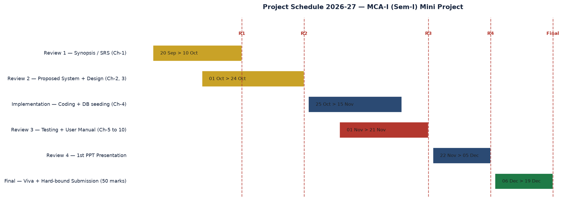
09 · TIMELINE
Seven weeks, four review gates
REVIEW 1
REVIEW 2
REVIEW 3
FINAL
SRS & feasibility
ERD · UML · module hierarchy
21-11-2026 — working build + tests
19-12-2026 — viva + hard-bound report
Effort ≈ 70 person-hours · Artefacts: report (33 pp) · PPT · app + tests · this demo — all in the repository on branch arena/aafd53cc-yashwant-git392
SmartLibrary — College Library Management System · SPPU MCA-I (Sem-I) Application Development · 2026-27
14 / 16

Slide 15
10 · FUTURE WORK
From a tool to a managed service
v1.x — EXTEND THE DESK
v1.3–1.5 — OPERATE IT
v2.0 — RESEARCH
ships on the current monolith
infrastructure & visibility
beyond the brief, deliberately
E-1
Barcode / RFID scanning — keyboard-wedge, zero form redesign
2 wks
E-5
MySQL 8 migration — DDL ports 1:1, portable SQL throughout
3 days
E-9
Recommendation engine — borrow co-occurrence CF
research
E-2
Overdue reminders — nightly cron, 1/3/7-day buckets
2 wks
E-6
Soft-delete + audit tables — reconstruct history anytime
1 wk
E-10
docker-compose — gunicorn + nginx + mysql, one command
3 days
E-3
Member self-service OPAC — search, own history, renew
3 wks
E-7
Management dashboards — circulation/month, defaulter rank
2 wks
E-4
Auto-numbered fine receipts + UPI QR
1 wk
E-8
Public OPAC kiosk — entrance touchscreen, kiosk mode
1 wk
Every limitation in the report (L-1…L-10) maps to one of these — the upgrade path is written down, not improvised.
SmartLibrary — College Library Management System · SPPU MCA-I (Sem-I) Application Development · 2026-27
15 / 16

Slide 16
QUESTIONS & ANSWERS
Thank you.
TRY IT YOURSELF
git clone https://github.com/
Yashwant-git392/Yashwant-git392.git
cd Yashwant-git392/mini-project
pip install -r requirements.txt
If you remember three things
python run.py
— Boring works — Flask + SQLite + seeded data beats a grand stack the library cannot maintain.
— Tests are the demo — 12/12 automated and 8/8 manual, run live in front of you.
— The college can run this tomorrow — clone, pip install, python run.py, sign in.
http://127.0.0.1:5000
admin / admin123
Report — 33 pages, Ch. 1–10 + Appendices A–C
Branch — arena/aafd53cc-yashwant-git392
Yashwant Santosh Ahire · MCA-I (Sem-I) · 2026-27
SmartLibrary — because the register deserved a better afterlife.

