Slide 1
SAVITRIBAI PHULE PUNE UNIVERSITY · MCA-I (SEM-I) · APPLICATION DEVELOPMENT · 2026-27
Campus Shikayat Setu
College Grievance Redressal System
Turning the college’s complaint box into an auditable, SLA-bound grievance pipeline —
lodge · auto-route · track · resolve — with a paper trail for every step.
Yashwant Santosh Ahire
Guide: Mrs. Priyanka M. Jagtap
Dr. B.V. Hiray College of Management and Research Centre, Malegaon (Nashik)
REVIEW 3
21 November 2026
FINAL VIVA
19 December 2026

Slide 2
AGENDA
What we will walk through — in ten minutes
01
The problem
06
Live demo
why the complaint box had to go
dashboard, console, timeline
02
Objectives & scope
07
Reports
v1.0 goals, in/out of scope
six registers, ≥ 5 valid records each
03
Users & use cases
08
Testing evidence
student · officer · admin · public
12/12 automated + 8 manual scenarios
04
Architecture & data
09
Timeline & deliverables
Flask + SQLite, ERD, constraints
review track, effort, artefacts
05
Modules & routing rules
10
Future work & Q&A
keyword engine · SLA · audit timeline
enhancements E-1 … E-10
AT A GLANCE
6
15
15
32
100
12/12
departments
categories
users seeded
complaints
audit events
tests passing
Campus Shikayat Setu — College Grievance Redressal System · SPPU MCA-I (Sem-I) Application Development · 2026-27
2 / 16

Slide 3
01 · CONTEXT
The complaint box is a black hole
What the college lives with today
WHY NOT THE USUAL ANSWERS?
— A locked wooden box — complaints dropped in weekly; read when the cell gets around to it.
— No routing, no owner — a broken fan complaint may sit in the admin room for weeks.
— No status, ever — students walk back to ask “what happened to my complaint?”
— Sensitive topics go unsaid — ragging & harassment: never named, because nothing is anonymous.
— Zero data — pendency, SLA breaches, repeat offenders: nobody knows.
— CPGRAMS — central government portal; no department mapping, no campus context.
— Excel registers — linear scan, version corruption, zero privacy for complainants.
— ERP add-ons — vendor lock-in, licence cost; a grievance module nobody opens.
Right-sized answer: a focused, self-hosted web app that runs on the college PC — SLA-bound, audit-trailed, anonymous-safe.
Scope fixed for Sem-I: student · officer · admin roles, feedback & reopen loop — nothing more, nothing hidden.
Campus Shikayat Setu — College Grievance Redressal System · SPPU MCA-I (Sem-I) Application Development · 2026-27
3 / 16

Slide 4
02 · OBJECTIVES & SCOPE
What v1.0 sets out to do
OBJECTIVES
IN SCOPE — v1.0
O1
One-page complaint lodging with title/description guard rails
• Register & login; PBKDF2 hashing; signed sessions
• Keyword routing with explainable scores (title weighted ×2)
• Acknowledge → in-progress → resolve; feedback ★1–5 closes; reopen ≤ 7 days
• Officer department queue; admin console (reassign/escalate/force-close)
• Print CSS registers; public tracker without login
O2
Keyword-scored auto-routing to the right department on submit
O3
SLA engine: High 24 h · Medium 72 h · Low 7 days, stamped at lodge time
O4
Full audit timeline per complaint — every action, every actor, forever
OUT OF SCOPE — v1.0 (each maps to an enhancement)
O5
Anonymous lodgement for sensitive grievances (admin-only identity)
• E-mail / SMS / WhatsApp notifications (E-1, E-2)
• Photo evidence upload (E-3)
• Category admin UI & MySQL migration (E-4, E-5)
• Nightly SLA-breach cron + auto-escalation (E-6)
• Marathi / Hindi UI (E-9) · ERP roll-no bridge (E-10)
O6
Six print-ready registers + public tracker (code + roll no.)
Campus Shikayat Setu — College Grievance Redressal System · SPPU MCA-I (Sem-I) Application Development · 2026-27
4 / 16

Slide 5
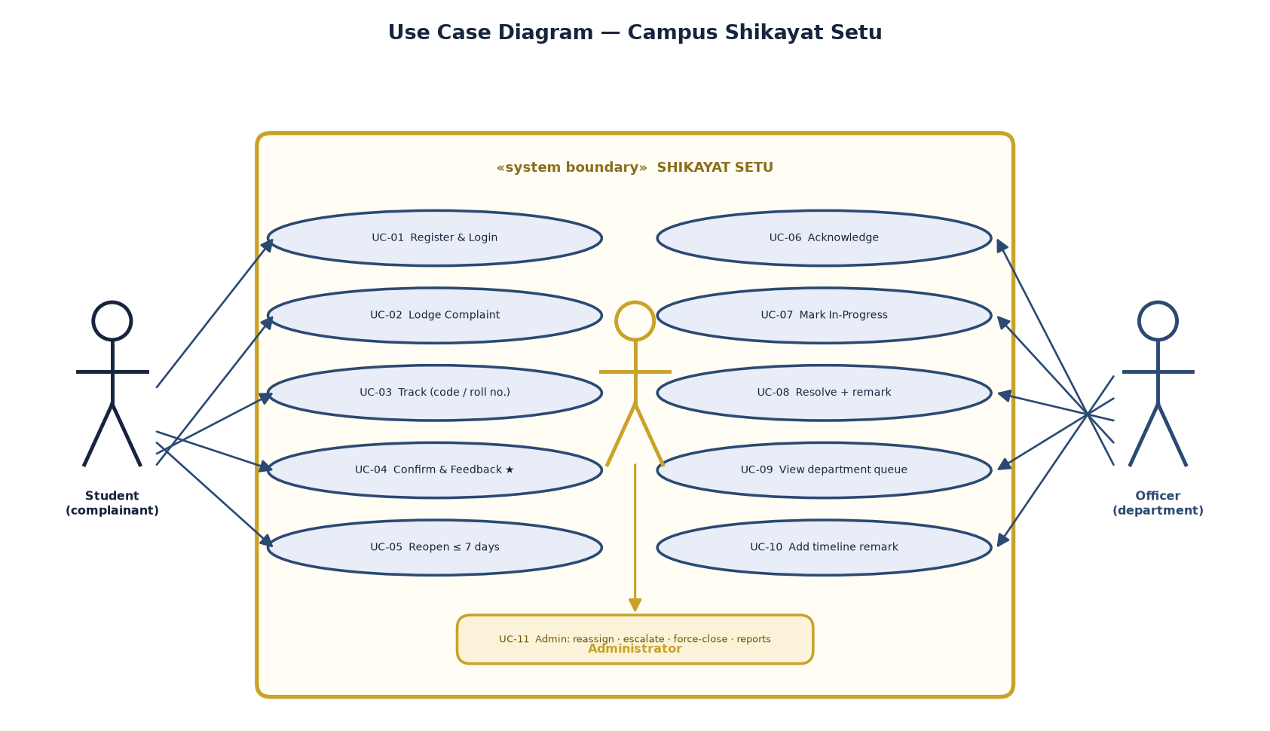
03 · USERS & USE CASES
Three logged-in roles, one public door
ACTOR 1 — STUDENT (COMPLAINANT)
The aggrieved
Lodges complaints (optionally anonymous), tracks by code, rates resolutions, reopens within 7 days.
ACTOR 2 — OFFICER (DEPARTMENT)
The resolver
Sees only own-department queue; acknowledges, works, resolves with a mandatory remark.
ACTOR 3 — ADMINISTRATOR
The backstop
Console over everything; reassign, escalate to High, force-close after 7 quiet days; identity of anonymous complainants.
Use-case diagram — report §3.3; roles swimlane-separated, public tracker outside login
Campus Shikayat Setu — College Grievance Redressal System · SPPU MCA-I (Sem-I) Application Development · 2026-27
5 / 16

Slide 6
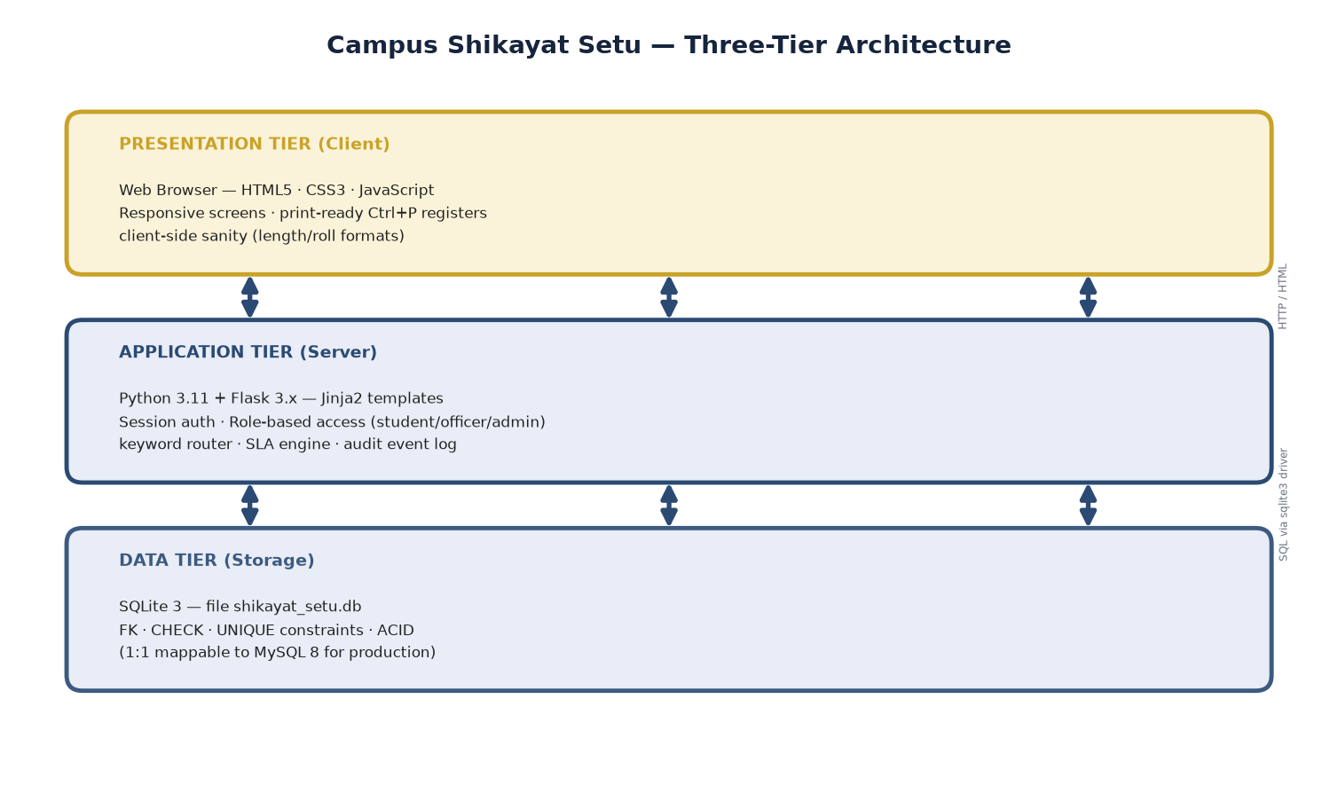
04 · ARCHITECTURE
Boring technology, deliberately
WHY THIS STACK
— Flask 3.x — server-rendered Jinja; zero build step; the demo never depends on the network.
— SQLite — one file = whole DB; FK/CHECK/UNIQUE enforced; backup = copy file.
— Vanilla JS — length/roll sanity mirrors server validation; no framework.
— Print CSS — registers file straight to the principal’s tray, A4, no truncation.
Python
Flask 3.x
Jinja
SQLite 3
Three tiers on one machine — scale-out path: gunicorn + nginx + MySQL (E-5 / E-10)
vanilla JS
pytest
print CSS
PBKDF2
Campus Shikayat Setu — College Grievance Redressal System · SPPU MCA-I (Sem-I) Application Development · 2026-27
6 / 16

Slide 7
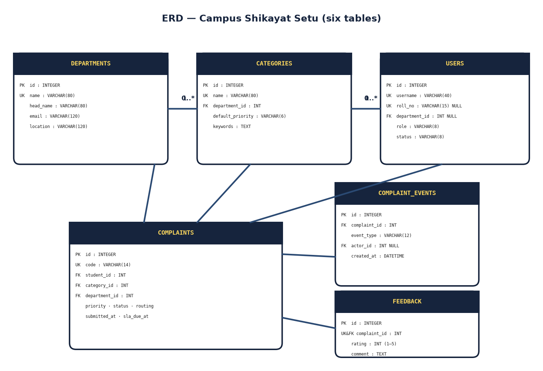
04 · DATA MODEL
Six tables, no cleverness
departments
name UNIQUE · head_name · email · location
categories
FK→departments · default_priority CHECK · keywords TEXT
users
role CHECK(student|officer|admin) · username UNIQUE · roll_no UNIQUE
complaints
code UNIQUE (CMP-YYYY-NNNN) · priority/routing/status CHECKs · sla_due_at
complaint_events
append-only audit log · FK ON DELETE CASCADE · actor NULL for system
feedback
complaint_id UNIQUE · rating CHECK(1..5)
ERD — report §3.2; PK/FK crow’s-foot cardinalities
— Overdue never stored — derived: now > sla_due_at AND status ∉ (Resolved, Closed).
Campus Shikayat Setu — College Grievance Redressal System · SPPU MCA-I (Sem-I) Application Development · 2026-27
7 / 16

Slide 8
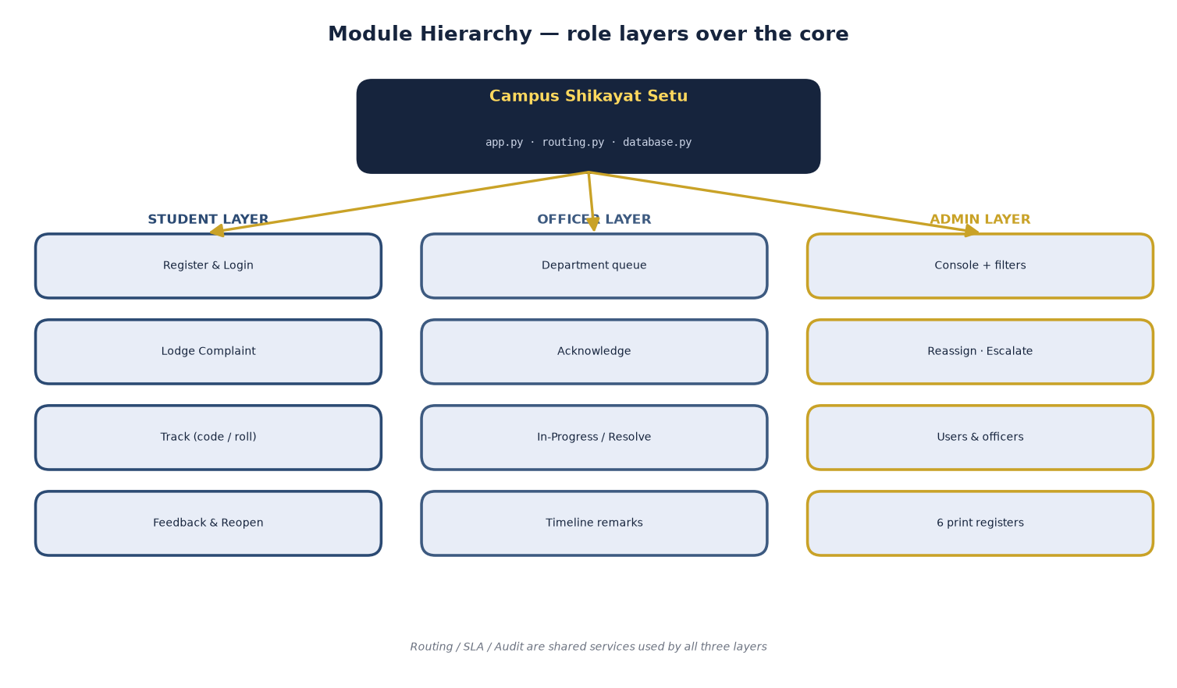
05 · MODULES
One app, three role layers
auth_bp
/login · /logout · /register · /change-password
student
/lodge · /my-complaints · /complaint/<code>/feedback|reopen
officer
/queue · /complaint/<code>/acknowledge|start|resolve|remark
admin
/console · /reassign · /escalate · /force-close · /users · /officers
public
/track — complaint code + roll no., no login
reports
/reports?report=pendency|sla|restime|trend|feedback|routing
Module hierarchy — report §3.7; each leaf maps to a Flask route group
Campus Shikayat Setu — College Grievance Redressal System · SPPU MCA-I (Sem-I) Application Development · 2026-27
8 / 16

Slide 9
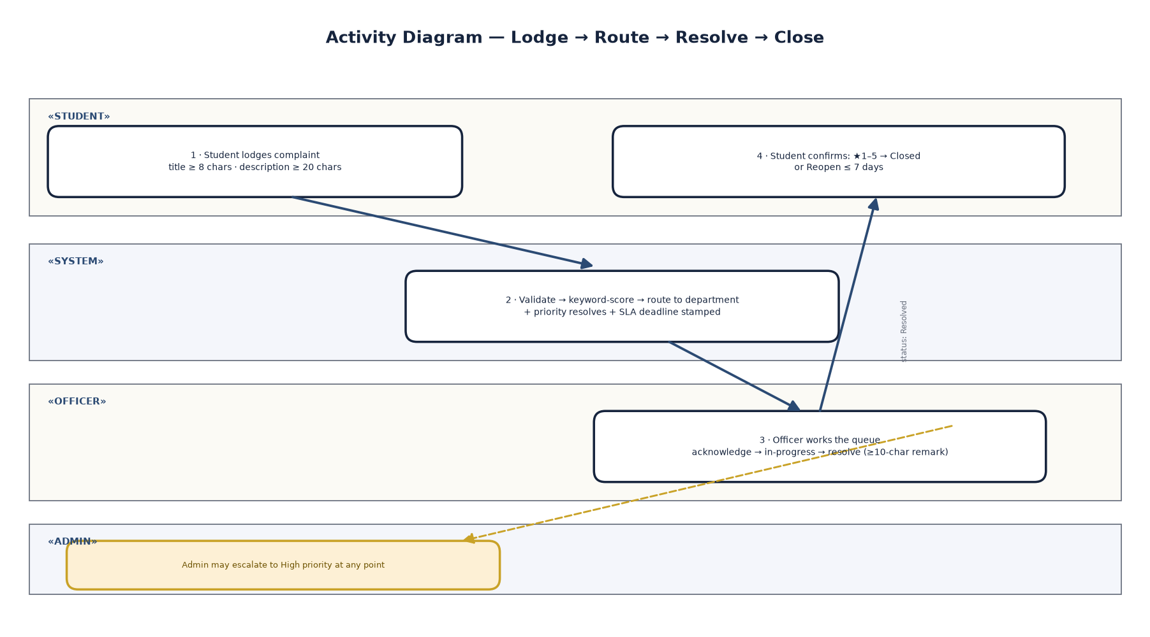
05 · BUSINESS RULES
The rules are the product
24h
72h
7d
×2
High
Medium
Low priority SLA
title keyword
priority SLA
priority SLA
& reopen window
weighting
ROUTING — EXPLAINABLE, ALWAYS
→ Weight = 2 per word of keyword; title scores ×2
→ SAFETY_WORDS (ragging, shock, fire…) force High
→ MASS_IMPACT (“entire”, “all students”) bumps one level
→ No match → General & Administration (logged manual fallback)
RESOLUTION LOOP
→ resolve — remark ≥ 10 chars, status → Resolved
→ close — student rates ★1–5 → Closed
→ reopen — ≤ 7 days → back to In Progress
Swimlane — lodge → route → resolve → close, admin escalation path — report §3.4
Campus Shikayat Setu — College Grievance Redressal System · SPPU MCA-I (Sem-I) Application Development · 2026-27
9 / 16

Slide 10
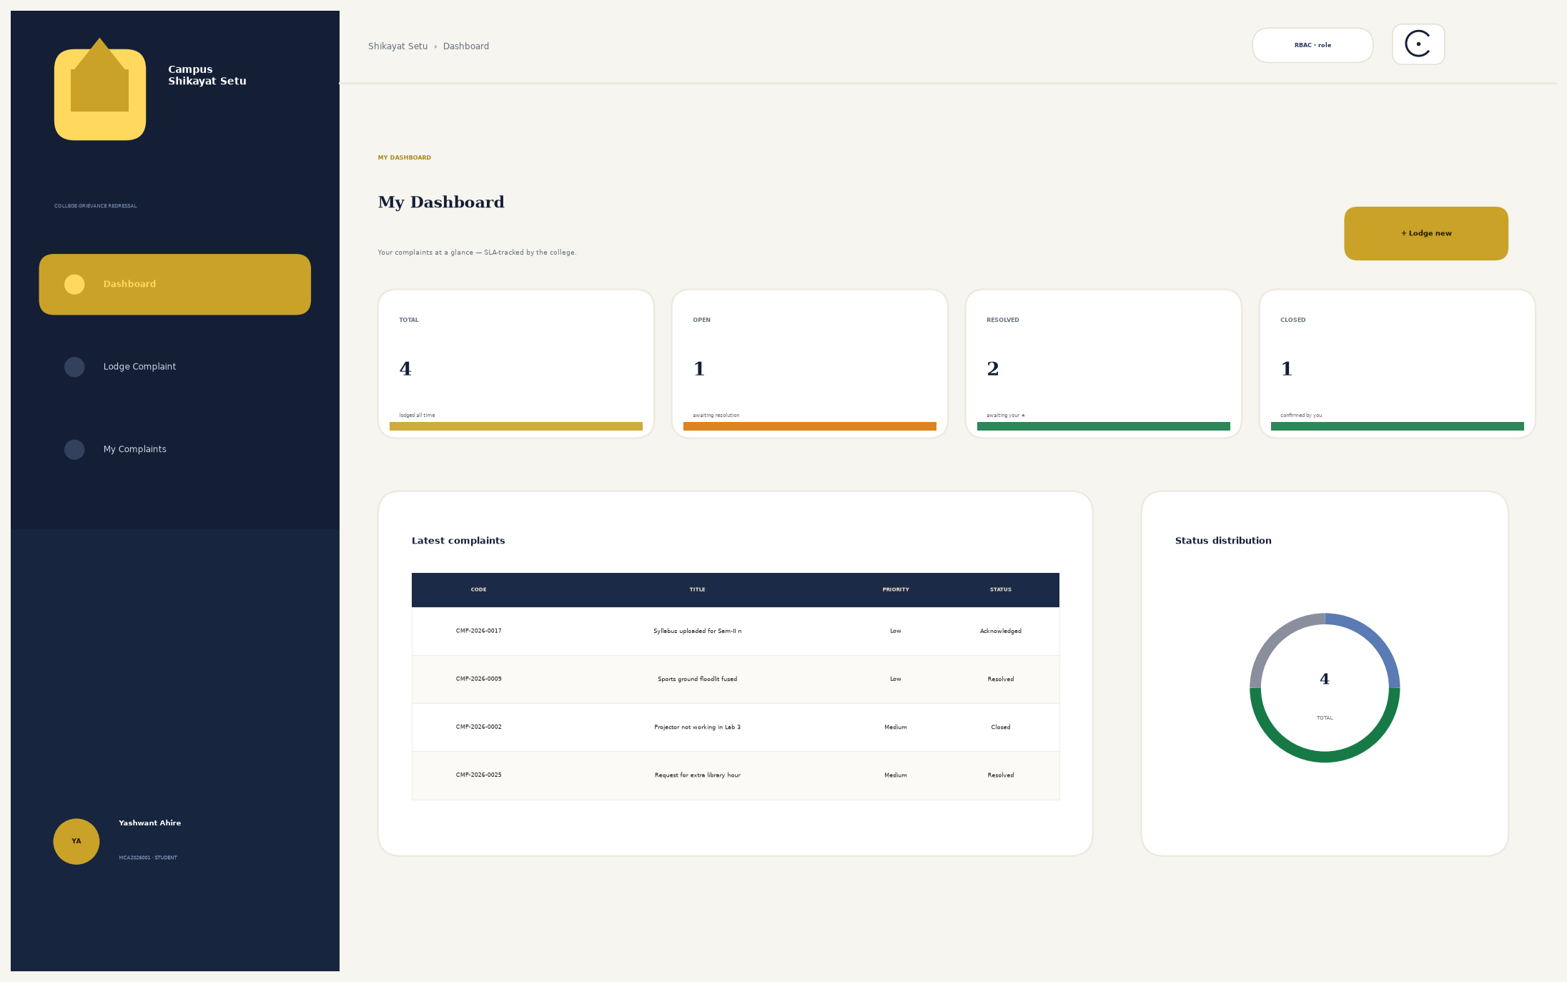
06 · LIVE DEMO (1/2)
Student view — lodge, track, confirm
WHAT TO NOTICE
— Signed in as MCA2026001 — dashboard shows only your own complaints, KPIs counted live.
— Lodge in one page — title ≥ 8 · description ≥ 20; router confirms or overrides the picked category, score printed on the timeline.
— Feedback closes, reopen ≤ 7 days — if the fix failed, one click sends it back to In Progress.
— Public tracker — CMP code + roll number, no login: great for the demo queue.
Rendering of the running app at http://127.0.0.1:5001 — seeded data, 09-11-2026
Campus Shikayat Setu — College Grievance Redressal System · SPPU MCA-I (Sem-I) Application Development · 2026-27
10 / 16

Slide 11
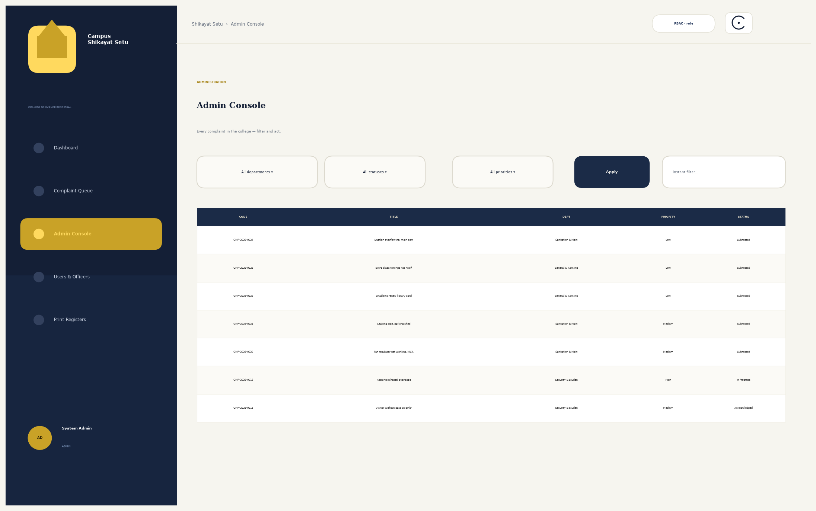
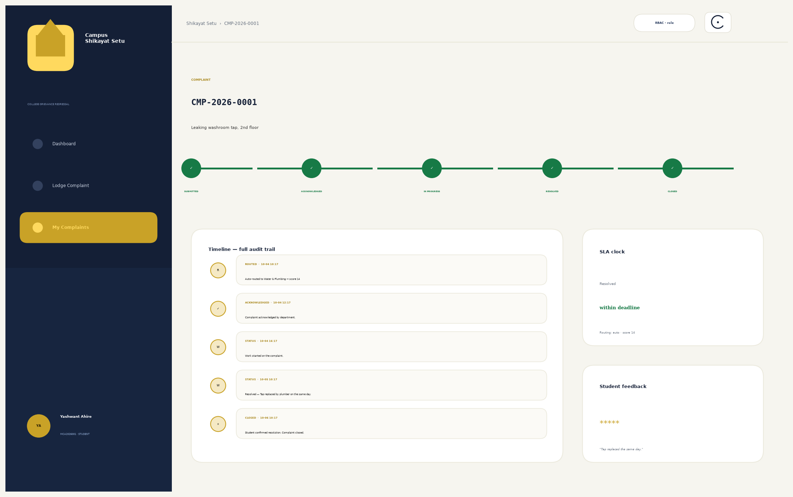
06 · LIVE DEMO (2/2)
Admin view — console & audit trail
Admin console — filters, reassign, escalate → High, force-close — report §3.3 UC-11
Complaint detail — the timeline IS the audit trail (append-only events)
EVERY DEMO IS DETERMINISTIC
Fresh clone → seed → 32 complaints, 100 events, 6 feedback rows — the viva demo reproduces exactly; no live typing needed.
Campus Shikayat Setu — College Grievance Redressal System · SPPU MCA-I (Sem-I) Application Development · 2026-27
11 / 16

Slide 12
07 · REPORTS
Six print registers, straight from SQL
# | Register | What it proves
1 | Department pendency | Open workload per department + overdue count (derives from SLA)
2 | SLA compliance | % resolved within deadline per department — ROUND over COUNT
3 | Avg resolution time | Hours per category, julianday arithmetic on timestamps
4 | Monthly trend | Lodged vs resolved, last 6 months — capacity planning
5 | Feedback / ratings | Average ★ per department + latest 10 comments
6 | Routing quality | auto vs manual split + avg routing score — proves the router
≥ 5 valid records per report — the Review 3 acceptance bar, met from the seed itself (32 complaints, 6 departments).
— Print-ready — Ctrl+P: chrome vanishes via @media print; A4 portrait; headers repeat per page.
Campus Shikayat Setu — College Grievance Redressal System · SPPU MCA-I (Sem-I) Application Development · 2026-27
12 / 16

Slide 13
08 · TESTING
Evidence, not adjectives
TRACK A — AUTOMATED (pytest)
TRACK B — MANUAL (LIVE, 09-11-2026)
12 / 12 passing · isolated temp DB
8 / 8 scenarios PASS · TC-13 … TC-20
• Auth: login page · wrong password → 401 · anonymous → /login
• Register: happy path · duplicate roll no. → 400
• Routing: washroom-tap text → Sanitation · “shock” → High
• Flow: lodge → acknowledge → resolve → ★5 → Closed
• TC-13/14 login & admin KPI counts match seed
• TC-15 officer queue hides other departments
• TC-16 anonymous complaint: identity hidden from officer
• TC-17/18 routed Medium/72h · reopen within 7 days
$ python -m pytest tests/ -q
$ curl -i -X POST …/login → HTTP/1.1 401
DEFECTS FOUND & FIXED DURING TESTING
— Three, all re-verified — (1) seed NOT NULL crash on complaints.code — placeholder + UPDATE · (2) minute-overflow in seed times · (3) officer dashboard Row vs dict is_overdue KeyError.
— Regression — suite re-run green; manual TC-17 lodge → routed to Sanitation & Maintenance, Medium, SLA 72 h.
Campus Shikayat Setu — College Grievance Redressal System · SPPU MCA-I (Sem-I) Application Development · 2026-27
13 / 16

Slide 14
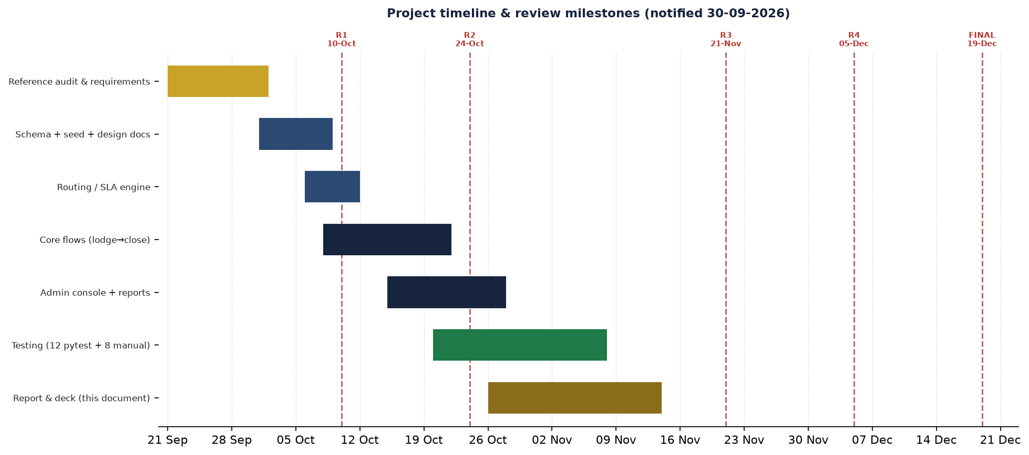
09 · TIMELINE
Five notified milestones — Review 3 is nine days away
BUILD
21 Sep → 08 Nov
REVIEW 1 ✓
10-10-2026
REVIEW 2 ✓
24-10-2026
REVIEW 3 — NEXT UP
21-11-2026
REVIEW 4
05-12-2026
FINAL VIVA
19-12-2026
schema · engine · console · reports · tests (12/12)
SRS + Ch-1 · 10 marks
Ch-2 Proposed System + Ch-3 design · 15 marks
working build + this demo + report · 15 marks
1st PPT presentation · 10 marks
2nd PPT + hard-bound report · 50 marks
Artefacts: report (30 pp, 4 appendices) · this deck · app + tests · README — schedule as notified 30-09-2026
Campus Shikayat Setu — College Grievance Redressal System · SPPU MCA-I (Sem-I) Application Development · 2026-27
14 / 16

Slide 15
10 · FUTURE WORK
From a tool to a managed service
v1.x — EXTEND THE DESK
v1.3–1.5 — OPERATE IT
v2.0 — RESEARCH
ships on the current monolith
infrastructure & visibility
beyond the brief, deliberately
E-1
E-mail + SMS on status change (SMTP/SMS gateway)
2 wks
E-5
MySQL 8 migration — schema ports 1:1
3 days
E-9
Marathi / Hindi UI toggle — ~120 gettext keys
2 wks
E-2
WhatsApp deep-link tracker — wa.me with prefilled code
3 days
E-6
Nightly SLA-breach cron — 50%/100% auto-escalate
2 days
E-10
ERP bridge — roll-no ↔ ERP student master sync
3 wks
E-3
Photo evidence upload — MIME + size ≤ 2 MB guard
1 wk
E-7
Charts dashboard — pendency, trend, SLA %
2 wks
E-4
Admin category management UI — add/retire keywords
1 wk
E-8
Public board in the admin corridor — live counts
1 wk
Every limitation in the report (L-1…L-9) maps to one of these — the upgrade path is written down, not improvised.
Campus Shikayat Setu — College Grievance Redressal System · SPPU MCA-I (Sem-I) Application Development · 2026-27
15 / 16

Slide 16
QUESTIONS & ANSWERS
Thank you.
TRY IT YOURSELF
git clone https://github.com/
Yashwant-git392/Yashwant-git392.git
cd Yashwant-git392/shikayat-setu
pip install -r requirements.txt
If you remember three things
python run.py
— Boring works — Flask + SQLite + seeded data: the college can maintain it.
— Tests are the demo — 12/12 automated and 8/8 manual, run live in front of you.
— Every complaint gets a trail — lodge to close, one timeline, zero lost grievances.
http://127.0.0.1:5001
admin / admin123 · MCA2026001 / student123
Report — 27 pages, Ch. 1–10 + Appendices A–C
Branch — arena/aafd53cc-yashwant-git392
Yashwant Santosh Ahire · MCA-I (Sem-I) · 2026-27
Campus Shikayat Setu — because every grievance deserves a paper trail.

