Slide 1

Entertainer Data Analysis

Slide 2
Introduction
Normal life can be stressful, and people need to relax. Being entertained by others is a wonderful way to take some time out of life. It can reduce stress and make life's issues easier to face. The media and entertainment industry consists of film, television, radio and print. These segments include movies, TV shows, radio shows, news, music, newspapers, magazines, and books. The entertainment industry is a group of sub-industries devoted to entertainment. The entertainment industry is used to describe the mass media companies that control the distribution and manufacture of mass media entertainment

Slide 3
Project Methodology
. Cleaning data
Analyzing information
Draw insights
. Proposing strategies

Slide 4
KPIs
Total Awards Won :-
The amount of awards and individual entertainer won.
Total Nominees:-
The amount of time individual entertainer is nominated for an award
Gender Distribution :-
Among the entertainer how many are male and how many are female.

Slide 5
Main Insights
Among the entertainer Tom Hanks won most Oscar award.
Among the entertainer Tony Bennett won most Grammy award.
Among the entertainer there are 71% entertainers are male, while 28% are females.
Tom Hanks, Will smith, willie Nelson these are the top 3 entertainer who won other awards,

Slide 6
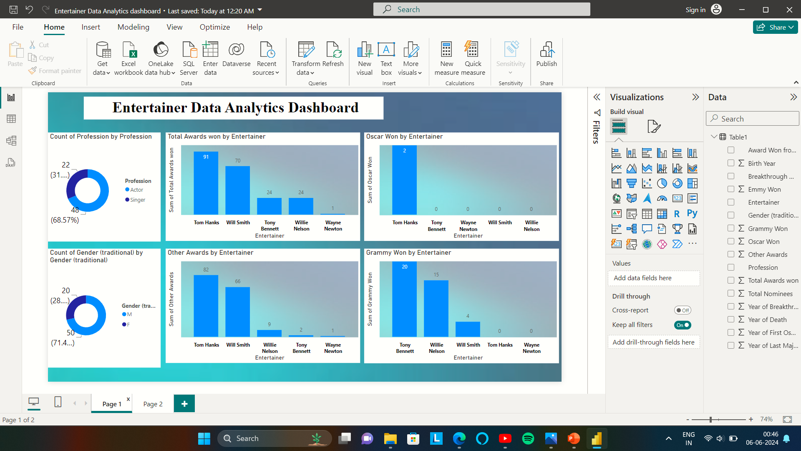
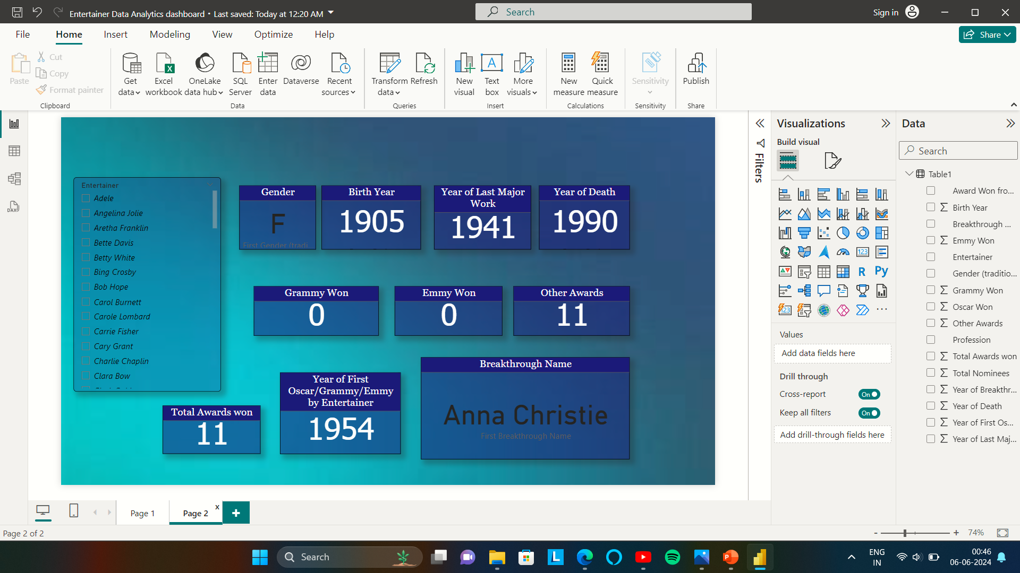
My Design

Slide 7
Thank you

