Slide 1
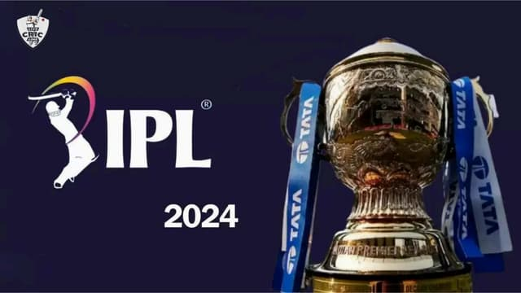
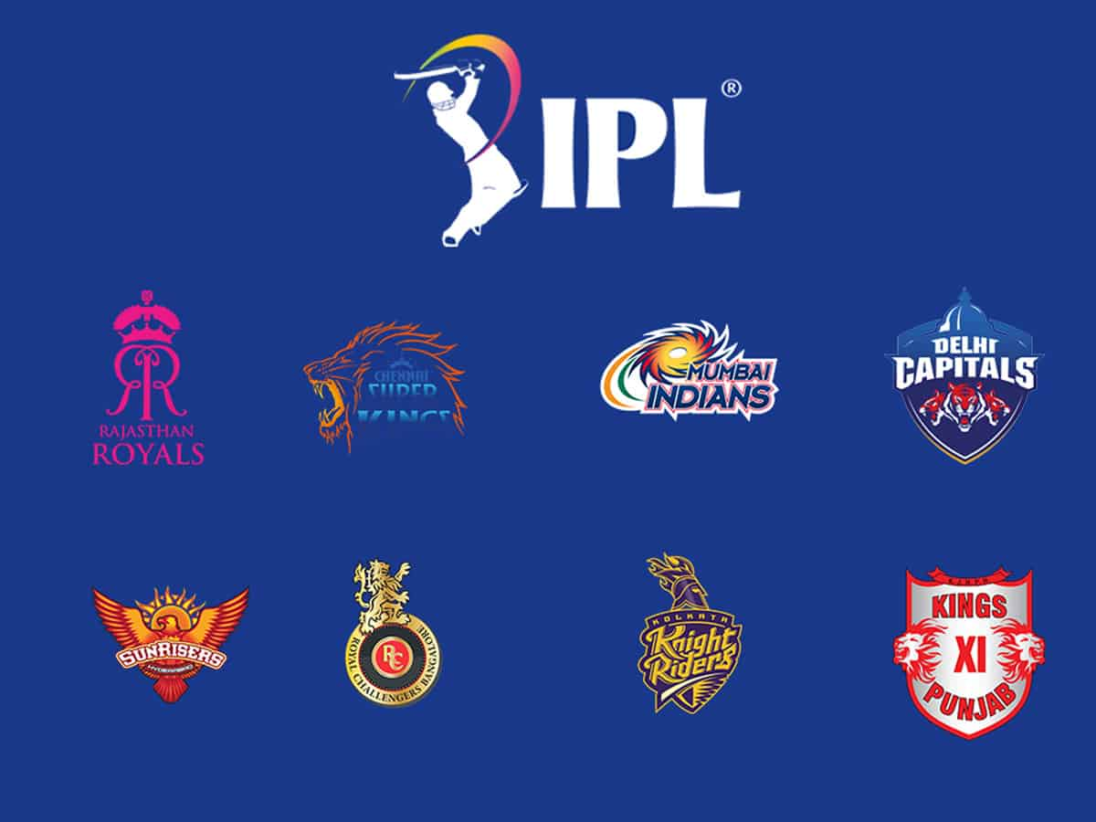
IPL Match Winner Prediction
By Yashwanth K
Date: 20-05-2025

Slide 2
Introduction
Goal: Predict the winner of an IPL match(2008 - 2019) using machine learning models.
Dataset: Contains 756 rows and 18 columns.
Includes match info like teams, toss, venue, outcome, etc.
Objective: Evaluate and identify the best model for prediction.

Slide 3
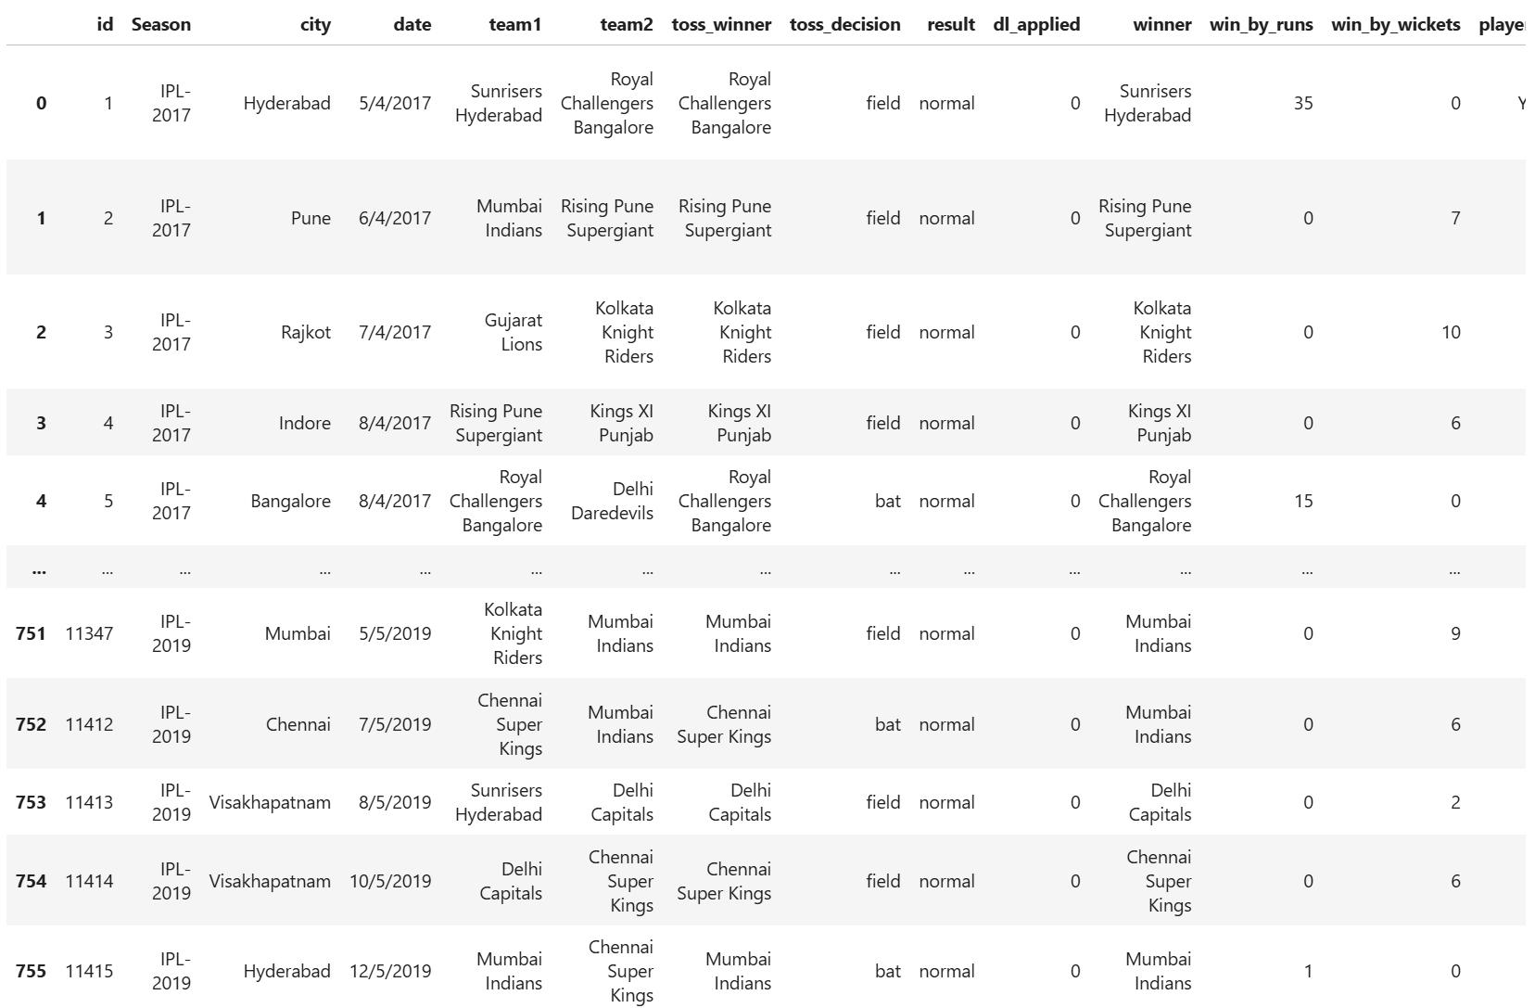
Data Understanding

Slide 4
Data Cleaning
Dropped columns: umpire1, umpire2, umpire3, player_of_match, date
Removed rows with null 'winner'
Filled other nulls with 'Unknown'
Standardized team names and removed duplicates
Applied One-Hot and Label Encoding

Slide 5
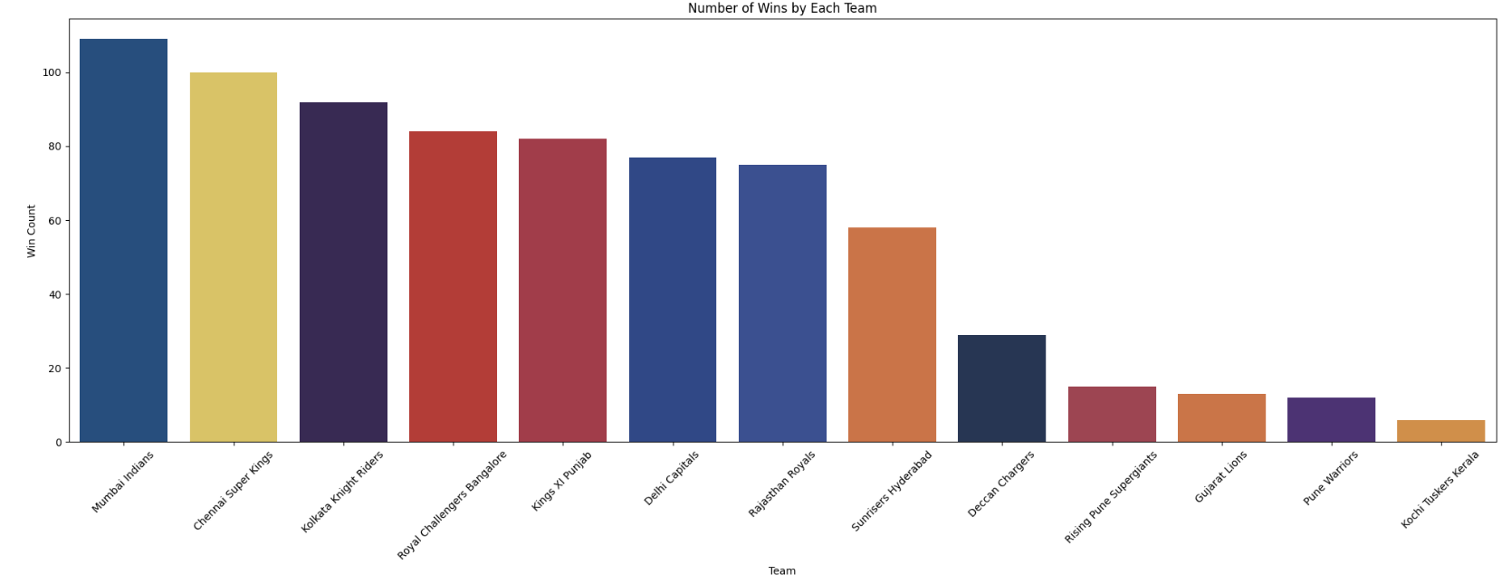
Exploratory Data Analysis
Mumbai Indians: 110 wins, CSK: 100 wins
61% of toss-winning teams choose to bowl
Toss-winning teams win 52% of the matches
Most matches played in Mumbai, followed by Kolkata and Delhi
Most common win margin: 6 wickets

Slide 6
Machine Learning Models
Used models: Logistic Regression, SVM, KNN, Decision Tree, Random Forest, XGBoost
Data split using StratifiedShuffleSplit
Features scaled with StandardScaler
Categorical features encoded using One-Hot Encoding

Slide 7
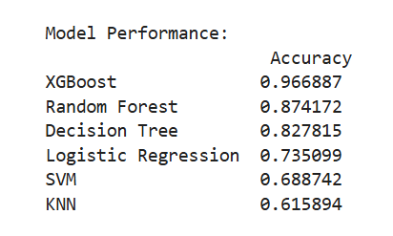
Model Evaluation
Valuated with Accuracy, Precision, Recall, F1-Score
Confusion Matrix and Classification Reports analyzed
XGBoost gave the highest performance across all metrics

Slide 8
Best Performing Model: XGBoost
Highest Accuracy and Balanced Metrics
Robust to overfitting with hyperparameter tuning
Performs well with categorical data and missing values
Tuned using GridSearchCV for best n_estimators and max_depth

Slide 9

Hyperparameter Tuning
- Used GridSearchCV to tune XGBoost model
- Parameters tuned: n_estimators = [100, 150], max_depth = [3, 5, 7]
- Selected best estimator based on cross-validation score

Slide 10
Conclusion & Future Scope
XGBoost selected as the best model
Future Work:
• Advanced tuning with Bayesian Optimization
• Real-time prediction interface(implementation)
• Model retraining with live data
• Visual dashboard for prediction insights

Slide 11
Thank You
"The game isn't over until
we say it is!"

